Slide 1
Images and 2D Graphics (2) COMP 112 2018

Slide 2
Overview
Graphics
Images and image manipulation see GIMP (free open source)
Matrices for
translation, rotation, scaling, ..
Transformations can be easily combined and inverted
Affine transformations are widly used in robitics, computer graphics and vision (here we only use very simple transformations)
bluring, sharpening, edgdetection, …
One convolution algorithm many effects
Latest advances in Deep Learning make use of Convolution Neural Nets. Consequently Convolution Filters have become more important!

Slide 3
Image manipulation
What kinds of manipulation are there?
Independent pixels:
changing colors: (brightness, contrast, redness,…..)
Geometric transformations
translate, rotate, reflect, skew, scale/resize parts of images
may involve interpolation to find new pixel values
Selecting and modifying regions
spread fill
representing non-rectangular regions
Applying “filters”
blur, sharpen, …..
Image recognition - image search.

Slide 4
Geometric Transforms
If you translate, rotate, scale, etc the pixels may not line up:
pixel (3,1) → pixel (2.7, 2.2) pixel (1,4) ← pixel (1.3, 2.8)
What value do you use for the new pixels?
Options:
use truncated pixel coordinates
use rounded pixel coordinates
take average of overlapping pixels
interpolate overlapping pixels (average weighted by distance or degree of overlap)

Slide 5
Geometric Transforms
If you translate, rotate, scale, etc the pixels may not line up:
pixel (3,1) → pixel (2.7, 2.2) pixel (1,4) ← pixel (1.3, 2.8)
What about pixels over the edge?
What about missing pixel values?
Options:
drop pixels outside
change dimensions of image
blank missing pixels (white/black/grey….)
use original pixel values.

Slide 6
Computing new pixel value
Easier doing reverse direction
than forward direction
Truncate/Round coordinates:
To compute new pixel value at (i, j)
work out the pixel that it came from (eg if translate by dx and dy, came from (i-dx, j-dy))
round/truncate to integers. oi = (int) (i-dx); oj = (int) (j-dy);
check coords are within image (oi>= 0 && oi<=width, …)
use pixel value at those cords of original image.
How do you make sure that the new values don’t mess up the old values during the calculation?
Always have two image arrays:
original image
new image.
Construct values in new image from values in old image
Then copy over.

Slide 7
Transforming
int [ ][ ][ ] newImage = new int [image.length] [image[0].length] [3];
for (int i = 0; i< newImage.length; i++){
for (int j = 0; j< newImage.length; j++){
int oi = (int)(i - translateX)); // or whatever transformation
int oj = (int)(i - translateY);
if (oi>=0 && oi<= image.length && oj >= 0 && ok <= image[0].length) {
newImage[ i ][ j ] = image[oi][oj]; // not safe ?
newImage[ i ][ j ] = Arrays.copyOf(image[oi][oj], 3);
} else {
newImage [ i ][ j ] = = new int[ ]{ 0, 0 ,0};
} }
image = newImage;

Slide 8
Rotation
How can we rotate image by θ degrees?
Must specify the center of rotation:
xCenter, yCenter
Need trigonometry:
forward
xNew = xCenter + (x-xCenter) cos(θ) – (y-yCenter) sin(θ)
yNew = yCenter + (x-xCenter) sin(θ) + (y-yCenter) cos(θ)
reverse
x = xCenter + (xNew-xCenter) cos(θ) + (yNew-yCenter) sin(θ)
y = yCenter - (xNew-xCenter) sin(θ) + (yNew-yCenter) cos(θ)
xNew, yNew
θ
xCenter,yCenter
x,y

Slide 9
Interpolating
double ox = (….i ….. j…);
double oy = (…. i …..j…);
int oi = (int) ox;
double oy = (int) oy;
newImage[ i ][ j ] = image[oi][oj] * (1-Math.hypot(ox-oi, oy-oj) + image[oi+1][oj] * + image[oi][oj+1] * + image[oi+1][oj+1] * +

Slide 10
Transformation composition
Rotation about the origin
Clockwise rotation
Anticlockwise
The composition of a clockwise followed by an anticlockwise rotation is the composition of the two matrices. Which if you remember you trigonometry give you the identity matrix.
Which is what you should expect.
It is efficient to compose two transformation matrices and apply the result rather than sequential apply each matrix.

Slide 11
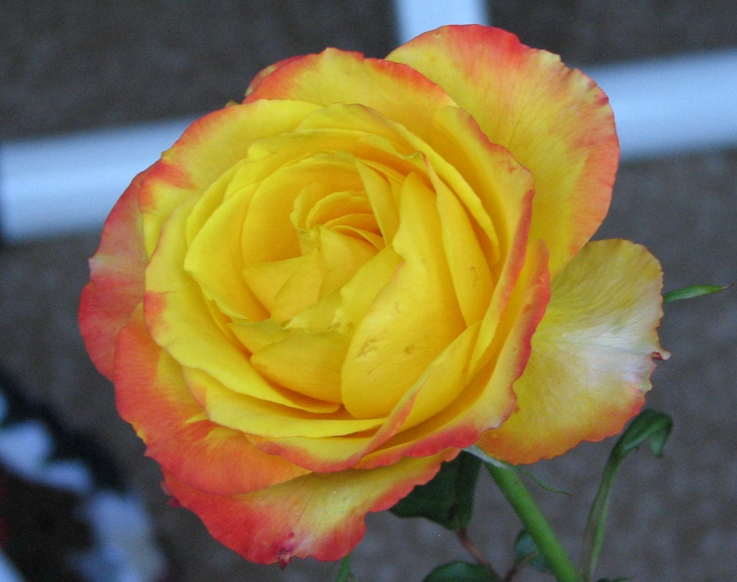
Blur, Filters, Convolution
Many image transformations involve replacing each pixel with some function of the pixel values in its neighbourhood:
Blur, changing resolution:
pixel → average of neighbourhood
Sharpening, edge detection
pixel → "difference" between pixel and neighbours

Slide 12
Convolution Matrix
Convolution image transformations replace each pixel with the weighted sum of its neighbouring pixel values:
Convolution:
Apply "neighbour weights" to each pixel in image then sum:
0.2(0.05+0.05+0.05+0.1+0.1+0.4) + 0.8(0.05+0.1+0.1)
=
If the matrix values sum to 1 the result is allways an color.
0.2
0.05
0.1
0.05
0.1
0.4
0.1
0.4
0.05
0.1
0.05
0.8
0.35

Slide 13
Convolution Filtering
input: image: rows x cols array of pixel
filter: height x width array of weights, usually height & width are odd, and weights sum to 1.0
output: newImage: rows x cols array of pixel
for row ← 0 .. rows-1
for col ← 0 .. cols-1
ht2 ← (height-1)/2, wd2 ← (width-1)/2
for r ← –ht2 .. ht2
for c ← –wd2 .. wd2
newImage[row, col] += image[row+r][col+c] * filter[r+ht2] [c+w2]
Problems:
Have to take care at the edges
How do you multiply colours?
0.05
0.1
0.05
0.1
0.4
0.1
0.05
0.1
0.05

Slide 14
Filters
Blur: Edge detection
Sharpen
0.05
0.1
0.05
-1
-1
-1
0.1
0.4
0.1
-1
8
-1
0.05
0.1
0.05
-1
-1
-1
0
-1
0
-1
5
-1
0
-1
0

Slide 15
Edge Detection
-1
-1
-1
Simple:
sum to 0
⇒ constant areas → 0
only "edge" regions bright
-1
8
-1
-1
-1
-1

