Slide 1
Introduction to Computer Science COMP 112 2018 T1 .
Peter Andreae
( “Pondy” )
Computer Science
Victoria University of Wellington

Slide 2
COMP 102
Menu:
Introductions
What is COMP112 about?
Where does COMP112 fit in your degree?
Course organisation
What to do NOW!
Admin:
Switching to COMP102: see me after the lecture, outside lecture room

Slide 3
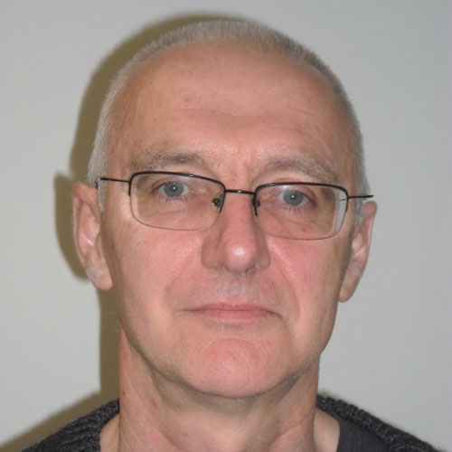
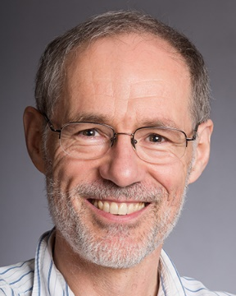
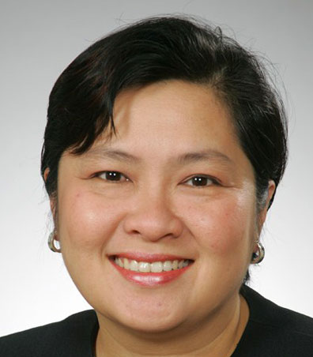
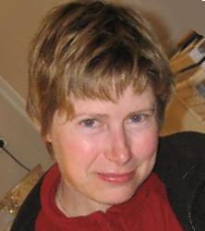
Introductions
Course Organiser
David Streader Office: CO 260 david.streader@ecs.vuw.ac.nz
Lecturer
Peter Andreae (Pondy) Office: CO 336 pondy@ecs.vuw.ac.nz
Senior Tutor (Administrative issues regarding labs)
Zarinah Amin Office: CO 252 Zarinah.Amin@ecs.vuw.ac.nz
Programmer
Dr. Monique Damito email to report problems: bugs@ecs.vuw.ac.nz
Tutors (Help in labs or via online help system)
Range of Undergraduates and Graduates
School Office (Forgotten passwords)
CO 358

Slide 4
Essential Info: Lectures, Labs, Assigs, Info
Lectures:
Tuesday 10am CO LT122
Thursday 10am MC LT101
Friday 11am CO LT122
Labs:
One hour session on Monday
12-1 or
2-3
Start next week. Sign up at https://student-sa.victoria.ac.nz
Assignments:
weekly, starting next week
Information:
ecs.victoria.ac.nz/Courses/COMP102_2018T1, also accessible via Blackboard
 | Mon | Tue | Wed | Thu | Fri
9 |  |  |  | Assig due
10 |  | LECTURE |  | LECTURE
11 |  |  |  |  | LECTURE
12 | Lab 1
1
2 | Lab 2
3
4
5

Slide 5
What is COMP 112?
A first course in
Computer Science
Computer Graphics
Software Engineering
Cybersecurity Engineering
A required course for
Electronic and Computer Engineering
Human Genetics
An important course for
Information Systems
Media Design
A useful course for Everyone
INFO
SWEN
ECEN
CS
MDDN
CS
CYBR
CGRA

Slide 6
COMP 112 primarily about programming
To understand the issues and principles of Computer Science, we need to understand and be able to talk about computation.
Programming is about specifying the computation that a computer should do
We need to be able to write, understand, think about, and analyse programs to address the issues of Computer Science
Programming is fundamental to the engineering side of Computer Science.
COMP 112 will focus on Object-Oriented programming, using Java.
COMP 112 will also introduce a range of topics in Computer Science.

Slide 7
COMP112 vs COMP 102
COMP 112 students:
Group 1: Done NCEA level 3 DT standards in programming and maybe Computer Science.
Group 2: Learned programming by themselves (not in a classroom)
Group 3: Learned programming in another course, institution, school course…..
Course is for all of you, but targeted at group 1.
Don't be intimidated by students who have years of programming!!
No programming experience
COMP 102
COMP 103
Programming experience
COMP 112

Slide 8
What's your background?
Introduce yourself to the students around you.
Say which group you are from (NCEA, self-taught, other course)
What programming language(s) did you learn?

Slide 9
Should you take COMP102 instead?
COMP102: alternative to COMP112 for BE or BSc(COMP)
Both courses let you proceed to COMP103
COMP 112 assumes programming experience:
variables, loops, conditionals (if’s), input and output
writing functions/procedures/methods with parameters
lists or arrays
little bit of event driven input, object oriented design
doesn’t care what language you used
COMP112 gives more breadth of coverage of Computer Science
also involves more complex programming problems
No programming experience
COMP 102
COMP 103
Some programming experience
eg level 3 NCEA DT programming standards
COMP 112
You can’t do COMP102 and COMP112 at the same time!

Slide 10
Switching to COMP 102
If you are not confident you have enough programming experience
See me after a lecture to get switched over
Within the first two weeks
Bring a change of course form from the science faculty office.
BUT
COMP 112 will run very parallel to COMP 102 this year.
Assignments, tests, and exams will be mostly shared!
You can pass COMP 112 and get in to COMP 103 with EXACTLY the same work as you would need in COMP 102.
COMP 112 lectures will be faster (less boring), and will be wider coverage.

Slide 11
Planning Ahead:
If you are doing BE, or BSc (COMP), BSc (CGRA), or BDI minor
then you should plan on taking COMP103 in Tri 2.
If you are doing BE, or BSc (COMP or CGRA)
Don’t forget the maths courses that you need for 2nd year!
If you are doing BSc (CGRA)
Don’t forget DSDN 132

Slide 12
Planning Ahead: Mathematics
Engineering maths Mathematics maths
BE SWEN: ENGR 121, 123 or MATH 161, STAT 193
BE NWEN: ENGR 121, 123 or MATH 161, 151, STAT 193
BE ECEN: ENGR 121, 122 or MATH 151, 142
BSc COMP: ENGR 121, 123 or MATH 161, STAT 193/MATH177
BSc CGRA: ENGR 121, 123, 122 or MATH 151, 142, 161
Which should you take?

Slide 13
Planning Ahead: Mathematics
Which should you take?
Most students are better off with the Engineering maths option.
slower start
focused on application of mathematics
Students with good mathematics should consider the Mathematics maths option:
Opens more options in later years
Better background for postgraduate study, especially in computer graphics
If you have the following NCEA achievement standards:
3.6 (differentiation, AS91578) and 3.7 (integration, AS91579)
one of 3.5 (complex nos, AS91577) or 3.1 (conics, AS91573) or 3.3 (trigonometry, AS91575) or 3.13 (probability, AS91585) or 3.14 (probability distributions, AS91586)).
At least 2 standards must be with grades of merit or excellence.
If you want to switch

Slide 14
Computing is everywhere
Computer based systems are everywhere
user application programs – browsers, photo editors, chat programs
social media and mobile phone apps,…
computer games
Information systems in commerce and business
specialised applications – analysing gene data, X-rays, simulations
controllers for device – cars, washing machines, TVs, DVD player, etc
operating systems that run computers, cell phones, etc.
network communication: internet connections, phone exchanges, fibre optics, cell phone systems, etc
….
⇒ Computing underlies almost all aspects of modern life

Slide 15
Computer Science
Computer Science is the science of Computing
The study of the computing processes that happen inside computers when they are working.
How do we design, build, analyse systems that deal with information:
text
numbers
graphics and video
sound
sensor and control signals
….

Slide 16
Computer Science Questions
How do you….
design a computer system to manage an organisation’s information?
design an intelligent assistant for your phone that can talk with you?
enable social interaction over communication networks
send data securely and reliably over unreliable public networks?
manage large teams of programmers building insanely complicated programs
design algorithms that will create new visual effects for augmented reality applications
design a database so that it is impossible to enter inconsistent data?
design programming languages to make programming easier
ensure that the computer program controlling a nuclear reactor or a spacecraft never makes a mistake?
design a self-driving car that drives safely on city roads?
make a safe encryption scheme for electronic commerce?
determine whether some computation is tractable or even possible?

Slide 17
What to do NOW!
Sign up for the labs: https://student-sa.victoria.ac.nz /
choose ONE Thu/Fri Lab and ONE Mon/Tue Lab
Note: You need to be registered for the course (a) to sign up for a lab (b) to be able to use the school computers
Details of course organisation tomorrow

Slide 18
Menu
Introducing yourself
More course details (FAST!)
Programs and programming languages
A first Java Program
Reading:
Text Book Chapter 1
Announcements:
Sign up for a lab session! Labs start Monday (12-1pm or 2-3)
Voting for a Class Rep
Put a message about yourself on the forum if you want to be class representative; the class will vote on Monday.
Trouble with passwords? Go to school office: CO 358

Slide 19
Course Organisation
All the details are in the course outline:
handout
on the course web page:
http://ecs.victoria.ac.nz/Courses/COMP112_2018T1/

Slide 20
Course Web Site
An essential resource for the course:
http://ecs.victoria.ac.nz/Courses/COMP112_2018T1 (also accessible via link on BlackBoard)
Course information, announcements, handouts, videos
Lab Assignment details (times, dates, handouts, files, ...)
Forum, for questions and discussion
Info about doing work at home.
Java documentation
Other useful links
Primary administrative communication channel.

Slide 21
Lab assignments
Ten assignments (roughly weekly),
hand out: Thursday
due: 10am Thursday (a week later) (except #10)
alternative labs: 6&7, 7&8 more challenging and interesting; your choice
Apply material from lectures and text book to practical programming problems.
This is where your learning happens!
Scheduled lab session is to help, but start before the lab!!
Further work required: expect 6 hours outside labs
any of the ECS labs,
on your home computer
First week’s lab is short, and doesn’t require additional work.

Slide 22
Course Organisation
Help Desk
Online help:
Forum for general questions;
email/web form for questions about your code.
Help Desk: Tutors available at various times at CO242a: see weekly timetable, starting wed in 3rd week.
Study groups
We will facilitate organising study groups and tutored help sessions
First year engineering/CompSci tutorials/help sessions
Excellent way of helping your learning
Science and Engineering Faculty Awhina programme:
support for Maori and Pacific Nations students
Women students support group.

Slide 23
Text Book and Handouts
Text Book
Java Foundations Lewis, DePasquale, Chase
Same as for COMP103.
[also OK: Java Software Solutions (6th ed) Lewis and Loftus]
We consider it a useful resource on Java.
Handouts
On COMP102 web page.
Handed out in class if there is a demand for it.

Slide 24
Tests and Exams
Terms Test 1:
15%
Monday 9 April 6-7 ?? (rooms to be confirmed)
NOT in lecture time!
Terms Test 2:
15%
Monday 14 May 6-7 ?? (rooms to be confirmed)
NOT in lecture time!
Exam:
50%
Date tba (between 9 June and 12 July)

Slide 25
Assessment
Mandatory Course Requirement:
Submit reasonable attempts ( at least D) for at least 8 of 10 assignments.
Final Grade:
Assignments: 20%
Terms Test 1: 15% (mark boosted to exam mark, if better) Terms Test 2: 15% (mark boosted to exam mark, if better) Exam: 50%
To pass the course, you must:
Satisfy the Mandatory Requirement.
Get overall grade of C- or better.
To keep grades comparable with COMP 102, There will be no C grades!!! ("just passing" will give you a B- )

Slide 26
Withdrawal dates
Early withdrawal with refund: up do Fri 16 March
no consequences to early withdrawal
Standard withdrawal without refund: up to Friday 18 May
Withdrawal recorded
No grade recorded on transcript
BUT, withdrawal counts as a fail for determining "Satisfactory Academic Progress"
Late withdrawal with Dean's permission: after 18 May
Requires permission of Associate Dean
Normally given only when special circumstances arise after deadline.

Slide 27
Plagiarism (Cheating)
You must not present anybody else’s work as if it were your own work:
Basic principle of academic honesty.
applies to work by other students, friends, relatives, the web, books…
If you received substantial help, then you must state who helped and how much.
If you declare any work from someone else, then it isn’t plagiarism!!!
In COMP102:
We encourage you to learn together, BUT you must submit your own answers
If you use code from the assigned text book, or from the lectures, then you do not need to declare it; If you use any other code that wasn’t yours, then declare it!

Slide 28
Cheating in the assignments.
Assignments are primarily for learning, not assessing
Cheating in the assignments is not worth it!
You won't learn, so you will probably fail.
If caught, you'll lose marks --- or worse.
Assignments have a fairly small contribution to your grade.

Slide 29
Lab Facilities
All scheduled labs are in CO219/238
Can also use other ECS labs (or other university student computing labs)
Can also use home computers. (Details on Web Site)
Lab Hours: 24/7
Need ID card to access in evenings and weekends
The labs are for getting work done
Don’t prevent other people from working
If you want to play around, go somewhere else
We expect professional behaviour in the labs.
Read the lab rules!

Slide 30
Where to go for Help
Depends on the kind of help needed
Course organiser / Lecturer, Senior Tutor, tutors (in labs or helpdesk only!)
Forum (via website)
On-line help system (via website)
Help desk (CO 242a)
ECS School Office: CO 358
Student Services: http://www.vuw.ac.nz/st_services/
Science Faculty office: http://www.victoria.ac.nz/science/student-administration
Science/Engineering/Arch&Des Awhina programme http://www.victoria.ac.nz/students/support/learning/awhina/
The Web

