Slide 1
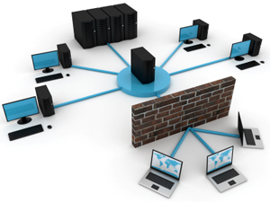
NWEN 243
Networked Applications
Lecture 10: Layer 3 – BGP & IP

Slide 2
What Is BGP?
Border Gateway Protocol BGP-4
The de-facto interdomain routing protocol
BGP enables policy in routing:
  Which information gets advertised and how
BGP is a Distance Vector like protocol
Within an AS, Interior Gateway Protocol (IGP or I-BGP)
Notes:
Vectoring Distributed Routing protocol
Each Router knows little about the network topology
Only best next-hops are chosen by each router for each destination network
Best end2end paths result from composition of all next-hop choices
Does not require any notion of distance
Does not require uniform policies at all routers
An Interior Gateway Protocol (IGP) is a type of protocol used for exchanging routing information between gateways (commonly routers) within an Autonomous System (for example, a system of corporate local area networks). This routing information can then be used to route network-level protocols like IP.
Interior gateway protocols can be divided into two categories: distance-vector routing protocols and link-state routing protocols. Specific examples of IGP protocols include Open Shortest Path First (OSPF), Routing Information Protocol (RIP) and Intermediate System to Intermediate System (IS-IS).

Slide 3
Headline grabbing !
https://www.youtube.com/watch?v=GOD8S6H7WGk

Slide 4
A BGP Graph
Each AS has designated BGP routers
BGP routers of an AS communicate internally with another protocol (IGP)
AS 2
AS 5
AS 4
AS 3
AS 1
Notes:
BGP-speaking routers peer with each other over TCP sessions, and exchange routes through the peering sessions.
Providers typically try to peer at multiple places. Either by peering with the same AS multiple times,
Or because soma Ass are multi-homed, a typical network will have many candidate paths to a given prefix.
-------------------
--The BGP Route is conceptually a “promise” to carry data to a section of IP space. The route is a “bag” of
Attributes.
--The section of IP space is called the “prefix” attribute of the route.
--As a BGP route travels from AS to AS, the ASN of each AS is stamped on it when it leaves that AS. Called
The AS_PATH attribute, or “as-path” in Cisco-speak
-------------
It provides a mechanism for loop detection. Policies may be applied based on AS path.

Slide 5
Some Basic Numbers
~20,000 Autonomous Systems approx.
  Corporate Networks
  ISP Internal Networks
  National Service Providers
Identified by ASN a 16 bit value
  Assigned by IANA
Superlinear growth
Notes:
IANA: Internet Assigned Numbers Authority
From Griffin RFC 1930:”… the administration of an AS appears to other Ases to have a single coherent interior
Routing plan and presents a consistent picture of what networks are reachable through it.

Slide 6
Advertising Routing Information
Each AS advertises what it can reach from each BGP router
Policies I: filter what you advertise
Policies II: filter from what you hear advertised
Build up a BGP routing table
  Remember which prefix you hear from which link

Slide 7
A video explaining BGP
https://www.youtube.com/watch?v=z8INzy9E628

Slide 8
Network examination.
Ping
Traceroute
http://www.lookinglass.org/
23905
Notes:
Traceroute, by default, sends a sequence of User Datagram Protocol (UDP) packets addressed to a destination host; ICMP Echo Request or TCP SYN packets can also be used.[1] The time-to-live (TTL) value, also known as hop limit, is used in determining the intermediate routers being traversed towards the destination. Routers decrement packets' TTL value by 1 when routing and discard packets whose TTL value has reached zero, returning the ICMP error message ICMP Time Exceeded.[2] Common default values for TTL are 128 (Windows OS) and 64 (Unix-based OS).
Traceroute works by sending packets with gradually increasing TTL value, starting with TTL value of 1. The first router receives the packet, decrements the TTL value and drops the packet because it then has TTL value zero. The router sends an ICMP Time Exceeded message back to the source. The next set of packets are given a TTL value of 2, so the first router forwards the packets, but the second router drops them and replies with ICMP Time Exceeded. Proceeding in this way, traceroute uses the returned ICMP Time Exceeded messages to build a list of routers that packets traverse, until the destination is reached and returns an ICMP Echo Reply message.[2]
ICMP: Internet Control Message Protocol
errors in the underlying communications of network applications
availability of remote hosts
network congestion

Slide 9
IP Addresses (IPv4)
32 bits
Network Node
00001010000001110000010100000001
00001010
00000111
00000101
00000001
10
7
5
1
10.7.5.1
Dotted Decimal
Notes:
32 bit number. Natural for computers to work in this way.
The problem is, humans don’t work in this way – if I tried to give you my IP address in binary, you’d soon be lost.
And therefore, we can’t talk about that number with any ease.
So the first thing we do, is represent them in some format we can talk about. To do this, we’re going to chop it up into 4 8 bit chucks, or octets.
So instead of having 1 long 32 bit number, we have 4 8 bit numbers. Now, we’re going to represent each one of those chunks with a decimal number.
Its much easier to convert an 8 bit number into decimal than a 32 bit number.
This is known as ‘dotted decimal’ notation. Dot allows us to separate out the octets and id which digits belong to which octet. Remember, this is just a DECIMAL representation of an IP address. It is not a real IP address – you can’t do any maths with it. But it allows us to talk about it. it is not useful for the machines, but is essential for humans, to parse, understand and manipulate IP addresses. A machine has to convert it back into a pure 32bit binary number in order to maniplate it.

Slide 10
Network Addressing (Other 3L)
Network Node
All network addresses split into 2 parts.
  A network portion of the address, representing the bit of ‘wire’ (naming the network).
  The node portion of the address describes a specific host.
  This depends on the network layer protocol.
    Novel IPX: 32 + 48
    Appletalk: 16 + 8
Notes:
This separation between network and host is always fixed for these examples.
IPX = Internet Packet eXchange.
How do we do it with IP?

Slide 11
IP Address Format
Where is the line?
Network Node
The problem we have with IP is that there is no fixed line.
The line moves depending on how we are using it we can have:
  lots and lots of networks and few hosts, or
  lots and lots of hosts and few networks.

Slide 12
IP Address Format (w/classes)
Where is the line?
Network Node
24 bits node
A
8 bits network
16 bits node
B
16 bits network
8 bits node
C
24 bits network
D - MULTICAST
E - RESERVED
Notes:
Back in the day, they decided how this was going to be split up.
255 networks 16.7 million hosts
65K networks, 65K hosts
16.7 million networks. Each one of which only supports 255 hosts.
Class A = big huge companies, US govt, IBM, HP etc.
Class B = medium companies.
Class C = small companies.
D – MULTICAST, for sending say video to a group of machines listening on that channel.
E -
Owners of Class A, B or C addresses were responsible for then allocating out their addr spaces. This meant that the old EGP (exterior gateway protocol) the prerunner to BGP was simple.

Slide 13
Differentiation of IP Addresses
How do we tell what type of address we have? They are all 32 bit numbers.
Use the MSB.
  0XXXXXXX – Class A,
  10XXXXXX – Class B,
  110XXXXX – Class C,
  1110XXXX – Class D
Notes:
Computer looks at first n bits, and says OK – I get this. It’s a A, B or C address.

Slide 14
Class A Address Ranges
24 bits node
A
01111111
If we have 0 as the MSB
  Then we can address127 (really 126, see below) networks (not 255)
  ½ of our address space are for other classes.
  Reserved:
    0.0.0.0 (old broadcast)
    127.0.0.0 (loop back address – for testing)
  Giving Class A available address range of
    1 – 126
Notes:
Loopback is for testing own HW and protocol stack.
So, whenever you see an IP address starting with 1-126.x.x.x. you know it is a class A address.

Slide 15
Class Address Ranges
16 bits node
10111111
If we have 10 as the MSB(s)
  Giving Class B available address range of
    128-191
If we have 110 as the MSB(s)
  Giving Class C available address range of
    192-223
8 bits node
11011111

Slide 16
IP class summary
Notes:
Why less two? For each network ID, two host IDs cannot be used: the host ID with all zeroes and the ID with all ones. These are addresses with "special meanings"

Slide 17
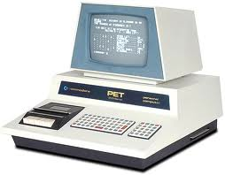
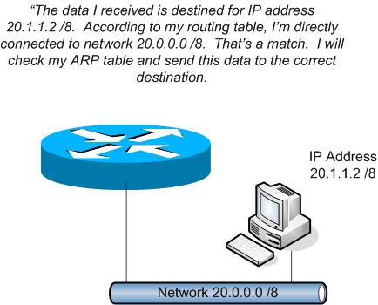
Hosts vs Networks
We can’t use 0 as it identifies the network
We can’t use 255 as it is reserved for broadcast
Class C address:
  Identifies the network: 192.168.1.0
  Hosts are 192.168.1.1 – 192.168.255.254
192.168.1.2
10.1.1.2
192.168.1.1
10.1.1.1
Ethernet 0
Ethernet 1
Address | Interface
192.168.1.0 | 0
10.1.1.0 | 1
192.168.1.3
10.1.1.3
Notes:
Please note: these addresses are PRIVATE addressed, dropped by BGP. We’ll talk more about them later/
Class C address on left, class A address on right.
Routers are only interested in the wires (networks), not the hosts. X.X.X.0 identifies/addresses a whole network, not a specific host (not broadcast).
NOTE: Router has 2 IP addresses! One for each Ethernet interface. Each ethernet interface is associated with an IP address.
Router says ‘ok I get this’ I’ve got a class C address 192.168.1.0 on ethernet interface: 0, and class A address on ethernet interface 1.
Basically it puts the ‘network’ portion of the address in its routing table, and ignores the host portion.
A datagram is generated at 10.1.1.2 for 192.168.1.2.
- Router reads it, compares it to the table, sees it should be sent out on interface 0, does so.
- Then host 192.168.1.2 picks it off the wire.

Slide 18
IP Addressing and Subnets
Imagine a medium company
  With a class B address: 172.16.0.0
  Giving 65532 Addresses (i.e. 2¹⁶)
  Take the longest ethernet cable you’ve ever imagined, and put 65532 computers on it.
  Will it work?
  NO!
  Remember collisions.
    Use switches? Too big.
    So, use Routers.
    Split the address range up using routers.
      Also keeps broadcasts in sub domains.

Slide 19
Addressing subnets
Class B address 172.16.0.0,
Subdivide into 255 networks of 255 hosts
172.16.1.0
172.16.2.0
172.16.3.0
Notes:
This is a good way to divide up the class B address space. Each subnet is represented by the second dotted decimal octet, and is easily identified and maintained.
Right, so lets program a router to do (part) of this.

Slide 20
Addressing subnets
172.16.1.2
172.16.2.2
172.16.1.1
172.16.2.1
Ethernet 0
Ethernet 1
172.16.1.3
172.16.2.3
×
Address | Interface
172.16.0.0 | 0
172.16.0.0 | 1
Notes:
Explain layout. This is how we’re setting up our network.
Now, lets look at the routing table. The router says, OK, I’ve got this.
I’ve got:
A class B address on ethernet 0 (from MSB), so the first 2 octets id the network.
A class B address on ethernet 1 (from MDB), so the first 2 octets id the network!
The router CANNOT differentiate these two subnets based on the class of the network. It has no way of telling there is two different networks on each side.

Slide 21
What We Want
172.16.1.2
172.16.2.2
172.16.1.1
172.16.2.1
Ethernet 0
Ethernet 1
HOW DO WE DO THIS?
172.16.1.3
172.16.2.3
Address | Interface
172.16.1.0 | 0
172.16.2.0 | 1
Notes:
Explain layout. This is how we’re setting up our network.
Now, lets look at the routing table. The router says, OK, I’ve got this.
I’ve got:
A class B address on ethernet 0 (from MSB), so the first 2 octets id the network.
A class B address on ethernet 1 (from MDB), so the first 2 octets id the network!
The router CANNOT differentiate these two subnets based on the class of the network. It has no way of telling there is two different networks on each side.

Slide 22
Subnet Masks
But how do we tell the router that we want to put the first 3 octets in the table, rather than the normal 2 octets for a Class B address?
In fact, how we divide up our set of addresses between network and host portions is up to us.
We use network masks.
Wherever (in the mask) there is a
  1 = network portion
  0 = host portion, of the address.
This means that we can split at arbitrary bit boundaries (although the math in dot decimal isn’t always pleasant)
Notes:
You can think of this as the class B address being divided up into 255 class c equivalent addresses, but will still have the MSBs of a class B.

Slide 23
Example
Consider this address 10.0.0.0
What network class is this?
Class A
00001010 00000000 00000000 00000000
What is the network mask?
Network portion
255.0.0.0
Notes:
What the subnet mask actually does is delineation between what is the network portion and the host portion of that address.
In the subnet mask, any 1 means that bit is a network bit and 0 means a node bit.

Slide 24
Example
Consider this address 162.16.0.0
What network class is this?
Class B
10100010 00000000 00000000 00000000
What is the network mask?
Network portion
255. 255.0.0
Notes:
The same logic applies to the C class

Slide 25
How router knows the address?
192.168.3.55 / 24
What is the network address?
Convert the address to binary then logically AND it with the subnet mask
11000000.10101000.00000011.00110111 (Class C)
11111111.11111111.11111111.00000000
Result:
11000000.10101000.00000011.00000000
That is 192.168.3.0
The broadcast address 192.168.3.255
Hosts: 1-254

Slide 26
Changing it a bit
Address: 10.0.0.0 (Still class A network)
subnet: 255.255.255.0
How many subnets we can have?
Host bits
Subnet bits
Network bits
2¹⁶ different subnetworks
How many hosts do we have inside each subnet?
2⁸ - 2 hosts
Notes:
We have 3 octets for the network portion of the address, and one for the host portion.
-2 here, because every network there are two addresses that can not be used:
Network address: when all the host bits are 0. This is the physical address to the wire itself.
Broadcast address when all the host bits are equal to 1.

Slide 27
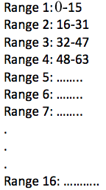
How router knows the address?
192.168.3.55 / 28 → Class C
Network mask?
255.255.255.240
What is the network address or network number?
Convert the address to binary then logically AND it with the subnet mask
11000000.10101000.00000011.00110111
11111111.11111111.11111111.11110000
Result: 11000000.10101000.00000011.00110000
That is 192.168.3.48 ← network address
How many hosts?
2⁴ = 16 hosts
How many subnets?
2⁴ = 16 subnet each of 16 hosts
How about the broadcast address?
192.168.3.63
Notes:
The highlighted ones are the subnet bits

Slide 28
Work this out?
Address: 10.15.67.128
subnet: 255.255.255.192
How many subnets we can have?
How many hosts do we have inside each subnet?
What is the network address?
What is the broadcast address?

Slide 30
IP Notation
So, we can describe our Classes as:
  a.0.0.0/8 - 255.0.0.0
  a.b.0.0/16 - 255.255.0.0
  a.b.c.0/24 - 255.255.255.0
  Indeed, we can put 0-31 after the slash which describes where our boundary is drawn, and therefore determine the mask:
  a.b.c.d/25 - 255.255.255.128, ½ C
  a.b.c.d/26 - 255.255.255.192, ¼ C
  etc.
Notes:
/0 = 4,294,967,296 hosts, 1 network
/31 = 1 host, 4,294,967,296 networks.
Just does with by doing a 32bit logical and. Very efficient.
Broadcast address is always the last one before the next set of network addresses begin. i.e.
Just by being given an IP address and subnet mask, we can compute, the subnet address, broadcast address, the host IP range.

Slide 31
IP assignments
The Internet Assigned Numbers Authority (IANA) issues blocks of IP addresses to regional Internet registries (RIRs)
  For example, 62.0.0.0/8, is administered by RIPE NCC, the European RIR.
The RIRs are each responsible for a single, large, geographic area.
These are then further subdivided into smaller blocks and issued to local Internet registries.
End networks receive subnets sized according to the size of their network and projected short term need.
The days of businesses getting /8 or /16 addresses are over (16M to 65K addresses is a big step).
Notes:
16.7 million addresses (Class A)

Slide 32
IP assignments and Routing
As long as the router is aware of the correct subnet mask, we can create arbitrary subnets within any IP address range.
Routing tables can grow large.
  We can aggregate adjacent IP ranges
  Two adjacent /20s may be aggregated to a /19
  This reduces the number of routes that need to be advertised and the size of the tables.
  This is possible due to the geographic way in which modern IP ranges are allocated.
  Routers higher up the hierarchy can aggregate whole regions into a single table entry.

Slide 33
Address Space Exhaustion
From the 1980s it was apparent that the available IPv4 addresses were being exhausted.
  Motivation for the creation of Classless Inter-Domain Routing (CIDR) and IPv6.
Things driving the acceleration of IPv4 address exhaustion:
  Unprecedented growth in the number of Internet users
  Always-on devices — ADSL modems, cable modems
  Mobile devices — laptop computers, PDAs, mobile phones
Technologies introduced to mitigate IPv4 address exhaustion include:
  Network address translation (NAT)
  Use of private networks
  Dynamic Host Configuration Protocol (DHCP)
  Name-based virtual hosting
  Tighter control by Regional Internet Registries on the allocation of addresses to Local Internet Registries
  Network renumbering to reclaim large blocks of address space allocated in the early days of the Internet
IANA's primary address pool was exhausted on 3 February 2011 when the last 5 blocks were allocated to the 5 RIRs. APNIC was the first RIR to exhaust its regional pool on 15 April 2011, except for a small amount of address space reserved for the transition to IPv6.
The address size was increased from 32 bits in IPv4 to 128 bits in IPv6, allowing improved route aggregation and potential for allocations of a minimum of 264 host addresses to end-users.
Migration to IPv6 is in progress but is expected to take considerable time.

Slide 34
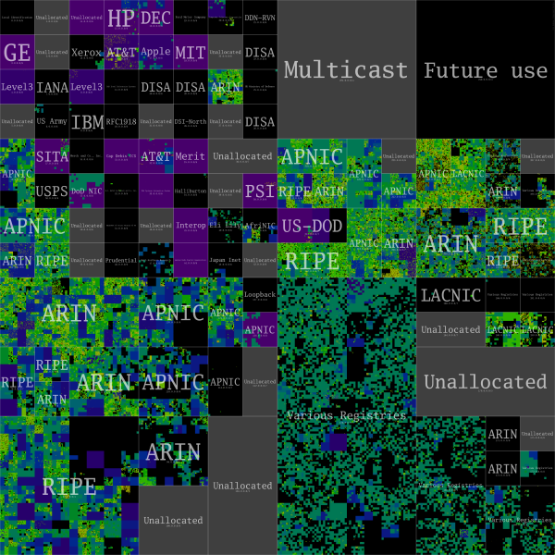
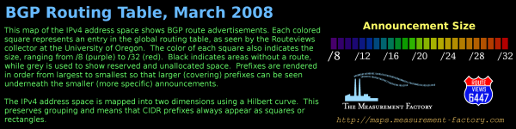
Notes:
Address blocks are labeled based on IANA's list of IPv4 allocations. Early recipients of large "class A" address blocks appear in the upper left, while the areas labeled Various Registries indicate allocations from the former "class B" and "class C" regions. Since the mid-1990's all address space allocations are now made through the Regional Internet Registries: RIPE, APNIC, ARIN, LACNIC, and AfriNIC.

Slide 35
Fin.
Friday…
- IPv6 etc.
- Protocol Layer Service model.

