Slide 1
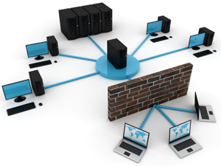
NWEN 243
Networked Applications
Lecture 3: Symmetric Key Cryptography

Slide 2
Symmetric Key Cryptosystems: Basics
Key
plaintext
Ciphertext
plaintext
Encryption Algorithm
Decryption Algorithm
Notes:
Modern Cryptographic Systems could be simply seen as either
Symmetric or asymmetric. Sometimes it is a hybrid one but let’s discuss the symmetric key cryptosystems.
In symmetric Key cryptosystems the same key is used for both encryption and decryption.

Slide 3
Notices
Labs start this week.
Your lab will be implementing a ‘new’ cypher. No electronic submission this week!
Lab groups:
email the tutors to get a session/group.
check the updated timetable. (no labs on Tuesday afternoon)

Slide 4
Recall
Leone Battista Alberti made a break though for constructing a better cypher in the 1460’s.
He proposed using two or more cypher alphabets (polyalphabetic) so that the substituion depended not only on the letter, but also its position.
a b c d e f g h i j k l m n o p q r s t u v w x y z
j u l i s c a e r t v w x y z b d f g h k m n o p q
l e o n b a t i s r u v w x y z c d f g h j k m p q
alice, meet you at the fountain, bob
jvros, wsbh pzh jg hes azhygjsy, eze

Slide 5
ALBERTI CIPHERS: Single Cipher Alphabet
Pointer
Encrypt → 21 APRIL 43 BC
Indicator
Notes:
the originator and in- tended recipient first agree upon a pointer character on the inner disk. In his own description of the wheel, Alberti used k as the pointer. The origi- nator then chooses an indicator character on the outer disk with which to align the pointer.
The originator then forms the ciphertext by writing the indi- cator followed in order by the characters on the inner disk that correspond to the plaintext characters on the outer disk.
Using an Alberti cipher with pointer k and indicator E, the plaintext 21 APRIL 43 BC encrypts to Ecfyg z&mth qi.
Progressive idea is to rotate the inner disk to di↵erent places during the encryption of a message, so that the indicator, and thus the cipher alphabet, could be di↵erent at di↵erent places in the ciphertext
What is the problem with this?
The recipient needs to know those indicators. Alberti accomplished this by having the originator include each new indicator in the ciphertext at the point where it began being used.

Slide 6
ALBERTI CIPHERS: Poly Cipher Alphabet
“Consider an Alberti cipher with pointer k and indicators E for the first four plaintext characters, F for the next three plaintext characters, and L for the rest of the plaintext. For reference, the cipher alphabets that result from pointer k with indicators E, F, and L are given in the following table.”¹
Encrypt → 21 APRIL 43 BC
¹ : http://www.appstate.edu/~klimare/MAT3530_6_1.pdf
Notes:
Progressive idea is to rotate the inner disk to di↵erent places during the encryption of a message, so that the indicator, and thus the cipher alphabet, could be di↵erent at di↵erent places in the ciphertext
What is the problem with this?
The recipient needs to know those indicators. Alberti accomplished this by having the originator include each new indicator in the ciphertext at the point where it began being used.

Slide 7
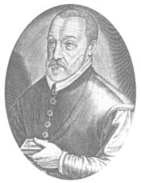
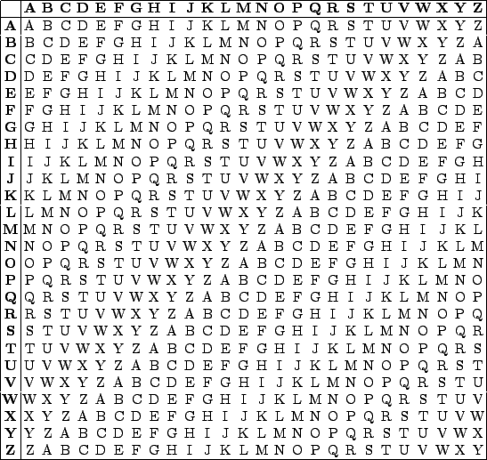
le chiffre indéchiffrable
The Vigenère Cypher
1586
Key selects alphabets
text is then encrypted using the repeated key.
KEY: W H I T E W H I T E
TXT: w h a t i s l i f e
CYP: S O I M M O S Q M I
No one much used it…
Notes:
Too hard for its time. Instead they used homophones and codewords
Key selects which alphabet is used for which position.

Slide 8
Polyalphabetic rarely used
Polyalphabetic cyphers where not used at the time, although considered ‘practically’ unbreakable -- as they were considered too difficult to use.
Cryptographer’s looked for a ‘middle-ground’ that would prevent frequency analysis:
Nomenclatures (Code words)
Homophones
Notes:
Even though completely unbreakable.
Codewords for some, bulk of text still subject to Freqanal, and codewords can be guessed from their context.

Slide 9
Homophones
Simeone de Crema's in 1401 developed a key in which each of the plaintext vowels had several possible equivalents (homophones: from Greek, same-sounds)
This approach attempts to ‘even out’ all the vowel frequencies in the cypher text.
This indicates a knowledge of frequency analysis as early as 1400 in Europe.
A more general use of homophones (same-sounds) is, if a letter has frequency n%, then we have it encrypt randomly into n% different homophones.
Can still be attacked by relationship between letters, characteristics.
Notes:
Personally, I think this is more difficult to use than the le chiffre indéchiffrable – but that was not the feeling at the time.

Slide 10
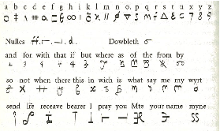
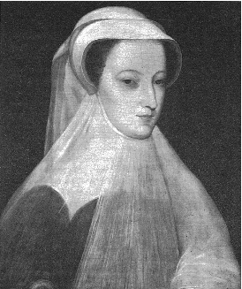
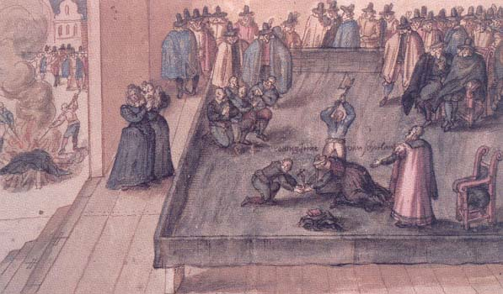
Mary Queen of Scotts (1586)
The sad tale of Mary Queen of Scotts.
+
=
Notes:
Problem is, trust in your cryptographic system.
Walsingham – Spymaster to EI
Babington - conspiritor

Slide 11
How to crack a polyalphabetic Cypher
If we have 2 alphabets
Split the cypher text into 2 separate monoalphabetic cypher texts
Now apply frequency analysis to each part seperately.
Recombine and apply grammactical and word structure knowledge.
How many alphabets used? Well we can try sequentially, 1, 2, 3, 4,…
There is a practical limit to how many keywords would have been used.
jvros wsbh pzh jg hes azhygjsy, eze
jrs …
vow …
Notes:
Remember in the days before computing devices this would have been impractical. By the time something was decoded by hand, it was probably no longer useful.

Slide 12
How to crack a Vigenère Cypher
It was not quite as simple to crack the Vigenère cypher, as
there was only one keyword
it could be any length, if length ∞ then ?
length of the keyword defined the interleaving of the mono alphabetic cyphers.
Notes:
if length ∞ then this becomes a one time pad and unbreakable as any cipher text can decript into every possible valid plaintext – we’ll see this again later.

Slide 13
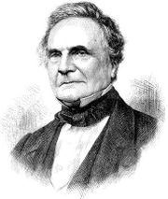
The Cryptanalyists Fight Back
Vigenère Cypher was unbreakable until…
The father of computing – Charles Babbage did so in 1854 (300 years is pretty good BTW).
He realised that by looking for repeated sequences and spacings he could make a good estimate of the key length by finding the greatest common divisor n.
The encoded text could then be divided up into n separate monoalphabetic encodings and treated using conventional frequency analysis (and substituting back into the entire text).
His work was suppressed by British Intelligence during the Crimean war and a Prussian Freidrich Kasiski independently developed the and published 9 years later in 1863.
Notes:
You typically need keylength * document length..
These days we take massive computation for granted.

Slide 14
People and Cryptography
The Man in the Iron Mask
Encoded sylables
The Victorian Personal Columns, fun for all.
Notes:
- Man in the iron mask was a cowardly general, uncovered by decypering of the great cyphr.
- Black chambers 16-1700s decyphering government txts.
- Young lovers sending encyrpted messages via ‘agony’ columns. Fun for the public to decode ☺

Slide 15
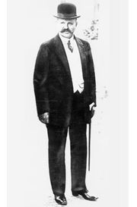
Automation
One of the problems with Cryptography is the cost of the encryption and decryption.
In WWI, a failure of the German cryptographers brought the US into the war on the side of the UK (the Zimmerman Telegram).
Near the end of WWI cryptographers developed an unbreakable code using one time random pads (random sequence as long the message). This was a non cyclic version of the Vigenère Cypher.
The problem was the cost – a pad/key distribution problem of immense practical difficulty and expense (i.e. subs)
After World War I inventors on both sides of the Atlantic developed electro-mechanical cryptographic tools – the most infamous of which is the Enigma Machine.

Slide 16
Cryptanalysis
Brute Force:
Basic Caesar Cypher: 25 Keys!!
Arbitrary substitution: Mapping = 26! Keys
Still not hard to break, as
Frequency Analysis (e most common)
Word breaks (limited number of 3 letter words)
Language characteristics (u follows q etc.)

Slide 17
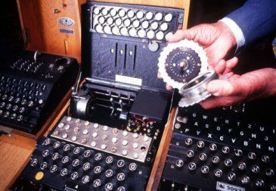
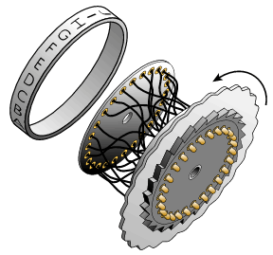
The Enigma Machine
First versions appeared in 1926
Both in commercial and military models.
Electro-Mechanical.
Very sophisticated.

Slide 18
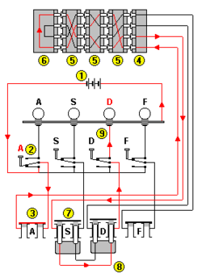
The Enigma Machine
Each scrambler disk rotates each time a letter (2) is encoded.
Scrambler disks (5) can be swapped in and out.
Plug leads (8) increase the security.
Polyaphabetic cipher is very long, 16,900 times longer than any message.
3-Rotor scrambler could be set in 26 x 26 x 26 ways = 17,576 ways.
With six plug leads, number of ways pairs of numbers could be interchanged = 100 billion.
Many many many possible subsitutions making cyptanalaysis hard!
Notes:
The M3 and M4 have 3 of 8 and 4 of 10 rotors used respectively, which results in the M4 having 26 times more positions you would need to guess/brute force.
17,576 is the period of the keystream, not the number of keys. The rotors can also be rearranged (6 choices with three available rotors, 24 with four like they used later on). Then there's the plugboard, which chooses six pairs of letters to swap at the beginning and end of the encryption. That's
((26*25/2)*(24*23/2)*(22*21/2)*(20*19/2)*(18*17/2)*(16*15/2))/(6*5*4*3*2*1) =
100,391,791,500
plugboard settings, for a total of
42,347,667,057,696,000
Which is actually not that far off from DES' 2⁵⁶, or
72,057,594,037,927,946
keys.

Slide 19
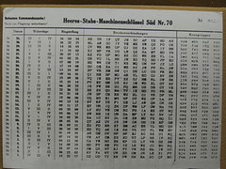
The Enigma Machine
Using the machine required setting the rotors and plugboard the same on the sender and receiver.
Code books shared by sender and receiver, gives setting that changed daily (more often later).
Each message had a different (session) key, agreed upon by the two communicating operators – which was sent enciphered using the ‘day’ key specified in the code book.
This avoided using the same key for all messages in a day. PGP etc.

Slide 20
The Enigma Machine
Example documents and Enigma daily settings passed to French by a German (Hans Schmidt).
Broken by Polish crytpographer Marian Rejewski in 1932, due to repeated day keys* (this version did not have the plug leads).
Communication channel – broadcast!
Cryptanalysts have ALL messages!
Due to radio errors, the military required the key to be repeated twice at the beginning of each message. i.e. Key ULJ
ULJULJ encodes to PEFNWZ
We can now link 1 and 4 as encryptions of the same letter, 2 and 5 and 3 and 6.
This was an operational flaw in the use of the machine that significantly erroded its security and ultimately allowed it to be decoded (in 1932).
https://youtu.be/G2_Q9FoD-oQ
Notes:
*The important point of engima was in the ‘keys’ or the initial settings of the rotors.
repeated day keys = a flaw in the prodcedural use of the machine. Not! the system itself.
RULE: Repitition is the enemy of security.

Slide 21
The Enigma Machine
Cut combinations by 1/2
Later improvements were broken with…
Cillies: Not a weakness in the machine, but in the way it was being used.
A scrambler may not be used in the same position on consecutive days.
Plugboard settings could not swap adjacent letters.
Operators using ‘favoured’ day keys (a girlfriend intials)
Cribs (Turing):
Regimented format, e.g. messages at 6:05 were weather reports, and contained the word ‘wetter’ in a fixed position.
Seeding: Special missions to determine encoded coordinates, e.g. laying special mine fields
Pinches: Theft of code books etc…

Slide 22
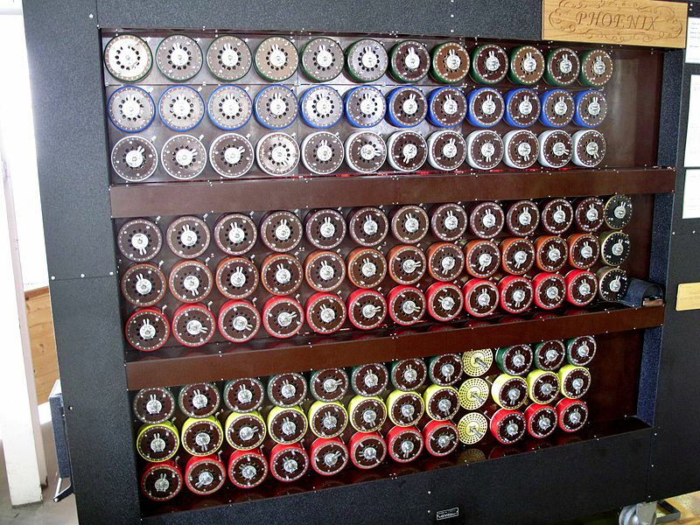
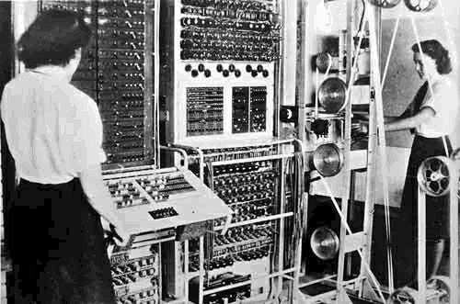
The Enigma Machine
British Bombe designed by Alan Turing and Gordan Welchman.
Automated some of cryptanalysis
Later, first programmable digital electronic computer Colosus developed.
Destroyed end of the war, kept secret until 1970s!
Movie

Slide 23
Partial Summary: Cyphers
Substitution cipher
One-to-one mapping of alphabets
Randomised or shifted
Easily cryptoanalysed using frequency analysis
Polyalphabetic substitution cipher
One-to-many mapping of alphabets
By guessing key length correctly can treat as several subtitution cipher problems
These ciphers are no longer used by themselves, however used as part of modern cipher systems (for example, DES and AES).

Slide 24
What is Secure?
Cyphertext only attack:
involves analysing only unknown text.
Known plaintext attack (see cribs):
occurs when some or all words are known, e.g. “Hello”, “Dear” or “Wellington”.
Chosen plaintext attack:
when the cryptanalyst manages to cause some text of his/her choice to be encrypted.
A secure system is secure against chosen plaintext.
Notes:
We can use the Caesar cipher as an example. There are only 25 keys! The work factor for brute force is low.
Ciphertext only attack involves analysing only unknown text.
Known plaintext attack occurs when some or all words are known, e.g. “Hello”, “Dear” or “Wellington”.
Chosen plaintext attack occurs when the cryptanalyst manages to cause some text of his/her choice to be encrypted.
A secure system is secure against chosen plaintext.
Colossus II was built during WWII to break Lorenz codes – the method was known, the machine would find the keys – was important in ending the war.
What is the difference between known-plaintext attack and chosen-plaintext attack?
Active Vs Passive attackers
Known plaintext attack: The attacker knows at least one sample of both the plaintext and the ciphertext. In most cases, this is recorded real communication. If the XOR cipher is used for example, this will reveal the key as plaintext xor ciphertext.
Chosen plaintext attack: The attacker can specify his own plaintext and encrypt or sign it. He can carefully craft it to learn characteristics about the algorithm. For example he can provide an empty text, a text which consists of one "a", two "aa", ... For example: if the Vigenère cipher is used, it is very easy to extract the key length and recover the key by repeating one letter.

Slide 25
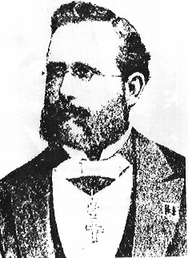
Kerckhoffs's Principle
Assume a published algorithm
Kerckhoff’s principle (1883):
“All algorithms must be public; only the keys are secret”
An encryption scheme should be secure even if enemy knows everything about it except the key
Attacker knows all algorithms, has all cypher-texts
Attacker does not know random numbers
Do not rely on secrecy of the algorithms (“security by obscurity”)
Easy lesson:
use a good random number
generator!
Jean-Guillaume-Hubert-Victor-François-Alexandre-Auguste Kerckhoffs von Nieuwenhof
Notes:
Full name:
Jean-Guillaume-Hubert-Victor-François-Alexandre-Auguste Kerckhoffs von Nieuwenhof

Slide 26
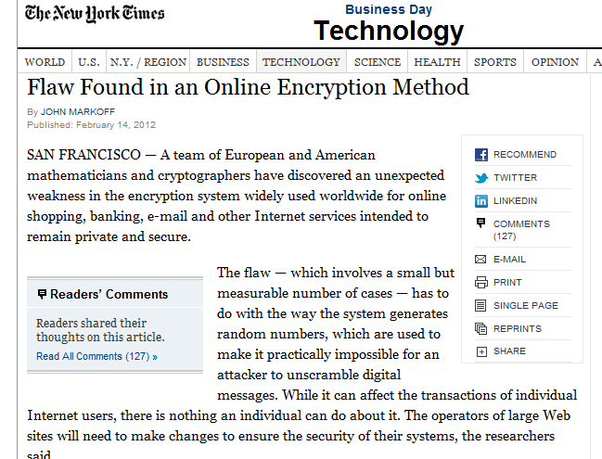
Randomness Matters!
Vitaly Shmatikov

Slide 27
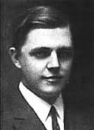
One-Time Pad (Vernam Cipher)
First described by Frank Miller in 1882
the one-time pad was re-invented in 1917 and patented a couple of years later.
It is derived from the Vernam cipher, named after Gilbert Vernam, one of its inventors.
Vernam's system was a cipher that combined a message with a key read from a punched tape.
In its original form, Vernam's system was vulnerable because the key tape was a loop, which was reused whenever the loop made a full cycle.
One-time use came a little later when Joseph Mauborgne recognized that if the key tape were totally random, cryptanalysis would be impossible.
Notes:
What we want here is to encrypt every message by a different key so there is no relationships between messages. So, if a message has been intercepted and decrypted this does not mean all subsequent ones will be cracked. That is why the term one-time is used here.
Messages encrypted with keys based on randomness have the advantage that there is theoretically no way to "break the code" by analyzing a succession of messages.

Slide 28
One-Time Pad
10111101…
-----
-----
-----
= 10111101…
⊕
⊕
10001111…
= 00110010…
00110010… =
Key is a random bit sequence
as long as the plaintext
Decrypt by bitwise XOR of
ciphertext and key:
ciphertext ⊕ key =
(plaintext ⊕ key) ⊕ key =
plaintext ⊕ (key ⊕ key) =
plaintext
Encrypt by bitwise XOR of
plaintext and key:
ciphertext = plaintext ⊕ key
Cipher achieves perfect secrecy if and only if there are as many possible keys as possible plaintexts, and every key is equally
likely.
(Claude Shannon, 1949)
Vitaly Shmatikov

Slide 29
Advantages of One-Time Pad
Easy to compute
Encryption and decryption are the same operation
Bitwise XOR is very cheap to compute
As secure as theoretically possible
Given a ciphertext, all plaintexts are equally likely, regardless of attacker’s computational resources
…as long as the key sequence is truly random
True randomness is expensive to obtain in large quantities
…as long as each key is same length as plaintext
But how does the sender communicate the key to receiver?
Vitaly Shmatikov

Slide 30
Problems with One-Time Pad
Key must be as long as plaintext
Impractical in most realistic scenarios
Still used for diplomatic and intelligence traffic
Does not guarantee integrity
One-time pad only guarantees confidentiality
Attacker cannot recover plaintext, but can easily change it to something else
Insecure if keys are reused
Attacker can obtain XOR of plaintexts
Generating good random numbers is hard
Atomic decay, entropy – unequal distributions
Pseudo random numbers – Exhibits pattern.
Key Transport
How to inform the receiver and sender of the keys.
Vitaly Shmatikov wth some additions.

Slide 31
Integrity : Recap
Assure Data Consistency, Accuracy and Trustworthiness
Data is modified in an authorised way only.
Checksum (cryptographic or non-cryptographic). Could use AC
Non-cryptographic Internet checksum: example
example: add two 16-bit integers
1 1 1 1 0 0 1 1 0 0 1 1 0 0 1 1 0
1 1 1 0 1 0 1 0 1 0 1 0 1 0 1 0 1
1 1 0 1 1 1 0 1 1 1 0 1 1 1 0 1 1
1 1 0 1 1 1 0 1 1 1 0 1 1 1 1 0 0
1 0 1 0 0 0 1 0 0 0 1 0 0 0 0 1 1
wraparound
sum
checksum

Slide 32
Partial Summary: Cyphers
Substitution cipher
One-to-one mapping of alphabets
Randomised or shifted
Easily cryptoanalysed using frequency analysis
Polyalphabetic substitution cipher
One-to-many mapping of alphabets
By guessing key length correctly can treat as several subtitution cipher problems
These ciphers are no longer used by themselves, however used as part of modern cipher systems (for example, DES).
One Time Pad
Random keys - difficult key coordination.
Does not guarentee message integrety (still single char).

Slide 33
Block Cyphers
A problem with character substitution cyphers was that each character stands alone allowing straightforward statistical analysis.
Ideally we should “scramble” information from adjacent letters, words and phrases to remove this operation.
This can be demonstrated by the general concept of block cyphers. A block cypher is a pipeline of two types of transformations:
P-box. The P-box is a permutation taking some number of bits in and rearranging them.
S-box. The S-box is a substitution. The substitution may be done efficiently by expanding an n bit input into 2^{n} lines that are zero except for the line representing the number. This is permuted using a P-box and the output (again a single line is a one) is encoded back into n bits.
Both of these are simple operations. The effectiveness comes when they are chained together.
Main advantage (and disadvantage) can be computed in HW.

Slide 34
Symmetric Key Cryptosystems: Approaches
Block Cipher
Encryption
Algorithm
M1
M2
C1
C2
M3
M4
C3
C4
Key
Decryption
Algorithm
Message M
Stream Cipher
M Xor One-time pad
Notes:
Symmetric key algorithms encrypt or decrypt data by using blocks or streams. In block cipher, the message is divided into blocks of the same size and each block is encrypted on its own then appended together to construct the cipher message. The same process is done to decrypt the massage to reconstruct the plaintext. When the final block is smaller than the block size padding is used. DES is an example of Block Cipher algorithms.
In stream cipher algorithms, the algorithm generates a long random string (or pseudorandom) called one-time pad. Then this one-time pad is Xored with the message to generate the cipher text. The same operation is done when decrypting the message to recover the plaintext. EC4 is the example of a stream cipher algorithm.

Slide 35
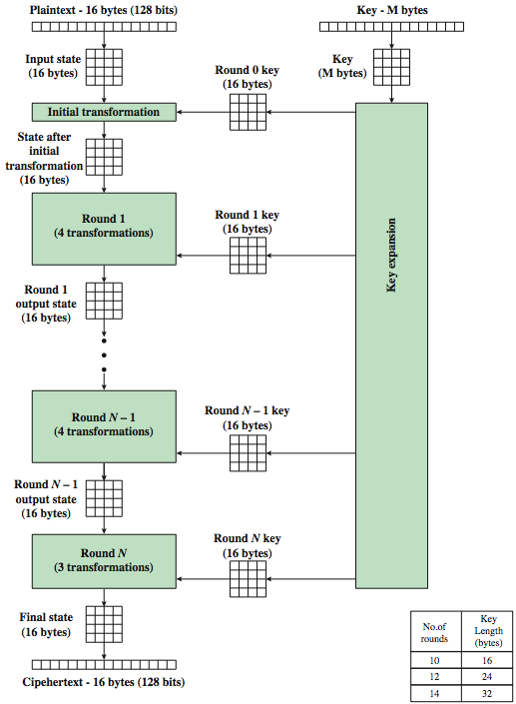
Symmetric Key Cryptosystems: AES EXAMPLE
Notes:
AES is widely used these days. It is a replacement for DES as DES
have theoretical attacks that can break it
have demonstrated exhaustive key search attacks
can use Triple-DES – but slow, has small blocks
US NIST issued call for ciphers in 1997
15 candidates accepted in Jun 98
5 were shortlisted in Aug-99
Rijndael was selected as the AES in Oct-2000
issued as FIPS PUB 197 standard in Nov-2001
designed by Rijmen-Daemen in Belgium
has 128/192/256 bit keys, 128 bit data
an iterative rather than Feistel cipher
processes data as block of 4 columns of 4 bytes
operates on entire data block in every round
designed to have:
resistance against known attacks
speed and code compactness on many CPUs
design simplicity
key expanded into array of 32-bit words
four words form round key in each round
4 different stages are used as shown
has a simple structure
only AddRoundKey uses key
AddRoundKey a form of Vernam cipher
each stage is easily reversible
decryption uses keys in reverse order
decryption does recover plaintext
final round has only 3 stages

Slide 36
Key Management Issues
Key Exchange Challenge?
Key life time.
Man-In-The-Middle Attack
Notes:
As the symmetric key cryptosystems all depend on a single key, the problem here is how to exchange the encryption key between parties remotely?
Remember with symmetric encryption (i.e. symmetric ciphers), keys must be secret
This is a challenging problem when those two parties have never been in communication before. They simply do know each other but seek secure communication. Adding to this difficulty is the fact that keys need to be changed every now and then. You can not risk using the same key, for example, for two sessions with sensitive banking transactions.
So how would we do this key exchange?
Sending plain text mail is not a good idea
Encrypting the key with another symmetric algorithm does not help either
So, can we use another encryption that uses two keys? So I don’t need to tell the other party what key I used to encrypt my message (i.e. key).
If this is the case and there exists such algorithm that uses two keys, why do I need the symmetric key crypto system anyway?!!!
So, lets answer the important question first: yes, we can use some techniques to exchange keys

Slide 37
Permutation
1
1
2
2
3
3
4
4
CODE becomes DCEO
For N-bit input, N! possible permutations
Idea: split plaintext into blocks, for each block use secret key to pick a permutation, rinse and repeat
Without the key, permutation should “look random”

Slide 38
Block Cyphers
P-box
S-box
1
1
0
1
3 to 8 decoder
8 to 3 encoder
1
1

Slide 39
Block Cyphers
P-box
S-box
3 to 8 decoder
8 to 3 encoder
P1
S1
P2
S5
P3
S9
P4
S2
S6
S10
S3
S7
S11
S4
S8
S12
Notes:
Note the 4 S boxes – this is because a single S box to cope with 12 bits would need 2^12 wires, having 4 S boxes that deal with 3 bits each breaks the problem down.

Slide 40
Block Cipher Operation (Simplified)
Block of plaintext
Key
S
S
S
S
Add some secret key bits
to provide confusion
S
S
S
S
Each S-box transforms
its input bits in a
“random-looking” way
to provide diffusion
(spread plaintext bits
throughout ciphertext)
repeat for several rounds
S
S
S
S
Procedure must be reversible
(for decryption)
Block of ciphertext
Notes:
SHA-1 is generated in a similar way.
Key basically becomes an additional bit of data inserted into the message, then we’re simply shuffling.

Slide 41
DES: Data Encryption Standard
Invented by IBM, issued as federal standard in 1977
64-bit blocks, 56-bit key + 8 bits for parity
Very widely used (usually as 3DES) until recently
3DES: DES + inverse DES + DES (with 2 or 3 different keys)
Replaced in 2001 with AES (128 bit Advanced ES)
Block Cypher – with,
Feistel structure
“Ladder” structure: split input in half, put one half through the round and XOR with the other half
After 3 random rounds, cyphertext indistinguishable from a random permutation
Notes:
Feistel

Slide 42
Data Encryption Standard
Block cipher of 64 bits (8 bytes)
Key of 56 bits (64 with parity)
Goal: “… every bit of cipher text depends on every bit of the data and every bit of the key …”
64 bit input
permute
L1
R1
56 bit key
f(L1,R1,K1)
L2
R2
repeat 15 times
L17
R17
64 bit output
Notes:
The Data Encryption Standard is a symmetric algorithm produced in 1976. It is an example of a block product cipher. The block is 64 bits in this case.
DES is now considered too weak. The last “contest” to break it took only 22 hours – they no longer bother. Today we normally run it three times - triple DES.
L2 is simply R1
F(R1,K1) takes 32 bits and makes 48 bits then fed through S-boxes to make 32 bits again = Feistel
R2 generated by xoring L1 with f(R1,K1)
To decrypt, run in reverse with same key

Slide 43
Cipher Block Chaining
P0
P1
P2
P3
random
xor
xor
xor
xor
key
DES
DES
DES
DES
C0
C1
C2
C3
Notes:
DES may be attacked by analysing the 64 bit blocks.
DES just operating like a mono-alphabetic cipher with big letters. Same input in, same output.
For example, bank account files says $1 dollar in my account.
Know $x dollars always last 8 bytes of record, intercept another communication where $1Million is encrypted – store the 8 bytes generated by encrypting it.
Replace the encoded $1 with encoded $1 Million – viola.
To defeat this we can XOR the output of block j with the data of block j+1 to get the input for DES (or triple DES). This is called cipher block chaining.
Cipher block chaining further distributes the information in the plaintext across the blocks of the ciphertext.

