Slide 1
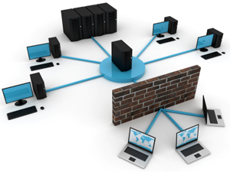
NWEN 243
Networked Applications
Lecture 4: Symmetric Keys & Distribution

Slide 2
Summary: Cyphers
Substitution cipher
  One-to-one mapping of alphabets
  Randomised or shifted
  Easily cryptoanalysed using frequency analysis
Polyalphabetic substitution cipher
  One-to-many mapping of alphabets
  By guessing key length correctly can treat as several subtitution cipher problems
These ciphers are no longer used by themselves, however used as part of modern cipher systems (for example, DES).

Slide 3
What is Secure?
Cyphertext only attack:
  involves analysing only unknown text.
Known plaintext attack (see cribs):
  occurs when some or all words are known, e.g. “Hello”, “Dear” or “Wellington”.
Chosen plaintext attack:
  when the cryptanalyst manages to cause some text of his/her choice to be encrypted.
A secure system is secure against chosen plaintext.
Notes:
We can use the Caesar cipher as an example. There are only 25 keys! The work factor for brute force is low.
Ciphertext only attack involves analysing only unknown text.
Known plaintext attack occurs when some or all words are known, e.g. “Hello”, “Dear” or “Wellington”.
Chosen plaintext attack occurs when the cryptanalyst manages to cause some text of his/her choice to be encrypted.
A secure system is secure against chosen plaintext.
Colossus II was built during WWII to break Lorenz codes – the method was known, the machine would find the keys – was important in ending the war.

Slide 4
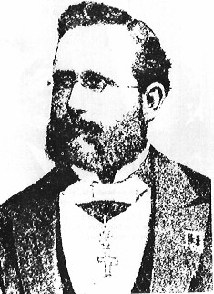
Kerckhoffs's Principle
Assume a published algorithm
Kerckhoff’s principle (1883):
  “All algorithms must be public; only the keys are secret”
An encryption scheme should be secure even if enemy knows everything about it except the key
  Attacker knows all algorithms, has all cypher-texts
  Attacker does not know random numbers
Do not rely on secrecy of the algorithms (“security by obscurity”)
Easy lesson:
use a good random number
generator!
Jean-Guillaume-Hubert-Victor-François-Alexandre-Auguste Kerckhoffs von Nieuwenhof
Notes:
Full name:
Jean-Guillaume-Hubert-Victor-François-Alexandre-Auguste Kerckhoffs von Nieuwenhof

Slide 5
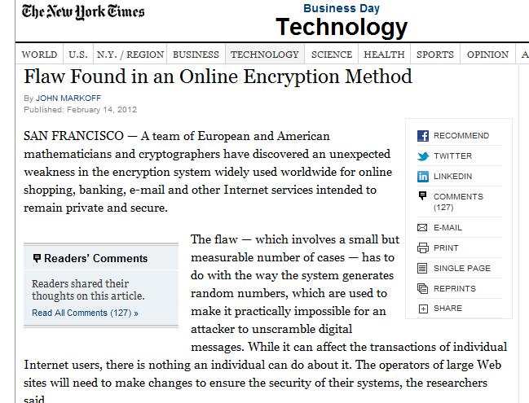
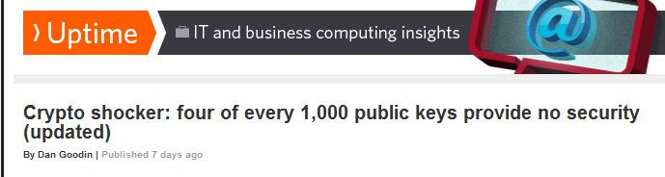
Randomness Matters!
Vitaly Shmatikov

Slide 6
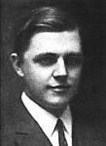
One-Time Pad (Vernam Cipher)
First described by Frank Miller in 1882
the one-time pad was re-invented in 1917 and patented a couple of years later.
It is derived from the Vernam cipher, named after Gilbert Vernam, one of its inventors.
Vernam's system was a cipher that combined a message with a key read from a punched tape.
  In its original form, Vernam's system was vulnerable because the key tape was a loop, which was reused whenever the loop made a full cycle.
  One-time use came a little later when Joseph Mauborgne recognized that if the key tape were totally random, cryptanalysis would be impossible.

Slide 7
One-Time Pad
10111101…
-----
-----
-----
= 10111101…
⊕
⊕
10001111…
= 00110010…
00110010… =
Key is a random bit sequence
as long as the plaintext
Decrypt by bitwise XOR of
ciphertext and key:
ciphertext ⊕ key =
(plaintext ⊕ key) ⊕ key =
plaintext ⊕ (key ⊕ key) =
plaintext
Encrypt by bitwise XOR of
plaintext and key:
ciphertext = plaintext ⊕ key
Cipher achieves perfect secrecy if and only if there are as many possible keys as possible plaintexts, and every key is equally
likely.
(Claude Shannon, 1949)
Vitaly Shmatikov

Slide 8
Advantages of One-Time Pad
Easy to compute
  Encryption and decryption are the same operation
  Bitwise XOR is very cheap to compute
As secure as theoretically possible
  Given a ciphertext, all plaintexts are equally likely, regardless of attacker’s computational resources
  …as long as the key sequence is truly random
    True randomness is expensive to obtain in large quantities
  …as long as each key is same length as plaintext
    But how does the sender communicate the key to receiver?
Vitaly Shmatikov

Slide 9
Problems with One-Time Pad
Key must be as long as plaintext
  Impractical in most realistic scenarios
Does not guarantee integrity
  One-time pad only guarantees confidentiality
Insecure if keys are reused
  Attacker can obtain XOR of plaintexts
Generating good random numbers is hard
  Atomic decay, entropy – unequal distributions
  Pseudo random numbers – Exhibits pattern.
Key Transport
  How to inform the receiver and sender of the keys.
Vitaly Shmatikov wth some additions.

Slide 10
Partial Summary: Cyphers
Substitution cipher
  One-to-one mapping of alphabets
  Randomised or shifted
  Easily cryptoanalysed using frequency analysis
Polyalphabetic substitution cipher
  One-to-many mapping of alphabets
  By guessing key length correctly can treat as several subtitution cipher problems
One Time Pad
  Random keys - difficult key coordination.
  Does not guarentee message integrety (still single char).

Slide 11
Block Cyphers
A problem with character substitution cyphers was that each character stands alone allowing straightforward statistical analysis.
Ideally we should “scramble” information from adjacent letters, words and phrases to remove this operation.
This can be demonstrated by the general concept of block cyphers. A block cypher is a pipeline of two types of transformations:
  P-box. The P-box is a permutation taking some number of bits in and rearranging them.
  S-box. The S-box is a substitution. The substitution may be done efficiently by expanding an n bit input into 2^{n} lines that are zero except for the line representing the number. This is permuted using a P-box and the output (again a single line is a one) is encoded back into n bits.
Both of these are simple operations. The effectiveness comes when they are chained together.
Main advantage (and disadvantage) can be computed in HW.

Slide 12
Permutation
1
1
2
2
3
3
4
4
CODE becomes DCEO
For N-bit input, N! possible permutations
Idea: split plaintext into blocks, for each block use secret key to pick a permutation, rinse and repeat
  Without the key, permutation should “look random”

Slide 13
Block Cyphers
P-box
S-box
1
1
0
1
3 to 8 decoder
8 to 3 encoder
1
1

Slide 14
Block Cipher Operation (Simplified)
https://youtu.be/-Gk9kaFoBxU?t=3s
Block of plaintext
Key
S
S
S
S
Add some secret key bits
to provide confusion
S
S
S
S
Each S-box transforms
its input bits in a
“random-looking” way
to provide diffusion
(spread plaintext bits
throughout ciphertext)
repeat for several rounds
S
S
S
S
Procedure must be reversible
(for decryption)
Block of ciphertext
Notes:
SHA-1 is generated in a similar way.
Key basically becomes an additional bit of data inserted into the message, then we’re simply shuffling.

Slide 15
DES: Data Encryption Standard
Invented by IBM, issued as federal standard in 1977
64-bit blocks, 56-bit key + 8 bits for parity
Very widely used (usually as 3DES) until recently
  3DES: DES + inverse DES + DES (with 2 or 3 different keys)
  Replaced in 2001 with AES (128 bit Advanced ES)
Uses block ciphers as basic building blocks
Notes:
Feistel

Slide 16
DEScription: Overview¹
Block cipher: 64 bits at a time
Initial permutation rearranges 64 bits (no cryptographic effect)
Encoding is in 16 rounds
¹: by Sandy Kutin, people.cs.uchicago.edu/~kutin/CSPP532/7-3-01/week3-notes.ppt

Slide 17
DEScription: One Round
64 bits divided into left, right halves
Right half goes through function f, mixed with key
Right half added to left half
Halves swapped (except in last round)
L_{i-1}
R_{i-1}
L_{i}
R_{i}

Slide 18
The F Function
Expand right side from 32 to 48 bits (some get reused)
Add 48 bits of key (chosen by schedule)
S-boxes: each set of 6 bits reduced to 4
P-box permutes 32 bits
Confusion:
6 bits * 8 s-Boxes → 8 * 4 bit

Slide 19
DESign Principles: Inverses
Equations for round i:
In other words:
So decryption is the same as encryption
Last round, no swap: really is the same
L_{i-1}
R_{i-1}
L_{i}
R_{i}

Slide 20
The Problem of Keys
Symmetric encryption (such as DES and AES) requires key exchange - parties must ‘know’ each other ahead of time.
In the 1970s COMSEC was responsible for transporting tons of keys each day.
Based on the growth of computing since this time, this would probably mean around a million tons worth of keys would need transported each day.
Logistically, commercially and environmentally infeasible.

Slide 21
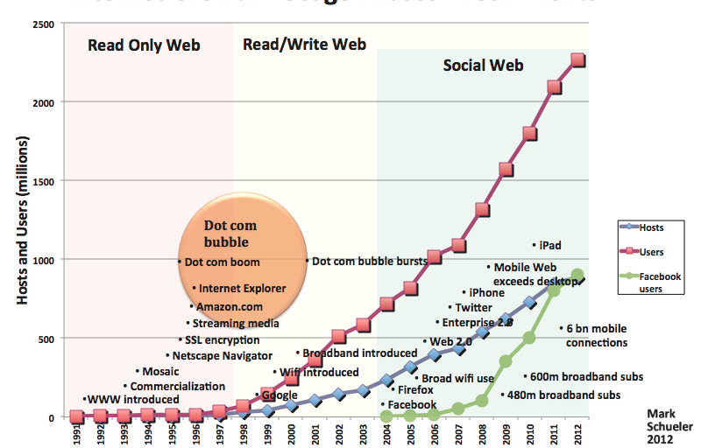
Gratuitous image of Internet Growth

Slide 22
Use a Trusted Intermediary
COMSEC acted as a ‘trusted’ intermediary
  2 parties wishing to communicate had to rely on COMSEC as a ‘trusted’ third party to deliver their keys.
  This involved physical key transport of paper keys.
How do two unfamiliar entities establish shared secret key, digitally, over a network
  A trusted key distribution center (KDC) acting as intermediary between entities, a digital analogue to COMSEC.
© 2011-13, Kris Bubendorfer
NWEN 243

Slide 23


Key Distribution Center (KDC)
Alice, Bob need a shared symmetric key.
KDC: server shares a different secret key with each registered user (many users)
Alice, Bob know symmetric keys, K_{A-KDC} K_{B-KDC} , for communicating with KDC.
KDC
K_{B-KDC}
K_{A-KDC}
K_{P-KDC}
K_{X-KDC}
K_{Y-KDC}
K_{Z-KDC}
K_{A-KDC}
K_{B-KDC}
Notes:
Q: how does the KDC get a shared key – out of band. But you only need to do this once!

Slide 24
Key Distribution Center (KDC)
How does the KDC enable Alice and Bob to determine a shared symmetric secret key to communicate?
K_{A-KDC}(B)
KDC generates SK₁
K_{A-KDC}(SK₁, K_{B-KDC}(A,SK₁) )
Alice
Learns SK₁
Bob learns SK₁ & communicates with Alice
K_{B-KDC}(A,SK₁)
Alice and Bob learn the SK₁ (session key) and ‘authenticate’ at the same time.
Notes:
We’re going to come back to ‘authentication’ later.
Problem is it is synchronous – not off line.

Slide 25
The Problem of Keys and KDCs
The KDC must be online, to initiate the conversation.
If the service is down, Alice and Bob cannot communicate.
The KDC knows SK, so it can read Alices and Bob’s communications directly.
An idea, what if we can avoid using a trusted 3rd party at all? What if we can do this ofline?
  For a long period of time solving the key-distribution problem was the ‘Holy-Grail’ of cryptography (aka, impossible).

Slide 26
Now for a slightly different Scenario.
We have been talking about securing 1 to 1 communications.
  All the secrets we have looked at involve 2-parties:
  Sam and Alice share a key (secret) and are able to communicate.
  Alice can read everything written using the shared secret, and
  Bob can read everything written using the shared secret.
But of course security also applies to systems, access, rights and authority.
  You are used to the idea that passwords are used to control access.
  Identity (usually demonstrated by knowledge of a password (secret)), represents rights and authority.
  Access and identity are usually tied together in this way. But this is misleading (see NWEN 304).

Slide 27
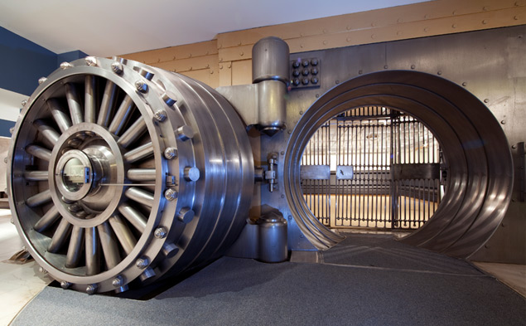
The Problem with Bank Managers
Imagine a vault that can only be opened using a secret code.
Our bank has n managers who need to be able to open the vault.
Solution: give the secret code (S) to all n managers.

Slide 28
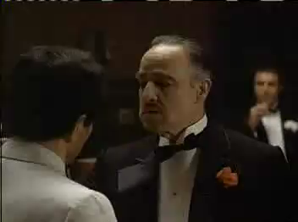
The Problem with Bank Managers
RESULT: this is dangerous, as the security of the vault may be vulnerable if one of the managers is compromised.
  This is called a 1 out-of n scheme.
The general problem is called secret sharing.
Notes:
I think Marlon Brando – The Godfather said it best.

Slide 29

Secret Sharing (n:n)
All managers are required to open the vault.
  Solution: give S₁ to manager₁, S₂ to the manager₂, etc.
  secret(S) = S₁ ⊕ S₂ ⊕ · · · ⊕ S_{n}
  the vault cannot be opened when fewer than n managers are present.
This is the principle of separation of duties.
Notes:
Titan nuclear missile launch keys.
One person can’t possibly do that, it takes 2 to tango!

Slide 30

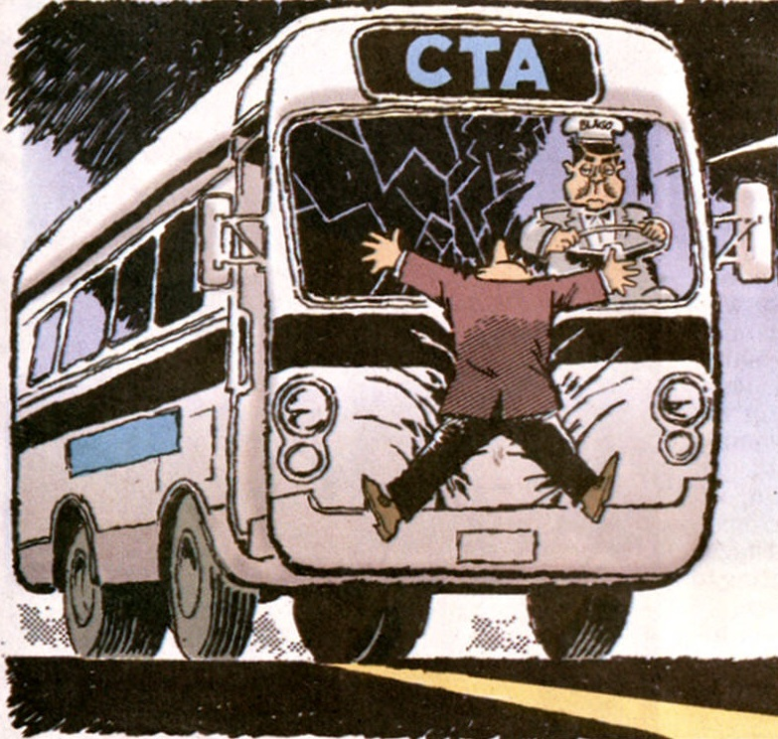
Secret Sharing (n:n)
RESULT: this is overly restrictive, e.g., if one of the managers has been killed, say, hit by a bus, then the vault cannot be opened. Ever.

Slide 31
Secret Sharing (2:n)
How about a compromise?
We want a scheme such that any two of the n managers can open the vault, but any one manager cannot open the vault by himself.
This makes it harder to subvert the managers as in 1:n, and is much less restrictive than n:n.
IDEA: we can use a line:
f(x) = mx + s
The principle is to use the y-intercept as our secret (S).
We calculate a point (or key share) for each manager_{i} = f(i).

Slide 32
Solving for Y (S)
RESULT: if we only know one point, then we learn nothing as there are an infinite number of possible solutions for S.
Share manager 4
Share manager 7
But if we know 2 points…
Share manager 4
S
RESULT: if we know 2 points, then we can completely solve for the y-intercept and therefore S.

Slide 33
Secret Sharing (m:n)
How can we generalize this?
We now want a scheme such that any m of the n managers can open the vault, but any collection of managers fewer than m cannot, i.e., 3 from 5 managers, 2 cannot open it, but 3 can.
IDEA: (Shamir) we can use a polynomial of the form:
f(x) = c_{n}x^{n} + … + c₂x² + c₁x + S
Shamir’s algorithm is based on the fact that a polynomial of degree k can be uniquely identified by k+1 points:
  A line f(x) = mx + s (degree 1) can be identified by 2 points.
  A parabola f(x) = c₂x² + c₁x + s (degree 2) can be identified by 3 points.
  f(x) = c₃x³ + c₂x² + c₁x + s (degree 3) can be identified by 4 points.

Slide 34
Secret Sharing (m:n)
Here you can see the degree 2 parabola has infinite solutions when only 2 points are defined.
With 3 points the curve is uniquely identified, and we can now work backwards to reconstruct the polynomial equation.

Slide 35
Secret Sharing (m:n)
The details…
We construct a polynomial f(x) of degree m-1 using m-1 random coefﬁcients and the secret S as the constant.
We then pick n random x values and solve the polynomial creating n points (or key shares) of the form (xi,yi) for the managers.

Slide 36
Secret Sharing (m:n)
To retrieve the value S, we need to know at least m of the n shares (in any combination, say 3 of 5) and,
We reconstruct the coefﬁcients for the equation using Lagrange interpolation (see http://en.wikipedia.org/wiki/Lagrange_polynomial).
Obviously we pick big numbers to make brute forcing the solution hard.
S

Slide 37
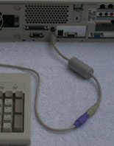
Other Concerns
Even though modern encryption is enormously strong a Cryptanalyists can still deploy Pinches:
  Remote reading monitor signals (tempest)
  Keyboard dongles
  Viruses, Trojans,
  Backdoors (mandated or otherwise)
  and Traffic anaysis.
These are much easier ways to hack into secure communications.

Slide 38
Fin.

