Slide 1
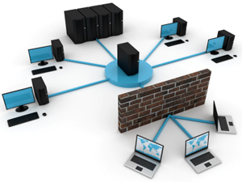
NWEN 243
Networked Applications
Lecture 5: The Key Problem & Asymmetric Cyphers

Slide 2
Notices
Tutorial 29th Jul 2016 (Friday, 9a.m).
Lab2 is out, no demos, only electronic submission.
Tentative list of registrations is online. Will be finalized on Wednesday.

Slide 3


Key Distribution Center (KDC)
How does the KDC enable Alice and Bob to determine a shared symmetric secret key to communicate?
K_{A-KDC}(B)
KDC generates SK₁
K_{A-KDC}(SK₁, K_{B-KDC}(A,SK₁) )
Alice
Learns SK₁
Bob learns SK₁ & communicates with Alice
K_{B-KDC}(A,SK₁)
Alice and Bob learn the SK₁ (session key) and ‘authenticate’ at the same time.
Notes:
We’re going to come back to ‘authentication’ later.
Problem is it is synchronous – not off line.

Slide 4
Key Distribution Center (KDC): Simpler Version
How does the KDC enable Alice and Bob to determine a shared symmetric secret key to communicate?
K_{A-KDC}(B)
KDC generates SK₁
K_{A-KDC}(SK₁)
K_{B-KDC}(SK₁)
Alice
Learns SK₁
Bob learns SK₁ & communicates with Alice
What are the disadvantages of this protocol?
Notes:
We’re going to come back to ‘authentication’ later.
Problem is it is synchronous – not off line.

Slide 5
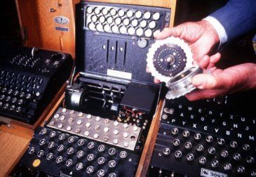
The problem with keys
Key exchange problem
DHM,
RSA
The Enigma Machine
Notes:
Pictured is the enigma, the German encoding machine from world war II. Changing or rearranging the wheels produced a different “engine”.

Slide 6
Reminder: The Problem of Keys
Symmetric encryption requires key exchange - parties must ‘know’ each other ahead of time.
In the 1970s COMSEC was responsible for transporting tons of keys each day.
2 parties wishing to communicate had to rely on the ‘trusted’ third party to deliver their keys.
For a long period of time solving the key-distribution problem was the ‘Holy-Grail’ of cryptography (aka, impossible).

Slide 7
The story of a Locked Box
Alice wishes to send Bob a personal message.
Alice places her message in an iron box, and secures it with a padlock.
Alice puts the box in the mail and keeps the key.
When the box reaches Bob, he is unable to open it as he does not have a key.
The only way Bob can open it is if Alice has previously given him a copy of the key.
Or is it….
Notes:
DEMO

Slide 8
The story of a Locked Box
Alice padlocks the box.
Sends the box to Bob, and keeps the key.
Bob cannot open the box, but places his own padlock on it in addition to Alice’s.
He sends the box back to Alice.
Alice removes her padlock, and
Sends the box back to Bob,
Bob can now remove his padlock and read the message!
No prior key exchange was needed.

Slide 9
The story of a Locked Box
The problem is, when we apply this to encryption,
The order of the encryptions matters.
  B(A(x)) ≠ A(B(x))
What was needed was a scheme where this order did not matter.
Whitfield Diffie and Martin Hellman attempted to do this by looking at one-way functions,
those that are easy to do in one direction, but almost impossible to reverse.

Slide 10
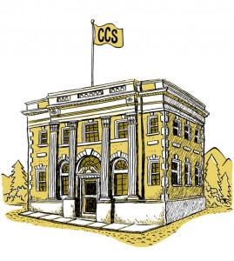
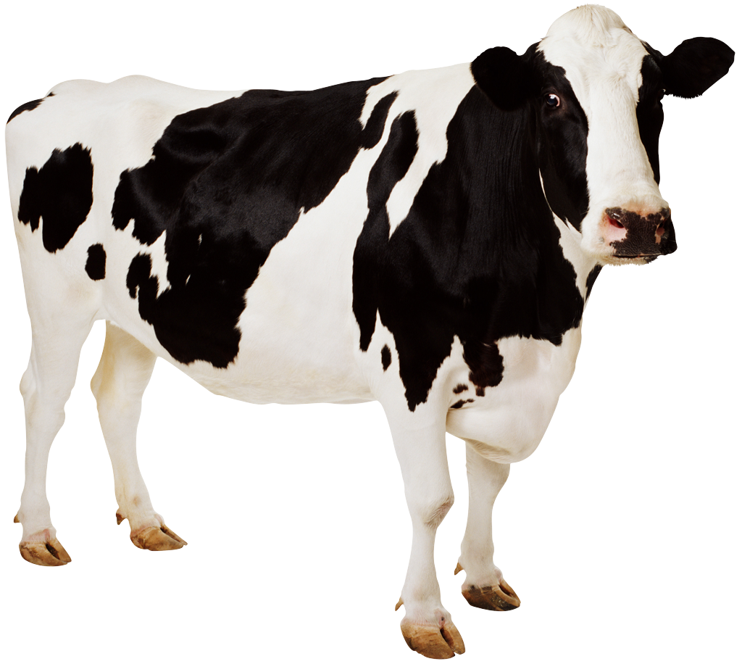


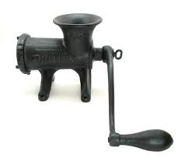

One Way Functions
?
Notes:
The point is, you want the answer to give little (or no) information about the thing before the 1-way function, so that an easy computation in one direction is a difficult, potentially impossible search space. Ideally infinite.

Slide 11
Diffie-Hellman-Merkle
DHM was the break through key exchange protocol in the mid 70s.
Paint Analogy:
  Bob, Alice each have 1 litre of yellow paint.
  Bob and Alice wish to exchange keys, so add a little of their own secret colour to the pot.
  Bob and Alice exchange pots.
  Bob adds his secret colour to Alice’s pot, and Alice adds her secret colour to Bob’s.
  Both pots are now the same colour.
Notes:
DEMO HERE
red + blue = purple
blue + yellow = green
yellow + red = orange
It does not matter if Sam observes the Yellow pot, Bobs pot (Yellow + his colour) or Alices pot. Without seeing the final pot Sam has no way of working out the key. The achievement was a secret was established over a public channel.

Slide 12
Diffie-Hellman-Merkle
The central idea is based on the one way function:
    Y^{x} (mod P) with Y < P
Y^{x} (mod P) is very easy to compute, but
  Is very hard to reverse, without building a huge table of solutions.
  This is because computing one ‘reversed answer’ does not give any hint or clue about another.
  The bigger Y and P the larger the search space.

Slide 13
Deffie-Hellman Key Exchange
Step 1: Let’s agree on a prime number p and a base g
Step 2: Alice chooses a secret number ‘a’ and sends the to Bob (gª mode p)
Step 3: Bob chooses a secret number ‘b’ and sends Alice (g^{b} mode p)
Step 4: For the Key:
Alice computes (g^{b} mode p)ª mode p
Step 4: For the Key:
Bob computes (gª mode p)^{b} mode p
Notice that p and g need not be protected. So, an attacker could have them
Notes:
To exchange symmetric keys, we can use Deffie-Hellman Key Exchange protocol. Actually the algorithm does not only exchange keys but it generates them as well. The algorithm works as follows when Alice and Bob needs to exchange a symmetric key as seen in Figure 2.09 – The DH Protocol:
Step 1: Let’s agree on a prime number p and a base g
Step 2: Alice chooses a secret number a and sends it to Bob (gª mode p)
Step 3: Bob chooses a secret number b and sends Alice (g^{b} mode p)
Step 4: For the Key:
Alice computes (g^{b} mode p)ª mode p
Bob computes (gª mode p)^{b} mode p
Notice that p and g need not be protected. So, an attacker could have them.
For more information about the foundation of the algorithm please watch video on Khan Academy. A link is provided in the lesson notes.
Let’s think if the attacker gets both p and g, would it possible for him/her to compute the same key and compromise the system?

Slide 14
Diffie-Hellman-Merkle
Alice and Bob establish two values for Y and P on a public channel, say 7 and 11, giving: 7^{x} (mod 11)
      Alice chooses her key: x = 3.
      7³ (mod 11) = 2
      Alice sends 2 to Bob over the public channel
      Alice Takes Bobs number 4 and computes:
      4³ (mod 11) = 9
      Bob chooses his key: x = 6.
      7⁶ (mod 11) = 4
      Bob sends 4 to Alice over the public channel
      Bob takes Alice’s number 2 and computes:
      2⁶ (mod 11) = 9
This was a most significant breakthrough in cryptography – to establish a secret key with no physical key distribution.
DHM is used in OpenID.
https://youtu.be/YEBfamv-_do?t=2m18s
Notes:
Bob and Alice now share a key 9, constructed over a shared channel – but without knowledge of x, cannot be easily reconstructed by Sam due to the one-way function mod.
7^3 = 343
343 mod 11 = 31 times r 2
---
4^3 = 64
64 mod 11 = 5 times r 9
-------
7^6 = 117649
117649 mod 11 = 10695 times r 4
THIS IS STILL SYMMETRIC! Note we don’t have asymmetric keys – both bob and alice have key 9, and we have no concept of private/public keys.
Also, the numbers do NOT have to be primes, very few restrictions…

Slide 15
Public Key Encryption
In 1975 Diffie proposed an asymmetric cypher scheme for public key encryption.
The central idea is that Alice has two keys, one public and one private.
Alice keeps her private key to herself, but lets everyone know her public key.
Anyone with Alice’s public key can encrypt a message for Alice, but only Alice can decrypt it with her private key (secrecy).
Alice can also encrypt things with her private key, and anyone with her public key can decrypt it. They know Alice sent the message, as only she knows he public key (authentication).
The problem was there was no known one-way function to make it work – the race was on.

Slide 16
Public Key Encryption
Message, M
attack at
dawn unless
it rains.
K_{X}⁺
K_{X}⁻
encryption
method
K_{X}⁺(M)
decryption
method
Cyphertext
K_{X}⁻(K_{X}⁺(M)) = M
attack at
dawn unless
it rains.
K_{X}⁺ X’s Public Key, K_{X}⁻ X’s Private Key
Notes:
Public key encryption avoids the problem of the parties having to distribute a shared key ahead of time. Assume Bob on the left wants to send Alice on the right a message. Bob obtains Alice’s public key (from some database, web page, etc.) and encrypts the message with the public key.
The cipher text is sent to Alice.
Alice uses a private (secret) key to decode the message.
Obviously the public and private keys are related.
Note: Alice’s public key is available. The algorithm is public. An attacker can encode likely messages from Bob with Alice’s public key to try to figure out Alice’s private key. It must be difficult to do so.

Slide 17
RSA Analogy
Alice creates a large number of padlocks, and keeps the key herself.
Alice deposits her padlocks in a ‘post office’.
When Bob wants to send a package to Alice he obtains an ‘Alice’ padlock and closes it to seal the message.
Bob can no longer open the package, only Alice can.
This is harder mathematically, than physically. The idea in RSA is to use large primes that are difficult to factor, and a one way (mod) function.
Notes:
Padlocks key’ed alike

Slide 18
RSA (Rivest, Shamir, Adleman)
Two steps to RSA
  Choice of public and private keys
  The encryption and decryption algorithms
Notes:
The concept of public key cryptography was first published by Diffie and Hellman 76, but Rivest, Shamir and Adleman 78 commercialised it. The RSA algorithm is now a standard.
Now summarize the method rather than the number theory underlying it. Its security is based on the difficulty in factoring a large number, in this case n = pq.
Relatively prime - Two integers are relatively prime if they share no common positive factors (divisors) except 1. Using the notation (m, n) to denote the greatest common divisor, two integers m and n are relatively prime if . Relatively prime integers are sometimes also called strangers or coprime and are denoted

Slide 19
RSA – choosing the keys
Alice picks two giant primes p and q
  Product pq should be about 1K-4K bits
  N = pq
  Z = (p - 1)(q - 1)
Choose some e < N relatively prime to Z
Alice’s public key is (N,e)
Find d such that (ed) mod Z = 1
  Uses Euclid’s algorithm to quickly find the GCD.
Alice’s private key is (N, d)
Notes:
Now summarize the method rather than the number theory underlying it. Its security is based on the difficulty in factoring a large number, in this case n = pq.
Relatively prime - Two integers are relatively prime if they share no common positive factors (divisors) except 1. Using the notation (m, n) to denote the greatest common divisor, two integers m and n are relatively prime if . Relatively prime integers are sometimes also called strangers or coprime and are denoted
The Euclidean algorithm is an efficient method for computing the greatest common divisor (GCD),

Slide 20
RSA – the algorithms.
Encryption
  C = Me mod N
Decryption
  M = C^{d} mod N
An elegant but expensive process!
Notes:
The algorithm makes use of modulo arithmetic. Given that we are working with large numbers this is hard work.

Slide 21
Tiny RSA Example
p = 3, q = 11
N = pq = 33
Z = (p-1)(q-1) = 20
Choose e < N and relatively prime to Z
  e = 3, no common factors with Z
Find d such that 3d (mod 20) = 1
  d = 7
  Public key = (33,3) Private key = (33,7)
Notes:
**The encryption of the message can be reversed by someone who know p and q. Public key is N, which is p*q. However if p and q are big enough primes it is practically impossible to deduce p and q from N. This is the critical and elegant contribution of RSA.

Slide 22
Tiny RSA Example
Bob wishes to send message M = 7 to Alice.
  Bob encodes with Alice’s public key e and C = Me mod N
  C = 7³ mod 33,
  C = 13
  Alice decodes with private key and M = C^{d} mod N
  M = 13⁷ mod 33
  M = 7
  Sam attempts to decode with the public key M = C^{d} mod N
  M = 13³ mod 33
  M = 19, which is incorrect.
Notes:
4+2+1 = 7 ** neat trick for computing exponentials in modulo arithmetic
** Note, these are the smallest numbers for which RSA works.

Slide 23
Reversability
  Can run in reverse: encrypt with private key and decrypt with public key.
  Bob encodes with C = M^{d} mod N
  C = 7⁷ mod 33
  C = 28
  Alice decodes with M = Ce mod N
  M = 28³ mod 33
  M = 7
Notes:
So how long would it take to break a 128-bit key?
Callas: Here's an analogy. Consider a computer the size of a grain of sand that can check one key in the amount of time it takes light to cross it. Now cover an Earth-sized planet (let's not use the actual Earth) with these computers to a depth of one meter. It will take this distributed network an average of 1,000 years to break a single 128-bit key
http://searchsecurity.techtarget.com/qna/0,289202,sid14_gci855800,00.html

Slide 24
Try this
P = 11 and q = 5
Generates public and private keys

Slide 26
The problem is,
It is mathematically expensive to perform RSA encryption.
Symmetric keys are much cheaper.
PGP (Zimmerman 1991) pretty good privacy combined both.
  RSA to establish authenticity, and
  RSA to securely transport the…
  symmetric conversation key.

Slide 27
PGP
No previous key exchange + efficiency
(K_{B}⁺(K_{A}⁻(K_{C}))
C = Kc(P)
K_{C} = conversation key (symmetric)
Wrapped by Alice’s private key K_{A}⁻ (anyone can decrypt) to prove K_{C} came from Alice (authenticity)
Wrapped by Bob’s public key K_{B}⁺, so only Bob can decrypt it, protecting K_{C} (secrecy).
Notes:
Kc = conversation key (symmetric) – analogue to enigma day key
Wrapped in Alices private key (anyone can decrypt) to prove session key really came from Alice (authenticity)
Wrapped in Bob’s public Key, so only Bob can decrypt it, protecting the session key.

Slide 28
Integrity
Identify signer/owner of document
  Non-repudiation
Ensure accuracy of document
Notes:
Integrity is straightforward. We want the equivalent (actually an improvement on) a signed piece of paper. Signature of person giving authority to document in a way that ensures document has not be forged or altered.
We want this to be offline. So, it cannot be based on a nonce. Likewise, we want nonrepudiation (can’t take back what you said).

Slide 29
Integrity – Digital Signature
Dear Bob,
This is to
let you know
blah, blah
Alice
K_{A}⁻(M)
K_{A}⁺(M)
Lcxkjasdkfjl
;lkjsdklfjkjr;
iue8925043
kfjh438957l
Dear Bob,
This is to
let you know
blah, blah
Alice
Notes:
Alice has message for Bob that needs to be signed. She encrypts it with her decryption algorithm and private key. She sends the encrypted message to Bob.
When Bob receives the message he uses Alice’s public key to decrypt it. This stands up to our criteria as a signature because:
Only Alice could have encrypted it since she is the only one that knows d_{A}.
If the message had been tampered with then it would not have decrypted correctly.
Note that this does not achieve secrecy. Although we sent an “encrypted” message anyone with access to Alice’s public key could have decrypted it.

Slide 30
Message Digests
Inefficient to sign large documents by encrypting them (public key)
Message digest (hash)
  Given message P it is easy to compute MD(P)
  Given a message digest x, it is infeasible to find a message P such that MD(P) = x
  It is infeasible to find two messages, P₁ and P₂, such that MD(P₁) = MD(P₂)
Notes:
Public key encryption is expensive and encrypting with a private key does not give us secrecy.
Rather the goal was to:
sign a document so that it is, verifiable, non forgeable, and non redudiable.
RSA does this.
Therefore, why encrypt an entire message, especially if it is large?
A message digest is similar to a checksum and is usually computed with a hash function such as MD5 or SHA-1. The important aspect of a digest is that it reliably identifies the message. MD5 produces a 128 bit digest and SHA-1 a 160 bit digest.

Slide 31
Digital Signature Using a Message Digest
Dear Bob,
This is to
let you know
blah, blah
Alice
Bob
H(M)
128 bit digest
MD(M, K_{A}⁻)
j209gjz76kre
Notes:
Alice has message for Bob that needs to be signed. This time she creates a digest of the message and then encrypts the digest with her private key. She places both the plaintext message and the signature in an “envelope” and sends it to Bob. MD = message Digest!
Note: This is probably MD5 as it is 128bits not 160 of SHA1.
Note: If Alice wants privacy as well she should now encrypt both the message and the signature with an appropriate key.

Slide 32
Receiving a Digest Signature
Bob
Dear Bob,
This is to
let you know
blah, blah
Alice
H(M)
128 bit digest
j209gjz76kre
K_{A}⁺(MD)
equal?
128 bit digest
Notes:
On receipt of the message Bob needs to do two things:
he runs the same digest algorithm over the plaintext message to obtain a digest; and
he decrypts the signature with Alice’s public key to obtain a second copy of the digest.
Bob can now compare the two copies

Slide 33
Is Bob Happy they are Equal?
Yes.
Alice signed the message because only she knows her private key.
The message hasn’t been tampered with because the digests match:
  The probability that a message could be changed to produce the same digest is essentially zero.
  The signature belongs to the message because the probability of copying a signature from another message and having the the digests match is also essentially 0.

Slide 34
Trusted Intermediaries
Symmetric key prob:
How do two unfamiliar entities establish shared secret key over network?
Solution:
  trusted key distribution center (KDC) acting as intermediary between entities
Public key prob:
When Alice obtains Bob’s public key (from web site, e-mail, diskette), how does she know it is Bob’s public key, not Sam’s?
Solution:
  trusted certification authority (CA)

Slide 35
Key Distribution Center (KDC)
Alice, Bob need shared symmetric key.
KDC: server shares a different secret key with each registered user (many users)
Alice, Bob know symmetric keys, K_{A-KDC} K_{B-KDC} , for communicating with KDC.
KDC
K_{B-KDC}
K_{A-KDC}
K_{P-KDC}
K_{X-KDC}
K_{Y-KDC}
K_{Z-KDC}
K_{A-KDC}
K_{B-KDC}

Slide 36
Key Distribution Center (KDC)
How does the KDC enable Alice and Bob to determine a shared symmetric secret key to communicate?
K_{A-KDC}(B)
KDC generates R₁
K_{A-KDC}(R₁, K_{B-KDC}(A,R₁) )
Alice
Learns R₁
Bob learns R₁ & communicates with Alice
K_{B-KDC}(A,R₁)
Alice and Bob learn R₁ (session key) and authenticate at the same time.
Notes:
Problem is it is synchronous – not off line.

Slide 37
Public Key Certification
Need to obtain public key from a trusted source (to avoid man in the middle).
Either:
  ObtainDirect from owner by secure channel.
  Certificate Authority
    Trusted (well known – i.e in browser) third party
    Verifies holder of key
    Creates signed digital certificate
    Available from information server
Notes:
We saw that the problem of a symmetric key was one of the secret key exchange. We also saw that public key encryption solves this, however, it has its own problems, namely ensuring that the true public key is available.
We can solve this in both instances by using a trusted 3rd party to distribute the shared or public keys. In the case of shared keys, we would likewise share a secret with the trusted 3rd party. For symmetric keys this is called the KDC (key distribution centre). For public keys, we have the trusted 3rd party called the certification authority (CA). All a CA does is certify that a particular key, belongs to a particular entity. If you can trust the CA, then we can be sure about the key, and it can be distributed from anywhere (email, webpage etc).
We use a trusted Certificate Authority to solve the problem of public key distribution. First, the key owner registers with the authority who will verify their identity. How thorough they are will generally depend on “level of service”.
The authority then creates a signed digital certificate that can be used to distribute Bob’s key. The certificate may be available from their web site, but can also be distributed by Bob. It is secure and guaranteed by the authority, e.g. Verisign, Baycorp. You can look at the CA’s in your browser.

Slide 38
Certification Authorities
E (person, organisation) registers public key with CA.
  Provides “proof of identity” to CA.
  CA creates certificate binding E to its public key.
  Certificate containing E’s public key digitally signed by CA – CA says “this is E’s public key”
certificate for Bob’s public key, signed by CA
+
K
B
digital
signature
(encrypt)
+
K
Bob’s
identifying information
B
-
K
CA

Slide 39
Certification Authorities
When Alice wants Bob’s public key:
  gets Bob’s certificate (Bob or elsewhere).
  apply CA’s public key to Bob’s certificate, retrieve Bob’s public key
+
digital
signature
(decrypt)
Bob’s
public
key
K
B
+
K
B
CA
public
key
+
K
CA

Slide 40
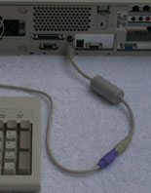
Other Concerns
Even though modern encryption is enormously strong a Cryptanalyists can still deploy Pinches:
  Remote reading monitor signals (tempest)
  Keyboard dongles
  Viruses, Trojans,
  Backdoors (mandated or otherwise)
  and Traffic anaysis, and
  Social Engineering (Phishing)

Slide 41



