Slide 1

NWEN 243
Networked Applications
Lecture 6: Certification and Sharing Secrets

Slide 2
Hash Functions
Non-Cryptographic Hash
Cryptographic Hash
Notes:
A hash function maps an arbitrary length input to a fixed-size output. It is sometimes used to compare data objects for equality. It is also used in indexing, as in databases. Having this mapping feature, it is also used in cryptography. We can classify these hash functions into cryptographic and non-cryptographic. In fact, every cryptographic hash function is a hash function, but this is not true the other way around. This is why it is good to classify hash functions into cryptographic and non-cryptographic.

Slide 3
Non-cryptographic Hash and Security Services
Collision
Cryptographic Hash
dkajshdkjsadkaskas
H
H(x)
H(x) = H(y)
p293203cllasdlasdlasa
H
H(y)
Notes:
Can we use non-cryptographic hash functions in, for example, authentication?
Non-cryptographic hash functions suffer from collisions. This happens when multiple input data objects are mapped into the same output (i.e. key). In cryptography, we can not allow this as the system could be compromised easily should a message be fabricated to generate the same key.

Slide 4
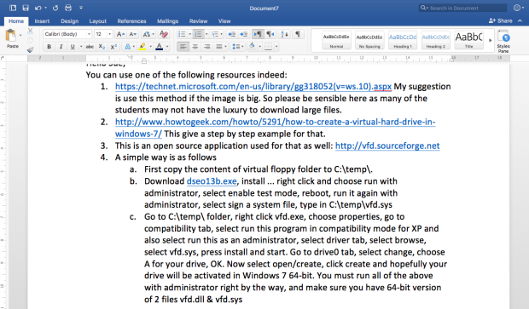
Cryptographic Hash Functions
Hash Value
Any Size Input
Specific Size Output
0101101010101110100100110
Notes:
Cryptographic hash functions solve this collision problem (or at least claim to have solved it ). They have many desirable cryptographic features. For example, they are:
1. One-way so that if you have the key you can not generate the original message.
2. Pseudorandom. This is important for the output not to be predicted which actually supports another important feature (i.e. hide information about the input. Remember you may have the output)
3. Collision resistant
4. Computationally efficient

Slide 5
Cryptographic Hash Functions: Applications
PKI → digital signatures
Integrity Checks → scanning for malware
Authentication → SSH
Notes:
Cryptographic hash functions could be used in many computer security applications such as in public key infrastructure. One of the usages is in digital signatures. I am sure you have seen some MD5 codes when you were downloading a file online. This is the fingerprint of the file and is used for integrity checks. Cryptographic hash functions could be also used for authentication purposes such as those in SSL.

Slide 6
Cryptographic Hash Functions
Examples:
MD5
SHA-0, SHA-1
SHA-3
XHA64
RIPEMD-160
Whirlpool
Tiger
GOST-3411
…….
Notes:
There are many examples for cryptographic hash functions such as:
Examples:
MD5
SHA-0, SHA-1
SHA-3
XHA64
RIPEMD-160
Whirlpool
Tiger
GOST-3411
…….
MD5 and SHA are the popular examples for cryptographic hash functions.

Slide 7

Digital Signatures
Document to be signed
Sender Private Key
Sender
Encryption
0101101010
Hash Value/Code
0101101010
0101101010
Digitally Signed Document
Receiver
Sender Public Key
Decryption
?
=
0101101010
0101101010
Signature Verification
Notes:
The simplest way to sign a message here is to hash it then encrypt the key (i.e. the hash value) by the sender private key then attach that (i.e. the encrypted message) to the original message and forward it to the receiver. At the verifier side, the message is split again into signature and message. The message is hashed again to generate a key. The signature part is decrypted by the sender public key to be compared to the hash value of the message received. If both are the same, the signature is valid otherwise it is not valid.
One of the main good things here with this digital signature protocol is that it provides integrity. Unlike that of the paper signature, where the signature itself is independent of the document, the digital signature here depends on the contents of the document. You now need to think of why we encrypt the hash value of the document - rather than the document itself - as the actual signature!

Slide 8
Certificates
?
e_{A}
Public Key
e_{A}
Public Key
d_{A}
Private Key
e_{A}
Public Key
e_{B}
Public Key
d_{B}
Private Key
Solution?
Key Server
Notes:
There is a small problem here with this digital signature. When using the public key of Alice, Bob needs to make sure it is really Alice’s key. One problem here is: how can Bob be convinced that eA is the RSA public key of Alice?
An attacker could masquerade as Alice by constructing a public-key pair eA’ that corresponds to a private key dA’ then send Bob that public key claiming it is Alice’s public key. Now Bob will send message m to Alice encrypted with the attacker’s public key, and the attacker could intercept that and decrypt the message. Alice won’t be able to decrypt it anyway. The attacker could also masquerade as Bob when communicating with Alice. We call this a MITM (Man In The Middle) attack. One way to store keys is to use some trusted key servers. This is not the perfect solution, however, as the server could be vulnerable to, for example, a dictionary attack.
So the solution is to get a third party to sign Alice’s public key so that Bob knows it is the real key of Alice . That Key server would not be as good as that trusted party unless the key server acts as a trusted authority and signs the public keys of the users. This is the public-key infrastructure (PKI).

Slide 9
Trusted Intermediaries
Symmetric key prob:
How do two unfamiliar entities establish shared secret key over network?
Solution:
  trusted key distribution center (KDC) acting as intermediary between entities
Public key prob:
When Alice obtains Bob’s public key (from web site, e-mail, diskette), how does she know it is Bob’s public key, not Sam’s?
Solution:
  trusted certification authority (CA)

Slide 10


Key Distribution Center (KDC)
Alice, Bob need shared symmetric key.
KDC: server shares a different secret key with each registered user (many users)
Alice, Bob know symmetric keys, K_{A-KDC} K_{B-KDC} , for communicating with KDC.
KDC
K_{B-KDC}
K_{A-KDC}
K_{P-KDC}
K_{X-KDC}
K_{Y-KDC}
K_{Z-KDC}
K_{A-KDC}
K_{B-KDC}

Slide 11
Key Distribution Center (KDC)
How does the KDC enable Alice and Bob to determine a shared symmetric secret key to communicate?
K_{A-KDC}(B)
KDC generates R₁
K_{A-KDC}(R₁, K_{B-KDC}(A,R₁) )
Alice
Learns R₁
Bob learns R₁ & communicates with Alice
K_{B-KDC}(A,R₁)
Alice and Bob learn R₁ (session key) and authenticate at the same time.
Notes:
Problem is it is synchronous – not off line.

Slide 12
Public Key Certification
Need to obtain public key from a trusted source (to avoid man in the middle).
Either:
  ObtainDirect from owner by secure channel.
  Certificate Authority
    Trusted (well known – i.e in browser) third party
    Verifies holder of key
    Creates signed digital certificate
    Available from information server
Notes:
We saw that the problem of a symmetric key was one of the secret key exchange. We also saw that public key encryption solves this, however, it has its own problems, namely ensuring that the true public key is available.
We can solve this in both instances by using a trusted 3rd party to distribute the shared or public keys. In the case of shared keys, we would likewise share a secret with the trusted 3rd party. For symmetric keys this is called the KDC (key distribution centre). For public keys, we have the trusted 3rd party called the certification authority (CA). All a CA does is certify that a particular key, belongs to a particular entity. If you can trust the CA, then we can be sure about the key, and it can be distributed from anywhere (email, webpage etc).
We use a trusted Certificate Authority to solve the problem of public key distribution. First, the key owner registers with the authority who will verify their identity. How thorough they are will generally depend on “level of service”.
The authority then creates a signed digital certificate that can be used to distribute Bob’s key. The certificate may be available from their web site, but can also be distributed by Bob. It is secure and guaranteed by the authority, e.g. Verisign, Baycorp. You can look at the CA’s in your browser.

Slide 13
Certification Authorities
E (person, organisation) registers public key with CA.
  Provides “proof of identity” to CA.
  CA creates certificate binding E to its public key.
  Certificate containing E’s public key digitally signed by CA – CA says “this is E’s public key”
certificate for Bob’s public key, signed by CA
+
K
B
digital
signature
(encrypt)
+
K
Bob’s
identifying information
B
-
K
CA

Slide 14
Certification Authorities
When Alice wants Bob’s public key:
  gets Bob’s certificate (Bob or elsewhere).
  apply CA’s public key to Bob’s certificate, retrieve Bob’s public key
+
digital
signature
(decrypt)
Bob’s
public
key
K
B
+
K
B
CA
public
key
+
K
CA

Slide 15
Certificate Authority: Trust model
Root Cert
CA₅
CA₄
PKI Trust Model
CA₁
CA₂
CA₃
C₁
C₂
C₃
C₄
[Figure 3.05 – CA Hierarchy]
Notes:
The public key certificate is a hierarchical model. One entity is actually authorized to sign the certificates. That is the Certification CA. The CA's certificate may itself be signed by a different CA, all the way up to a 'self-signed' root certificate. So public key certificate is a hierarchical model.

Slide 16
Web Transactions Using SSL
Trusted Certificate Authorities
Public Key
www.mybank.com
Certificate
Verification
[Figure 3.07 – SSL]
Notes:
For an SSL to take place, a handshaking process runs first to establish a session key. This session key will be used to encrypt all data. As you have already seen in the previous lessons, public key encryption takes a lot of processing power to encrypt real messages, so it is only used to exchange the session key of a symmetric algorithm.
What actually happens when you open an SSL connection is as follows:
1. The web browser demands the server to identify itself.
2. The server sends a copy of its certificate back to the web browser. This includes the public key of the server.
3. Web browsers come with some preinstalled list of trusted CAs. So, the web browser checks that server certificate for validity.
4. Upon a successful validation of the server certificate, the browser creates a session key and encrypts it with the server’s public key and forwards this to the server.
5. The server decrypts the session key by its private key and acknowledges this back to the web browser. The acknowledgement is encrypted by the session key as a sign to start off the session.

Slide 17
Is this the only way to establish trust?
Please research this online ☺
Notes:
After identifying the problems with CA model, the question here is how can users decide what to trust on the web in a way does not require a CA?
Perhaps the simplest way would be if A signs B, that simply means that A has some trust in B. So, if we could find a feasible path representing a chain of trust from a key that I trust (i.e. possibly my key) to the one that I have no idea about, that simply implies that some level of trust could be established. Whenever there are multiple paths (i.e. diversity of paths) that would be better. This is the main idea of ‘web of trust’ as opposed to the hierarchical trust in CA.

Slide 18
Now for a slightly different Scenario.
We have been talking about securing 1 to 1 communications.
  All the secrets we have looked at involve 2-parties:
  Sam and Alice share a key (secret) and are able to communicate.
  Alice can read everything written using the shared secret, and
  Bob can read everything written using the shared secret.
But of course security also applies to systems, access, rights and authority.
  You are used to the idea that passwords are used to control access.
  Identity (usually demonstrated by knowledge of a password (secret)), represents rights and authority.
  Access and identity are usually tied together in this way. But this is misleading (see NWEN 304).

Slide 19
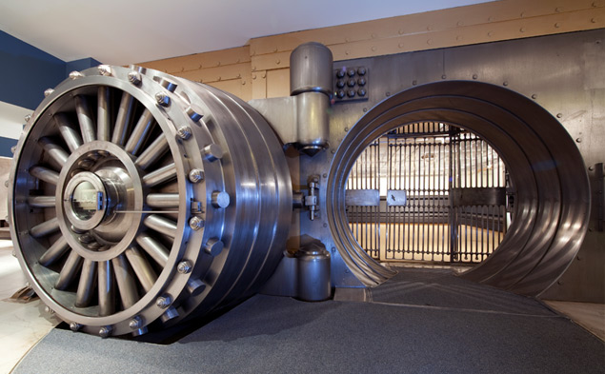
The Problem with Bank Managers
Imagine a vault that can only be opened using a secret code.
Our bank has n managers who need to be able to open the vault.
Solution: give the secret code (S) to all n managers.

Slide 20

The Problem with Bank Managers
RESULT: this is dangerous, as the security of the vault may be vulnerable if one of the managers is compromised.
  This is called a 1 out-of n scheme.
The general problem is called secret sharing.
Notes:
I think Marlon Brando – The Godfather said it best.

Slide 21

Secret Sharing (n:n)
All managers are required to open the vault.
  Solution: give S₁ to manager₁, S₂ to the manager₂, etc.
  secret(S) = S₁ ⊕ S₂ ⊕ · · · ⊕ S_{n}
  the vault cannot be opened when fewer than n managers are present.
This is the principle of separation of duties.
Notes:
Titan nuclear missile launch keys.
One person can’t possibly do that, it takes 2 to tango!

Slide 22

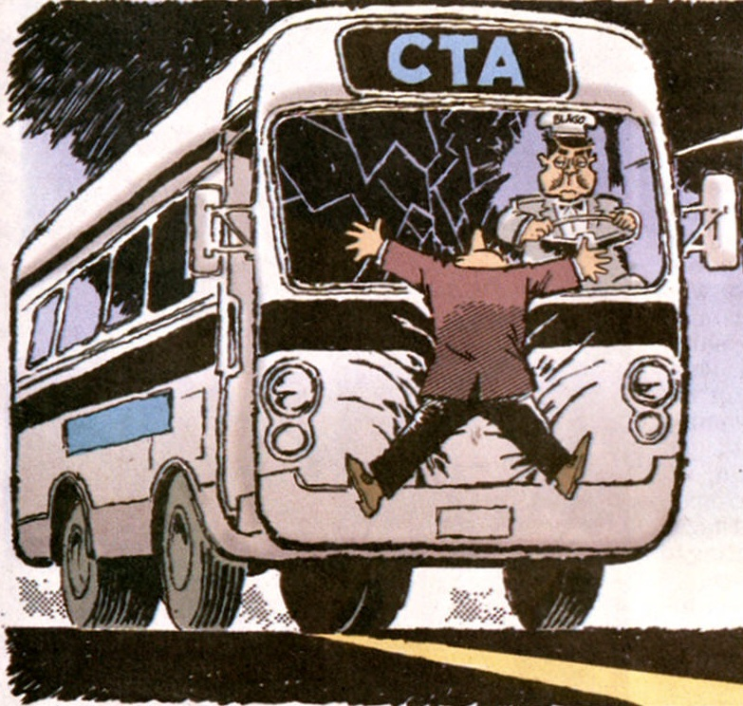
Secret Sharing (n:n)
RESULT: this is overly restrictive, e.g., if one of the managers has been killed, say, hit by a bus, then the vault cannot be opened. Ever.

Slide 23
Secret Sharing (2:n)
How about a compromise?
We want a scheme such that any two of the n managers can open the vault, but any one manager cannot open the vault by himself.
This makes it harder to subvert the managers as in 1:n, and is much less restrictive than n:n.
IDEA: we can use a line:
f(x) = mx + s
The principle is to use the y-intercept as our secret (S).
We calculate a point (or key share) for each manager_{i} = f(i).

Slide 24
Solving for Y (S)
RESULT: if we only know one point, then we learn nothing as there are an infinite number of possible solutions for S.
Share manager 4
Share manager 7
But if we know 2 points…
Share manager 4
S
RESULT: if we know 2 points, then we can completely solve for the y-intercept and therefore S.

Slide 25
Secret Sharing (m:n)
How can we generalize this?
We now want a scheme such that any m of the n managers can open the vault, but any collection of managers fewer than m cannot, i.e., 3 from 5 managers, 2 cannot open it, but 3 can.
IDEA: (Shamir) we can use a polynomial of the form:
f(x) = c_{n}x^{n} + … + c₂x² + c₁x + S
Shamir’s algorithm is based on the fact that a polynomial of degree k can be uniquely identified by k+1 points:
  A line f(x) = mx + s (degree 1) can be identified by 2 points.
  A parabola f(x) = c₂x² + c₁x + s (degree 2) can be identified by 3 points.
  f(x) = c₃x³ + c₂x² + c₁x + s (degree 3) can be identified by 4 points.

Slide 26
Secret Sharing (m:n)
Here you can see the degree 2 parabola has infinite solutions when only 2 points are defined.
With 3 points the curve is uniquely identified, and we can now work backwards to reconstruct the polynomial equation.

Slide 27
Secret Sharing (m:n)
The details…
We construct a polynomial f(x) of degree m-1 using m-1 random coefﬁcients and the secret S as the constant.
We then pick n random x values and solve the polynomial creating n points (or key shares) of the form (xi,yi) for the managers.

Slide 28
Secret Sharing (m:n)
To retrieve the value S, we need to know at least m of the n shares (in any combination, say 3 of 5) and,
We reconstruct the coefﬁcients for the equation using Lagrange interpolation.
Obviously we pick big numbers to make brute forcing the solution hard.
https://www.youtube.com/watch?v=kkMps3X_tEE
S

Slide 29
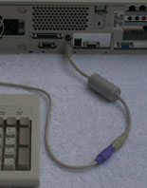
Other Concerns
Even though modern encryption is enormously strong a Cryptanalyists can still deploy Pinches:
  Remote reading monitor signals (tempest)
  Keyboard dongles
  Viruses, Trojans,
  Backdoors (mandated or otherwise)
  and Traffic anaysis, and
  Social Engineering (Phishing)

