Slide 1
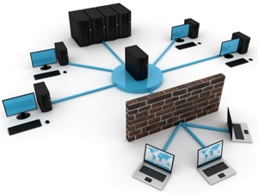
NWEN 243
Networked Applications
Lecture 7: What are Networks?
Travelling upwards from the hardware to the application

Slide 2
What is a Network
By this lecture, you should be aware of how data transmission is secured by the network.
Recall the definitions from the 1st lecture:
A network is a number of computers connected together to share information and hardware.
A network is a series of points or nodes interconnected by communication paths. Networks can interconnect with other networks and contain sub-networks.
In the next 3weeks we will try to understand how the network ensures reliable data transmission across the network
Notes:
Important words highlighted. Sharing is important, but comes with some significant limitations!
Sharing underpins the whole ‘Socialization of the web’

Slide 3
Networking challenges
Loss,
Delay,
Corruption,
Limited Bandwidth,
Standards (media, architectures, encoding)
Clocks and timing differences.

Slide 4
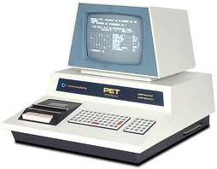
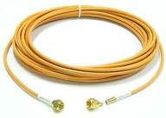
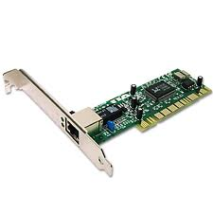
Building a Network
We need some basic components:
A device that needs to communicate, lots of different choices possible.
Some media to transfer the signals, lots of choices possible.
An interface that will let you encode data signals onto the ‘wire’, lots of choices possible.
Notes:
Commodore Pet – late 1970s.

Slide 5
Characteristics of Plain Wire
Each wire is insulated wires are open to free space.
19.2 kbps @ 50m
Problems:
Crosstalk: cross-coupling of electrical signals between adjacent wires in the same cable.
Noise: the open structure makes it susceptible to spurious noise signals from other electrical sources.

Slide 6
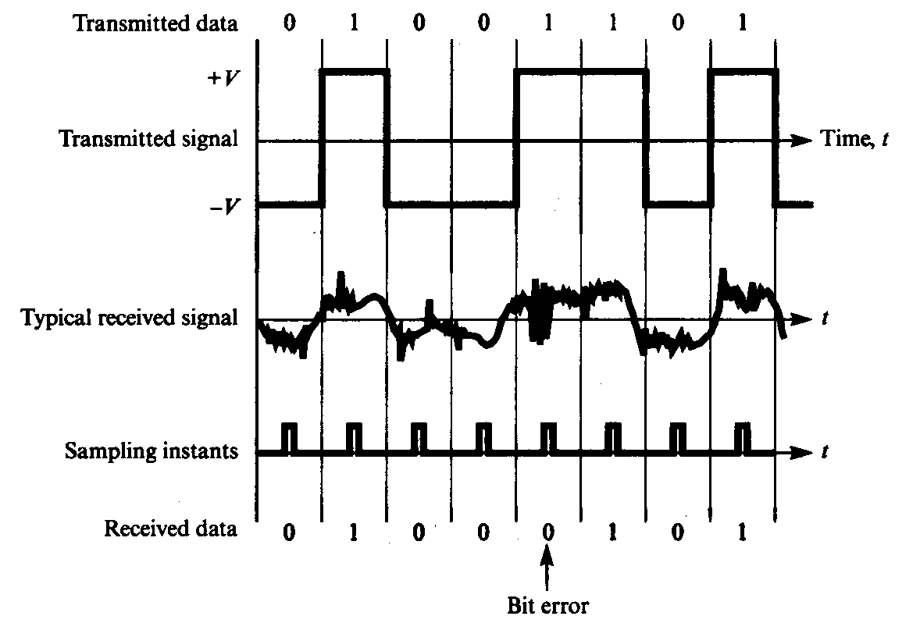
Signal Degradation

Slide 7
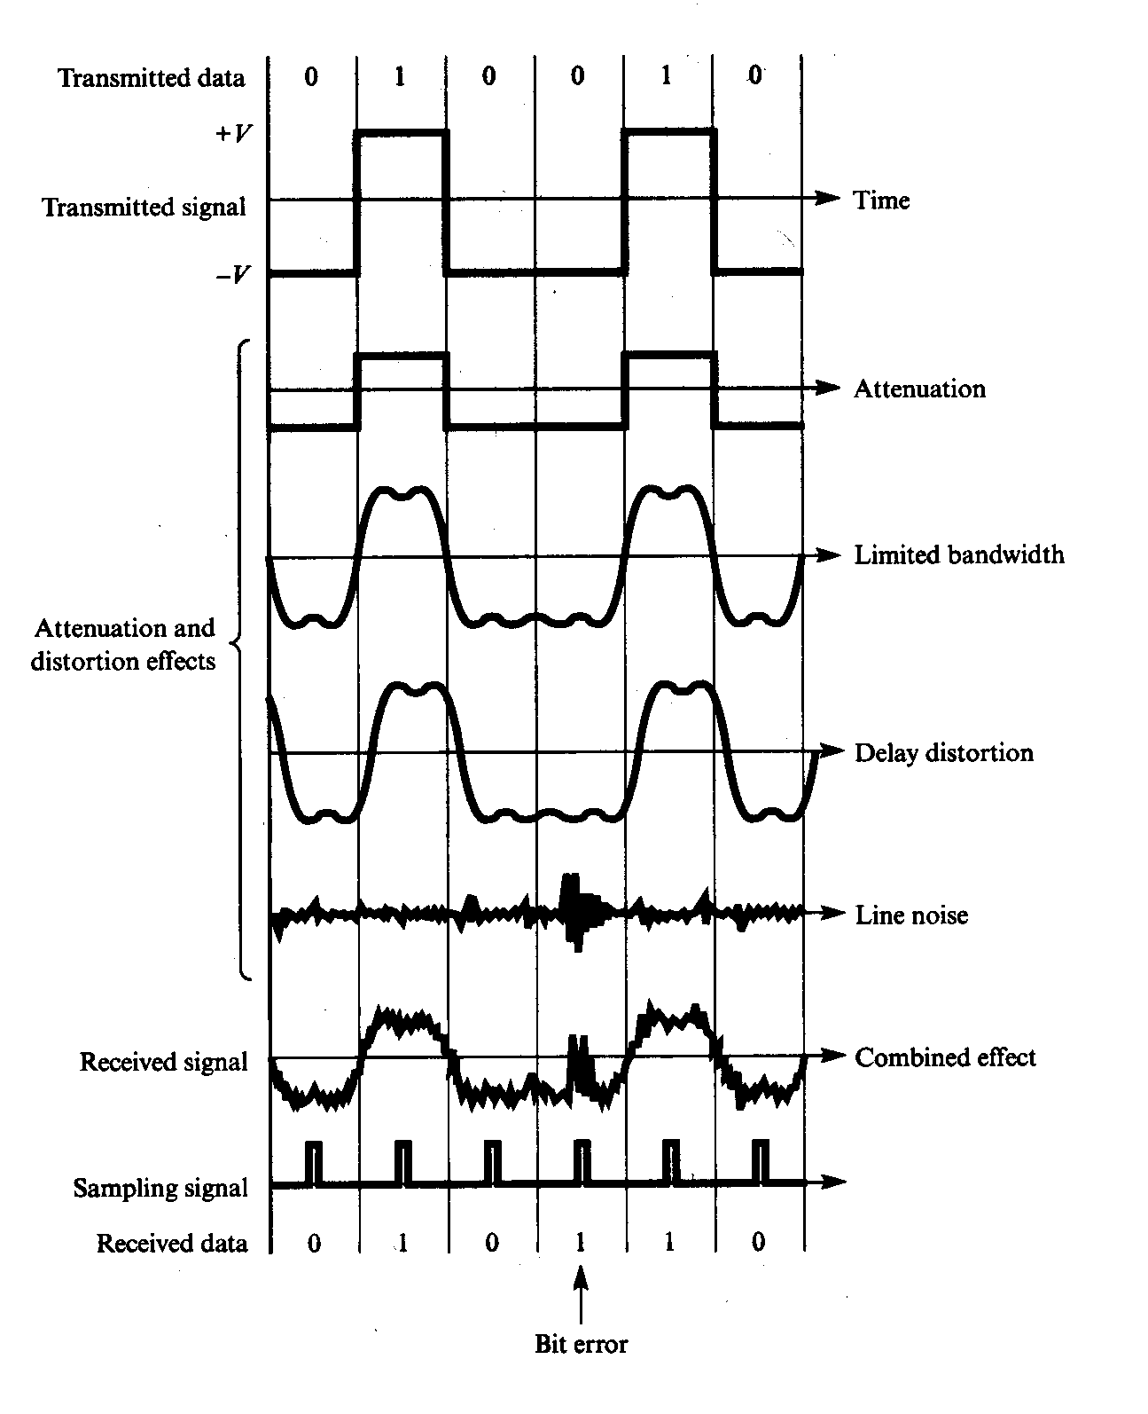
Sources of Signal Degradation
Notes:
When a signal propagates along a transmission medium its amplitude decreases. This is known as signal attenuation.
The rate of propagation of a sinusoidal signal along a transmission line varies with the frequency of the signal. Therefore, when we transmit any signal through a transmission line, all its components reach at the destination with varying delays.
There are random perturbations on the line even when no signal is being transmitted. This is called line noise level.

Slide 8
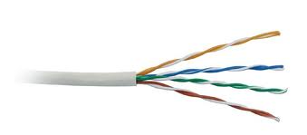
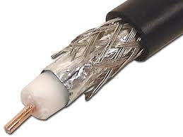
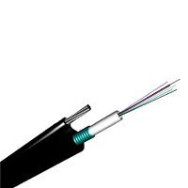
Characteristics of Wired Media
Twisted pair:
Copper wire twisted into pairs (to reduce crosstalk). Common in Telephone systems and Ethernet. Unshielded < 100Mbps, shielded (STP) < 500 Mbps @ 100m.
Coax:
Copper or aluminum wire wrapped with a flexible insulating layer with a high dielectric constant and then surrounded by a conductive layer to minimize interference and distortion. Largely superseded by STP and fiber.
Fiber:
A filament(s) of glass fiber that encodes data in light pulses. Fiber is not affected by electromagnetic radiation and is hundreds of times faster than coax or twisted-pair. WDM (colour multiplexing) can carry multiple signals in a single fiber.
Notes:
Crosstalk (XT) is any phenomenon by which a signal transmitted on one circuit or channel of a transmission system creates an undesired effect in another circuit or channel. Crosstalk is usually caused by undesired capacitive, inductive, or conductive coupling from one circuit, part of a circuit, or channel, to another.
Mbps is million bits per second.
Fibre has largely replaced Coax outside TV/RF use. Tbps

Slide 9
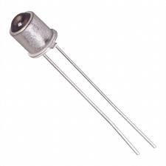
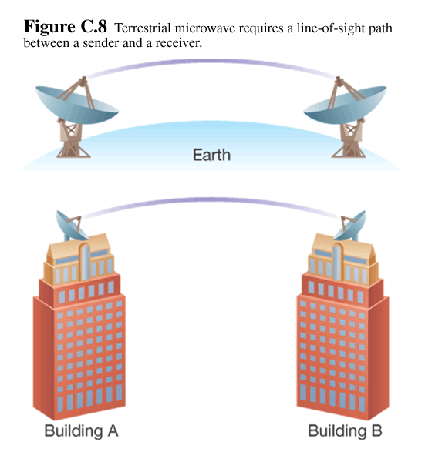
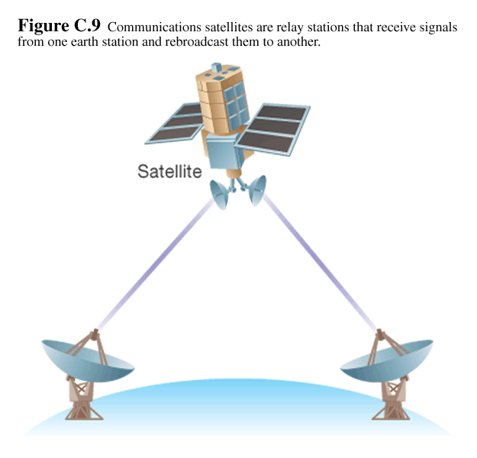
Characteristics of Wireless Media
Infrared:
Line of sight propagation, typically less than 10m, but up to 1km is possible. 1-16 Mbps, depending on aim.
Microwave:
Terrestrial microwaves use low-gigahertz range, which limits all communications to line-of-sight, with relay stations spaced approx, 50 km apart < 280 Mbps
Satellites also use microwave radio which are not deflected by the Earth's atmosphere. (ordinary radio bounces) < 90 Mbps.
Radio:
Bluetooth uses low-power (1mW) radio waves on a frequency of around 2.45 GHz. Uses frequency hopping to avoid interference with with other devices. Range < 10m and up to1Mbps.
WiFi uses 2.4 GHz radio waves and around 30-50mW for data rates up to 54 Mbps.
Notes:
Microwave antennas are usually placed on top of buildings, towers, hills, and mountain peaks..

Slide 10
The Physical Layer
The physical layer deals with the physical aspects such as pin-outs, electrical characteristics, modulation and encoding of data bits on carrier signals.
The way in which we modulate and encode depends on the media. For example, copper, coax, fiber and wireless (radio) due to the very different characteristics - wireless is susceptible to interference, while fiber is fast and accurate. This means we have to adopt different standards depending on the media.
Notes:
We have facilitated a connection, now we need a ‘common’ language so we can get the devices to communicate. No point bringing a lizard and a horse together enabling them to communicate if they don’t share a common lexicon.
We need to define how the data is represented on the wire, how it is packaged, and controlled. A complex controller such as Ethernet will do this for us, but that is because this HW embodies a prearranged set of standards.
So, for wireless, we need to do lots of checking and ensuring the messages are received accurately. For fibre, the error rate is so low, we can skip this at this layer and worry about it later.

Slide 11
Connecting more computers
Can these talk?
How to add another?

Slide 12
With just the Physical Layer?
No
We need another interface and cable
End up with a fully connected network
n(n - 1) / 2
Too expensive for anything but a small net
A LAN
Notes:
Plus 2 times as many interfaces. Simply don’t have enough slots to put interfaces in a computer.

Slide 13
Fully Connected Topology
Notes:
For 7 machines, each machine has 6 connections, needing 6 interfaces and 21 links.
Imagine this scaling to 1 lab, ECS, the university, let alone New Zealand or the internet. It is simply not feasible.
- Also very low utilisation, pay costs for machines that will never communicate.

Slide 14
Bus
We can ‘share’ the single wire
Each device only needs 1 interface.
A single ‘wire’, daisy chains devices together.

Slide 15
Bus
All messages are ‘broadcast’ over the bus
So, each device sees all messages
We need to be able to tell which messages
are for which device.

Slide 16
Addressing
Sharing links requires a way to identify communication end-points, or ‘interfaces’
An example of this is an Ethernet MAC address, that uniquely identifies an interface card.
All interfaces monitor the bus.
When a packet arrives, it checks the address in the packet header!
If it is for this device, it passes it on.
otherwise, ignore it.

Slide 17
A Packet
Until now, we have mostly ignored what is in a ‘packet’ of data.
We have data.
We also need some ‘meta’ information.
We need an address.
We may also need a sender’s address.
We usually also need some bits to check that the data has not been corrupted.
We transmit this information in a header, attached to the data.
Header
Data
Notes:
Meta information – information about the data.
Can also have a trailer as well as a header, but this isn’t significant in the overall description.

Slide 18
Datalink Layer
The physical layer was concerned with encoding bits on the ‘wire.
Now we are doing something more, we’re identifying devices and checking errors.
We call this the datalink layer.
We are starting to build the ‘protocol stack’
Datalink Layer
Physical Layer
Notes:
Draw picture of the wire next to Physical layer, draw arrows up to datalink layer.
But wait, there’s more! We’re not done with out BUS just yet.

Slide 19
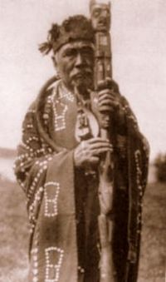
Link layer functions
Framing + link access
Error detection & correction – Parity / CRC
Reliable delivery through ACK, NACK
Notes:
The talking stick, also called a speaker's staff,[1] is an instrument of aboriginal democracy used by many tribes, especially those of indigenous peoples of the Northwest Coast. The talking stick may be passed around a group or used only by leaders as a symbol of their authority and right to speak in public.

Slide 20
What if?
Two devices try to send at about the same time?
The messages will collide, corrupting both!
We can use the ‘checksum’ to detect this, but
how do we know to and when resend it?
×
×
×
×
×

Slide 21
Protocols for shared media
Imagine a party bore, who simply talks, regardless if someone else is already talking or not.
Think about the rules for polite conversation that your parents taught you!
Before you start talking, make sure no one else is. Let them finish.
If someone else is starts talking at the same time, stop talking.
We use these same rules in networking.

Slide 22
Protocols for shared media
Imagine a party bore, who simply talks, regardless if someone else is already talking or not.
Think about the rules for polite conversation that your parents taught you!
Before you start talking, make sure no one else is. Let them finish.
If someone else is starts talking at the same time, stop talking.
We use these same rules in networking.

Slide 23
Dealing with Collisions
Each device decides independently when to begin transmission (we have no coordination - vip).
We need some simple rules to resolve these collisions:
Check there is no signal before you start transmitting, this is Carrier Sensing.
Listen while you transmit, and if your signal is corrupted, then there is a collision, this is Collision Detection.
This gives the algorithms:
CSMA and CSMA/CD
We need CD as well as CS, due to transmission delay on the wire.
Notes:
Carrier Sense Multiple Access, and Carrier Sense Multiple Access with Collision Detection.
Plus for wireless CDMA (Code division Multiple Access)

Slide 24
Resolving Collisions
When can we ‘resend’ our data?
Fixed delay (repeat collisions)
Priority (1/lastsent) or based on const, like ID.
Random Backoff.
Other methods – taking turns.
Use a Polling protocol, in which a ‘master’ says who’s turn it is.
Token passing:
Pass a token (talking stick)
If you have data, send up to maximum permitted by the token and pass it on.
otherwise, just pass it on.
Use more hardware.
Notes:
Lots of network protocols are based on social protocols for communication. They have been well honed in practice over many 1000s of years.
The talking stick, also called a speaker's staff,[1] is an instrument of aboriginal democracy used by many tribes, especially those of indigenous peoples of the Northwest Coast. The talking stick may be passed around a group or used only by leaders as a symbol of their authority and right to speak in public.
Token and polling is very efficient, but strike problems if a machine is down (token) or the master is off line.

Slide 25
Token Ring
Token
Notes:
Pass a token in one direction.
Token itself is data, so it is the last data that is sent by the previous holder.
Limited size vs utilisation tradeoff.

