Slide 1
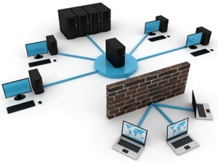
NWEN 243
Networked Applications
Lecture 8: putting networks together

Slide 2
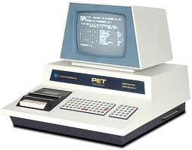
What if?
Two devices try to send at about the same time?
The messages will collide, corrupting both!
We can use the ‘checksum’ to detect this, but
how do we know to and when resend it?
×
×
×
×
×

Slide 3
Protocols for shared media
Imagine a party bore, who simply talks, regardless if someone else is already talking or not.
Think about the rules for polite conversation that your parents taught you!
Before you start talking, make sure no one else is. Let them finish.
If someone else starts talking at the same time, stop talking.
We use these same rules in networking.

Slide 4
Dealing with Collisions
Each device decides independently when to begin transmission (we have no coordination - vip).
We need some simple rules to resolve these collisions:
Check there is no signal before you start transmitting, this is Carrier Sensing.
Listen while you transmit, and if your signal is corrupted, then there is a collision, this is Collision Detection.
This gives the algorithms:
CSMA and CSMA/CD
Notes:
Carrier Sense Multiple Access, and Carrier Sense Multiple Access with Collision Detection.
Plus for wireless CDMA (Code division Multiple Access)

Slide 5
Resolving Collisions
When can we ‘resend’ our data?
Fixed delay (repeat collisions)
Priority (1/lastsent) or based on const, like ID.
Random Backoff.
Other methods – taking turns.
Use a Polling protocol, in which a ‘master’ says who’s turn it is.
Token passing:
Pass a token (talking stick)
If you have data, send up to maximum permitted by the token and pass it on.
otherwise, just pass it on.
Use more hardware.
Notes:
Lots of network protocols are based on social protocols for communication. They have been well honed in practice over many 1000s of years.
The talking stick, also called a speaker's staff,[1] is an instrument of aboriginal democracy used by many tribes, especially those of indigenous peoples of the Northwest Coast. The talking stick may be passed around a group or used only by leaders as a symbol of their authority and right to speak in public.
Token and polling is very efficient, but strike problems if a machine is down (token) or the master is off line.

Slide 6
Token Ring
Token
Notes:
Pass a token in one direction.
Token itself is data, so it is the last data that is sent by the previous holder.
Limited size vs utilisation tradeoff.

Slide 7
Recall a Bus
All messages are ‘broadcast’ over the bus
So, each device sees all messages
We need to be able to tell which messages
are for which device.
ADDRESSING

Slide 8
Datalink Layer
The physical layer was concerned with encoding bits on the ‘wire.
Now we are doing something more, we’re identifying devices and checking errors.
We call this the datalink layer.
We are starting to build the ‘protocol stack’
Datalink Layer
Physical Layer
Notes:
Draw picture of the wire next to Physical layer, draw arrows up to datalink layer.
But wait, there’s more! We’re not done with out BUS just yet.

Slide 9
Datalink Layer Defn
Built on top of the physical layer
Provide to service to layer above
Transmits/receives short messages
Goal is to detect/correct errors at the physical layer.
2
1
Datalink
Datalink
Physical
Physical
Notes:
We introduced the physical layer in the last lecture.
Key functions:
encoding bits as signals on a wire
decoding received signals back into bits
If the physical layer was perfect it would make implementing networks very simple.
However, problems such as interference can lead to bit flipping where was intended to be sent was not received.
Worse, more bits might be received than sent and vice-a-versa.
This means we need to add an extra layer that can deal with these problems.

Slide 10
Ethernet Datalink Layer
A data packet on an Ethernet link is called an
Ethernet frame
Each frame contains source and destination addresses and error-checking data so that damaged data can be detected and re-transmitted
Frame
Frame
2
1
Datalink
Header
Data
Datalink
Physical
Physical
Notes:
We introduced the physical layer in the last lecture.
Key functions:
encoding bits as signals on a wire
decoding received signals back into bits
If the physical layer was perfect it would make implementing networks very simple.
However, problems such as interference can lead to bit flipping where was intended to be sent was not received.
Worse, more bits might be received than sent and vice-a-versa.
This means we need to add an extra layer that can deal with these problems.

Slide 11
Error Detection
A error in transmitted data can be a:
single-bit, or
a burst
How to detect errors?
If we only transmit data, we cannot detect any errors.
However, we can:
Send meta data with the data that satisfies some special relationship
Add redundant data

Slide 12
Parity Check
Simplest
Parity bit - ensure the sum is odd or even.
7 bits + 1 parity
Also known as a Vertical Redundancy Check (VRC)
7 data bits | Sum of bits | even | odd
0000000 | 0 | 0 | 1
0011101 | 4 | 0 | 1
1111111 | 7 | 1 | 0
Notes:
Performance:
So you can say – parity detects all odd-number errors in a data block, 1,3,5 etc. It CANNOT detect an even number of errors, Reguardless if odd or even partiy chosen.
Also known as a Vertical Redundancy Check (VRC)

Slide 13
What are the problems with Parity Check?!!
1 | 0 | 1 | 1 | 0 | 1 | 0 | 0
1 | 0 | 1 | 1 | 0 | 1 | 0 | 0
1 | 0 | 1 | 1 | 0 | 1 | 0 | 1
Can detect 1 bit error
Cannot correct errors

Slide 14
Longitudinal Redundancy Check (LRC)
Organize data into n, n bit words (e.g. 8)
Find the (even) parity of each word.
01101110 01110111 01100101 01101110
01101110
01110111
01100101
01101110
00010010
01101110 01110111 01100101 01101110 00010010
Data
LRC
Notes:
Performance:
Detects all burst errors up to length n (number of columns)
Misses burst errors of length n+1 if there are n-1 uninverted bits between the first and last bit
If the block is badly garbled, the probability of acceptance is ½

Slide 15
Longitudinal Redundancy Check (LRC)
Problems?
At the sender
At the receiver:
01101110 01110111 01100101 01101110 00010010
01101110 01010111 01100101 01001110 00010010
01101110
01010111
01100101
01001110
00010010
01101110 01010111 01100101 01001110 00010010
Data
LRC
Notes:
Performance:
Detects all burst errors up to length n (number of columns)
Misses burst errors of length n+1 if there are n-1 uninverted bits between the first and last bit
If the block is badly garbled, the probability of acceptance is ½

Slide 16
Cyclic Redundancy Check
Powerful error detection scheme
Rather than addition, binary division is used
Can be easily implemented with in hardware
Shift registers, and XOR (for addition and subtraction)
assume k message bits and n bits of redundancy
xxxxxxxxxx yyyy
Block of length k+n
k bits
n bits

Slide 17
Internet CheckSum
Non-cryptographic Internet checksum: example
example: add two 16-bit integers
1 1 1 1 0 0 1 1 0 0 1 1 0 0 1 1 0
1 1 1 0 1 0 1 0 1 0 1 0 1 0 1 0 1
1 1 0 1 1 1 0 1 1 1 0 1 1 1 0 1 1
1 1 0 1 1 1 0 1 1 1 0 1 1 1 1 0 0
1 0 1 0 0 0 1 0 0 0 1 0 0 0 0 1 1
wraparound
sum
checksum
Notes:
One of the simplest form of checksum is the internet checksum where data is divided into 16-bit integers and summed up to generate the checksum that will be appended to the data. The receiver should do the same calculations to verify the received checksum is the same as the locally generated one.

Slide 18
Error Correction: Simple method
Is there any way we can correct the errors using those techniques discussed so far?

Slide 19
Solution
Data
01101110 01110111 01100101 01101110

Slide 20
Cyclic Redundancy Check
assume k message bits and n bits of redundancy
Associate bits with coefficients of a polynomial 1 0 1 1 0 1 1 1x⁶+0x⁵+1x⁴+1x³+0x²+1x+1 = x⁶+x⁴+x³+x+1
xxxxxxxxxx yyyy
Block of length k+n
k bits
n bits

Slide 21
Cyclic Redundancy Check
Let M(x) be the message polynomial
Let P(x) be the generator polynomial
P(x) is fixed for a given CRC scheme
P(x) is known both by sender and receiver
Create a block polynomial F(x) based on M(x) and P(x) such that F(x) is divisible by P(x)
…
Notes:
We could do an entire lecture on CRC – but this high level taste is all that is needed in this course.

Slide 22
Properties of CRC
Example P(X):
CRC-12 = x¹²+x¹¹+x³+x²+x+1 CRC-16 = x¹⁶+x¹⁵+x²+1 CRC-CCITT = x¹⁶+x¹²+x⁵+1
CRC-16 and CRC-CCITT catch all
Single and double bit errors
Odd numbers of bit errors
Bursts of length 16 or less
99.997% of 17-bit error bursts
99.998% of 18-bit and longer error bursts

Slide 23
Error Detection - Sending
Create the data part of the frame.
Compute error detection code over data.
Parity (cheap, good for quality media)
CRC (Cycling Redundancy Code) is common for lossy media.
Add header containing the error detection code.
Send one bit at a time via the physical layer.
Data
Header
Data
Notes:
We introduced the physical layer in the last lecture.
Key functions:
encoding bits as signals on a wire
decoding received signals back into bits
If the physical layer was perfect it would make implementing small networks very simple.
However, problems such as interference can lead to bit flipping where was intended to be sent was not received.
Worse, more bits might be received than sent and vice-a-versa.
This means we need to add an extra layer that can deal with these problems.

Slide 24
Error Detection - Receiving
Read the frame (frame = header + data) one bit at a time using physical layer.
Compute error detection code over data.
Compare received EDC with recomputed EDC.
Reject if do not match.
Header
Data
Data
Compute
Header
Header
Compare
Header
Notes:
We introduced the physical layer in the last lecture.
Key functions:
encoding bits as signals on a wire
decoding received signals back into bits
If the physical layer was perfect it would make implementing networks very simple.
However, problems such as interference can lead to bit flipping where was intended to be sent was not received.
Worse, more bits might be received than sent and vice-a-versa.
This means we need to add an extra layer that can deal with these problems.

Slide 25
A quick note on Error Correction
Instead of error detection code, add error correction code.
Add extra bits that allow the bit flip to be detected and corrected.
Hamming codes are one technique.
Tradeoff between cost of retransmission, frequency of error and overhead of number of bits.
The worse the media, the better the error detection/correction required.
Notes:
we need to add an extra layer that can deal with these problems.

Slide 26
The main issue with Buses
They are shared media, i.e. usually
Wire, but also
Wireless
WiFi (802.11) has up to 14 Channels (depending on country regulations) each channel is 22Mhz (802.11b) wide.
Each non overlapping channel is like a bus.

Slide 27
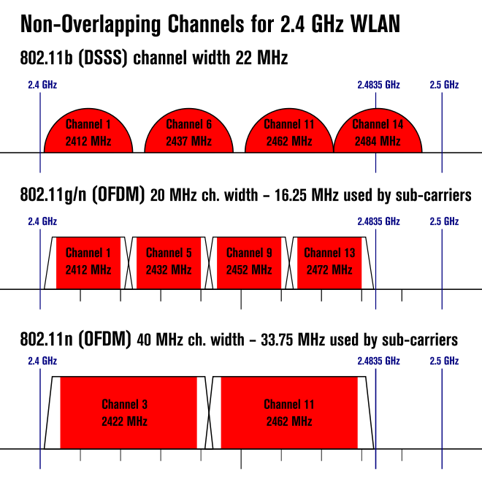
Notes:
OFDM = Orthogonal frequency-division multiplexing
A subcarrier is a separate analog or digital signal carried on a main radio transmission, which carries extra information

Slide 28
Recall…. so far we have seen
Fully connected
Bus
Ring

Slide 29
Problems:
Fully connected
Bus
Ring
Non practical Ideal
Notes:
Imagine that we have a single break in each of these organisations.
Which is worse?
Fully connected – no real issue, too expensive, does not scale and not realistic – so forget it.
Bus can be bad, isolates two hosts. + Security.
Ring can be worse, isolate everyone. + Security.

Slide 30
Better, use a Star Topology
Hub
Notes:
Uses additional hardware.
Node in the middle is a hub
Hub simply cleans up the signals, and rebroadcasts on all links, so a Star network with a hub is exactly equivalent to a bus.
This is purely a level 1 (physical layer solution)
Same problems with collisions!
But better with partitions – only isolates one. Good compromise with Fully connected (which is of course ideal).

Slide 31
Hubs
Hubs are transparent to the nodes.
A hub simply rebroadcasts, so a Star network with a hub is exactly equivalent to a bus.
Collisions must be resolved in the same way.
Operates at Physical Layer (layer 1)
A hub does not care who is connected, on what link.
Arriving frames are simply relayed on all other links.
No Management.
Notes:
Called switched ethernet.
Up until now I have simply been talking about messages. Since we are starting to talk about specific standards, we need to use the proper terms. In this case for ethernet = frame.

Slide 32
Recall …. resolving Collisions
When can we ‘resend’ our data?
Fixed delay (repeat collisions)
Priority (1/lastsent) or based on const, like ID.
Random Backoff.
Other methods – taking turns.
Use a Polling protocol, in which a ‘master’ says who’s turn it is.
Token passing:
Pass a token (talking stick)
If you have data, send up to maximum permitted by the token and pass it on.
otherwise, just pass it on.
Use more hardware.

Slide 33
Star Topology
Hub
Switch
Notes:
Uses additional hardware.
A switch is better, giving a ‘collision-less’ network. Also, packet sniffing is impossible.

Slide 34
Switches
Switches are also transparent to the nodes.
A switch is more complex & expensive.
Incoming frames are sent only on the link(s) to which they are addressed.
If a link is busy, the frame is stored in the switch until it can be sent.
Switches need to know what is connected to each link, so it can send out frames on the appropriate link (store and forward).
This means we need to configure it = Management!
Notes:
Called switched ethernet.
This is the modern way of building wired LANs.
It operates at the DLL Layer (layer 2)

Slide 35
Switch Functionality
Switch Table (SwT)
A table in the switch contains, some but not always, all, of the nodes on a LAN.
When a frame arrives on an (in-link) interface, the table is consulted to determine which (out-link) on which to send the frame.
MAC ADDR | INTERFACE | TIME
DD-DD-DD-DD-DD-DD | 1 | 12.12
… | … | …

Slide 36
Filtering and Forwarding
A switch makes the decision on which link to forward the frame to, or if to filter the fame (drop it) in the following way:
Frame received on interface x.
There is no entry in the switch table.
Act like a hub and broadcast on all links (!x) (Flood)
There is an entry for the address
If the interface (y) associated with the address in the table != x, then forward on y.
If (x = y) then no need to send out on any link, so filter the frame (drop it).
Notes:
Should draw a picy to illustrate.
3.2 talking to itself.

Slide 37
Self learning of SwT
Creating the Switch table by hand is onerous, requiring updating each time a node changes.
Table can be built dynamically, through self-discovery, without any human help.
Table starts out empty.
When a frame arrives, record the MAC address from the frame’s source field (sender) and associate it with the interface on which it arrived, and the time stamp.
Once every node has sent one frame, the table will include all connected nodes.
If a hub is connected to a switch interface, eventually all addressed connected to that hub will be represented in the SwT.
We use aging (from the time stamp) to purge entries from machines no longer on the network.
Notes:
Draw it!!!!
Especially mobile devices, laptops etc.
PTO

Slide 38
Addr | Int | time
A | 1 | 9:32
B | 1 | 10:03
… | … | …
Q | 3 | 7:43
Switch
1
2
3
Hubs
A
B
C
D
Q
Hosts

Slide 39
Advantages of DLL switching
Plug and play
Elimination of Collisions
If a LAN is built from switches (not hubs)
Heterogeneous link speeds!!!!!
Due to the buffering, switches can handle links operating at different speeds, e.g. 10, 100 Mbps 1 Gbps.
Switch can mix new and legacy equipment.
Notes:
Switch poisoning, send lots of fake ‘source’ mac addresses. Fills up SWT, leaving no room for the real entries. Therefore, by default, all packets broadcast on all links – so we can snoop. More advanced switches can detect this (like jabbering) and isolate that link.
In the older days admins often spent hours ‘walking the line’ – really crawling on the floor, to find a break in the bus cable. This is automatically isolated in a switched star network.
Management
Switches can filter out ‘jabbering’ links.
Sniffing/security – though switch poisoning…
Damage to one cable, effects only one link (!bus)

Slide 40
Flooding : Basic Routing
A
E
G
H
C
F
B
E
D

Slide 41
Flooding : Max Hubs
A
E
G
H
C
F
B
E
D

Slide 42
Building an Internet with layer 2?
Layer 2 is:
Sufficient for a local area network but what if we want to go bigger?
We need to wrap layers 1 and 2 in another higher level layer.
Why?

Slide 43
Layer 2 doesn’t scale.
MAC addresses provide a flat addressing range, based on individual nodes.
Once networks get bigger, SwT grow large, and incomplete.
Certainly many nodes would be purged from the tables, resulting in frequent broadcasts.
This grows very inefficient as the network grows in size.
Switches are OK for networks of a few hundred machines, but not larger.
We need another layer…

Slide 44
Network Layer 3.
Network / Internet Layer
Network Access Layer
Data Link Layer
Rowter or Rootor?
We need more intelligence to deal with incomplete network information.
Hierarchical addressing, so that we can identify and route messages between ‘localities’.
Physical Layer
7 – layer OSI
TCP/IP
Notes:
People spend a lot of time arguing about pronunciation.
Layer 2 relied on complete information or flooding when it wasn’t possible. This is impossible on a larger network, everything would be flooding and there would be o room for real data.

Slide 45
Network Layer Functions
path determination: route taken by packets from source to dest.
Routing algorithms.
forwarding: move packets from a router’s input to appropriate router output
call setup: some network architectures require router call setup along path before data flows (ATM).

Slide 46
CNet Tutorial
Data-link layer,
Network layer
Transport layer
Notes:
cnet enables development of and experimentation with a variety of data-link layer, network layer, and transport layer networking protocols in networks consisting of any combination of wide-area-networking (WAN), local-area-networking (LAN), or wireless-local-area-networking (WLAN) links.

Slide 47
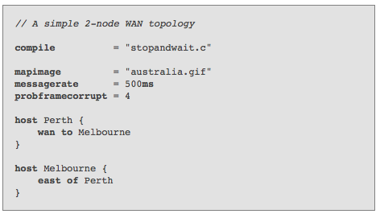
Topology File
Notes:
Consider the following simple topology file which defines a 2-node network. An implementation of the stopandwait protocol is being developed over a single bidirectional WAN link which experiences dataframe corruption. cnet keywords are case-sensitive and are presented here in bold font.

Slide 48
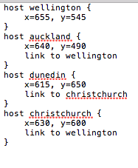
New Zealand MAP

Slide 49
Requirements: Test Topologies
Wellington & Auckland (North Island)
You need to compile a map for this
Wellington, Auckland, Christchurch and Dunedin (NZ)
This provided for you.
NZ + Australia
You need to compile a map for Australia first then add NZ.
The world
This is provided for you

Slide 50
North Island Topology
host wellington
{
x=655, y=545
}
host auckland
{
x=640, y=490
link to wellington
}

Slide 51
Run the Examples
Run each of the 3 implementations of flooding over each of the above topologies.
To do this, you should make versions of "getfloodstats" that use your new topologies (getfloodstats currently uses the supplied NEWZEALAND.MAP)

Slide 52
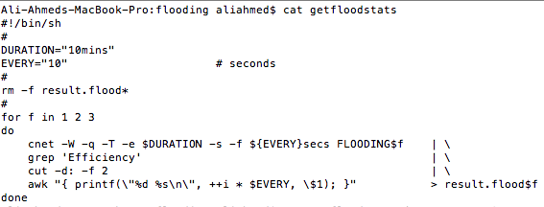
Flood 1/2/3: North Island Topology
There is no reference to NEWZEALAND.MAP!!!!!
Please check FLOODING1/2/3 files

Slide 53
Running the script
./getfloodstats
./plotfloodstats.gp
You might need to change the permissions here (chmod +777 plotfloodstats.gp)

Slide 54
Graph the Results
Graph the results - 4 graphs (plot each of the 3 flooding implementations per topology).
Run plotfloodstats.gp script
For Mac users:
please install HomeBrew: copy this into your terminal /usr/bin/ruby -e "$(curl -fsSL https://raw.githubusercontent.com/Homebrew/install/master/install)”
Install gnuplot: copy this into your terminal brew install gnuplot --with-x11

Slide 55
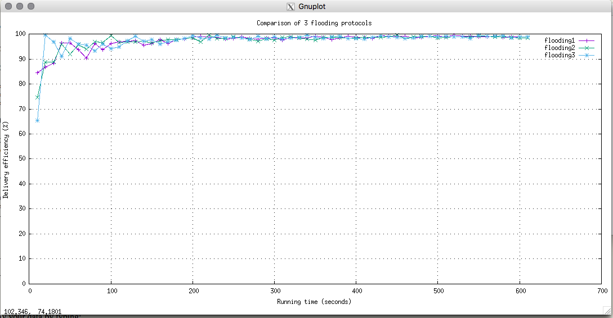
Result

