Slide 1
NWEN 243 Network Applications

Slide 2
Lecturing team
Course lecturer: Dr Ali Ahmed
Email: ali.ahmed@ecs.vuw.ac.nz
Phone: 463 5233 x7527
Office: EA104
Course coordinator: Dr Aaron (Gang) Chen
Email: aaron.chen@ecs.vuw.ac.nz
Phone: 463 5114
Office: AM4O5
Six tutors help with the lab sessions

Slide 3
Introducing the course
Modern applications are rarely standalone
They communicate
They coordinate
They authenticate, and
Users participate (user generated content, Web 2.0)
Networking is everywhere (IoT)
This course looks at how we build networks and the applications that use them.
Designed as a first course on computer networks, with an application focus.

Slide 4
Learning objectives
Understand network security and related security technologies
Explain the basics of networks and the design of their associated protocols
Layered communication architecture
Design of IP networks
Communication control technologies
Explain the role of the application layer, the socket API and the basics of building networked or distributed applications
Implement applications that make use of the
Socket API, Web services, and
mobile devices (Android)
Notes:
An instruction set, or instruction set architecture (ISA), is the part of the computer architecture related to programming, including the native data types, instructions, registers, addressing modes, memory architecture, interrupt and exception handling, and external I/O.
In another word, ISA defines the interface between software and computer hardware. In fact, our focus in this course is to study the boundary between software and hardware and explore the level of hardware in the vicinity of this boundary.
->
Understand the execution of a program
Improve the program performance (through smart programming)
The design of programming languages
->
We shall talk about performance in more detail later (what it means and how can it be measured reliably). As we will emphasize repeatedly, performance is the main perspective that we follow to guide our discussion of almost all topics to be covered in this course.

Slide 5
Main topics
Security, Public Key Cryptography, Authentication and Digital Signatures.
Introduction to Networking, layered communication architecture, LANs, Internet protocol Stack, TCP/IP and the socket API
Models of networked applications and application layer protocols
Hypertext Transport Protocol (HTTP), Domain Name System (DNS), Simple Mail Transfer Protocol (SMTP), and File Transfer Protocol (FTP)
Technologies for building networked applications:
XML, Android Application Development, and Web Services
NWEN 243 is an introductory course, so we will look at the general concepts rather than focus on the finest of details.

Slide 6
Knowledge assumed
Basic mathematics skills
Binary calculation
Basic probability knowledge
C programming knowledge
NWEN241
Online c tutorial: http://www.cprogramming.com/tutorial/c-tutorial.html
Java programming knowledge
COMP102, SWEN221
Online java tutorial: https://docs.oracle.com/javase/tutorial/

Slide 7
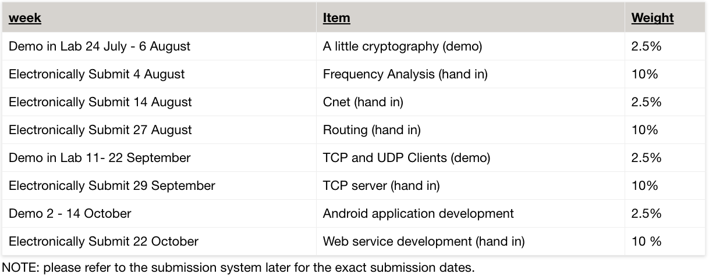
Assessments
Examination
Final exam (50%)
All topics covered in lectures, tutorials, and projects are examinable

Slide 8
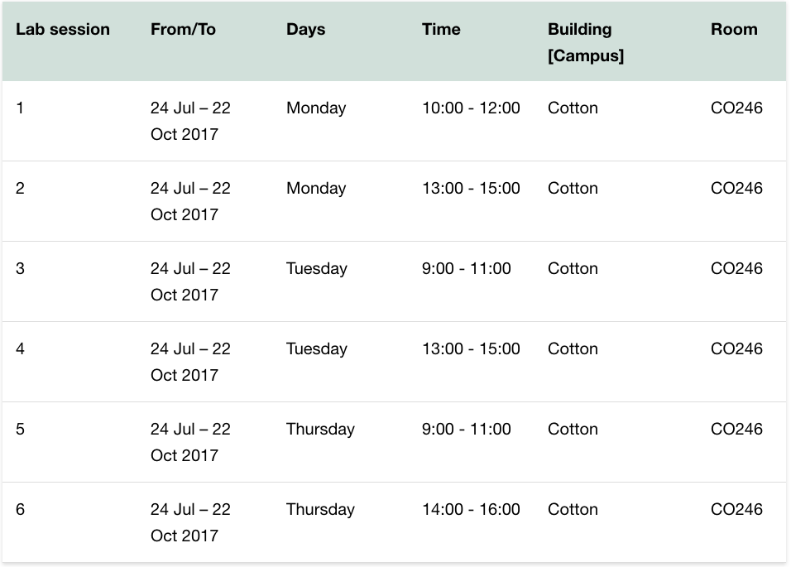
Lab sessions
Please register your lab session through myAllocator.

Slide 9
Lecture & tutorial arrangement

Slide 10
What to do after this lecture
Look at the course website
https://ecs.victoria.ac.nz/Courses/NWEN243_2017T2/
Refresh your c programming
If necessary, follow some online c programming tutorials
www.learn-c.org
Check our official textbook from the library.
Be prepared for your lab project.

Slide 12
Let’s start our learning journey together …

