Slide 1
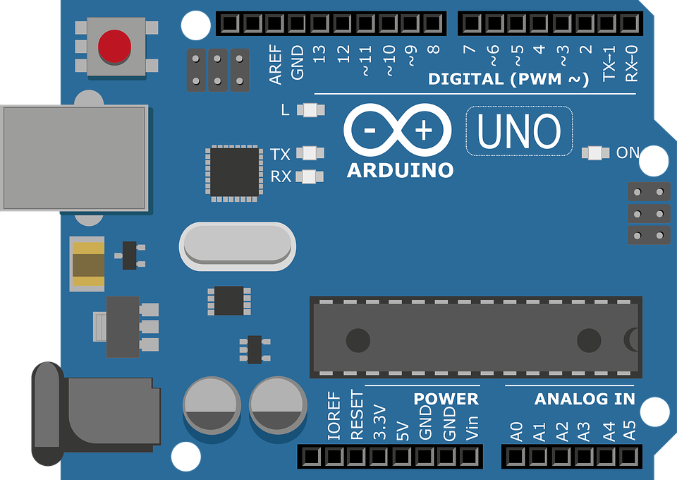
Arduino in the Classroom
Pravin Vaz, Outreach Coordinator, ECS

Slide 2
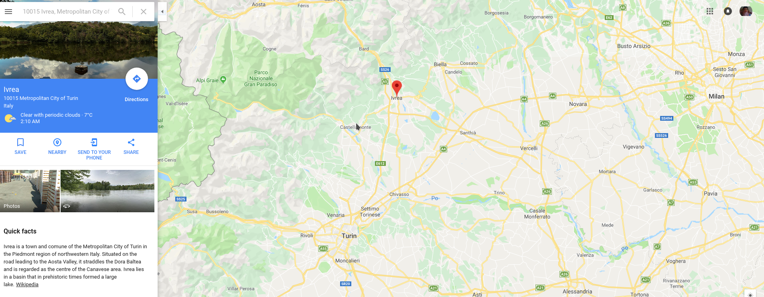
Humble Beginnings

Slide 3
Open Source movement

Slide 4
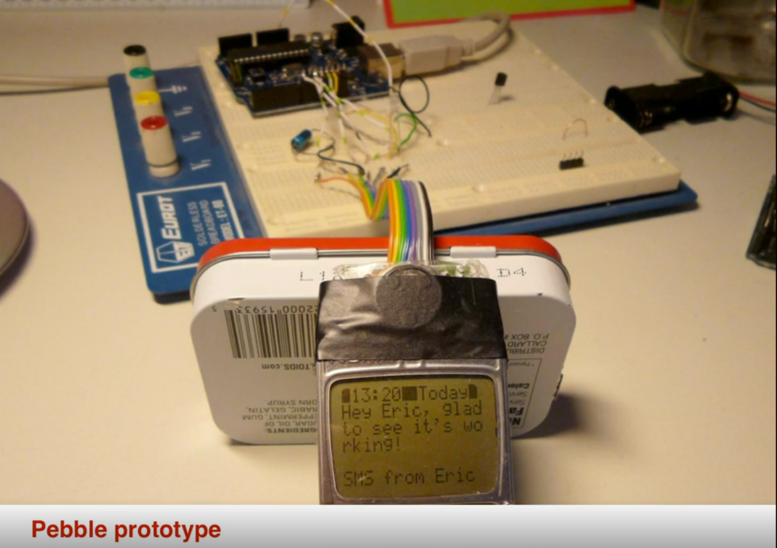

Slide 5
ArduSat - Open source Satellite !

Slide 6
Original vs Fake

Slide 7
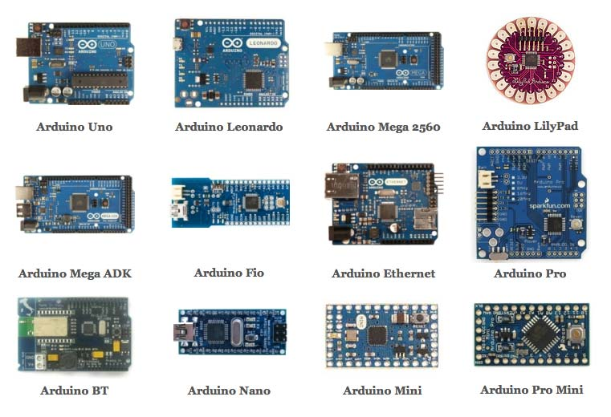
Types of Arduino
https://goo.gl/images/U9xj5E

Slide 8
Practicality of projects
Something they can take back home
Easy to get going
Cheap to source

Slide 9
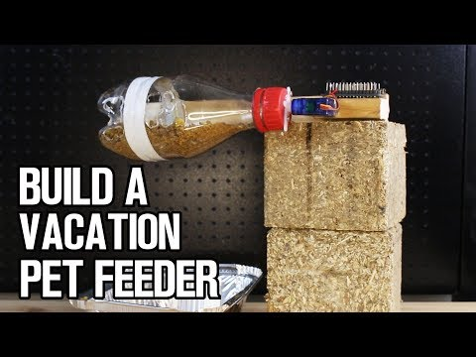

Slide 10
Solving Local Problems with easily accessible electronics

Slide 11
Using old RC cars from Trash Palace / Sallies
http://techteacherslog.net/current-projects/

Slide 12
Competitions as Classroom projects?

Slide 13
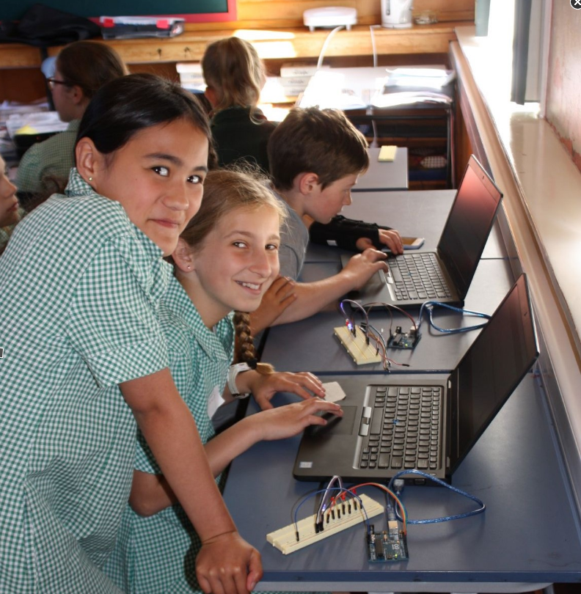
Organising a Hackathon
Chanel College

Slide 14
Successful Arduino Units in Schools
Onslow College (Ex students returning back to run outreach programmes)
Queen Margaret College (Doing a Traffic lights scenario)
Paraparaumu College( Jackbord using the ESP32 - a type of Arduino)

Slide 15
Arduino and Android
Arduino (prototyping) - Processing (Coding Graphics) - Java (Android Studio)

Slide 16
My inspiration comes from…
https://makezine.com/
Books and Magazines

Slide 17
and....
www.instructables.com
www.thingiverse.com

Slide 18
Questions yet?

Slide 19
Should we try some Arduino code out ?

Slide 20
Where to start in a classroom?
http://techteacherslog.net/2018/07/31/arduino-unit-now-complete-10-plus-hours-of-classwork-on-slideshows-and-provided-code/

