Slide 1
Soldering Tutorial

Slide 2
Lab Briefing
General Lab Rules for this Lab
No Food or drink to be consumed in the room
Appropriate gear must be worn
Work must be carried out in the appropriate areas
Report incidents/accidents
Report all broken equipment/Desks/chairs
Covered Footwear at all times- no jandals or bare feet permitted

Slide 3
Lab Safety
Small Items:
Risks:
Small items may fall onto the floor while work is being carried out. These items may contain sharp edges or points which may embed into skin if enough force is present. Covered shoes must be warn to prevent this from happening. Please be aware that the Cleaners do not clean labs and so while it may look clean there will be small parts on the floor. The floors may be cleaned once a year, when there is the least disruption to occupants.
Power supplies:
Risks:
Do not solder with battery attached! Ensure battery is taken out if you have to solder some missing joins.

Slide 4
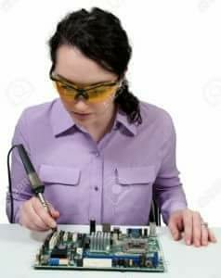
Lab Safety
Soldering:
Risks:
Soldering iron tips are hot - up to 400 degrees. Never touch tip of the iron – remember, hot soldering iron looks exactly same as cold one. To check the temperature touch wet cleaning sponge at soldering stand with tip of the iron. If you can hear hissing sound – iron is hot enough to use.
Lead is hot as well and it does not stick to iron tip. Never shake soldering iron to remove excessive lead – always use cleaning sponge.
Always ensure that the cleaning sponge is damp

Slide 5
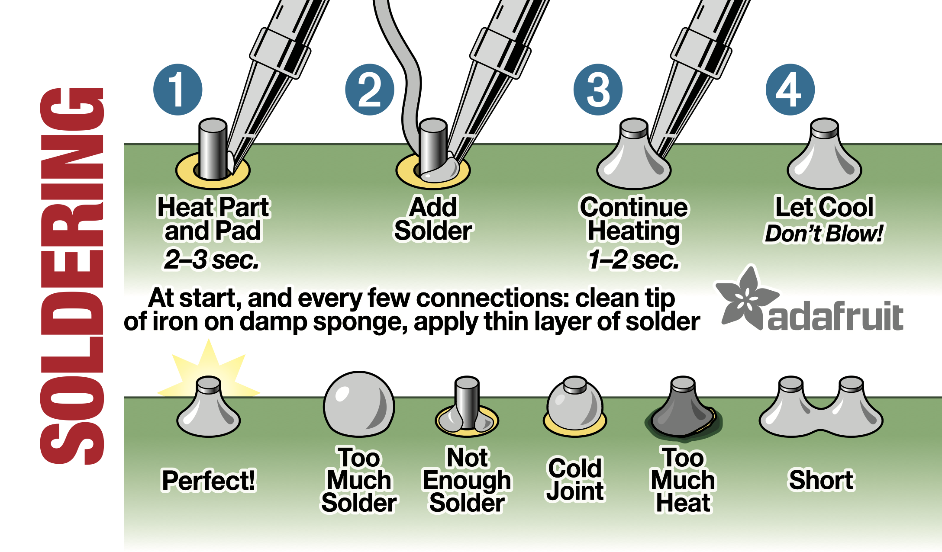

Slide 6
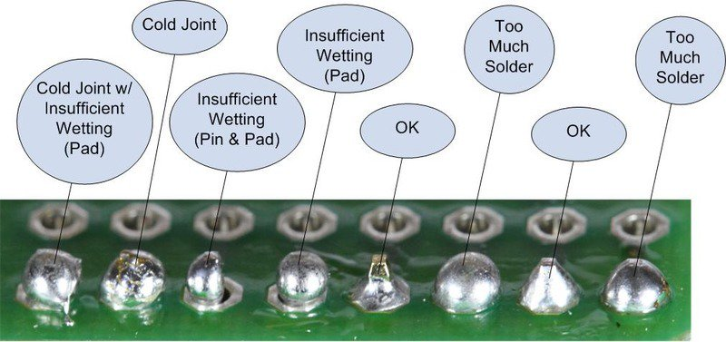

Slide 7
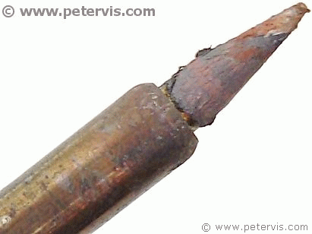
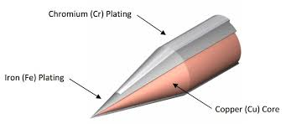
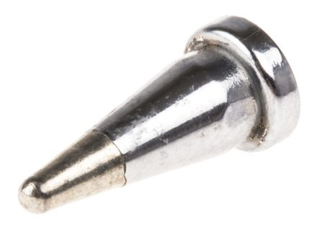
Tips and tricks
Clean the tip and add solder to protect it
Wait for the pad and the pin to heat up
Let the solder melt and fill the pad
Wait for the solder to cool down, you don’t need to blow on it
Use the right solder for the job,
lead solder is easier to work with
Silver solder is non toxic

Slide 9
Questions?

Slide 10
Resources
Fixing a soldering iron tip
https://www.youtube.com/watch?v=a9hbANJRKvQ

Slide 11
