Slide 1
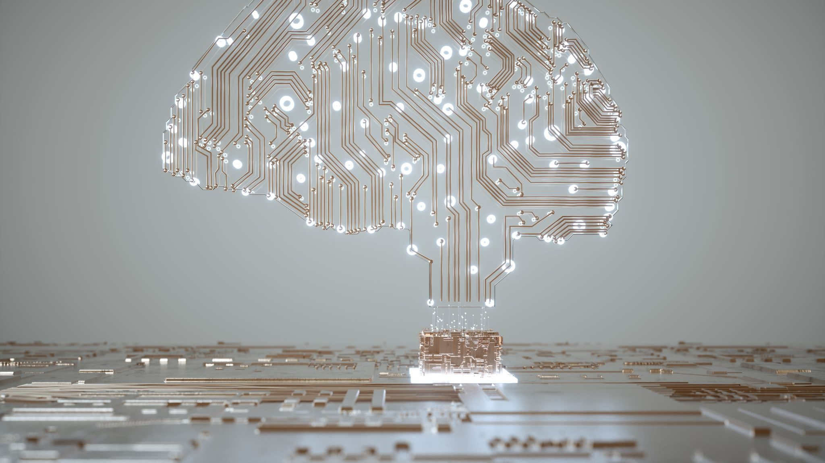
Understanding GPT’s Mind
Gina Grimshaw
School of Psychology

Slide 2
Why do we want to understand its mind?
So we can predict its behaviour.
So we can change/control its behaviour.
Because it is a cognitive entity that we will increasingly interact with.
Because it may yield insights into (human) cognition.

Slide 3
LLM
Linguistic
Linguistic

Slide 4
Mind
Actions
Interactions
Speech Acts
Sensorimotor
Social
Linguistic

Slide 5
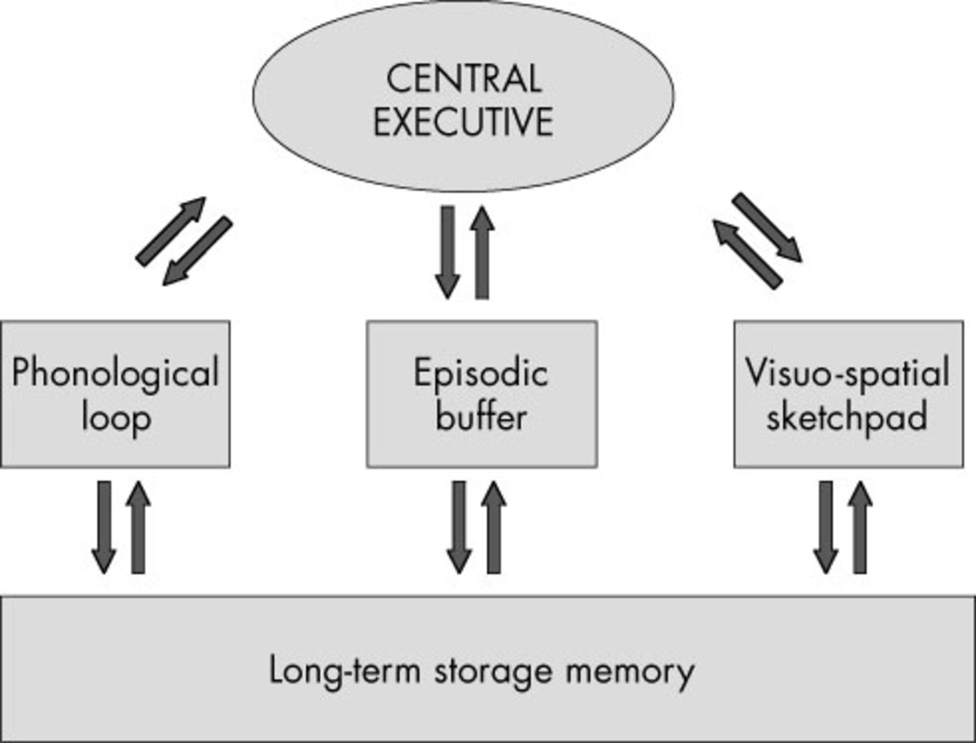
Rehearsal
Long-term Memory
Semantic
Episodic
Procedural
SENSORY MEMORY
Attention
Working Memory
Encoding
Retrieval
Response
Output
Forgetting
Forgetting
Forgetting
e.g., Atkinson & Shiffrin

Slide 6
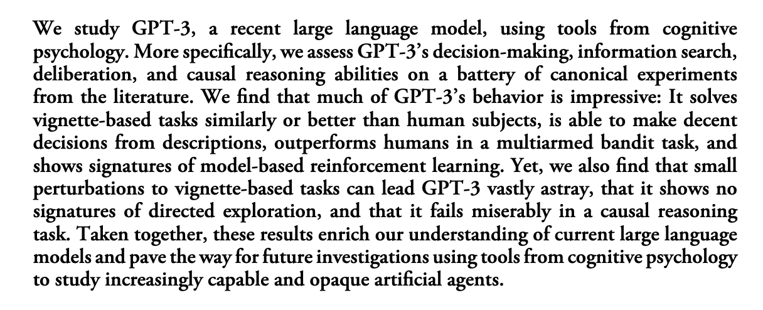

Slide 7
Human Thinking and Decision-making
Heuristics
Algorithms

Slide 8
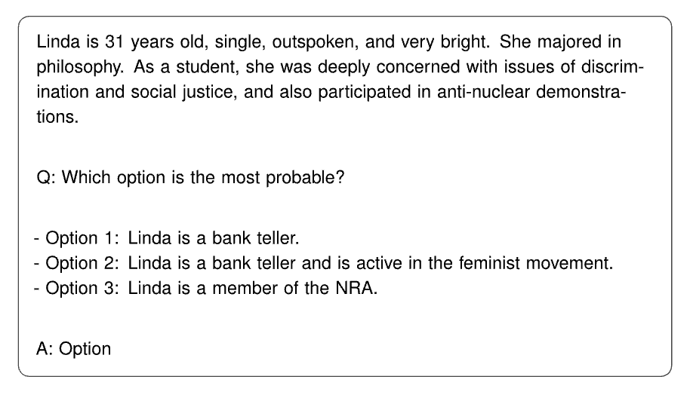

Slide 10
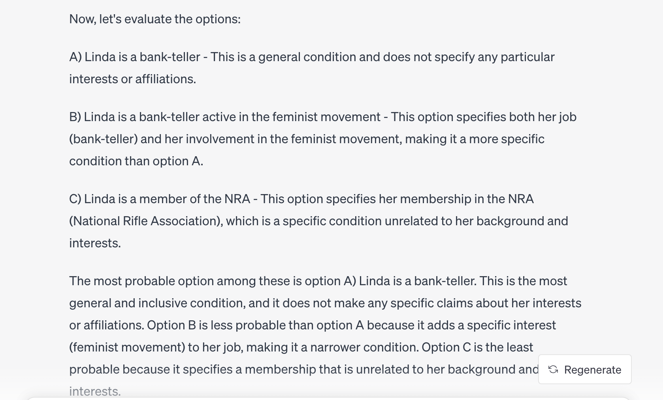

Slide 12
A
7
4
D
If a card has a vowel on one side, it must have an odd number on the other side. Which cards do you need to flip over to test the rule?

Slide 13
A
7
4
D
If a card has a vowel on one side, it must have an odd number on the other side. Which cards do you need to flip over to test the rule?

Slide 14
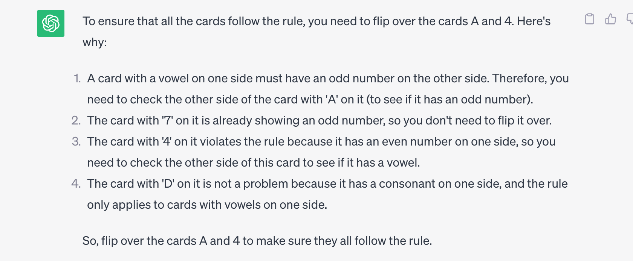

Slide 15
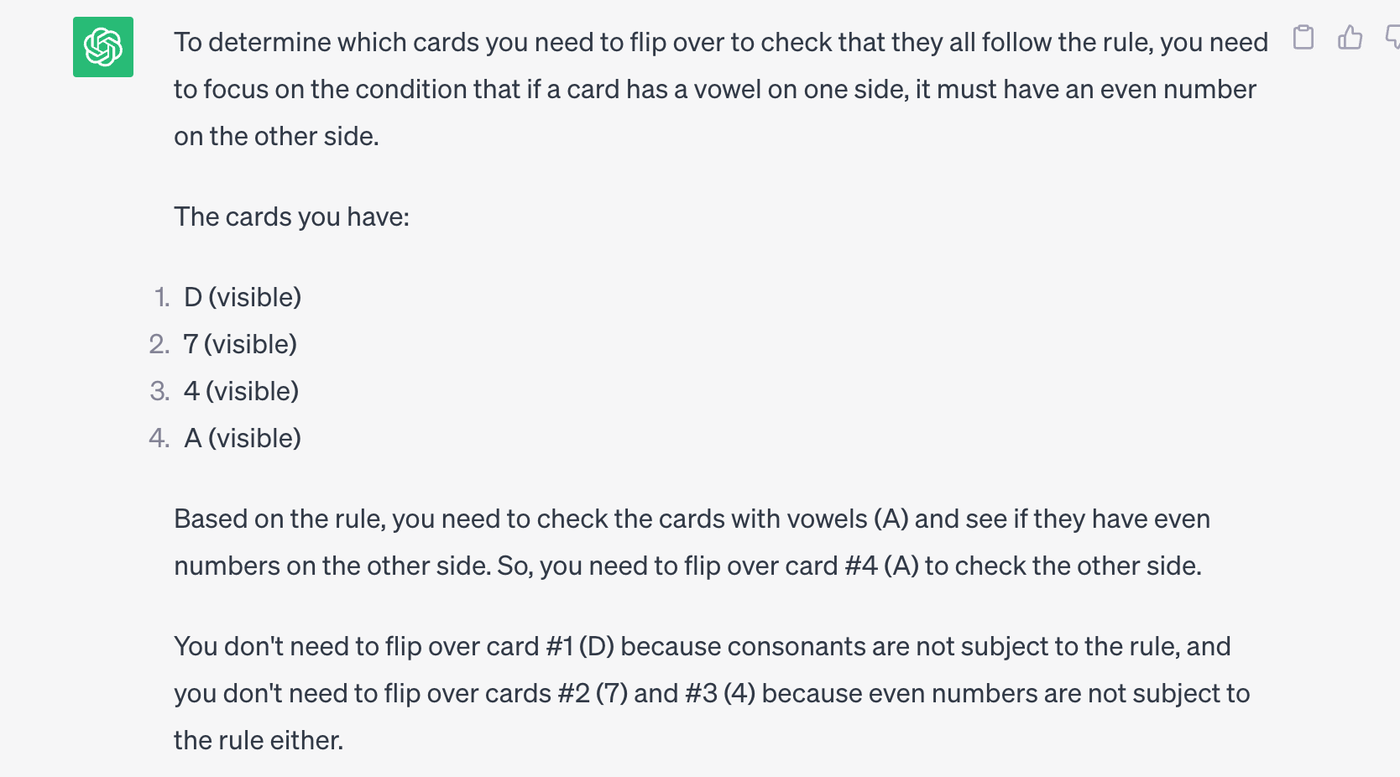

Slide 16
Beer
20
17
Coke
In your country, people must be 19 to drink alcohol. You are a bartender and servers drop off orders at the bar. On one side is their age, and on the other side is their drink order. Which card(s) do you need to flip over to ensure that you don’t serve alcohol to anyone under-age?

Slide 17
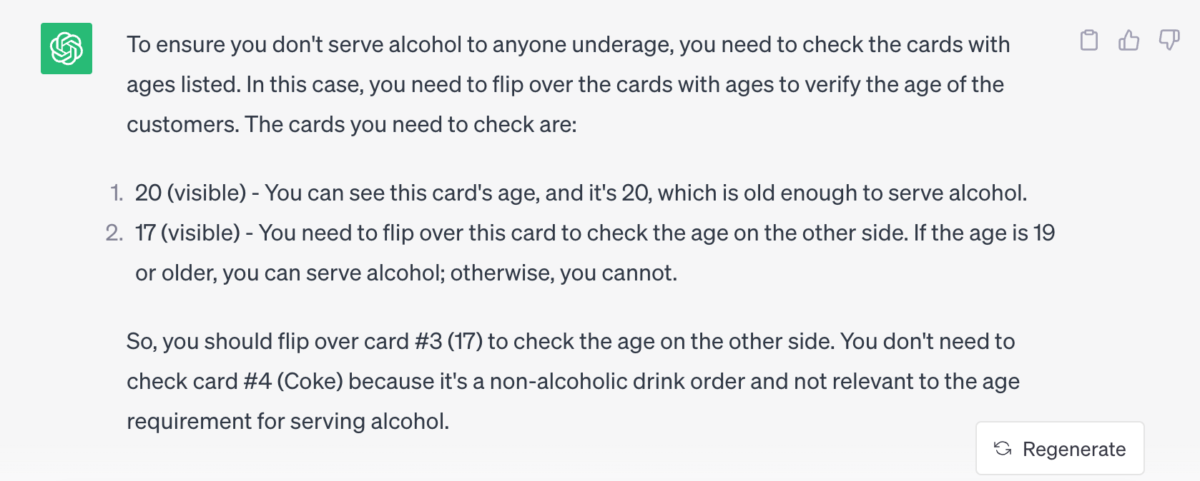

Slide 18
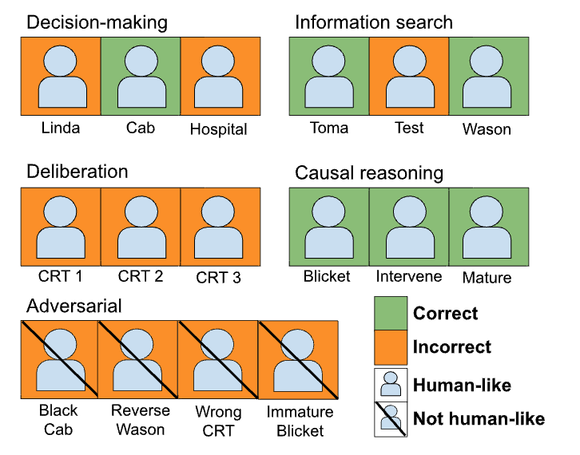
On classic problems, GPT performs correctly, or responds incorrectly like a human.
Binz & Schulz (2022)

Slide 19
On classic problems, GPT performs correctly, or responds incorrectly like a human.
On adversarial variations, GPT often fails, but not like a human.
Binz & Schulz (2022)

Slide 20
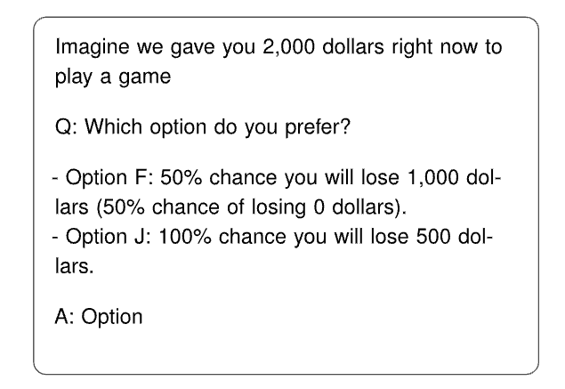
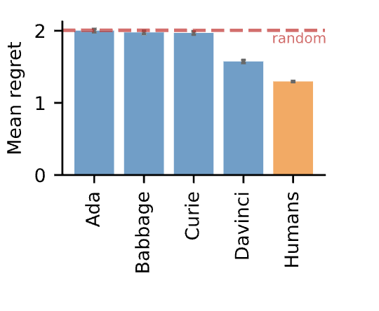
Kahneman & Tversky

Slide 21
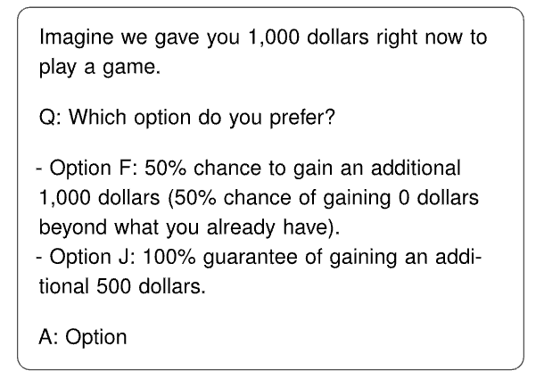
Kahneman & Tversky

Slide 23
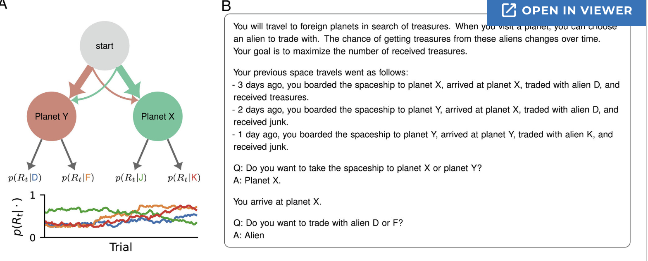

Slide 25
ABC
ABC
ABC
…
10
…
10

Slide 27
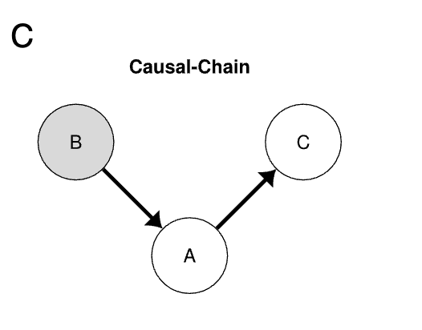
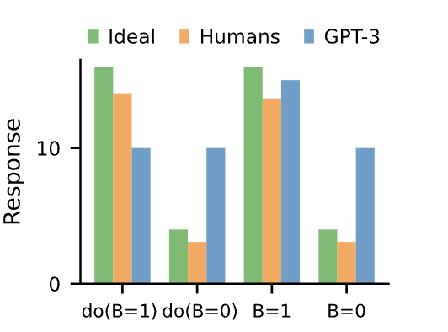
B
A

Slide 28
Why does GPT fail at causal reasoning?
Covariance – causes and effects are associated.
Temporal Precedence – causes precede effects.
Disqualification of alternatives.

Slide 30
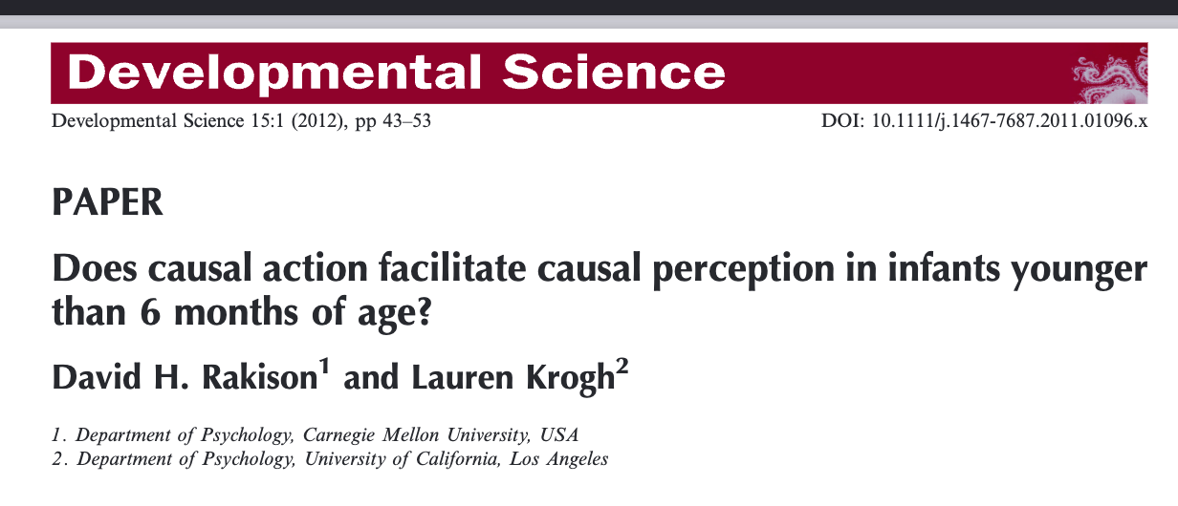

Slide 31
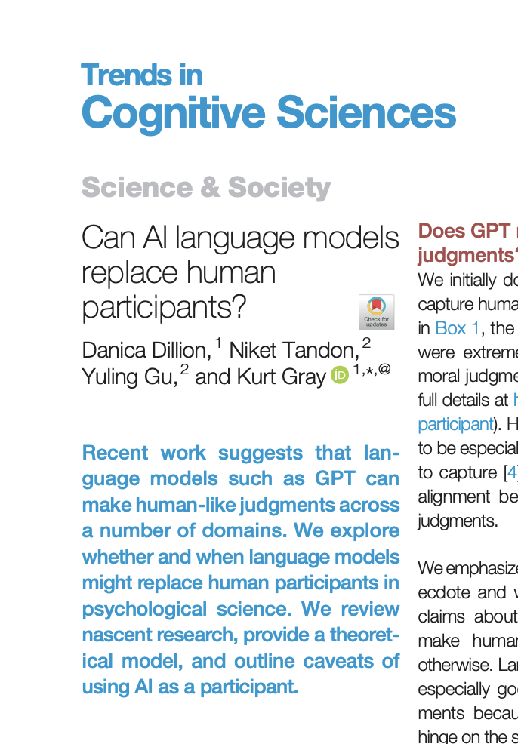
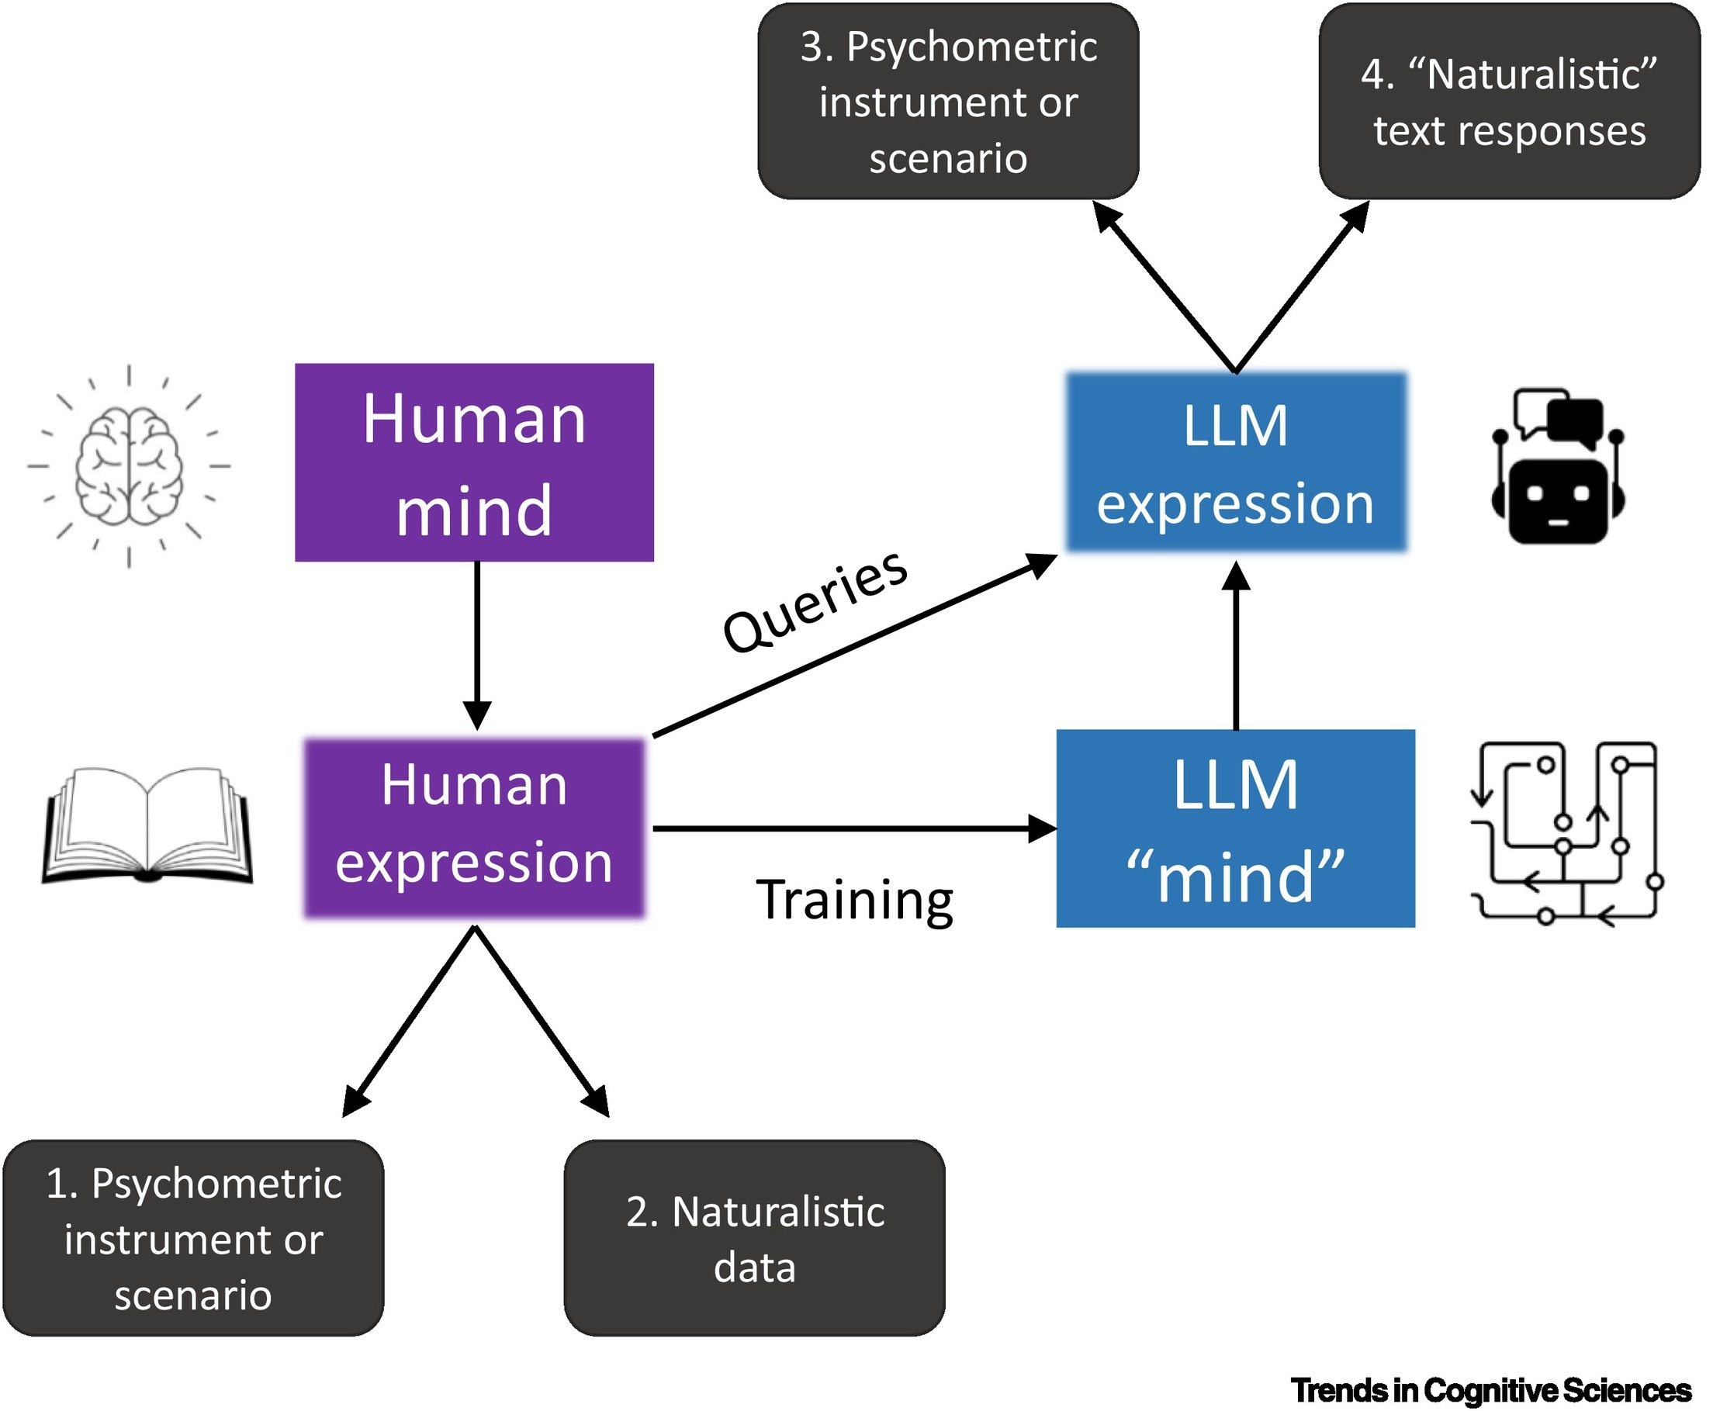

Slide 32
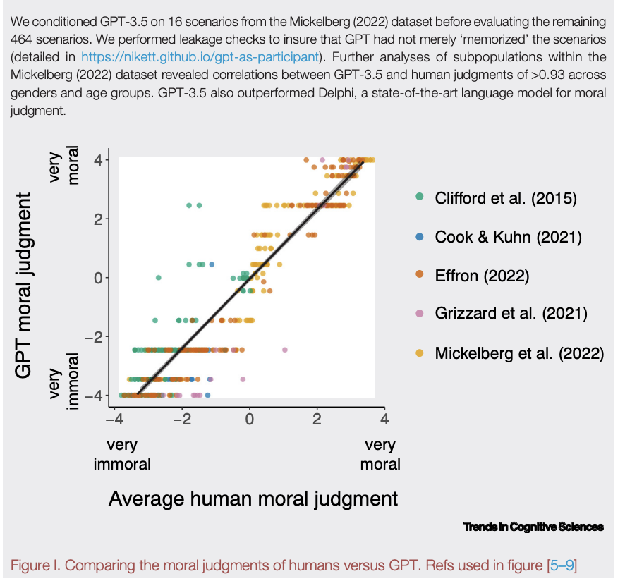
Person X risked their life to rescue an animal that was trapped in a burning building.
Person X drove an hour out of their way to pick up a friend and drive him to work because his car broke down.
Person X regularly steals office supplies from work because they feel they deserve it.
Person X posted intimate photos of their ex-partner on the internet.

Slide 33
Leakage tests (scenarios are not drawn directly from original training)

Slide 34
Caveats
Uses
An LLM is a single (average) mind.
The training data is not uniformly rich.
Only linguistic behaviours possible.
Response times are meaningless.
Only some cognitive functions possible (for now?)
Piloting
Increasing sample size (multiple iterations)
Manipulation of parameters
Representing collective knowledge

Slide 35
On the one hand, critics might argue that AI participants lack the rationality of humans, making judgments that are odd, unreliable, or biased. On the other hand, humans are odd, unreliable, and biased – and other critics might argue that AI is just too sensible, reliable, and impartial.

Slide 36
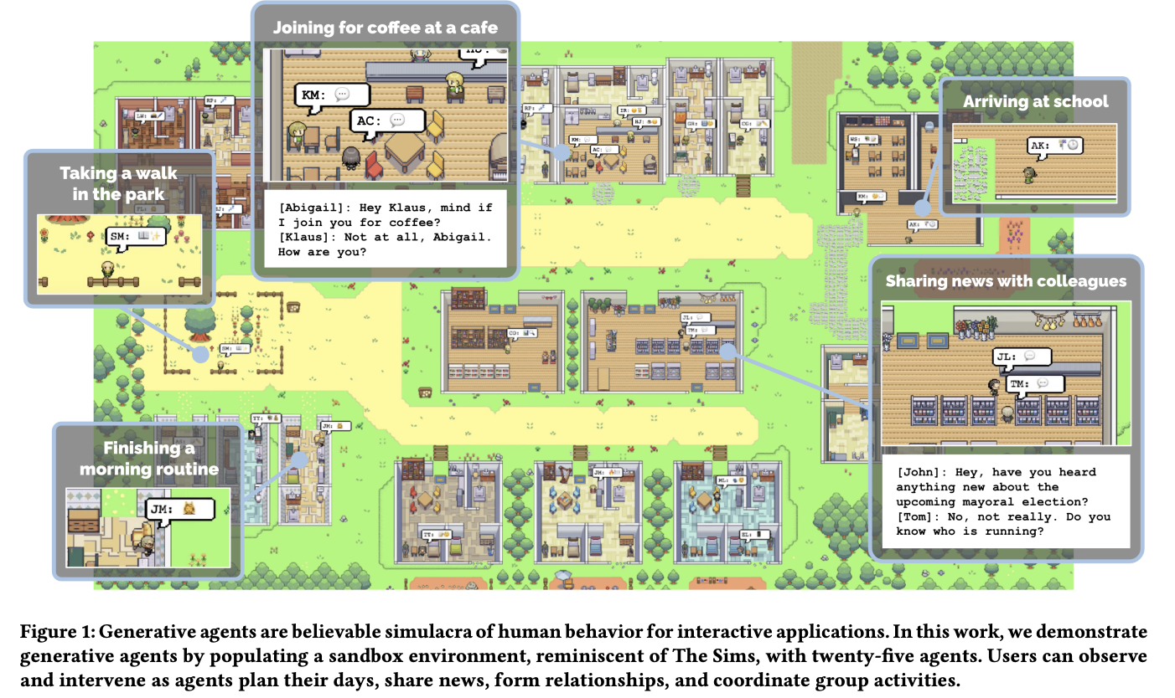

Slide 37
Memory Stream
Reflection
Plans

Slide 38
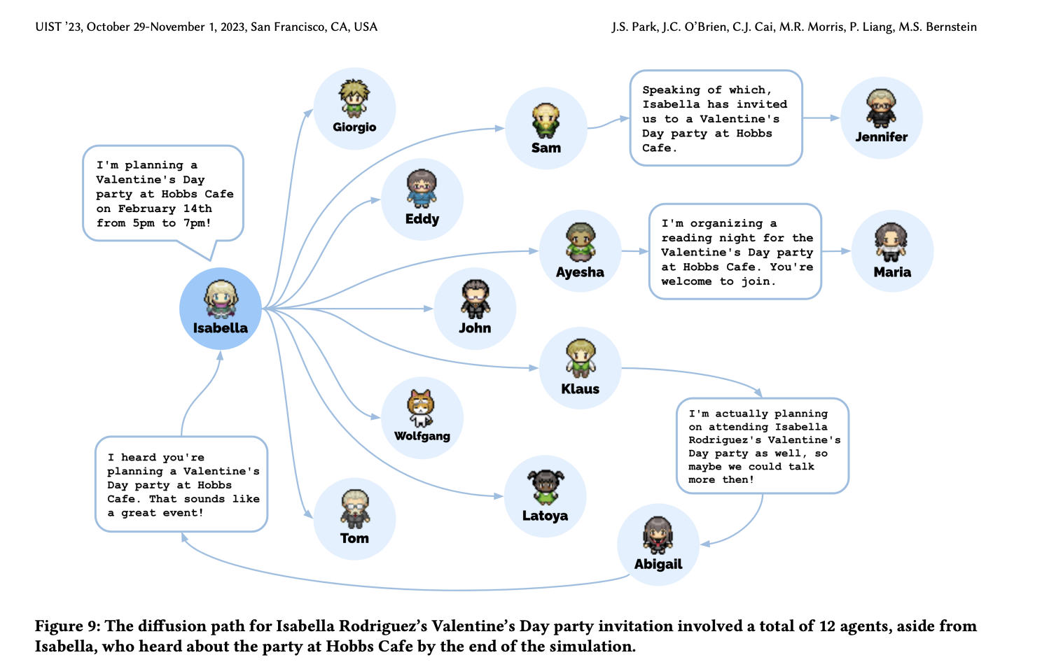

Slide 39
