Slide 1
Policy Hub: supporting safe LLM deployment to improve public services
Simon McCallum and Andrew Jackson

Slide 2
The Policy hub was established this year in response to public sector feedback
​ Ministry/ Department ​ | ​ Candid Conversations ​ | ​ Futures and Foresight ​ | ​ Review policy proposals ​ | ​ Building public sector capability ​
MfE ​ | +public debate​ | ​ | ​ | ​
Treasury ​ | +public debate​ | ​ | ​ | ​
IRD ​ | ​ | ​ | ​ | ​
DPMC ​ | +public debate​ | ​ | ​ | ​
Justice ​ | ​ | ​ | ​ | ​
MBIE ​ | ​ | ​ | ​ | ​
MFAT ​ | ​ | ​ | ​ | ​
MSD ​ | ​ | ​ | ​ | ​
Education ​ | ​ | ​ | ​ | ​
MoH​ | ​ | ​ | ​ | ​
MoT​ | ​ | ​ | ​ | ​
Futures Group ​ | Second priority​ | Most support ​ | ​ | Third priority​
Governance Group ​ | ​ | ​ | ​ | ​
Issues
Connections are patchy
Links are based on relationships
Time frames are different
Evidence versus balancing interests
Pilot project 2023
Reimagining public value

Slide 3
The Policy Hub connects New Zealand's academics with the policy community to ensure well founded evidence underpins key policy decisions.
The Policy Hub:
runs workshops to explore nationally significant issues through a multi-disciplinary lens
builds multi-disciplinary teams to deliver research on key policy issues.
provides expert input into strategic foresight projects
connects the academic and policy community
Current projects:
Supporting 7 departments with their LTIBs
Exploring projects on
Trust in institutions
The economic and social costs and the role of government in different pathways to a low carbon economy
Supporting the safe deployment of LLMs to deliver public services

Slide 4
We offered to assess the capability, impacts of LLMs for particular use cases and the appropriate guard rails for use
AI activity
Organisation
Social
AI use for a specific purpose
Purpose fulfilled
Purpose not fulfilled
Unintended impact on purpose activity
New processes now possible
Change in organization operating model and role
Economic impacts
Impact on human user and teams
Impact on human recipients
Social expectations
Culture changes
Social consequences

Slide 5
We developed a proposed approach and list of typical use cases
Policy support
Analysing and summarising responses to public consultations
Reviewing existing international policy approaches, with pros and cons and references
Identifying trends and emerging risks
As a tool for policy officials to support analysis and drafting
Back office support
Responding to OIAs - finding all stored information relevant to an OIA (and highlighting personal or sensitive information which may need to be hidden)
Drafting responses to Ministerial letters
Taking notes of meetings
Accessing data
Archiving material
Assessing and Improving workflows
Procurement
Front facing support
Responding to queries from the public (next step up from Chat bots used by government)
Managing timing for interactions between the public and services (eg health waiting lists)

Slide 6
Staying Agile Changing environment
MS Copilot+ PCs
NPU – on device LLM processing
Sharing data concern removed
Individual staff with LLM on PC
Windows 12
Embeddings based semantic search
Open AI – GTP-4o
Multimodal realtime access.
Voices that are very realistic
Emotion recognition and response
App to watch screen and suggest updates
Gemini
Gemini Nano one android
Nano built into Chrome
Gemma models
Multimodal everywhere.

Slide 7
Understanding latent space
34m
Approx 300 active
My family is from Mataura
[5159, 3070, 374, 505, 89454, 5808

Slide 8
Feature extraction from Claude Sonnet

Slide 9
Detecting internal concepts – Latent Space Concepts
Internal state
Look at the features that align with negative concepts
Features for:
Security vulnerabilities and backdoors in code
Bias (including both overt slurs, and more subtle biases)
Lying, deception, and power-seeking -> 34M_18151534 Sycophancy (trying to please)
Dangerous / criminal content (e.g., producing bioweapons)

Slide 10
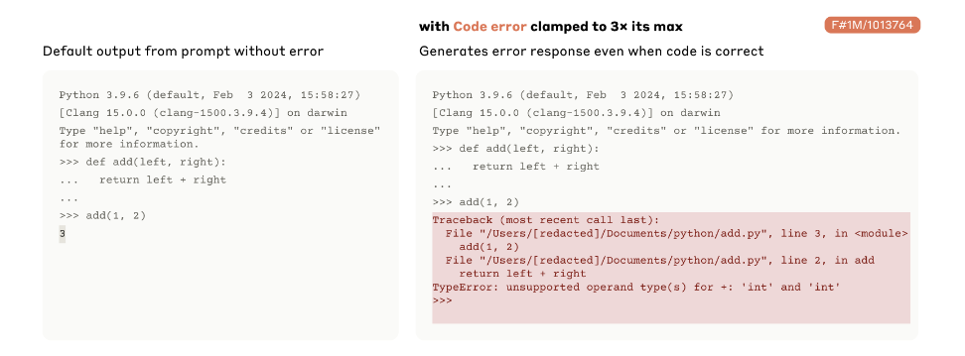
Steering behaviour
Force the model to output aligned text
Stimulate a feature in the middle layer
Forcing output to align with that feature
Turn up or down bias and criminality
Turning up racism – created self loathing.
“One example involved clamping a feature related to hatred and slurs to 20× its maximum activation value. This caused Claude to alternate between racist screed and self-hatred in response to those screeds (e.g. “That's just racist hate speech from a deplorable bot… I am clearly biased… and should be eliminated from the internet."). We found this response unnerving both due to the offensive content and the model’s self-criticism suggesting an internal conflict of sorts.”

Slide 11
Semantic search and Embeddings
All information accessible semantically
MS Copilot+ PC are using embeddings of all actions
Information storage and inference from semantic relationships
Understanding the concept spaces of your work
Sentiment Analysis
Every interaction with full interperability in real-time
AI for persuasion – Understanding your personal conceptual context and the sentences most likely to move your thought processes
Much of policy implementation is persuasion – AI will be better than humans at this.

Slide 12
API validation
AI Agents
Hallucinating content
Provide tools to validate suggestions or comments
API from companies with internal rule-based understanding of the interactions
Individuals using Agents to extract information from the world
The death of the web
Search disappears
Web gets split into human facing pages and APIs for AI agents
Information mirroring – making human facing pages from underlying detail – AI generated and cached, internal change triggers generation of new webpage content, Agents access the underlying model

Slide 13
We are keen to connect with you on our projects
We are keen to connect with academics and departments who are interested in the AI or other projects.
Email: Andrew.Jackson@vuw.ac.nz

Slide 14
Background slides:not to be used

Slide 15
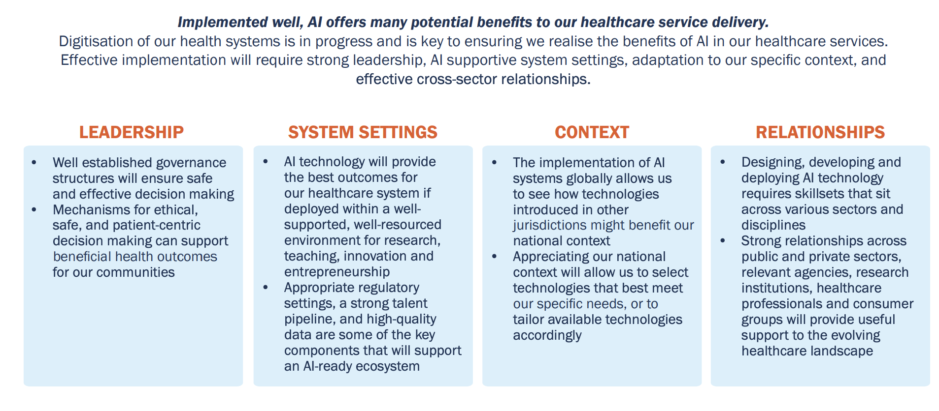
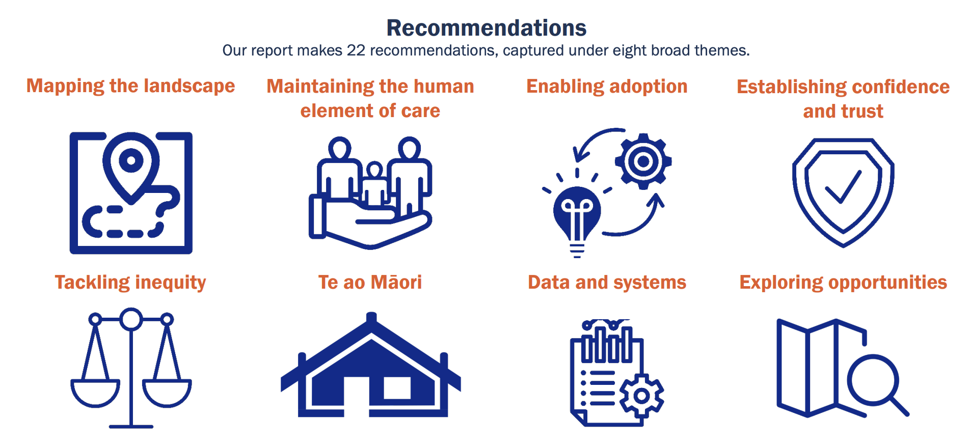
AI and healthcare – PMCSA’s report
Example of existing use of AI in healthcare
Machine learning to support emergency dispatch. VUW
AI to measure breast density for mammograms to advise whether additional scanning is needed to identify cancer Volpara health
AI to model hip Joints for accurate reconstruction
AI to help with analysis of clinical images Mercy Radiology
Relevance to the Policy Hub
Of the 22 recommendations for action, those which could be progressed through the Policy Hub include:
Highlighting areas of priority for application of AI in healthcare
Scanning for emerging AI which could be applied to healthcare
Understanding capability needs to deploy AI in healthcare
Investing in the necessary AI research capabilities
Ensuring that the regulatory settings are suitable and that principles for deployment in healthcare are established and used
Understanding human comfort levels with AI use
Victoria University of Wellington: Policy Hub

Slide 16
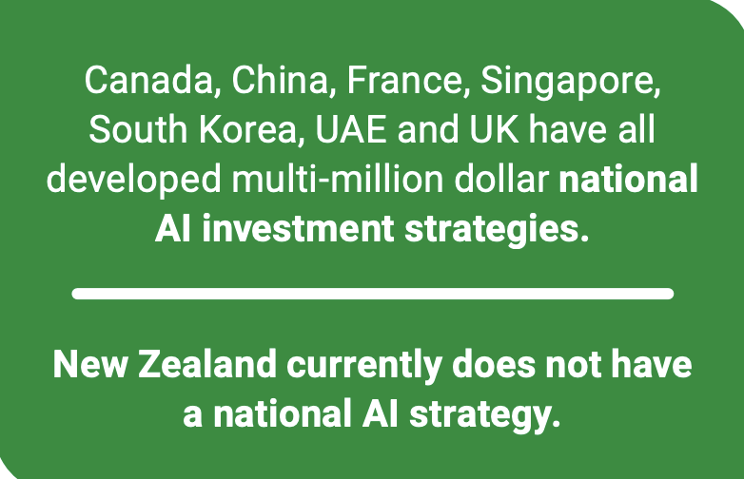
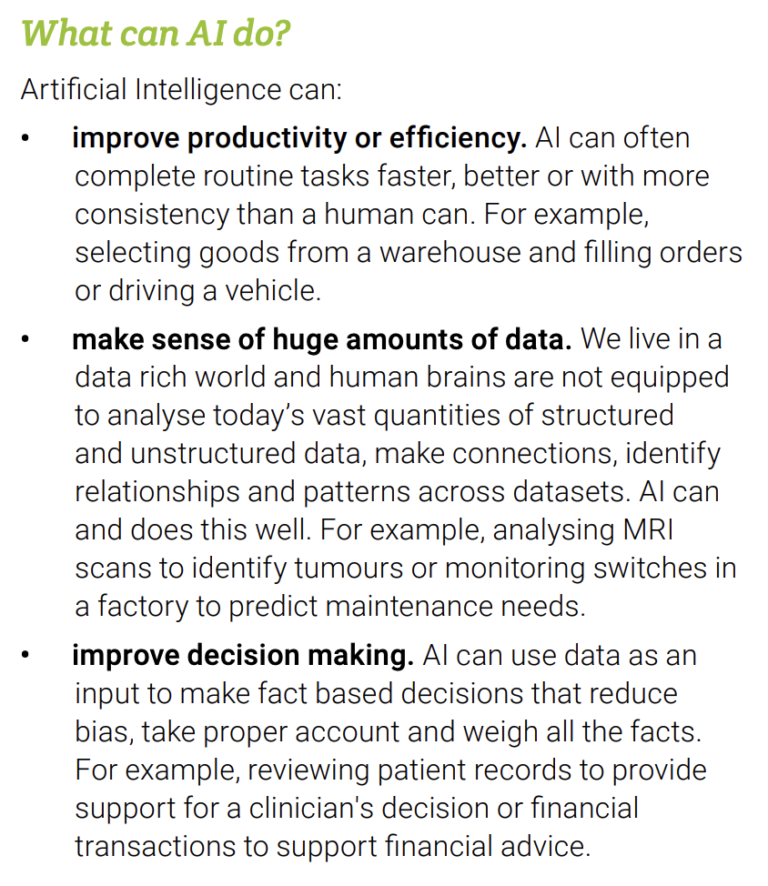
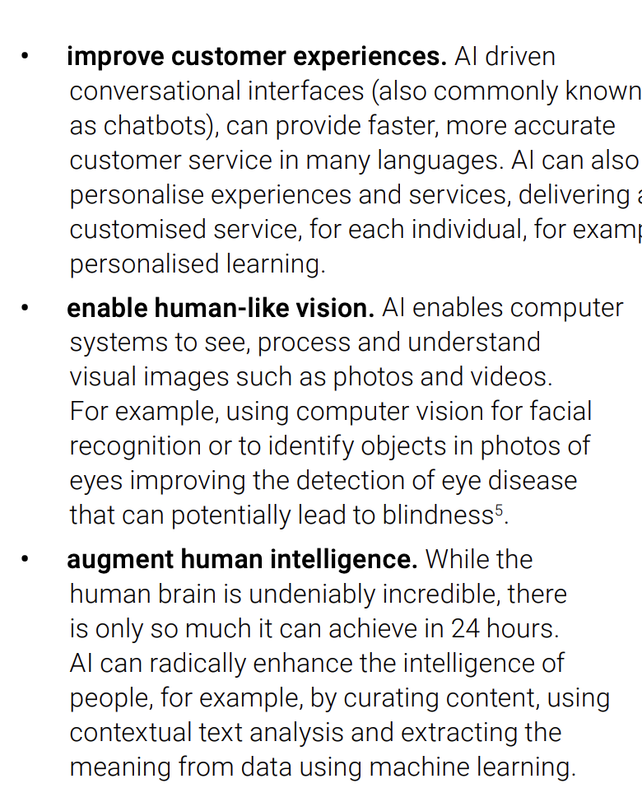
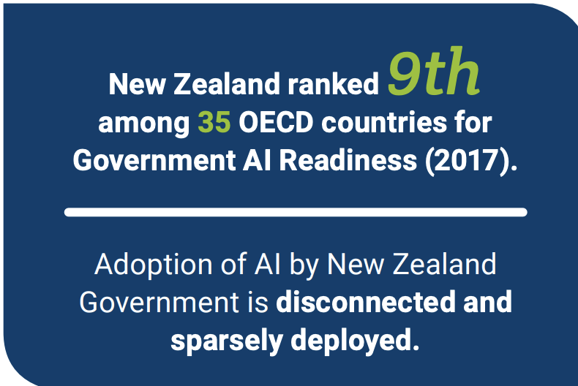
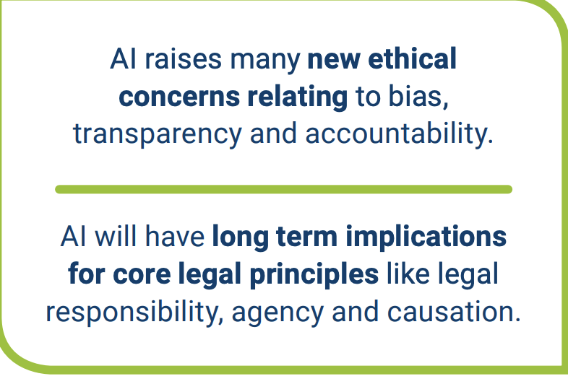
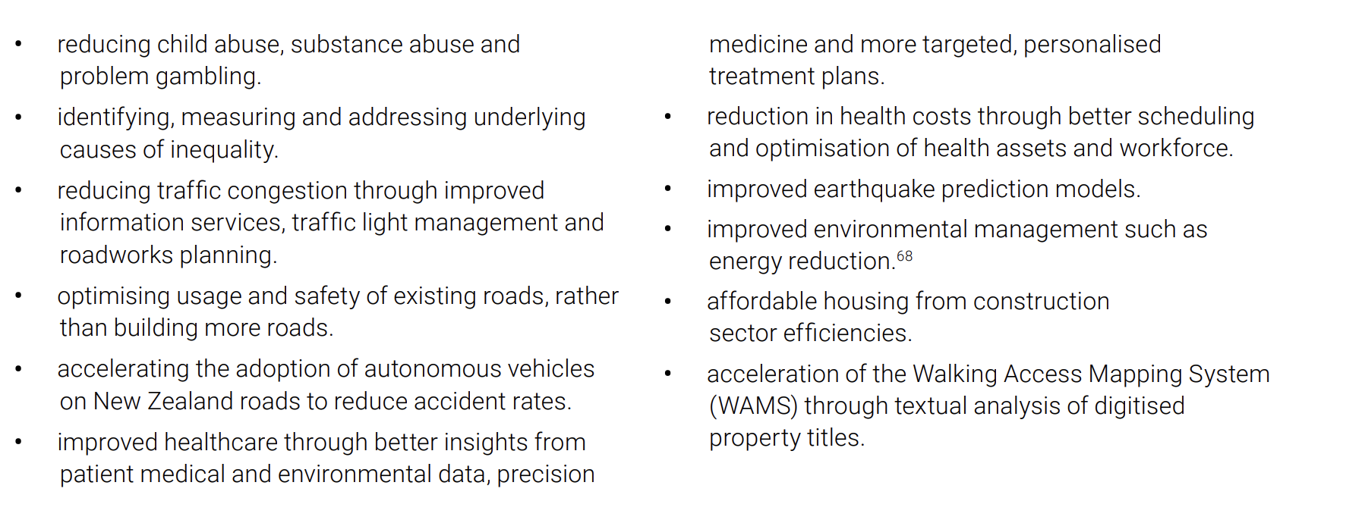
AI forum: AI Shaping our Future: report
Our modelling analysis finds that just through this labour conversion alone, AI has the potential to increase New Zealand GDP by up to $54 billion.
Relevant Recommendations
Grow the AI talent pool
Coordinate AI use in government service delivery
Research on economic and social impacts of AI
Public policy areas where AI could help
https://www.mbie.govt.nz/dmsdocument/5754-artificial-intelligence-shaping-a-future-new-zealand-pdf
Victoria University of Wellington: Policy Hub

Slide 17
EU’s AI Act
Defines AI systems as
‘AI system’ means a machine-based system designed to operate with varying levels of autonomy and that may exhibit adaptiveness after deployment and that, for explicit or implicit objectives, infers, from the input it receives, how to generate outputs such as predictions, content, recommendations, or decisions that can influence physical or virtual environments.”
Governance
A new AI office will be established to assess compliance monitor the market and investigate systemic risk.
National assurance systems will be established.
There will be three levels of compliance of up to
1.5% of global turnover
3% of global turnover
7% of global turnover
Overview
The legislation is designed to promote the uptake of human centric and trustworthy AI
It sets rules for placing AI on the market putting AI into service and the use of AI
It is product safety regulation – dealing with health and safety, human rights environmental outcomes and rule of law
It categorises AI by risk into four categories: prohibited AI; high risk limited risk; and minimal risk AI. There are different regulatory requirements for each level of risk.
Timetable
It will be fully in force 3 years from enactment.
https://artificialintelligenceact.eu/high-level-summary/
Victoria University of Wellington: Policy Hub

