Slide 1
Viewing AI Regulation Through A Washington Lens
Dr Bronwyn Howell School of Management
Wellington School of Business and Government
2 August 2024
Bronwyn.Howell@vuw.ac.nz

Slide 2
Agenda
Risk and Uncertainty
Safety Regulation – a primer
The Elephant in the Room
AI Regulation: the EU and US
US Operator Perceptions

Slide 3
Risk and Uncertainty

Slide 4
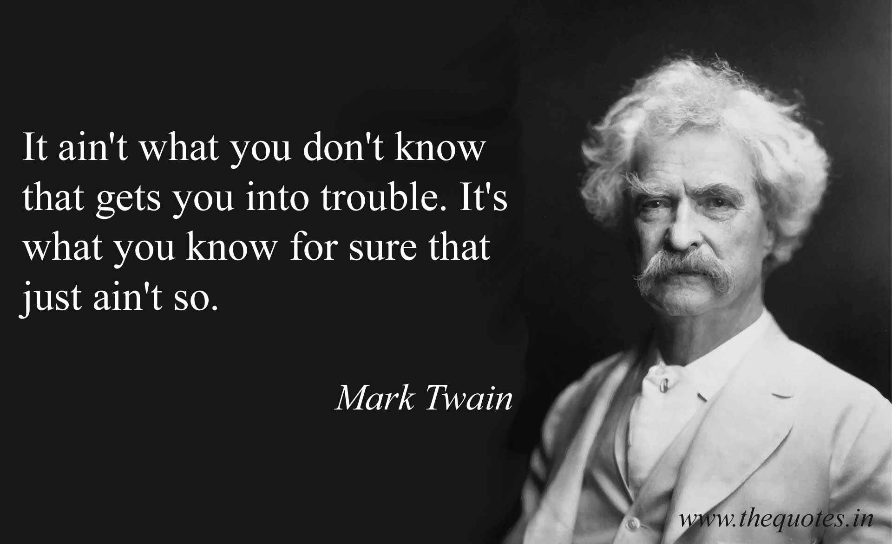

Slide 5
Risk vs Uncertainty
Uncertainty must be taken in a sense radically distinct from the familiar notion of Risk, from which it has never been properly separated..... It will appear that a measurable uncertainty, or "risk" proper.... is so far different from an unmeasurable one that it is not in effect an uncertainty at all. Frank Knight, 1921, Risk, Uncertainty and Profit.

Slide 6
What is risk?
Knightian Uncertainty = “unknown unknowns”: we don’t know and we know that we don’t know
Knightian Risk => we know, or can estimate, the probability and magnitude of an outcome (even if only to rank magnitudes and preferences for outcomes) Sunstein (2023), Knightian Uncertainy
EU AI Act: ‘risk’ means the combination of the probability of an occurrence of harm and the severity of that harm (Chapter 1, Article 3)

Slide 7
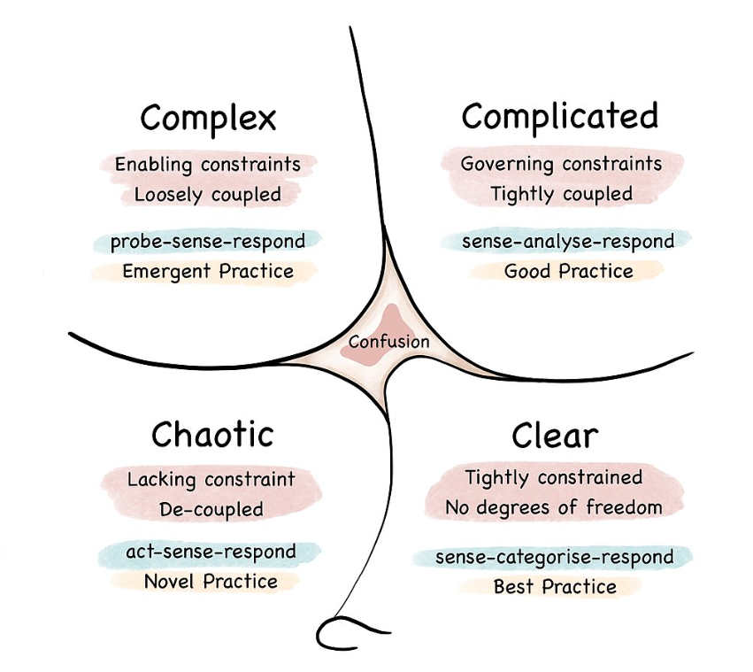
Managing in risky and uncertain environments
Dave Snowden (1999) at IBM Global Services
From 2014
The evolving Cynefin Framework
Notes:
Clear : stable; predictable. Cause and effect obvious; decision-making in the realm of reason
Complicated : relationship between cause and effect requires analysis and expertise; a complicated but bounded problem (e.g. Deep Blue and chess game)
Complex : cause and effect known only in retrospect; no “right answers”; “your very actions change the situation in unpredictable ways”
Chaotic : cause and effect unclear – even in retrospect; too confusing to wait for a knowledge-based response

Slide 8
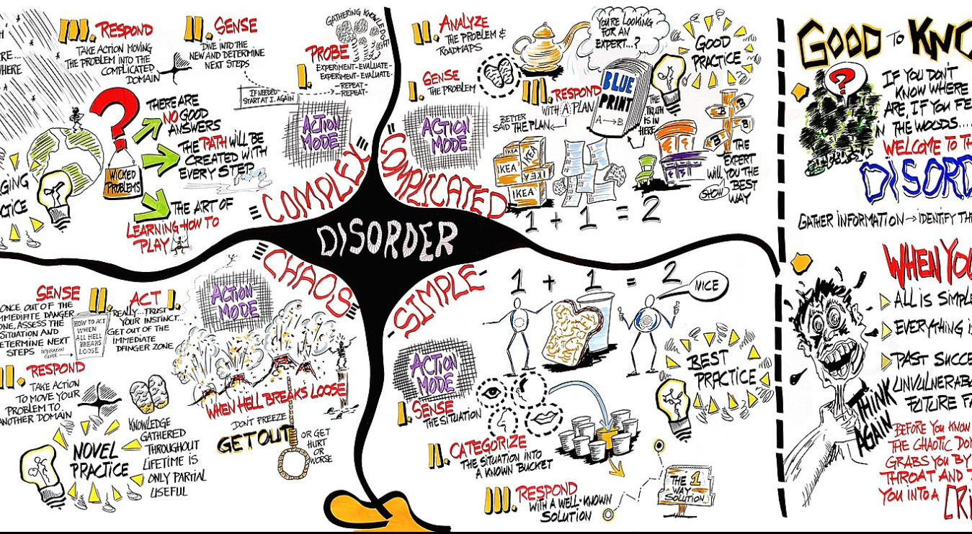
Edwin Stoop (n.d.)

Slide 9
(Biased) Human responses to uncertainty
“if it looks like a lion, then run for your life”

Slide 10
Humans Faced with Uncertainty
Are neurologically programmed to
overestimate the probabilities and costs of harm from low probability, high-cost events
overemphasise recent experiences and information
fear losses more than they value gains
wish to avoid irreversible events (e.g. death)
substitute a problem for which they do know the answer for the one they don’t
act precipitously when waiting may have been the better thing to do
Kahneman, Sibony, Sunstein (2021) Noise: a flaw in human judgement

Slide 11
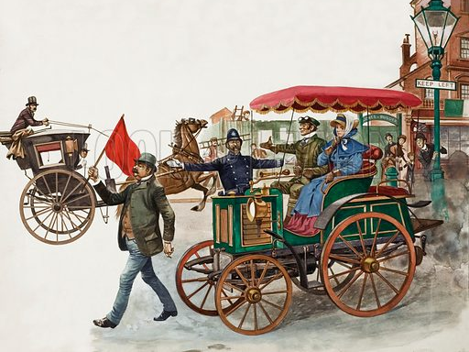

Slide 12
Safety Regulation:
a primer

Slide 14
Safety Regulation: the Precautionary Principle
“First, do no harm”
PP and risk management: co-opting science
“Where there are threats of serious or irreversible damage, lack of full scientific certainty shall not be used as a reason for postponing cost-effective measures to prevent environmental degradation.” UNCED (1992), Principle 15
“When an activity raises threats of harm to human health or the environment, precautionary measures should be taken even if some cause-and-effect relationships are not fully established scientifically. In this context the proponent of an activity, rather than the public, should bear the burden of proof. The process of applying the precautionary principle must be open, informed and democratic and must include potentially affected parties. It must also involve an examination of the full range of alternatives, including no action.” Wingspread Conference (1998)

Slide 15
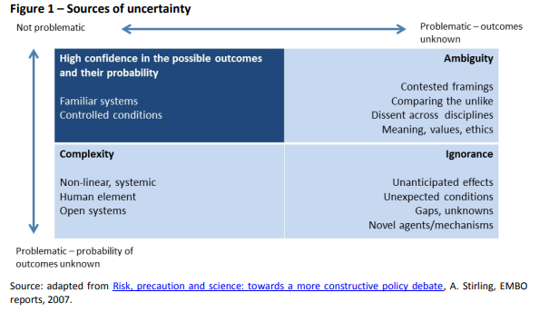

Slide 16
Three levels of precaution
First/minimal
uncertainty does not justify inaction and warrants legislation despite the absence of complete scientific evidence concerning a particular hazard;
Second/median
uncertainty justifies action and warrants legislation even if the link between cause and effect has not been fully established;
Third/maximal
uncertainty necessitates legislation until the absence of hazard has been proven.

Slide 17
EU Procedural Interpretation European Parliament (2015) The precautionary principle: definitions, applications
the potential hazards are characterised by serious, irreversible and uncertain consequences;
dynamic decision-making processes are both iterative and informative to allow learning over time;
the burden of proof is shared between the regulator and the proponent; and
no decision is prescribed a priori

Slide 18
Principles
Not discretionary and presupposes the identification of potentially negative effects and a scientific evaluation of an uncertain risk
Actions
proportional to the chosen level of protection;
non-discriminatory;
consistent with measures already taken;
based on an examination of the benefits and costs of action or lack of action; subject to review in the light of new scientific data; and
capable of assigning responsibility for producing the scientific evidence necessary for a more comprehensive risk assessment.

Slide 19
Governance
Risk assessment
Risk management
Risk communication (and stakeholder participation)
Other approaches:
Stirling - 5 phases (screening, appraisal, evaluation, management and communication)
IRGC 4 steps – framing, assessment, management, review

Slide 20
Methods to determine appropriate measures
cost-benefit analysis incorporating Bayesian risk assessment.
When appropriate and possible
Socio-economic impact and non-economic considerations may be relevant
risk trade-off analysis – but overestimates negative effects of regulation
Cost-effectiveness analysis – pre-establish acceptable level of risk at acceptable cost
Props and cons of action and inaction

Slide 21
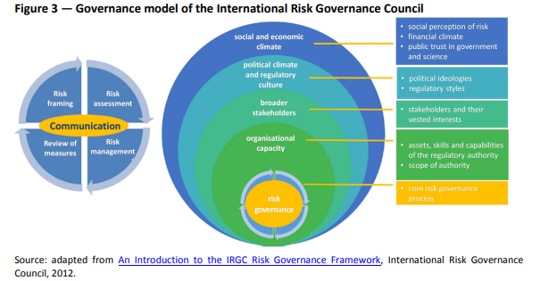

Slide 22
ISO 31000 Enterprise Risk Management
Risk identification – identifying potential sources of risk, areas of impact, events and causes, and their consequences.
Risk analysis - developing an understanding of the risk, including likelihood and potential outcomes.
Risk evaluation – comparing the magnitude of risks to determine which ones need treatment, and the priority.
Risk treatment – planning and implementing methods to modify the risk, such as avoidance, sharing, transfer, reduction and acceptance.
Monitoring and review – continuously tracking the risk landscape and the effectiveness of risk management efforts.

Slide 23
Examples
Toy safety
Food quality assurance
Drug development
Exposure to (potentially) toxic chemicals
Increases in scientific knowledge directly applicable to relaxing (or increasing) regulatory restrictions

Slide 24
The Elephant
in the Room

Slide 25
“Risk Management” is not “Decision-making in a state of Uncertainty”
Risk management assumes outcomes
are known or at least definable ex ante
have reasonably assessable probabilities
are perfectly observable when they occur
The liable parties can control (or at least reliably observe and understand) the circumstances in which the technology is deployed
scientific/engineering/technological precision
definable, observable, controllable, known (and limited) use contexts
every time it is used

Slide 26
ERM, ICTs and AI
Quite appropriate for “traditional” computer engineering applications
symbolic algorithms pursuing increasing accuracy, reproducibility etc.
e.g. “big data” AI models
But not for GPTs
infinite variety and novelty, not precise reproducibility and explainability
where even the developers and the AIs themselves don’t know/can’t explain the outcomes, even ex post
if not logic-based, is meaningful ex post evaluation even possible? (what “science” or formal understanding can be enhanced?)

Slide 27
Existing AI Risk Management Processes
Confined to known or anticipatable scenarios HAI (2024) AI Index Report
cybersecurity
accuracy and reproducibility of human processes
statistical biases etc.
Multiple, unclear objectives
“safety” – but whose, and when/why does it matter?
Focus on avoiding current (limited perspectives of) Western-centric normative social biases
shaping future beliefs, not scientifically reporting current observations
processes biased against allowing the objectives to change
in scientific inquiries, objectives are the one thing that must remain constant

Slide 28
Special GPT Considerations
Initial developer does not control the GPT value chain
subsequent unanticipatable developments by unanticipatable and uncontractable end users
Limits to human cognition
uses not even contemplated yet
unanticipatable interactions with other not-well-understood systems (most human-mediated complex systems, e.g. biologies, economies. ecosystems)
Limits to control, but need to set the applications free
benefits of “innovation GPTs” (General Purpose Technologies, which “AI GPTs” surely are) come over time as new users find new, unanticipated uses for them

Slide 29
Regulations create risk
Regulating to ensure the “Safe, Secure and Trustworthy Development and Use of AI” using a generic (backward-looking, human-constrained) risk management-based framework
is an impossible fool’s errand?
gives false assurance as it promises something it can’t deliver
is extremely transaction-cost intensive
watching and documenting everything intensively just in case something goes wrong
has a chilling effect on innovation/constrains its direction
won’t prevent unanticipatable harms from occurring anyway

Slide 30
Are Legislative Regulations Even Practical?
Global technologies, constrained by local laws
developers might want consistent international standards (reduces costs of bringing new products to market)
but this may not be helpful when there is still so much we don’t know
competition between different standards is preferable in chaotic/complex contexts
The value chain is different
can/should AI developers be held liable for downstream user app development, use by non-contracted parties?
c.f. the freedom from liability given to internet service providers for end-users actions (e.g. US section 230 provisions)
Malicious use and accidental harm are inevitable (and unable to be fully prevented ex ante)
how to deal with harm ex post?

Slide 31
Are LLMs Actually Very Dangerous?
AI Incident Database 2023
123 unique incidents recorded (only 68% more than 2022)
despite exponential uptake and usage of LLMs
Is regulation primarily to assuage anxious consumers?
WEIRD paper
If so, this is a poor use of inappropriate regulation
education is a better policy

Slide 32
A solution?
Focus regulatory activity on specific use cases or industries, not the technology
e.g. medical uses governed by medical regulation; education uses governed by education regulation; employment uses governed by employment regulation; financial uses governed by financial regulation
Embrace uncertainty
explore “insurance” remedies
compensate harms arising
no-fault coverage for developers provided state-of-the-art precautions undertaken (prudent management of known risks but no liability of truly unexpected event occurs) – reduces the chilling effect of existing regulation

Slide 33
AI Regulation:
the EU and the US

Slide 34
Its not an unregulated “wild west”

Slide 35
Not an “unregulated wild west”
All countries have laws governing competition, fair trading, consumer, protection, content censorship, copyright protection etc. to protect citizens
AI firms, applications are all covered by these
Industry self-regulation
voluntary (international) alliances of developer firms and other stakeholders to develop and share standards, best practices, other learnings, e.g.
AI Alliance (includes IBM, Meta, Dell, Oracle and many universities)
AI Governance Alliance (includes OpenAI, Google, Amazon, ByteDance, Microsoft, Meta, Cisco)
interests of end users mostly aligned with deployers (in a commercial sense) – what is good for consumers is profitable for deployers

Slide 36
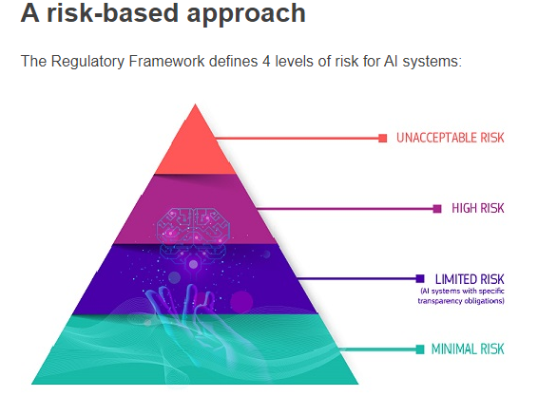
European Union
EU AI Act and EU AI Liability Directive
Draws extensively on product safety regulation, which underpin the GDPR and EU Digital Markets Act
Binds developers, deployers, importers, distributors, operators of AI apps
for any app used in the EU (regardless of where developed, hosted etc.)
Implemented 2 years after signed (not yet occurred)
Notes:
Whose problem? Each stakeholder perceives the problem differently

Slide 37
And not classic risk management either
EU Risk classification not based on ISO 31000 principles
Unacceptable apps: subliminal techniques to impair decision making; exploiting vulnerabilities to cause user to harm others; social scoring; predicting criminal behaviour; facial recognition from internet scraping; inferring emotions in workplace or educational setting; real-time biometric identification in public places
High-risk apps: biometrics; critical infrastructure; education admission, assessment monitoring, directing toward level of participation; employment recruitment and retention decisions; access to or enjoyment of services – eligibility, creditworthiness, pricing life and health insurance; law enforcement; migration and asylum; justice and democracy (plus a list in Annex 1 including things such as AI in children’s toys, based on historic harmonisation principles)

Slide 38
EU continued
Compliance for High-Risk systems
Authorized person to be registered
Documentation required for risk management as per ISO 31000
Strict technical documentation and record-keeping requirements
High level of transparency – “sufficient to enable interpretation of output and use it appropriately” including data sources, tests
Human oversight
Ex ante certification of compliance required before offered
Member states issue; all to have sandboxes prioritising new entrants
Other apps have minimal requirements (mainly just disclosing where an AI has been used)
Strict liability for failure to comply with regulations in the event of harm occurring

Slide 39
EU continued
Separate provisions for General Purpose AI models
Definition based on compute power (greater than 10^(25))
Or has high impact capabilities on yet-to-be-determined indicators and benchmarks
Additional model training documentation required
Except for Open Source model carve-out

Slide 40
EU implications
Most AI apps won’t be subject to any rigorous obligations (including Open Source)
so will inevitably generate some unexpected harms
“High-risk” apps have very high administrative overheads
not because of inherent model risks specifically, but because they are applied in sectors/areas where harm will not be tolerated
greater obligations than “human apps” in the same sectors?
high costs, penalties for unexpected outcomes borne by developers and deployers
even though harmful outcome could not have been reasonably foreseen
inevitable chilling effect on innovation and deployment
“Sandboxes”, “red-teaming” also limited by current knowledge
human biases in setting benchmarks, developing scenarios

Slide 41
United States
No explicit Federal legislation (so far), but
White House Executive Order on the Safe, Secure and Trustworthy Development and Use of AI
individual states are moving (e.g. California, SB 896)
focus on apps developed by, used in Government
National Institute of Standards and Technology
principled framework for AI Risk Management
further developments for Generative AI
National Telecommunications and Information Administration
Accountability Policy guidelines
Office of Management and Budget
rules for government departments and agencies

Slide 42
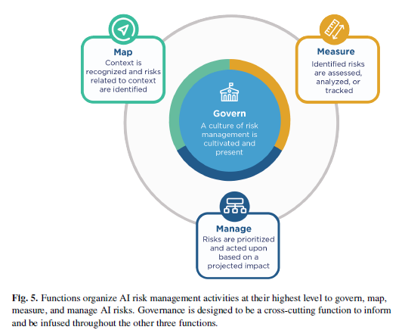
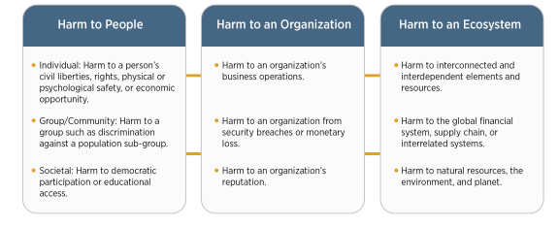
The NIST (US) Approach
Based closely on ISO 31000
Broad focus

Slide 43
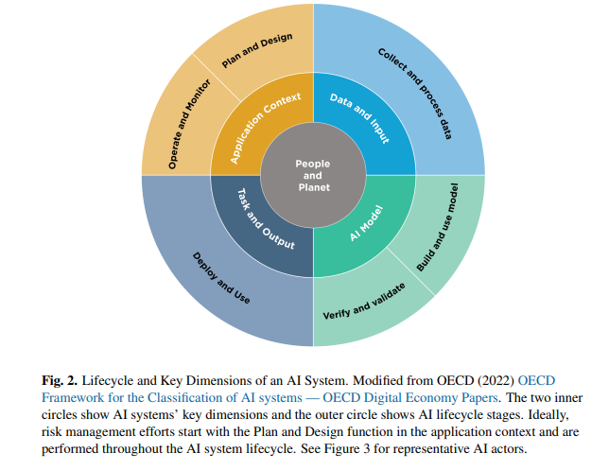

Slide 44
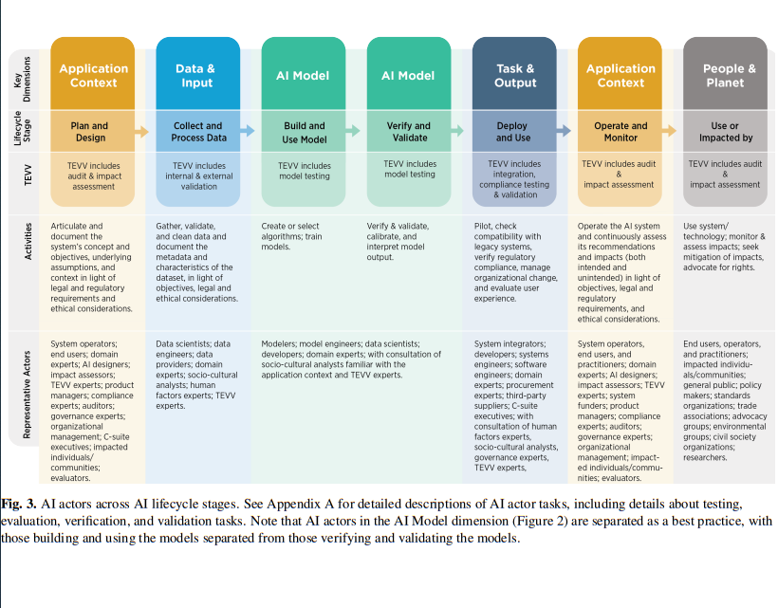

Slide 45
Voluntary Adoption Strongly Encouraged
Documentation, transparency etc
Playbook facilitates compliance
72 areas (19 Govern; 13 Manage; 18 Map; 22 Measure)
impact assessment and risk management
measurement where feasible
specifically addresses adversarial testing, risky emergent behaviour, privacy, bias, fairness, constant improvement
Well-supported within government and industry
reflected in firms’ internal policies (e.g. Microsoft Responsible AI Standard)
likely formulated with strong input from them
But GPTs go into completely new territory
472 action areas in the NIST Draft Generative Artificial Intelligence Profile

Slide 46
US Implications
No single set of rules, standards
competition in standard-setting good when we don’t have good sector understanding
the “best” rules will reveal themselves over time
firms must choose which set of standards to adopt
meantime incur high costs complying with all or only most stringent
all app providers must make conscious choices over compliance, disclosure (no “free pass” as for low-risk EU apps)
Consumers, users, must play their part too
share some of the risks, but will get earlier access to benefits
need to ensure good information is available to facilitate checking relevant disclosures

Slide 47
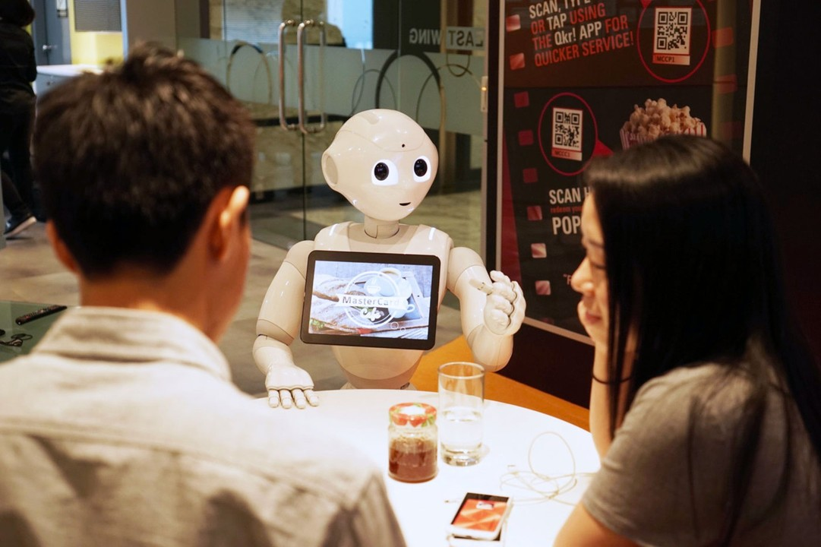

Slide 48
If we make AIs that act like humans, then should we govern and manage them more like we govern and manage humans (not as we govern and manage machines operating under human control)?

