Slide 1
Overview
AI is already having significant impacts on work. This talk explores three different but related aspects of the question of AI’s impacts on work. First, the concept of work is explored, examining its philosophical foundations. I argue that work is best thought of as a pluralistic entity – that “work” does not adhere well to any singular definition/characterisation. Next, the likely impacts of AI on economic work are explored, according to recent reports/predictions. And finally, policy options which could deal with AI’s impacts on work, and their impacts on wellbeing, are considered for different possible AI scenarios - such as if progress slows, or if AI reaches beyond human-level capability across most or all work-tasks.

Slide 2

“Work” in the age of AI
Daniel Guppy
19/09/25
PhD candidate, Philosophy,
University of Otago
Image: Midjourney – “artificial intelligence doing work”, 2022

Slide 3
“Work” in the age of AI
Background: I recently completed my PhD in philosophy at the University of Otago, focusing on the potential impacts of AI on work.
The purpose of the talk is very broad – to consider what we should do, if anything, about AI’s impacts on work. I won’t have all the answers.
Background
What is work? (Philosophy of work)
If work is done to improve wellbeing, what does the data show about work and wellbeing?
How will AI likely impact on work?
What could be done about this? (Policy)

Slide 4
AI’s impacts on work
Artificial intelligence can now do a LOT of things:
Video (Genie3, Sora)
Agentic AI
Programming
Gaming (MuZero beat Go, Atari games; AlphaStar can beat Starcraft)
Protein folding (AlphaFold basically solved the protein folding problem)
Solving maths problems
Diagnosing better than doctors, and being more empathetic
Large language models (GPT-5, Claude, Meta AI, Deepseek)
Speech-to-text/text-to-speech
Music/art
Tesla Bot
Notes:
AlphaStar beat a pro player 5-0.

Slide 5
Reflections: here is a slide I made in 2022:
What will AI be able to do soon?
Given the developments above, it seems in not too long a time (within 0-10 years), AI will be able to do things like:
You say “write a program that does x” or “add a profit column, with values, to the spreadsheet” or “add John Doe from Google as a lead and email him with my Calendy and ask for a 30 minute call” and it does.
You upload a pdf of essay instructions, and it can write a very good essay for you, to your specifications.
It tracks the work you do on your computer, and later on, once it’s gathered data, you say “write my monthly report” and it does it for you.
You input something like “make a short movie about a 12 year old girl in India finding out about good communication and life lessons through economic struggles and her connections” and it makes one.
Do narrow manual labour tasks, if we get the hardware and data right.

Slide 6
AI and jobs
In 2017, according to the McKinsey Global Institute:
“currently demonstrated automation technology has the potential to affect activities associated with 41 to 56 percent of global wages depending on country (Exhibit 10). This amounts to about $14.6 trillion in wages and the equivalent of 1.2 billion workers.”
So, technology 8 years ago was already in a place where 50% of labour time (based on tasks) was automatable.
This suggest uptake/market response is a significant factor (and/or they were incorrect).

Slide 7
Philosophy of work
The philosophy of work usually refers to:
What work is.
What the value of work is.
How work relates to society (e.g., anthropology, justice).
2 and 3 have received a lot of attention. I will focus a lot on 1.

Slide 8
What is work?
I present various key thinkers’ ideas on the meaning of work.
  Anthropology
  Historical economics/political philosophy
  Philosophy of work
  Modern economics
I critique each thinker’s ideas.
Later, I present my own ideas regarding characterisations of work.
I recently published a paper on this in AI and Ethics.

Slide 9
Suzman/anthropology
James Suzman (2020) states that:
"The closest thing to a universal definition of ‘work’ – one that hunter-gatherers, pinstriped derivatives traders, calloused subsistence farmers and anyone else would agree on – is that it involves purposefully expending energy or effort on a task to achieve a goal or end." (p8)
Criticism: this is far too broad – I could be playing football and thus working, according to Suzman, or lying down to get rest.

Slide 10
Locke (1689)
“…every man has a “property” in his own “person.” This nobody has any right to but himself. The “labour” of his body and the “work” of his hands, we may say, are properly his. Whatsoever, then, he removes out of the state that Nature hath provided and left it in, he hath mixed his labour with it, and joined to it something that is his own, and thereby makes it his property. It being by him removed from the common state Nature placed it in, it hath by this labour something annexed to it that excludes the common right of other men. For this “labour” being the unquestionable property of the labourer, no man but he can have a right to what that is once joined to, at least where there is enough, and as good left in common for others.”

Slide 11
Locke
For Locke, work is essentially labour that transforms matter.
Criticism: not all of what we would call ‘work’ transforms matter. A psychologist helping someone, or a security guard watching a camera are not really doing this.
In response, Locke could make an exceptionally broad claim about what ‘transforming matter’ is to include changes in brain-states or any material changes whatsoever, but this would then include almost anything we do (e.g. breathing).

Slide 12
Smith (1776)
“But though labour be the real measure of the exchangeable value of all commodities, it is not that by which their value is commonly estimated…
There may be more labour in an hour’s hard work than in two hours’ easy business; or in an hour’s application to a trade which it cost ten years’ labour to learn, than in a month’s industry at an ordinary and obvious employment. But it is not easy to find any accurate measure either of hardship or ingenuity. In exchanging, indeed, the different productions of different sorts of labour for one another, some allowance is commonly made for both. It is adjusted, however, not by any accurate measure, but by the haggling and bargaining of the market, according to that sort of rough equality which, though not exact, is sufficient for carrying on the business of common life.”
“Labour alone, therefore, never varying in its own value, is alone the ultimate and real standard by which the value of all commodities can at all times and places be estimated and compared. It is their real price; money is their nominal price only.”

Slide 13
Smith
Smith sees labour input as where the real value of a commodity lies, and its monetary value only its nominal price.
This is different to how we usually think about value nowadays: basically, as supply and demand.
Criticism to come after Marx…

Slide 14
Marx/Marxists (1867)
“A use value, or useful article, therefore, has value only because human labour in the abstract has been embodied or materialised in it. How, then, is the magnitude of this value to be measured? Plainly, by the quantity of the value-creating substance, the labour, contained in the article. The quantity of labour, however, is measured by its duration, and labour time in its turn finds its standard in weeks, days, and hours. Some people might think that if the value of a commodity is determined by the quantity of labour spent on it, the more idle and unskilful the labourer, the more valuable would his commodity be, because more time would be required in its production. The labour, however, that forms the substance of value, is homogeneous human labour, expenditure of one uniform labour power.

Slide 15
Marx
Marx and Smith essentially agree. Labour is where the real value of a commodity lies, and its monetary value is only its nominal price.
However, Marx went further than Smith. Marx had the idea that uniform “labour power” is the value input which determines the actual final value.
Criticism: Machines mean less labour is necessary to create a product, meaning labour power input differs for the same products. Marxists could argue that labour power has been put into the machine too, which is a part of the labour power of the final product. But, this principle could extrapolate all of the way back to cavemen creating fire, which seems unreasonable. Perhaps value is determined by the market / supply and demand?

Slide 16
Arneson (philosophy of work)
Richard Arneson (2016), in Routledge’s Work, philosophy of, states that:
“Work is effort directed at some goal other than enjoyment taken in the experience of putting forth the effort. In contrast, play is effort that is not aimed at any goal beyond the enjoyable experience of that very effort…Tying my shoelaces is not typically work, even though the activity is goal directed, because the effort involved is too slight (p 1).”
Criticisms: Some people enjoy their work. Also, this idea of “too slight” effort makes little sense. If I found it very difficult to tie my shoes, Arneson would seemingly have to agree on some sort of effort threshold, after which my activity very suddenly becomes work with a minimal effort increase.
Note: this is very different to historical ideas we’ve seen so far. This is about effort and goals, and previously work has been about some labour input creating value.

Slide 17
Danaher (2017)
Work is: “The performance of some act or skill (cognitive, emotional, physical etc.) in return for economic reward, or in the ultimate hope of receiving some such reward.”
Danaher defines this to only apply to certain contexts, and likely would admit the following criticisms.
Criticism: This definition does not include unpaid work such as housework, charity work, etc. It also does not allow for someone to put extra work into a task aside from the rewards which it produces. So, putting energy into something where money is not relevant would not be work.

Slide 18
Cholbi (2022)
“Still, work appears to have as one of its essential features that it be an activity that increases the objective (or perhaps intersubjective) value in the world. Some human activities are therefore arguably not work because they generate value for the actor instead of for others.”
Criticism: this means that any activity that does not increase the objective value in the world (whatever that means) would not count as work. This would mean tobacco salespeople, tax lawyers for the rich, etc. could not be counted as doing work, if these are net-negative. This seems far too constraining a conception of work.

Slide 19
Marshall (economics, 1920)
“We may define labour as any exertion of mind or body undergone partly or wholly with a view to some good other than the pleasure derived directly from the work”.
Criticism: this seems to encompass far too much, such as breathing, pushing yourself too hard at sports, or helping grandma around the house [though perhaps this isn’t work??].
Note: none of the criticisms I’ve made are really knock-down arguments – they depend on the nuances of how you define work.
But, we can conclude that people definitely disagree on what work is.

Slide 20
Weiss (2009)
“A straightforward “economic” answer is that work is any time activity for which we receive a positive wage.”
“A person stops working only when the marginal disutility of work exceeds the marginal utility of the consumption derived from additional work, which is presumed positive when the wage is positive. Hence, operationally, any time activity that a person sells at a positive wage is labor.”
“…leisure may be defined as the time that is under the control of the individual, irrespective of the way it is used, and work can be defined as time that is under the control of others.”

Slide 21
Weiss
Weiss thinks that work is whatever we do to receive a positive wage.
Any time sold at a positive wage is labour, and people stop working when the marginal utility of working is lower than the marginal utility of leisure.
He also thinks that work is time under the control of others, and leisure is time under the control of oneself.
Criticism:
1. This doesn’t fit with other ideas of work. It seems we can do work-like things, such as work for free for a charity shop, and Weiss would not consider this to be work due to lack of wages.
2. Some people work for themselves. Thus, as they are under their own control, they are not working according to Weiss?

Slide 22
The (simplified) ‘standard’ neoclassical economic view
I’m sure this is contentious but I don’t think it’s worth quibbling over.
Work is what creates overall monetary value (e.g. to a firm). The marginal revenue product of labour is the amount a worker is worth to the firm in terms of outputs (after accounting for expenses), and this is supposed to be equal to their wage.
Criticism: this has nothing to do with labour inputs – what I’m doing. One might think that work is done by activities, but work here is defined in terms of outputs. Also, this would mean a machine can perform labour when it creates value [and perhaps it can?]. It’s also disputable that people are actually paid at their marginal value – workers often create more value than they are paid. And, am I working whenever my stocks go up (and thus own more money)?

Slide 23
Where to from here?
Clearly, this needs more clarity. There are wildly different interpretations of what ‘work’ means. What’s the best approach?
Questions so far?

Slide 24
Pluralism about work
People don’t agree on what ‘work’ is.
I propose that we can think of ‘work’ as having multiple allowed characterisations or meanings.
I will make a list of reasonable characterisations of work.
First, I present conceptions of work that don’t make much sense upon further consideration. For these, I won’t give full reasons as to why I discount them, due to limiting the length of this talk, but I’m happy to discuss later. Then, I present the most promising conceptions.

Slide 25
Conceptions of work that won’t work
Work as manual labour
Work as change of material substance
Work as non-leisure/non-play
Work as thinking that one is doing work
Work as based on feeling towards the work (usually ill-feeling)
Work as market-valued output
Work as activity in a workplace
Work as tasks done from an objective list of tasks

Slide 26
Conceptions of work that show promise
Energy work: work as energy or effort input.
Agreement work: work as an understood (or contracted/agreed upon) activity, role, or goal to be undertaken, usually done in exchange for something of economic value.
Income work: Work as activity done, at least one of the purposes of which is to receive something of economic value in return
Service work: work as any activity done, at least one purpose of which is to provide value to another.
Economic work: work as contributions to marginal revenue product of labour.
Good work: work as activity expected to provide net benefit to society.
Volunteer work: work as activity done that provides value and where one is not paid. Often someone in similar circumstances would be paid to undertake such an activity.
Goal work: work as activity expected to progress a task/goal.
Notes:
I’m still refining a few of these

Slide 27
Wellbeing

Slide 28
Considering wellbeing regarding work
Work is a large part of our lives.
Is it better for us if we work, or if we don’t work?
Bertrand Russell (1935) was “In Praise of Idleness”.
Keynes thought in 1930 that we would soon “solve the economic problem”. He predicted that in 100 years we could all be working a 15-hour work week.
Others think that work is good for us as it stops boredom, gives us purpose, and helps to us contribute something useful.
So, is work good for us?

Slide 29
Wellbeing theories (psychology)
Psychologists tend to either:
  1. Have theories about wellbeing, or
  2. Try to measure it directly (e.g. through experience sampling, or asking questions about quality of life).
Some of the key theories are: PERMA and Positive Psychology, Self-Determination Theory, the Capabilities Approach, or specific work-oriented theories such as the Job Characteristics Model.
Some of the key aspects from these, which make work good for wellbeing, are: autonomy; competence; positive relationships; engagement, meaning, or purpose; and variety.

Slide 30
Wellbeing measurements and findings (hedonic)
Researchers tend to directly measure wellbeing through questionnaires (e.g. life satisfaction), or experience sampling.
Some of the findings relevant to work are:
  In general, doing work correlates with positive wellbeing. Unemployment has worse outcomes for wellbeing, particularly for the previously self-employed.
  Relationships matter a lot for wellbeing. Relationships with managers are especially important.
  Income has some small impacts on wellbeing (logarithmic improvement).
  Some work might provide all of the wellbeing benefits of work. A couple of studies suggest that a small amount of work (e.g. just 8 hours per week) can suffice.
  Retirement is roughly neutral-good for wellbeing, but the verdict isn’t out. This suggests the story isn’t as simple as “not working is bad for wellbeing”.

Slide 31
Philosophy of wellbeing
A lot of the data on wellbeing is used in this hedonic sense.
We can establish that hedonic wellbeing is an essential aspect of wellbeing if it is essential in each individual prominent wellbeing theory in philosophy.
The main theories of wellbeing in philosophy are:
  Hedonism (the positive or negative experiences of moral patients matters)
  Desire theories (you have higher wellbeing if you get what you want)
  Perfectionism (to live a good life is to best develop one’s human nature)
  Objective list theories (“certain things are good or bad for people, whether or not these people would want to have the good things, or to avoid the bad things” (Parfit, 1987). Subjective goods are included).
I find that all of the above wellbeing theories (except for some styles of perfectionism, which are predominantly not endorsed by perfectionists) endorse a hedonic component of wellbeing.
Thus, in using wellbeing data based on hedonism, we can be confident that philosophers of wellbeing also agree that this impacts wellbeing similarly.

Slide 32
Wellbeing for different jobs
Most people report being satisfied with their jobs, but at the same time a lot of people are “quiet quitting” (59%) or “actively disengaged” (18%).
Stiehl et al., 2019:
  Wellbeing tends to be higher for things like business owners, professionals, managers, and farming/fishing workers.
  Wellbeing tends to be lower for clerical/office, service, manufacturing/production, and transportation workers.
PayScale, 2021:
  Jobs where one is supporting others (doctors, teachers, clergy, etc.) tend to have higher wellbeing.
  Those focused on more narrow and socially isolating tasks (parking lot attendants, machine operators, dishwashers, etc.) tend to have lower wellbeing.
Self-employment is generally good for wellbeing.

Slide 33
Wellbeing - summary
Wellbeing from work seems to be mainly based on what the job tasks are, and other work factors such as relationships with others and level of autonomy. Income has some impact on wellbeing, but less than other factors.
A lot of people are disengaged from their work. Perhaps they find it satisfying compared to other work they might do. I personally suspect from what we can see that most people would choose not to work as they do now if they could (controlling for other factors).

Slide 34
AI’s impacts on work
I guess we should talk about…
The industrial revolution…

Slide 35
The Industrial Revolution
Very very broadly (sorry, history buffs)…
Starting around the 1750s in England, people moved into the city as rural jobs declined.
Work was hard. Productivity increased, but many also became very poor.
It was not smooth sailing as machinery technology evolved.
Energy and resourcing was far more plentiful than it had ever been.
Enlightenment thought had some influence on the culture of invention and ingenuity.
At first, laissez faire ran rampant. After awhile, people realised that government really needed to deal with things like child labour, lacking infrastructure, urban design, and public health.
Jobs changed, and frictions were difficult, but ‘jobs’ (as a whole) did not disappear. Humans still found a comparative advantage in machine creation, operation, and management. Later, services became big.

Slide 36
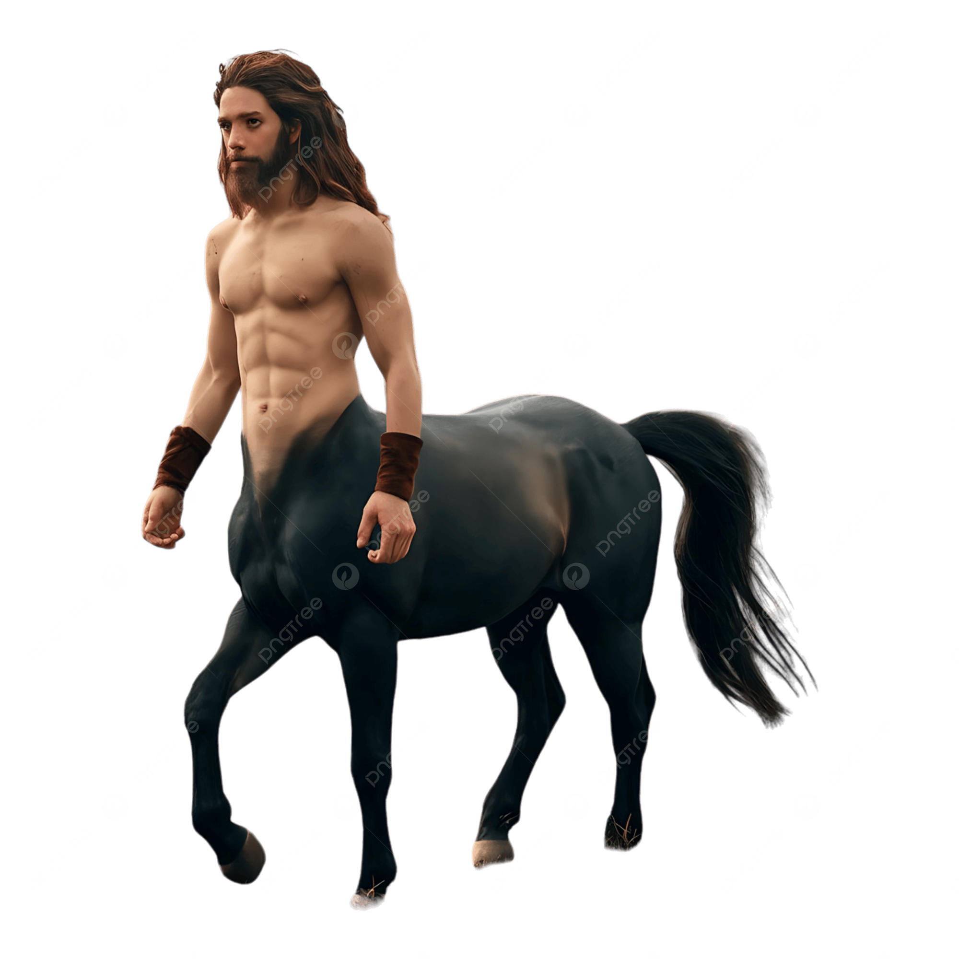
Will AI be the same?
The industrial revolution meant that:
  Energy and resourcing was significantly enhanced
  Trade boomed
  Towns/cities became dominant centres of economic activity
  Mechanical problems were largely solved through machinery
  Firms streamlined the production process and economic output
  Government (sometimes) regulated where needed
Crucially, the question for us is: what were humans left to do?
Humans’ comparative advantage changed, including a move to services.
In the US, in 1850, 60% of jobs were still in agriculture. It is now less than 2%. Jobs can change a lot with new technologies!
We don’t use horses anymore, and for good reason.
https://png.pngtree.com/png-clipart/20240828/original/pngtree-centaur-man-png-image_15873945.png

Slide 37
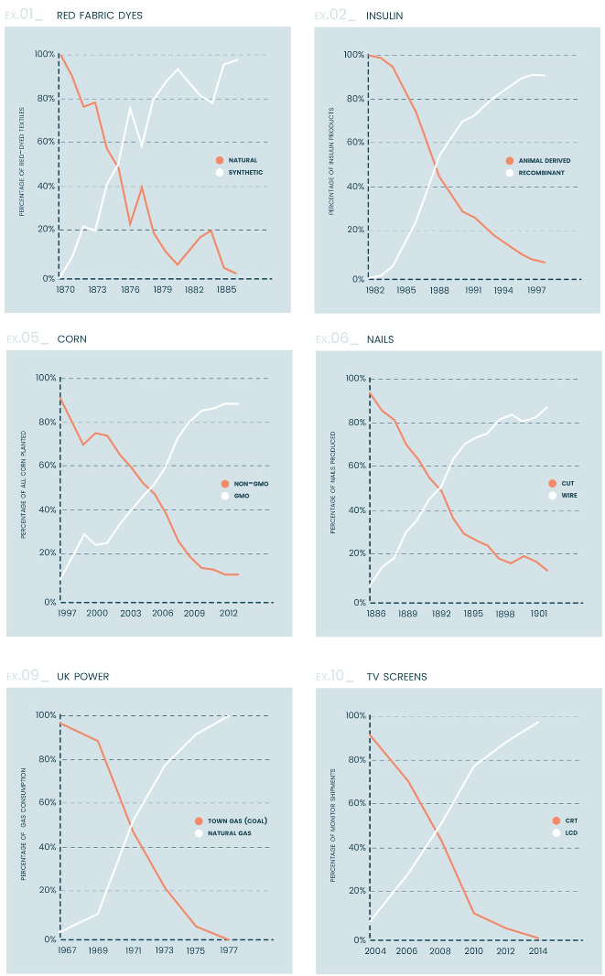
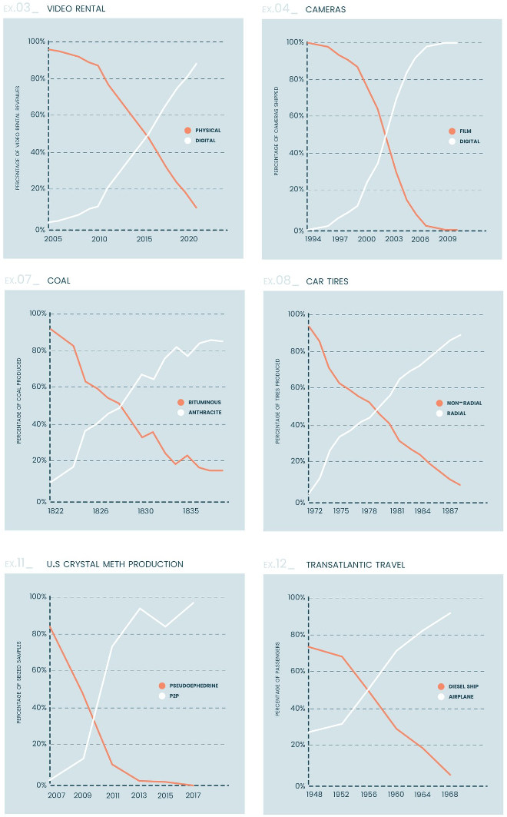
Seba, Dorr and Libby, 2024
RethinkX

Slide 38
Why do tasks get automated?
The question for us moving forward is:
“What will humans be able to do more cheaply than automation can do?”
If we have no marginal advantage (including but not limited to costs), why would firms hire humans over machines?
Usual responses:
  “AI will never be able to _____”
  “We’ll still want the ‘human touch’”
  “We will want human oversight over _____”
  “We can just make AI so it complements jobs rather than substitutes them.
I don’t find these responses particularly convincing.
I think if/when AI gets actually better at everything, we will want to use AI for everything. The real problem is how we interact with ‘work’, and not with AI.

Slide 39
Diffusion of technology
We should also consider the diffusion/adoption of technology. This doesn’t happen instantly.
Considering other general-purpose technologies:
  Electricity took over three decades to reach a diffusion level of over 50%.
  Microprocessors took decades to be useful for home computers.
  The internet was not quite as slow – dial-up could be used through phone cords, but for fast internet it needed better cables to be laid.
  Cloud computing adoption happened quite fast.
Lessons/considerations:
  Technological diffusion takes time
  Available infrastructure affects technological uptake
  Businesses do not instantly switch to a new technology (especially small businesses)
Conclusion: Online AI will/is being adopted quickly. Robots might take time.

Slide 40
How should we think about the likely impacts of AI on work over time?
Most contemporary studies look at how AI might affect jobs with currently available technology. This would be in order to ensure they are not doing too much speculation.
AI is also very unpredictable. I don’t think many people suspected GPT-3 would be as good at writing as it was, and to start the modern AI revolution. I didn’t predict that GPT-5 would still be pretty terrible at editing images and object recognition and modification.
AI is also getting very good at coding, among other things. Will the next leap be where AI is able to self-improve? Or will it not be creative or reliable enough?
For now, what are the likely impacts of currently available AI?

Slide 42
Which jobs are most affected right now?
According to a couple of sources (Felten, Raj and Seamans, 2023; Acemoglu et al. 2022; (Di Battista et al., 2023; ) that I put some credence in:
  Trades, sustainability, and digitisation are least exposed.
  Language, literature, history, and law teaching; office/admin; bank tellers and related clerks; cashiers; legal services; insurance brokerage; business services and educational services are the most exposed to AI.
Note: I would be surprised if education took as big a turn as implied by these studies, but the rest are somewhat unsurprising. E.g. AI phone support is increasing considerably.
And we don’t know what it will be good at next.

Slide 43
What will happen, and how can we cope?
A lot of people are concerned with AI taking basically all of the jobs.
This is a major concern, but definitely not the only one.
AI could be extremely disruptive to the economy. Although diffusion of technology often takes time, AI could significantly shift jobs, and leave people who previously had marginal advantages with no advantages. There could be ‘unemployable’ people.
We should be careful about the disruption that AI could cause to jobs, especially if it is more substituting than complementary.
Graetz and Shapiro (2020) are concerned that:
  “The challenge is less that robots will make humans redundant and more that changing technologies perpetually require people to develop new skills.”

Slide 44
Diffusion of technology
We should also consider the diffusion/adoption of technology. Diffusion doesn’t happen instantly.
Considering other general-purpose technologies:
  Electricity took over three decades to reach a diffusion level of over 50%.
  Microprocessors took decades to become useful for home computers.
  The internet was not quite as slow – dial-up could be used through phone cords, but for fast internet it needed better cables to be laid.
Lessons/considerations:
  Technological diffusion takes time
  Available infrastructure affects technological uptake
  Businesses do not instantly switch to a new technology (especially small businesses)
Conclusion: AI will/is being adopted quickly.

Slide 45
What are the possibilities?
Here are eight possible worlds for us to consider:

Slide 46
What would we expect in different scenarios?
Briefly, as AI gets better, jobs will change more.
We should be worried about ‘unemployable’ people.
The exception could be in some of the trades for a while, which require fine mechanical movements that we have not yet solved.
Or AI progress could completely stall.
Other workers will surely need to retrain, unless we reach AGI.
If we want to keep our system of performing economic work in return for money/goods, the best-case scenario is where AI improves slowly and people have time to retrain, and are supported by the government in their retraining efforts.

Slide 47
Fast AI progress/AGI worries
Concentration of power.
Huge and rising inequality; poverty; class divisions; disenfranchisement.
Owners of capital continue to control more and more of society.
AI is used to do bad things, and is competent. E.g. AI is used in financial markets, one algorithm is far superior and collects all the wealth.
AI does almost all work and most people are unable to compete, and there are few social safety nets.
Huge negative effects on wellbeing from jobs changing, loss of economic work, and poverty/inequality.
The possibility of economic collapse. If people don’t have money, what happens to the economy? This might be unlikely, but possible.

Slide 48
Policy solutions for various scenarios
There is a variety of things that we could do about this:
  Increase taxation to support those who need it.
  A Universal Basic Income (UBI), or an income guarantee
  Retraining support
  Increasing current social safety nets, especially those for job transitions (e.g. covering a percentage of wages upon job loss)
  Working hour decreases
  Other wellbeing support (e.g. community involvement or workplace wellbeing)
  Distributing AI’s benefits (e.g. through (partial) public ownership)
  IP and antitrust laws could be used or modified to ensure everyone benefits
Which of these are used might depend on where we find ourselves.

Slide 49
UBI
Each member of a community (e.g. adult resident citizens of a country) is entitled to the some no-strings-attached amount of money, often such that they can live a life free from economic insecurity.
Morgan and Guthrie (2011) found that a UBI of about $11 000 to each NZ adult resident would be possible, with their suggested changes to taxation.
Broadly, the lesson from this is that right now a full UBI is likely not possible. But, in future, productivity gains from AI, and cheaper goods due to AI, could make a UBI affordable.
We could plans the seeds for a UBI. Korinek (2023) suggest a “seed UBI” – a small UBI that sets up the system for a full UBI when it is needed.
  E.g. India has implemented such a system for biometric identification at a cost of US$1.16 per person (Gentilini et al., 2020).

Slide 50
Justifications for a UBI
(accompanied by taxation or other means of government revenue)
Poverty eradication
A set level of wealth distribution/more equality
Wellbeing enhancement
A considerable simplification of the social support system
A large reduction in the psychological burden and stigma associated with receiving social support
Comprehensive coverage of the population, and income security
Elimination of poverty/unemployment traps
Rawlsian justice/freedom (Van Parijs, 1991)
UN declaration of human rights:
  “Everyone has the right to a standard of living adequate for the health and well-being of himself and of his family, including food, clothing, housing and medical care and necessary social services, and the right to security in the event of unemployment, sickness, disability, widowhood, old age or other lack of livelihood in circumstances beyond his control”.

Slide 51
Again, the tools we have are:
Increase taxation to support those who need it.
A Universal Basic Income (UBI), or an income guarantee
Retraining support
Increasing current social safety nets, especially those for job transitions (e.g. covering a percentage of wages upon job loss)
Working hour decreases
Other wellbeing support (e.g. community involvement or workplace wellbeing)
Distributing AI’s benefits (e.g. through (partial) public ownership)
IP and antitrust laws could be used or modified to ensure everyone benefits

Slide 54


