Slide 1
^{The Algorithm Charter} (and other ways to build trust)
^{Emma MacDonald}
Centre for Data Ethics and Innovation

Slide 2
An unofficial Government 101 – who what where and how
Minister
Common Minister
Ministers
The CEs
Stats
DIA
GSISO
MBIE
System leads
Data
Digital
Information Security Lead
Digital Government
Government Statistican
AI in government
AI security
AI and the economy
Agencies doing AI
The AI space

Slide 3
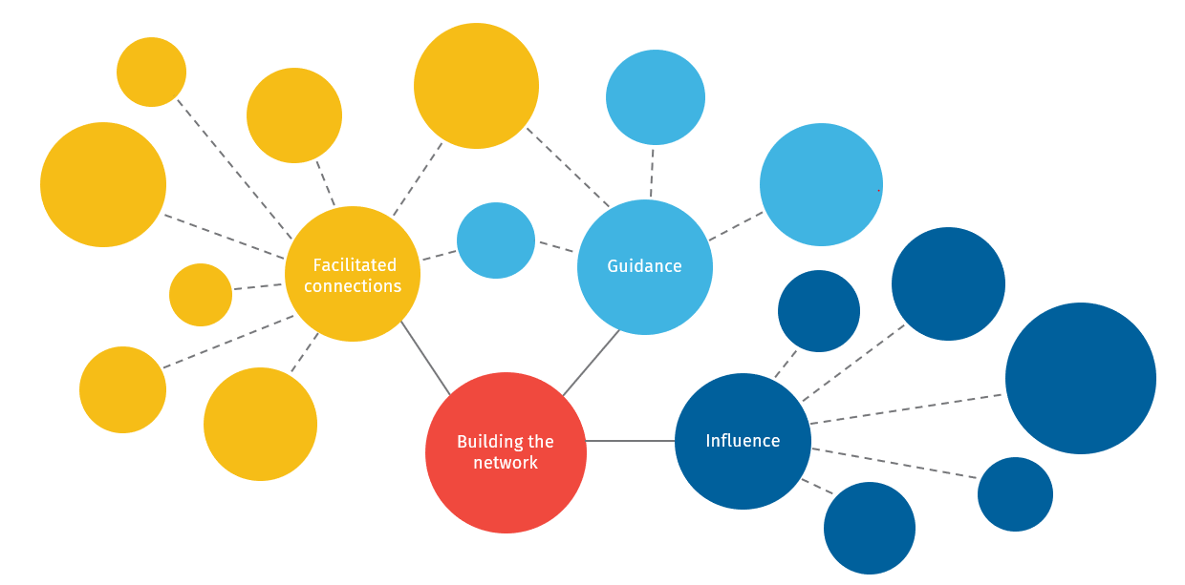
The Centre for Data Ethics and Innovation
Pūtahi mō ngā Matatika me te Auahatanga Raraunga
CDEI TEAM
3.5 FTEs
ENGAGE
Data Ethics Games
Workshops & Newsletters
A lot of coffee
ADVISE
Curate relevant guidance incld the Algorithm Charter
Data ethics training options
NETWORK
Expert directory
Algorithm CoP
Wānanga & Conferences
SUPPORT
DEAG
Data Ethics 101 & introduction
Human Libraries
+ network
of 500+

Slide 4
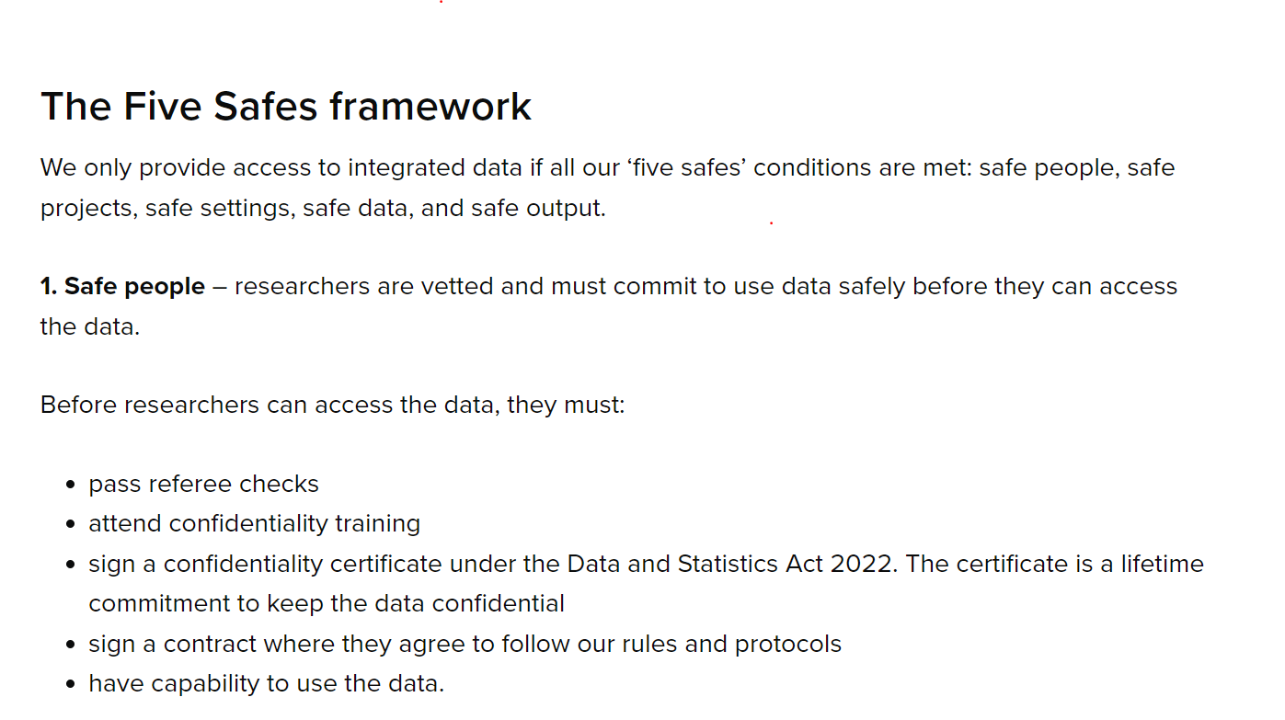
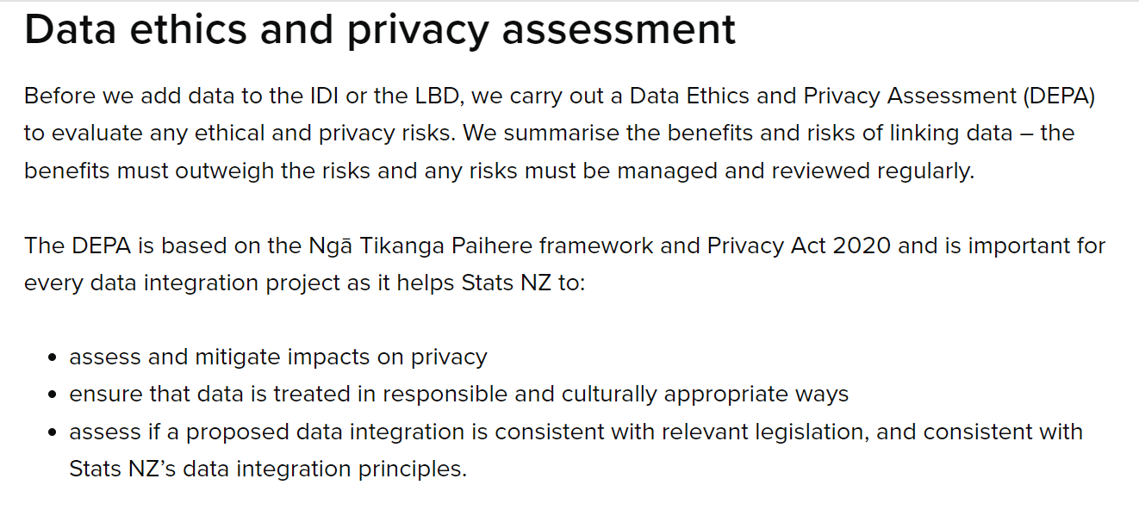
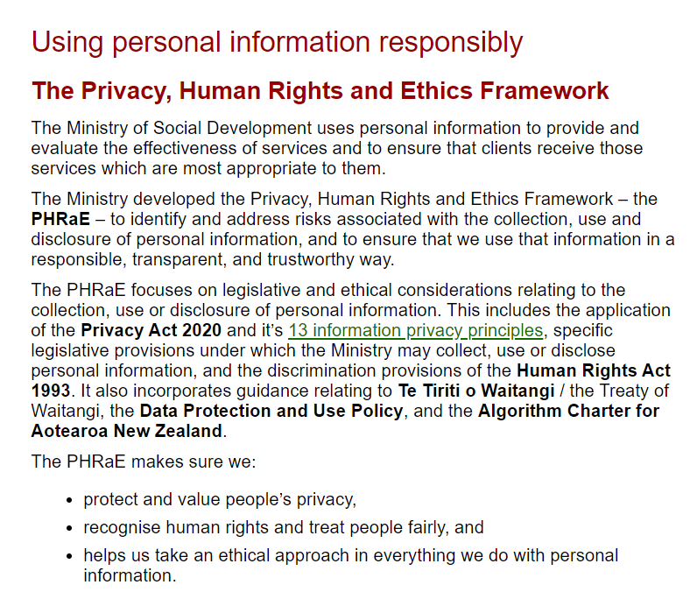
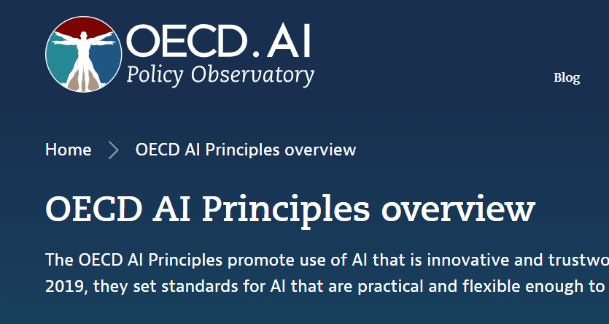
The guidance

Slide 5
Algorithm Charter for Aotearoa
Launched in July 2020
For government agencies
Voluntary commitment
Aims to improve transparency and accountability
Focus on high-impact algorithms

Slide 6
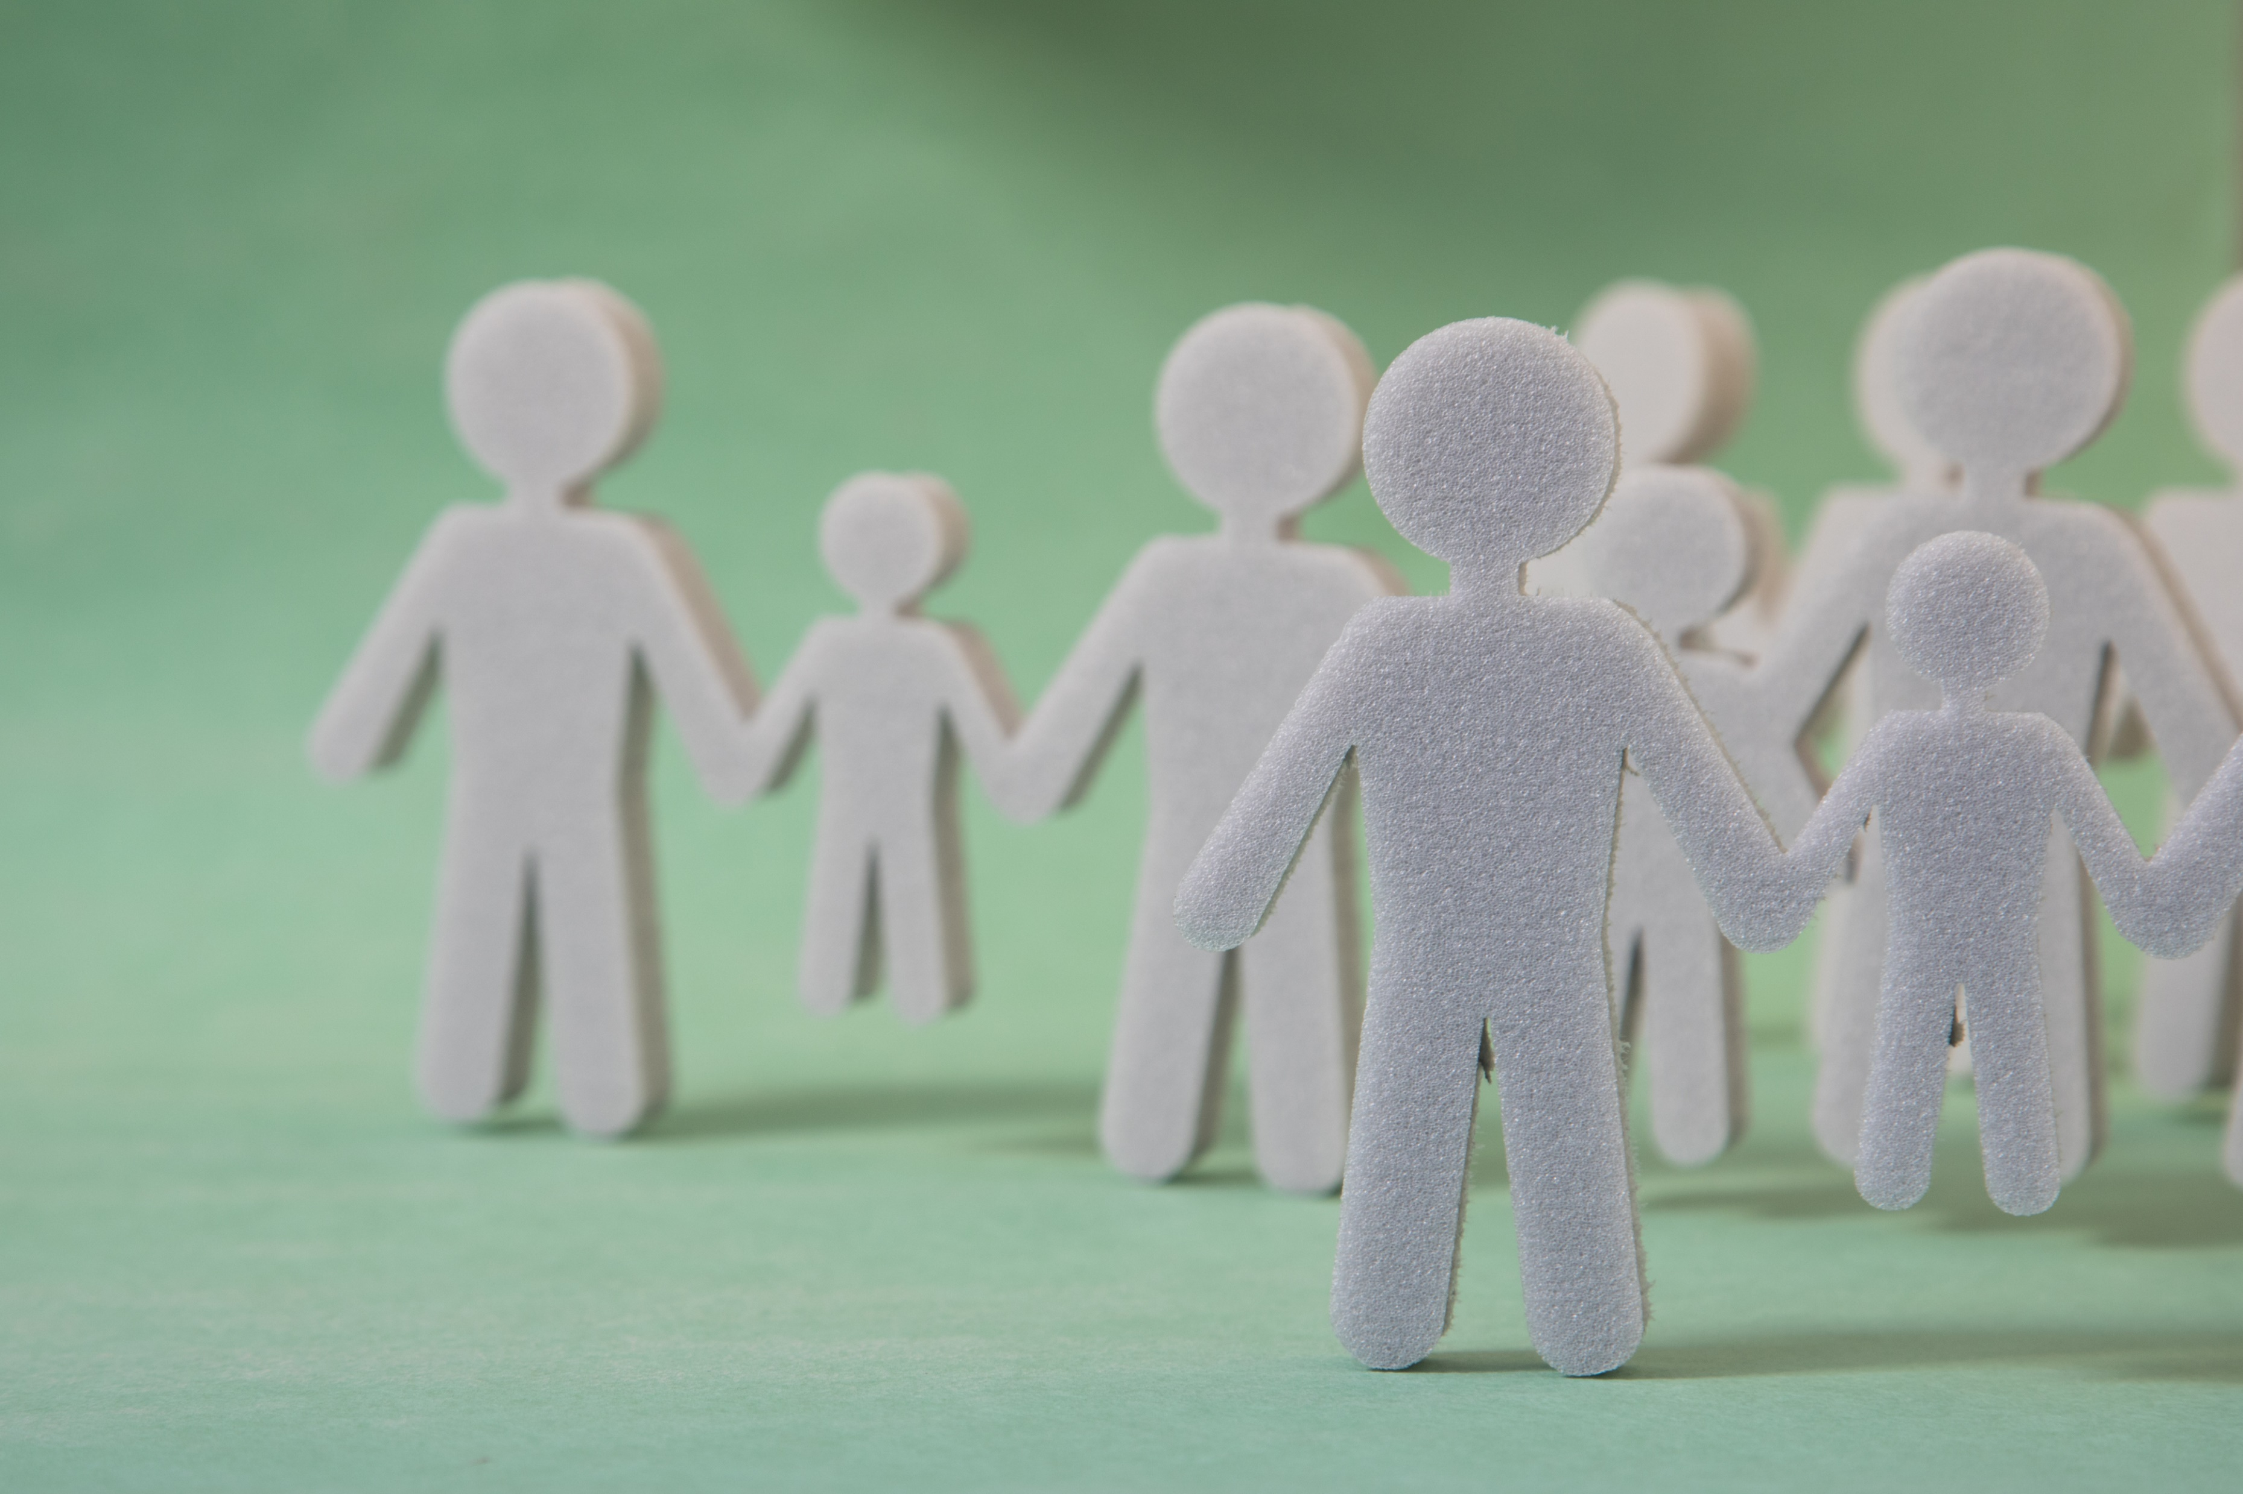
Transparency
Partnership
People
Data
Privacy, Ethics & Human Rights
Human Oversight
Principles
- in action

Slide 7
The Charter was reviewed in 2021.
Stats response
Phase 1 Strengthened Guidance and Best Practice
Phase 2 Transparency and Engagement
Phase 3 Oversight and governance

Slide 8
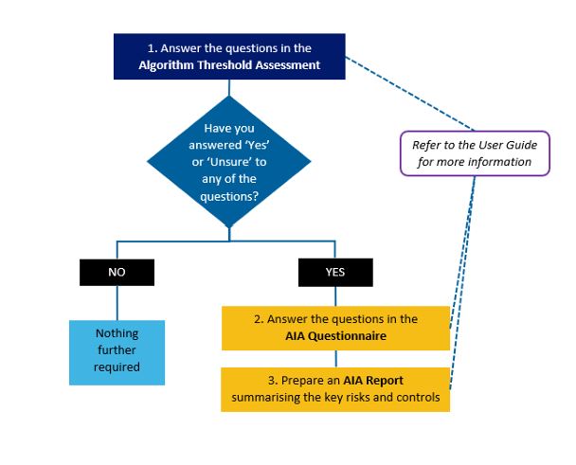
Algorithm Impact Assessment Tool
• Conduct early
• Involve a multi-disciplinary team
• Scalable approach
• Living document
• Transparency

Slide 9
Initial screening for high-risk algorithms that may have a ‘material impact’ on individuals, communities, or other groups.

Slide 10
Community of Practice
Share information, experience, challenges and practice.

Slide 11
CDEI is looking to more creative ways to engage
people-diverse-auckland-iStock-906600056.jpg, jpg File, Private, Modified 17/02/2022, edited by Joel Wearne, 4.46 MBpeople-diverse-auckland-iStock-906600056.jTS682813_l.jpg, jpg File, Private, Modified 21/12/2022, edited by Peter Badalamtechnology-phone-computer-pexels-rodnae-productions-10376172.jpg, jpg File, Private, Modified 04/10/2022, edited by Joel Wearne, 4.83 MBtechnology-phone-computer-pexels-rodnae-productions-10376172.jpg
October 4, 2022
enti, 852 KBTS682813_l.jpg
December 21, 2022
pg
February 17, 2022

Slide 12
And the start of a conversation …

