Slide 1
The Social Media Ban in Australia: Protection or Prohibition?
Lorraine Finlay, Human Rights Commissioner
AI and Society Seminar Series, 23 May 2025

Slide 2
Australia’s Social Media Ban
What is the law?
Legislative process
Arguments for and against the ban – focus on human rights impacts
Other policy alternatives

Slide 3
What is the Australian law?
The Social Media Ban requires that “age-restricted social media platforms” must take “reasonable steps to prevent” children and young people under 16-years-of-age from having accounts.
Relevant social media platforms that fail to take “reasonable steps” will be liable for a civil penalty of up to $49;.5 million

Slide 4
What is an ‘age-restricted social media platform’?
Under the legislation, an electronic service is considered an “age-restricted social media platform” where (amongst other parts of the test):
the sole purpose, or a significant purpose, of the service is to enable online social interaction between two or more end-users.
Key issues include:
Broad definition;
Ministerial rule-making power; and
Implementation details still to be determined.

Slide 5
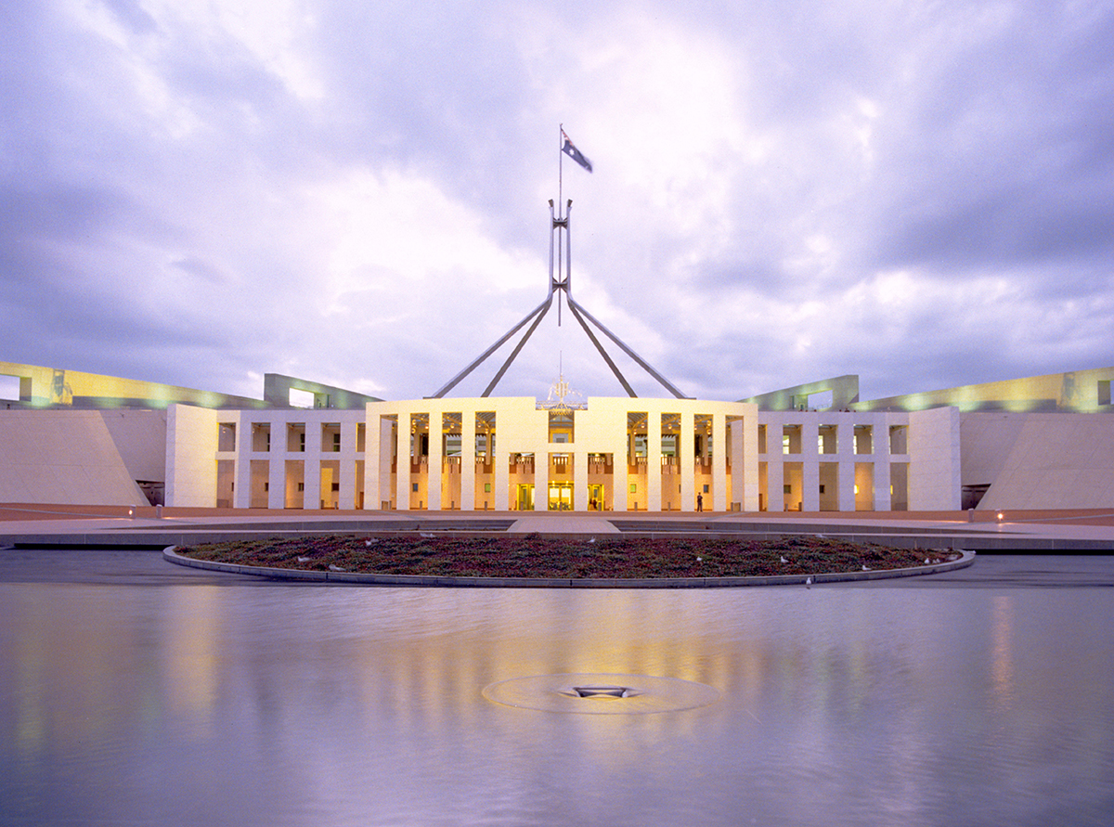
The Legislative Process
Online Safety Amendment (Social Media Minimum Age) Bill 2024 introduced into Parliament on 21 November 2024 and passed on 29 November 2024.
One day public consultation period.
Over 15,000 submissions received, but only 117 published.
Parliamentary committee held one 3-hour hearing.

Slide 6
Key Arguments For & Against
The Case For the Ban
Protection from Harm
Promoting Healthy Development
Addressing Online Privacy Concerns
Support Parents
The Case Against the Ban
Right to Freedom & Access to Information
Inclusion and Participation
Privacy Risks for Every Australian
Will Not Be Effective

Slide 7
Are there Alternative Options?
Digital Duty of Care
Would require social media companies to take proactive steps to protect their users.
Recommended by Joint Select Committee on Social Media and Australian Society in 2024.
Recommended by independent Statutory Review into Online Safety Act 2021.
Australian Government has announced intention to legislate, but no details presently available.

Slide 8
Contact Details
Lorraine Finlay
Human Rights Commissioner
lorraine.finlay@humanrights.gov.au
@lorrainejfinlay
linkedin.com/in/lorrainejfinlay

