Slide 1
New Zealand’s policy and regulatory approaches to generative AI
Neil Miller, NZQA. 2023

Slide 2
New Zealand Qualifications Authority
New Zealand government Crown entity established by the Education Act 1989
Administers the New Zealand Qualifications and Credentials Framework (NZQCF)
New Zealand’s National Education Information Centre
Independently quality assures tertiary providers (except universities)
Leads New Zealand’s international qualifications liaison work
Administers Code of Practice for the pastoral care of students
Administers the secondary school exam system

Slide 3
Universities New Zealand (UNZ)
Peak body for New Zealand universities
Statutory authority for quality assurance of university academic programmes
CUAP – Committee on University Academic Programmes
AQA – Academic Quality Agency for New Zealand Universities.

Slide 4
NZQA response to generative AI
Secondary school assessment – working with schools on maintaining integrity of internal and external assessment and moderation.
Identification of where AI is used across the learning journey is the first step
2. Quality Assurance – developing a plan to provide advice for tertiary education providers on how AI may impact teaching, learning and assessment.
AI² = academic integrity + artificial intelligence.
3. NZQA Artificial Intelligence Working Group – identify how to use AI within NZQA for lower value work, analyse data and generate insights. Explore opportunities to test and learn.
4. AI Symposium – a joined-up education response focused on assessment practices.

Slide 5
Artificial Intelligence and Assessment Symposium
An initiative across the whole of the education sector – learners, teachers, schools, tertiary providers (including universities), Ministry of Education, NZQA.
Focused on validity of assessment.
Starting with what is generative AI and how do Large Language Models work?
Sharing a wide range of perspectives asking:
What do we need to do now?
What do we need to keep thinking about?
Looking for opportunities to augment teaching, learning and assessment

Slide 6
Assessment redesign for generative AI: A taxonomy of options and their viability
Jason M. Lodge, Sarah Howard and Jaclyn Broadbent distilled the options into six categories:
Ignore
Ban
Invigilate
Embrace
Design around
Rethink
https://www.linkedin.com/pulse/assessment-redesign-generative-ai-taxonomy-options-viability-lodge%3FtrackingId=wd2%252B5Hwm3UhZkJ5%252Fg6rI3A%253D%253D/?trackingId=wd2%2B5Hwm3UhZkJ5%2Fg6rI3A%3D%3D
Notes:
Ignore
The first option is to simply ignore this development and hope it goes away. Some colleagues believe that generative AI will not significantly impact education. They argue that, given the long history of hype surrounding various educational technologies such as tablet computers, electronic whiteboards, and massive open online courses, generative AI may not have a lasting impact. However, this approach seems unlikely to be viable in the long term. By most accounts, generative AI is poised to have a significant impact on education. It seems as though 'this time is different'.
Ban
The second option on the table is to attempt to ban these technologies. As previously discussed, banning was a common initial reaction to the introduction of ChatGPT. Students almost immediately found ways to bypass these bans. Setting aside debates about the validity and reliability of various policing methods, there are already numerous YouTube channels and popular websites that teach students how to cheat effectively and avoid AI detection tools. Generative AI will also feature in core productivity applications such as word processing, slideware, and spreadsheets. As a result, attempting to ban ChatGPT and similar large language model-based tools seems futile, especially in the medium and long term. Imagine trying to ban spellcheck or autocomplete for a corollary.
Invigilate
The third option is to design assessments that circumvent the use of AI. One obvious approach is to revert back to traditional exam settings where students are monitored as they produce written artefacts (as was the immediate response in many jurisdictions and institutions). While this may be necessary for certain subjects and contexts, it is unlikely to be a widespread solution. Written exams have their place but they should not be the default assessment approach in all circumstances. Other alternatives include oral examinations and ongoing reflection activities. Although these methods can help ensure that students genuinely learn the material, they are not infallible and must be designed well, be appropriate for the specifics of the context, and implemented fairly to be effective.
Embrace
The fourth option is to embrace generative AI in assessments. This could range from allowing or requiring students to use AI in specific tasks to having them critique, update, or assess AI-generated artefacts themselves. A wide range of options is emerging (Ethan Mollick is worth following to keep updated on what is happening in this space). As generative AI is likely to increasingly impact how people work and live, it seems as though it will be important to embrace these tools in the classroom over the medium to long term. While there are opportunities to embrace AI, there are also concerns surrounding ethics, fairness, and equity, particularly in terms of privacy, access to advanced AI technologies, and the varying abilities of students to use them effectively.
Design around
The fifth option is to design assessments around the limitations of generative AI. This approach involves exploiting the weaknesses of AI technologies. I (JL) have described previously how the tasks I have been assigning my students do so. However, as AI becomes increasingly sophisticated, this strategy is likely to become riskier and less effective. The introduction of GPT-4 made substantial improvements to the plausibility and accuracy of responses to prompts that GPT-3.5 seemed to struggle with. This improvement was clearly evident when the same assessment tasks were tested using the newer model. These models are only going to improve from here, as will the capability of students to prompt them. As such, while designing around generative AI seemed like a promising approach early on, that promise has evaporated and this is unlikely to be a viable option in the short to medium term.
Rethink
Lastly, is the option to rethink assessment entirely This challenging approach requires asking how and why students are assessed in the first place. If assessments feel like chores and do not encourage creativity or inspire actual learning, or there is substantial time pressure to complete tasks, there is increased motivation to cut corners. Further, if assessment tasks are not designed to align with the developmental process that is learning and continue to view this process through snapshots provided by the production of artefacts, the methods of assessment need a rethink. None of this will be straightforward but is increasingly necessary, if it wasn't already This is perhaps the set of options that will require emphasising over the medium to long term.

Slide 7
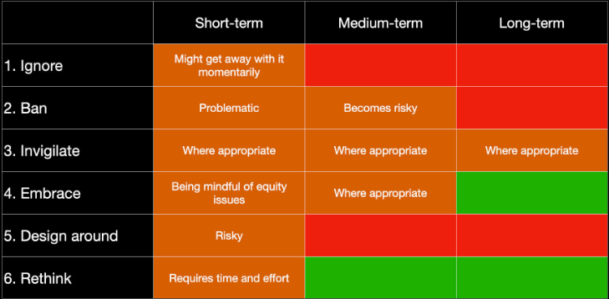
Viability of options for assessment redesign
Viability (represented by traffic light colouration - red - likely not viable, orange - care needed, and green - seems most viable) of the six types of assessment redesign responses to generative AI over the short, medium, and long term:
Table outlining giving estimates of viability over the short, medium and long term (red - likely not viable, orange - care needed, and green - seems most viable).
Notes:
Viability (represented by traffic light colouration - red - likely not viable, orange - care needed, and green - seems most viable) of the six types of assessment redesign responses to generative AI over the short, medium, and long term: nred - likely not viable, orange - care needed, and green - seems most viable.
Ultimately, a combination of these options may be necessary to address the challenges posed by generative AI in education.
The successful rethinking of assessment approaches for the age of AI is also likely to require the combined and coordinated efforts of researchers, teachers, design professionals, learning technologists, and policymakers.
When exploring these assessment redesign options, it will also become increasingly critical to consider how learning as a developmental process occurs and what motivates students to seek to take shortcuts through this process.

Slide 8
Complexity
“Surfing the wave of change”
Simon McCallum,
Victoria University of Wellington, 2023
“There is always a well-known solution to every human problem – neat, plausible and wrong”
H.L. Menken, 1920

Slide 9
neil.miller@nzqa.govt.nz

