Slide 1
Dispelling the Illusion of Learning: Shifting the Culture for Professional Students in an AI Future
MaRK BENNETT (Law), John Randal and Amanda Wolf (WSBG)
AI & Society, 1 August 2025

Slide 2
What should we teach? How should we assess?
John Randal (Wellington School of Business and Government)

Slide 3
John Randal - Teaching context
Since mid-1990s
Introductory applied statistics
Mathematical statistics
Actuarial science
Time series analysis
Service courses
Often developing and/or enhancing tools

Slide 4
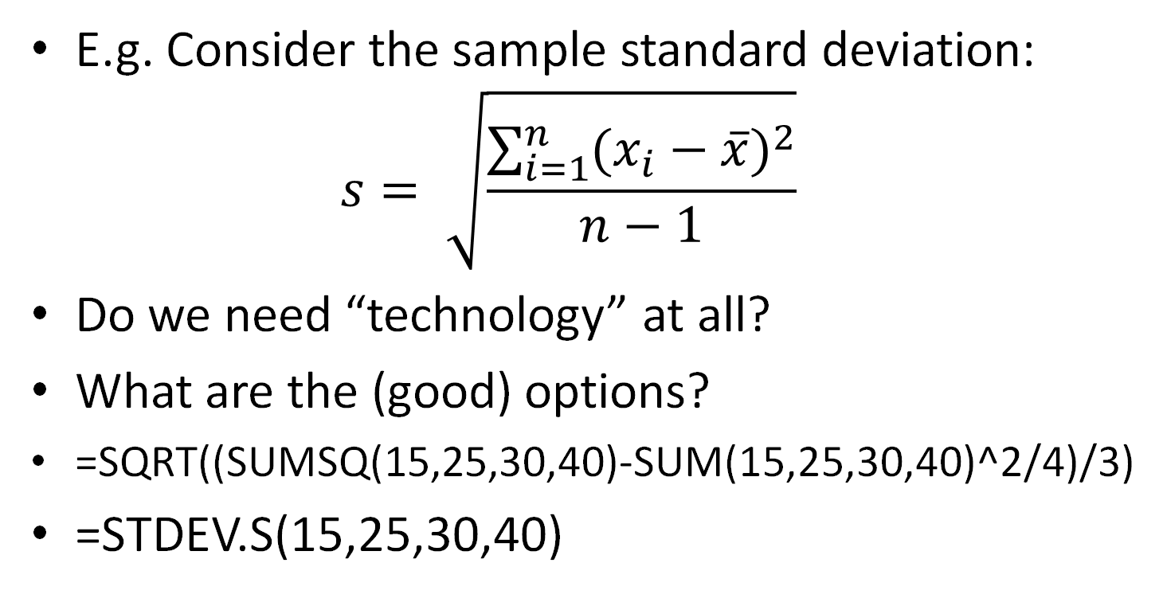
Technology-driven curriculum change
E.g. Consider the sample standard deviation: $s= \sqrt{\frac{\sum_{i=1}^{n}{(x_{i}−\overline{x})^{2}}}{n−1}}$
Do we need “technology” at all?
What are the (good) options?
=SQRT((SUMSQ(15,25,30,40)-SUM(15,25,30,40)^2/4)/3)
=STDEV.S(15,25,30,40)

Slide 5
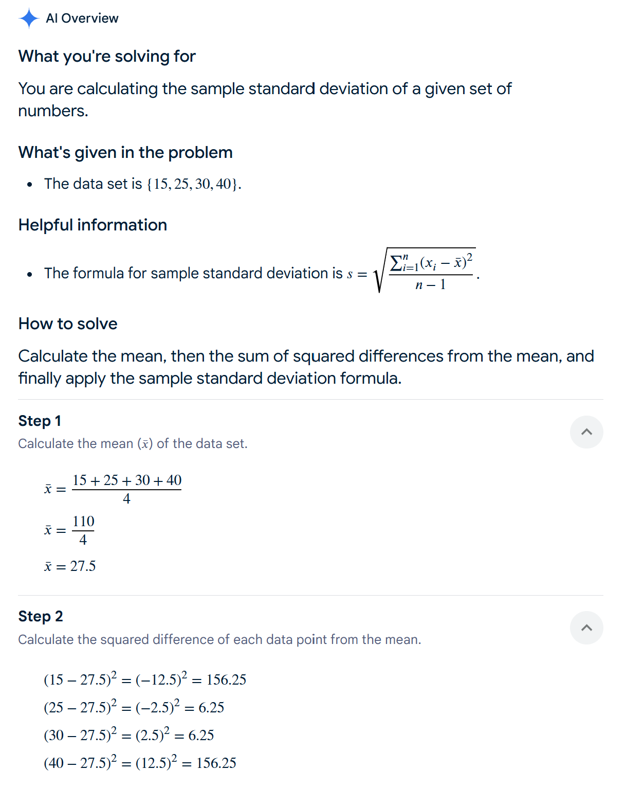
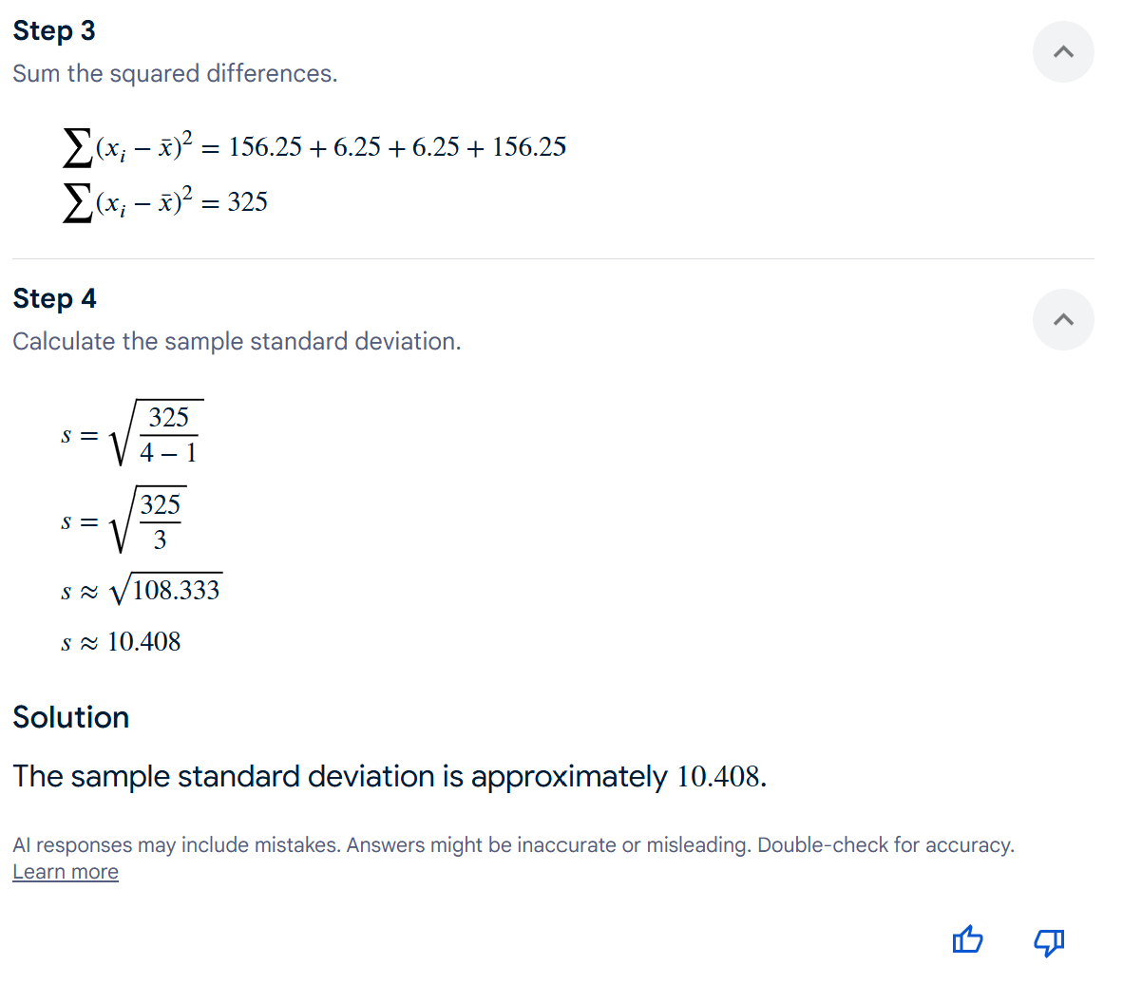


Slide 6
Learning and assessment of learning
Revising the curriculum gives insight into the necessary assessment environment...s
What is the measure? How does it work? When can/should it be used?
How is it calculated?
Calculate it

Slide 7
At the end of the course, students should be able to...
Know when to do it
Know what to do with the output, including what the limitations might be
Know under what circumstances it might be a dumb thing to do, and know how to ensure that isn’t true for the task at hand
Have a vague sense of what is going on under the hood
Be able to actually do the task in a way that reflects how they will do it beyond the course...

Slide 8








More complex analyses
$\frac{\overline{x}−μ}{s/{\sqrt{n}}}\sim t_{n−1}$
$\hat{β}=\frac{\sum{(x_{i}−\overline{x})(y_{i}−\overline{y})}}{{\sum{(}x}_{i}−\overline{x})^{2}}=$ $\frac{\sum{x_{i}y_{i}−n\overline{x}\overline{y}}}{\sum{x^{2}}−n{\overline{x}}^{2}}$

Slide 9
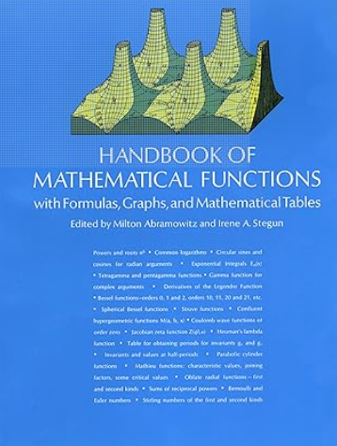
Reference material
What do we actually need to know off by heart? (And when?)
Formulae?
Distributions?

Slide 10
Observed benefits
“work ready graduates”
Genuinely removed aspects of the discipline that were: time consuming, error prone, unpleasant, inconvenient...
Genuinely reduced/removed barriers to success for some students
Time saved gives opportunities for new curriculum

Slide 11
Academic Integrity
I believe we should use this to refer to the education, not just how students engage with assessment
Course Learning Objectives must be fit for purpose (the learner and what they can do)
Assessment tasks need to be aligned to these CLOs
The assessment environment needs to support modern CLOs and assessment tasks
These need to (constantly?) evolve as the tools around us improve
We must ensure equity of access
Significant resource implications (if we do), and increasing jeopardy (if we do not)

Slide 12

Illusion-Breaking
Amanda Wolf
AI & Society, 1 August 2025

Slide 13
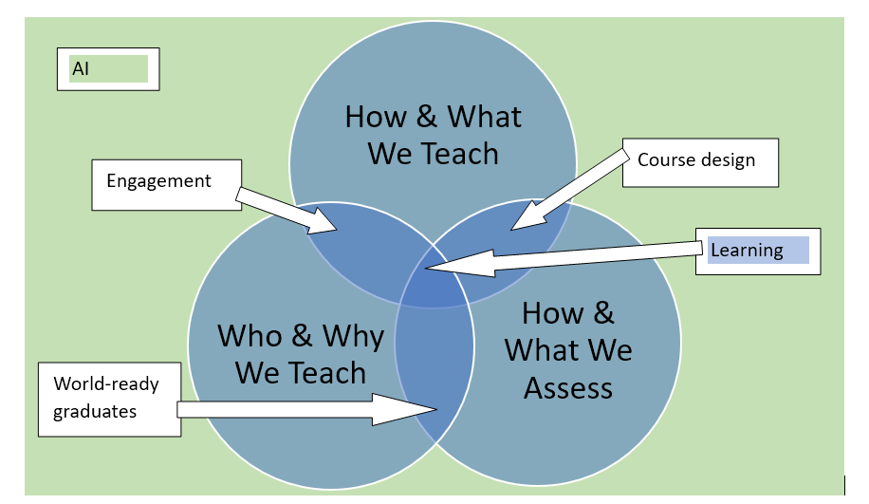

Slide 14
The ‘Learning’ Challenge
The conditions for learning are surprisingly delicately balanced.
Can’t ‘learn’ what you already know; if there is nothing to build on; if you think you already know; if you think you can’t, etc
The who, what and how of learning for knowledge/skill/competence are varied and variously mixed
Challenges persist despite mountains of research; GenAI amplifies many challenges
Available ‘solutions’ can both ‘work’ and have unintended consequences!

Slide 15
The Illusion of Learning
Unproductive success: students “maximize performance in the shorter term without maximizing learning in the longer term,” creating “an illusion of learning” (Kapur, 2016)
True beliefs are not the same as understanding
AI-related exacerbations:
Threats to retention, internal motivation, etc
AI does it, student decides they know how and can do it
Students avoid the stress of learning, which is masking or rewarding
Lack of feedback/checks on understanding

Slide 16
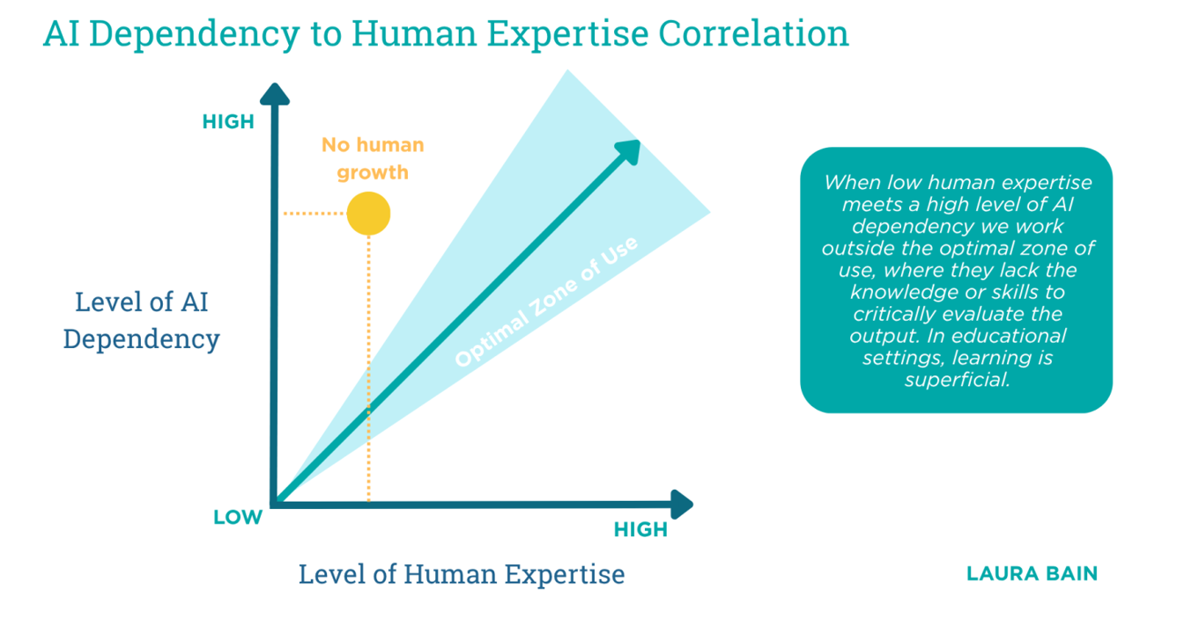
Typical at transition to uni?
https://www.linkedin.com/pulse/ai-use-human-expertise-correlation-why-must-scale-skill-laura-bain-dcdrc/?trackingId=JRMYnv9ZJqitntVOq7V7lQ%3D%3D

Slide 17
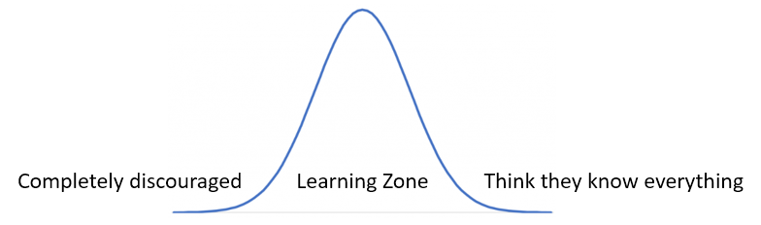
A Modern-Day Quest
Myths and legends are filled with quests: journeys undertaken by heroes to achieve a specific goal or overcome a challenge. Often involve trials, tribulations, and encounters with mythical creatures, ultimately leading to personal growth or societal transformation. (Gemini)
We need (with students) to move that yellow dot into the zone

Slide 18
How and What: Curriculum & Delivery
Students have to (1) actually learn and (2) learn the ‘right stuff’
Challenges:
Curriculum change: AI abilities in, other tasks out
Establish relevant foundations for new learning
Convince students in the face of change and uncertainty
Avoid the paternalistic downsides of rational arguments or ‘bad’ psychological manipulation or (over)reliance on old methods

Slide 19
One Response Strategy
Lean into ‘experiential learning’; create revelatory moments in the curriculum where learners have to do stuff, not just hear about it or watch it

Slide 20
Experiential Learning
New knowledge, skills, or attitudes are achieved through confrontation among four modes of experiential learning. Learners, if they are to be effective, need four different kinds of abilities
Concrete experience abilities, to involve themselves fully, openly, and without bias in new experiences
Reflective observation abilities, to reflect on and observe their experiences from many perspectives
Abstract conceptualization abilities, to create concepts that integrate their observations into logically sound theories
Active experimentation abilities, to use these theories to make decisions and solve problems (Kolb, 1984, p. 30)

Slide 21
Example: Finding ‘Insight’
Think of a question for which you already have some sense of the answer, but want to gain some new or surprising idea, one that you will recognise as such.
Pursue a prompting session using one or more AI tools
Keep prompting until you are satisfied the result is as concise, on-point, and as insightful/relevant as it can be (even if this point is never reached to your satisfaction)
Example: How can I help public policy students provide well-argued justifications for government intervention?

Slide 22
Hypothesis On Track For Confirmation . . .
Justification in public policy is the reasoned explanation of why a policy is necessary, legitimate, and appropriate, drawing on evidence, values, and legal or political principles to secure support and demonstrate accountability. (ChatGPT)
A justification is a reasoned, evidence-based argument that defends a policy response as the most appropriate solution to a public problem, grounded in core public values and capable of withstanding critical scrutiny. (CoPilot)

Slide 23
Debrief
I chose an objective for which I hypothesised AI would fail, but set this as an experiment where students were ‘free’ to explore (and potentially prove me wrong)
Also a central concept in my educational philosophy, and an opportunity to unpack what I take insight to mean (notwithstanding its over-extension in policy-speak)
While also (I hope) connecting experience, reflection and conceptualisation as learning
(Open use of AI demonstrates my ‘high-trust’ attitude)

Slide 24
Example of ‘Productive Failure’
Productive failure: even though students “generate suboptimal or even incorrect solutions” to a problem, their failure prepares them “to learn better” in the short and long term. (Kapur, 2016)
Involves a problem-solving phase followed by a consolidation (or instruction) phase
Challenge: holding back too much ‘off-loading’ to give strategies space

Slide 25
One More Example
Context
Students don’t (like to) read
Internal motivation under attack from ‘ease’ of AI
“Grandma says, eat your porridge, and you’ll grow big and strong”
Experiment:
Assigned reading and created a Notebook.LM ‘deep dive’ podcast
Class secretly sorted themselves
Debrief: Both modes have strengths, but own reading has some unique benefits

Slide 26

Haven’t read it: Jot your answers
Have read it: Jot your answers
What do frames do?
How can policy analysts use frames?
What is framing?
What is the relationship between stakeholders and frames/framing?
What is critical frame reflection?
What did you pick out differently?
Any inconsistencies or gaps?
What further questions occur to you?
What else did you take from the article?

Slide 27
Conclusions
Even when students use AI (whether required, accepted, or discouraged), the focus needs to be on the PERSON’S EXPERIENCE and not on their PRODUCTS
Knowledge isn’t merely a ‘thing’ that can be instilled, developed, ‘applied’, etc but an interaction of a person with a learning situation
Since learning happens to someone, in some context, our first job is to help them unpack the elements and tensions in learning

Slide 28
References
Kapur, M. (2016). Examining Productive Failure, Productive Success, Unproductive Failure, and Unproductive Success in Learning. Educational Psychologist, 51(2), 289–299. https://doi.org/10.1080/00461520.2016.1155457
Kolb, D.A. (1984) Experiential Learning: Experience as the Source of Learning and Development. Englewood Cliffs, NJ: Prentice-Hall.
CoPilot, ChatGPT, Gemini, Notebook.LM

Slide 29

Thoughts?
Thank you!

