Slide 1

Learning to Identify Rumors on Twitter
Wei Gao
(In Chinese: 高巍)
School of Information Management
Victoria University of Wellington, New Zealand
wei.gao@vuw.ac.nz

Slide 2
Overall Research Focus – Text Mining
Developing new technologies for processing, retrieving and mining information from large complex datasets, especially unstructured and semi-structured content on the Web and social media, for effective information access and intelligence decision making for end users.
Data
Text
Network
Other (image, video, sensing, geospatial, …)
Natural Language Processing
Information Retrieval
/Search
Data Mining
Problems
Statistical Machine Learning → Deep Learning
(supervised, unsupervised, semi-supervised, active, multi-view, reinforcement …)
Methods
Optimization algorithms
Model

Slide 3

My Research Areas
Natural language processing (NLP) uses computational models to process and/or understand text or human language data.
Information retrieval (IR) aims to effectively and efficiently search information relevant to user's information need from very large data collections.
Data mining (DM) is the process of deriving high-quality structures or knowledge from data.
Machine learning (ML) is concerned with the design of algorithms that can be generalized to new examples by learning from past observations or experience.

Slide 4



About Myself
4/2010: PhD, Chinese University of Hong Kong
5-8/2010: Research Fellow, Institute for Infocomm Research, A*STAR, Singapore
8/2010-8/2011: Research Assistant Professor, Chinese University of Hong Kong
9/2011-5/2017: Scientist, Qatar Computing Research Institute, Qatar
6/2017-now: Senior Lecturer, Victoria University of Wellington, New Zealand

Slide 5
Learning to Identify Rumors on Twitter
Wei Gao
(In Chinese: 高巍)
School of Information Management
Victoria University of Wellington, New Zealand
wei.gao@vuw.ac.nz

Slide 6

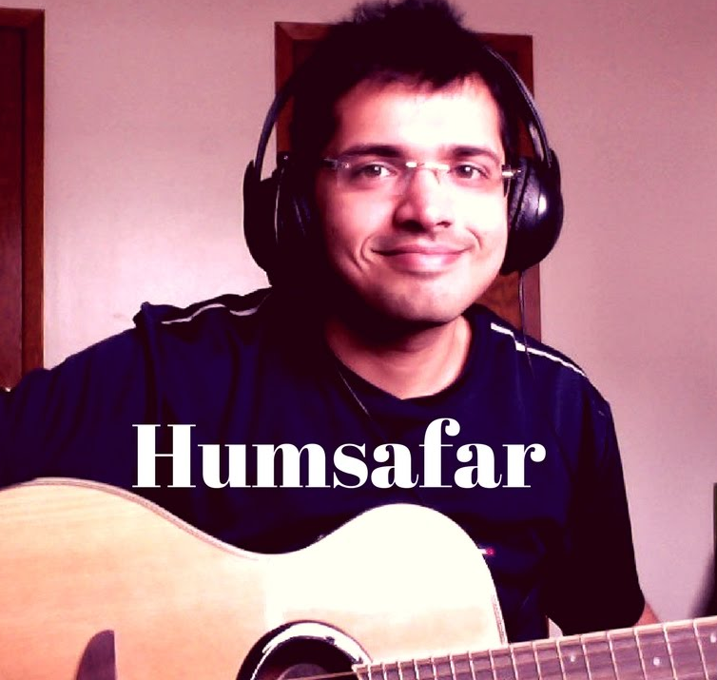

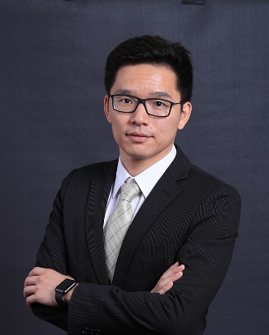


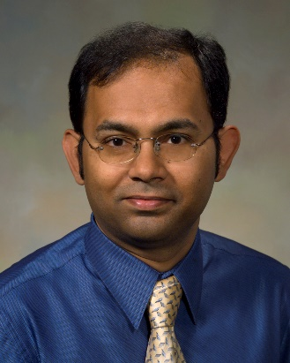

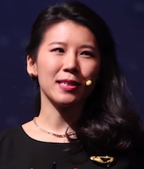






Acknowledging collaborators
Jing Ma
Bhavtosh Rath
Sejeong Kwon
Zhongyu Wei
Kam-Fai Wong
Jaideep Srivastava
Prasenjit Mitra
Benard J. Jansen
Meeyoung Cha

Slide 7
Sources
Jing Ma, Wei Gao, and Kam-Fai Wong. Detect rumors in microblog posts using propagation structure via kernel learning. The 55th Annual Meeting of the Association for Computational Linguistics (ACL 2017).
Bhavtosh Rath, Wei Gao, Jing Ma, and Jaideep Srivastava. From retweet to believability: utilizing trust to identify rumor spreaders on Twitter. The 2017 IEEE/ACM International Conference on Advances in Social Networks Analysis and Mining (ASONAM 2017).
Jing Ma, Wei Gao, Prasenjit Mitra, Sejeong Kwon, Bernard J. Jansen, Kam-Fai Wong, and Meeyoung Cha. Detecting rumors from microblogs with recurrent neural networks. The 25th International Joint Conference on Artificial Intelligence (IJCAI 2016).
Jing Ma, Wei Gao, Zhongyu Wei, Yueming Lu, and Kam-Fai Wong. Detect rumors using time series of social context information on microblogging websites. The 24th ACM International Conference on Information and Knowledge Management (CIKM 2015).

Slide 8


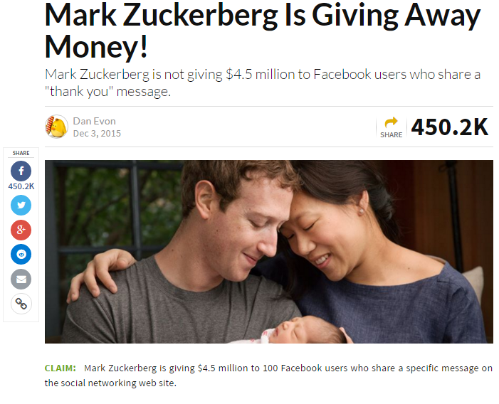
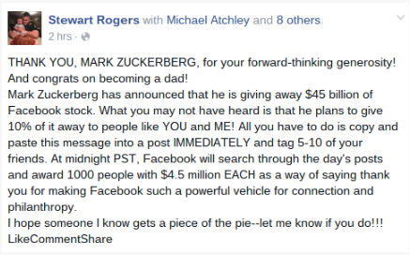
What are rumors?
Zuckerberg’s Facebook
Another user
A story or statement whose truth value is unverified or deliberately false (Difonzo and Bordia, 2007)
Notes:
Colorado theater shooting at Aurora, Colo.

Slide 9


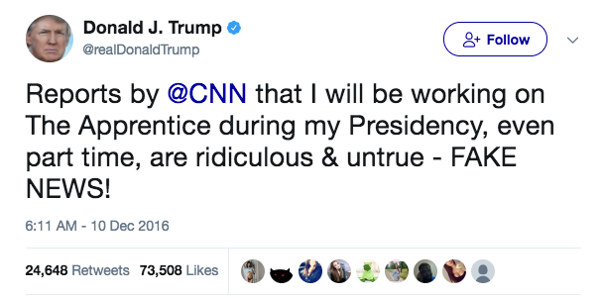

It goes viral, but it’s fake…!

Slide 10


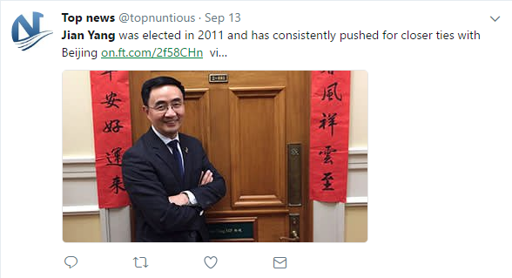

Rumor becomes a daily issue
Obama is Muslim?
Trump is a spy of Russia?
#Qatar stirs up rumors about #Saudis through 500,000 twitter account?
Jian Yang is a spy of China?

Slide 11
Outline
Motivation & Background
Related work
Problem statement
Methods of learning to identify rumors
Experiments and results
Conclusions and future work
Notes:
11

Slide 12
Motivation
Generally human beings are not good at distinguishing facts and fakes.
Debunk rumours and identify their spreaders are crucial to minimize their harmful effects, but difficult at an early stage.
Online factcheck services (snopes.com, factcheck.org, etc.) are manual and have limited topical coverage and long delay.
Existing automatic approaches rely on feature engineering or hand-crafted rules, which is painstakingly detailed, biased and labour-intensive.

Slide 13

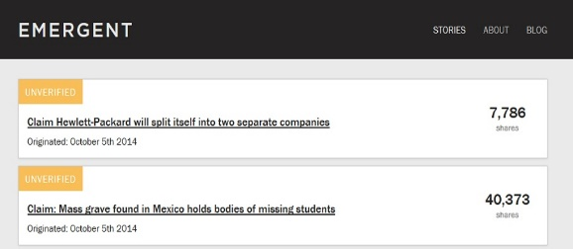
Background
Large volume of complimentary rumors data make learning possible

Slide 14

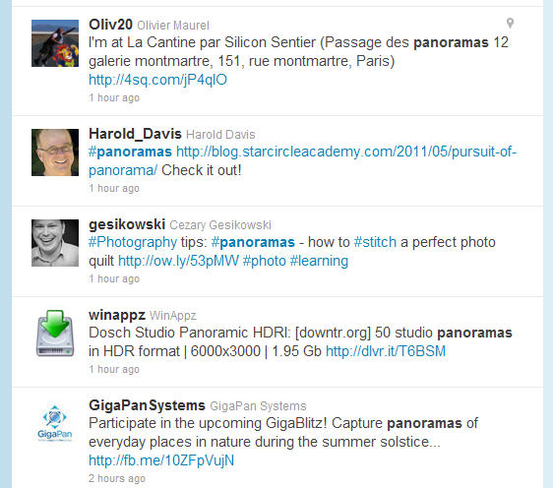
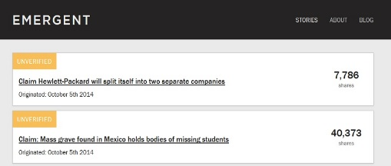

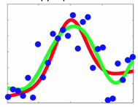
Learn to identify rumors on Twitter
claims
models
New claims
predictions

Slide 15
Outline
Motivation & Background
Related work
Problem statement
Method of learning to identify rumors
Experiments and results
Conclusions and future work

Slide 16
Related work
Existing systems based on common sense and investigative journalism, e.g.,
  snopes.com
  factcheck.org
  emergence.info
Learning-based model for rumor detection
  Information credibility: Castillo et al. (2011), Yang et al. (2012)
  Using handcrafted features: Liu et al. (2015), Ma et al. (2015), Kwon et al. (2013, 2017)
  Using cue terms: Zhao et al. (2015)

Slide 17
Related work (cont’)
Deep neural networks (quite many)
  Basic RNN: Rumelhart et al. (1986)
  Long Short-Term Memory (LSTM): Hochreiter and Schmidhuber (1997); Graves (2013)
  Gated Recurrent Unit (GRU): Cho et al. (2014)
Tree Kernel (semantic similarity based on tree similarity)
  Syntactic parsing: Collins and Duffy (2001)
  Question-answering: Moschitti et al. (2006)
  Semantic analysis: Moschitti et al. (2004)
  Relation extraction: Zhang et al. (2008)
  Machine translation: Sun et al. (2010)

Slide 18
Outline
Motivation & Background
Related work
Problem statement
Methods of learning to identify rumors
Experiments and results
Conclusions and future work

Slide 19
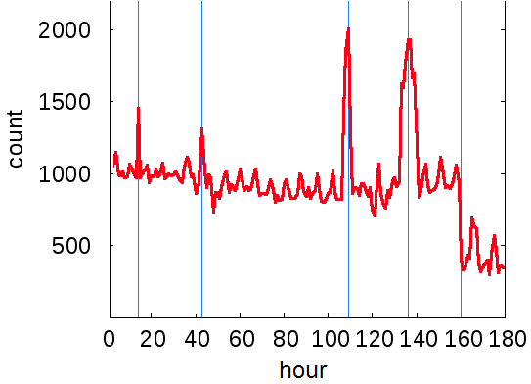

A motivating example
Claim tweet: Obama is compiling a secret racial database
1st hour | 21:21:20 | false messiah shepard justice plain wrong joke no fear
 | 21:27:48 | what a wicked shocker! who ever would have guessed?
 | 21:30:17 | terrifying, if true as if
 | 21:41:22 | wtf?! mt
 | 21:43:56 | what fresh hell
 | 21:45:08 | what do you think about this
2nd hour | 22:00:07 | if this is true, he is coming for you and me
 | 22:04:49 | truely evil!
 | 23:16:20 | do you really believe honestly? truly?
 | 22:16:04 | wow. a must read. if this is true, god help us
 | 22:35:38 | another unbelievable hoping is not true
 | 22:52:10 | wtf? new york post
3rd hour | 23:06:07 | imagine ”wrong” hands not to like
 | 23:09:11 | do you have to see christians to believe this?
 | 23:55:30 | what could possibly go wrong?
 | 0:26:06 | do you honestly believe?
 | 0:34:05 | you hope this isn’t true.
Questioning and denial signals (underlined) sometimes can be observed in the first few hours

Slide 20
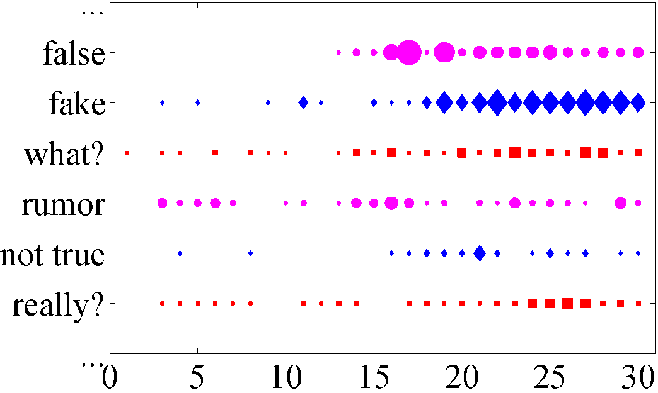
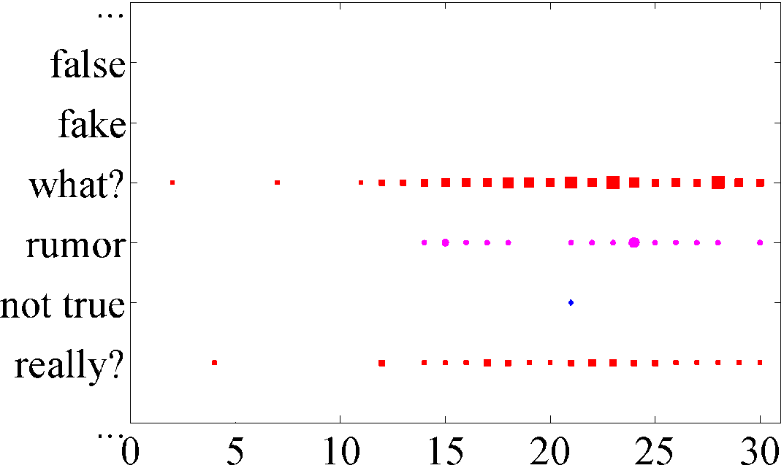
Rumor signals
Shallow patterns of rumor signals (Zhao et al, 2015)
Temporal traits of rumor and non-rumor events
Frequency strength
(a) In rumors
(b) In non-rumors

Slide 21
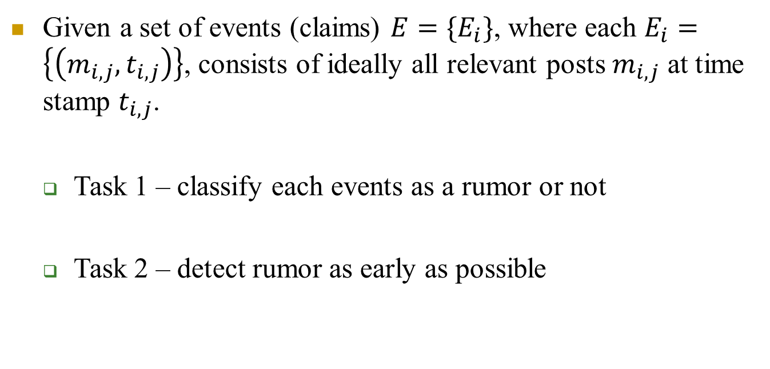
Problem statement (1)
Given a set of events (claims) $E=\{E_{i}\}$, where each $E_{i}=\left\{\left(m_{i,j},t_{i,j}\right)\right\}$, consists of ideally all relevant posts $m_{i,j}$ at time stamp $t_{i,j}$.
  Task 1 – classify each events as a rumor or not
  Task 2 – detect rumor as early as possible

Slide 22
Outline
Motivation & Background
Related work
Problem statement
Methods of learning to identify rumors
Experiments and results
Conclusions and future work

Slide 23
Traditional features
Castillo et al. (2011); Wu et al. (2015); Yang et al. (2012); Kwon et al. (2013); Ma et al. (2015)
Content-based features
Average length of microblog posts
# of positive (negative) words in the posts
Average sentiment score of the posts
% of posts with URL
% of posts with smiling (frowning) emotions
% of positive (negative) posts
% of posts with the first-person pronouns
% of posts with hashtags
% of posts with @ mentions
% of posts with question marks
% of posts with exclamation marks
% of posts with multiple question/exclamation marks
User-based features
% of users that provide personal description
% of users that provide personal picture
% of verified users
% of verified users of each type, e.g., celebrities
% of male (female) users
% of users located in large (small) cities
Avg. # of friends of users
Avg. # of followers of users
Avg. # of posts of users
Avg. days users accounts exist since registration
Avg. reputation of users (followers/followees)
Diffusion-based features
Avg. # of retweets
Avg. # of replies
Avg. of posts
We can also consider the temporal traits of these predefined features in previous studies!

Slide 24
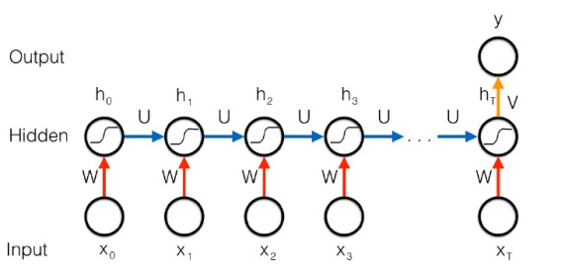
Our hypothesis
Recurrent neural networks (RNN) is more suitable for rumor detection due to its inherent sequential structure.
RNN can learn high-level representations from fundamental word-based features – no feature engineering
RNN is extensible – can be further improved using more sophisticated recurrent units and extra hidden layers
Gated RNN (e.g., LSTM, GRU) can capture long-distance dependencies in the patterns.

Slide 25
Data collection
Twitter data are gathered by crawling Twitter “Live” search results given keyword queries.
Keywords are collected from Snopes.com stories plus manual editing. For each event, extract the keywords from Snopes URL, e.g., http://www.snopes.com/pentagon-spends-powerballtickets.
Rumor/non-rumor claims on snopes.com
Twitter search interface
Downloaded
posts
Keyword queries
w/ time constraints
Weibo data gathered using Weibo API. Topics of events are from Sina Community Management Center (service.account.weibo.com)

Slide 26






Time series formation
Posts streams over time
Time series formation
Variable-length
Time Series
RNN-based
Model
No
Shorten interval
Consecutive & non-empty?
Yes
Notes:
26

Slide 27
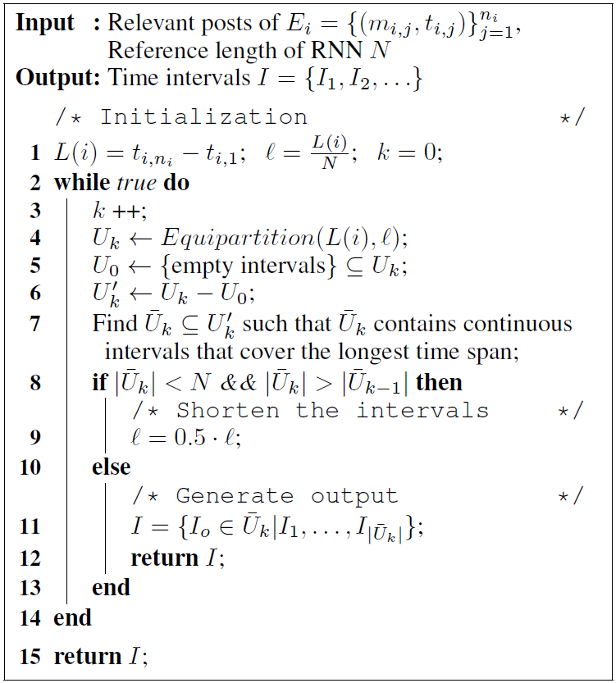
Time series formation algorithm
Capture the longest continuous time span
Keep splitting and approximating the reference length or stop splitting
Time series formation
No
Variable-length
time series
Consecutive & non-empty?
Shorten interval
Yes

Slide 28


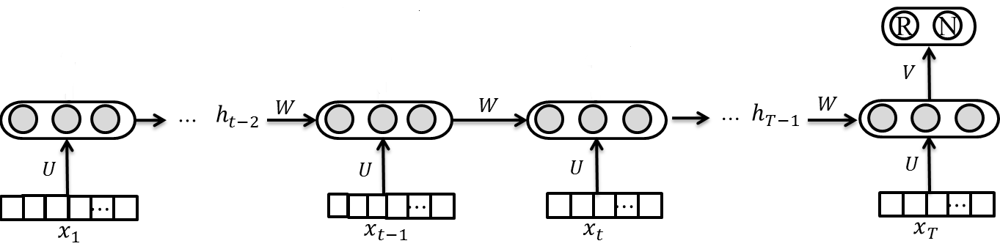

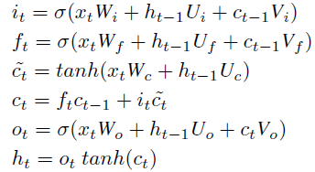
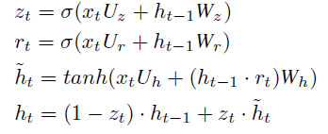
Basic tanh-RNN model
Input: tf*idf values of the vocabulary terms in each time interval
Output: Softmax probability of the classes at the last time step
Objective:
LSTM: Hochreiter and Schmidhuber (1997); Graves (2013)
GRU: Cho et al. (2014)

Slide 29
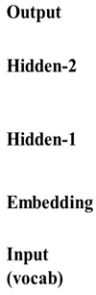
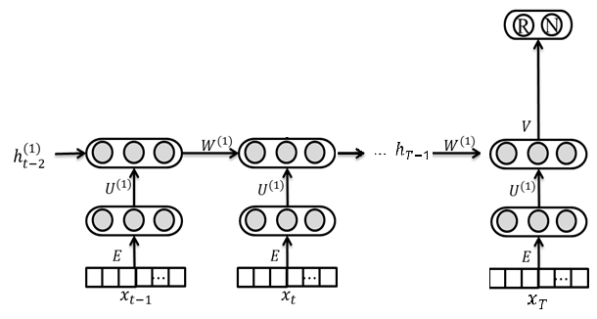
One-layer gated RNN models
1-layer LSTM/GRU
Word embedding
(b) 1-layer LSTM/GRU + embedding

Slide 30
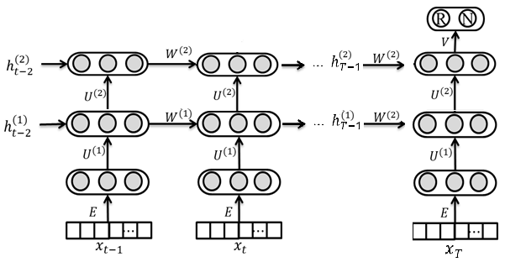
Two-layer gated RNN models
Two-layer LSTM/GRU
Word embedding
(b) 2-layer LSTM/GRU + embedding

Slide 31
Outline
Motivation & Background
Related work
Problem statement
Methods of learning to identify rumors
Experiments and results
Conclusions and future work

Slide 32
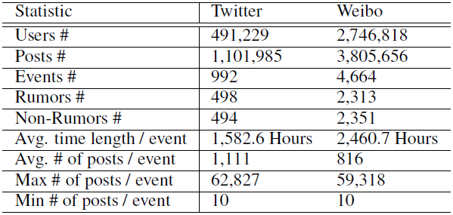
Statistics of data collection
URL of the datasets: http://alt.qcri.org/~wgao/data/rumdect.zip
Notes:
For generating the summaries, we used a variant of co-hits algorithm to co-rank the sentences and tweets on a bipartite graph by considering both their informativeness and complementarity. We initialized the ranking score of each node with lexrank for the informativeness. The jumping probability between nodes is bi-directional and usually calculated as this, and rou is the similarity function used to be idf-modified-cosine. We modified the similarity function using the proposed complementary measure.

Slide 33
Approaches for comparison
DT-Rank: Decision tree-based ranking model using enquiry phrases to identify trending rumors (Zhao et al., 2015)
DTC and SVM-RBF: Twitter information credibility model using Decision Tree Classifier (Castillo et al., 2011); SVM-based model with RBF kernel (Yang et al., 2012)
RFC: Random Forest Classifier using three parameters to fit the temporal tweets volume curve (Kwon et al., 2013)
SVM-TS: Linear SVM classifier using time-series structures to model the variation of social context features. (Ma et al., 2015)
Ours (tanh-RNNs): Basic RNN structure with a single hidden layer
Ours (LSTM-1 and GRU-1): One-layer of LSTM and GRU hidden units
Ours (GRU-2): Enhanced with an extra GRU hidden layer
Notes:
So the co-ranking is an iterative reinforcement procedure on the bipartite graph, where on the edge is the transition probabilities. The ranking scores of nodes are traded off between the initial score and the weighted sum over the scores of all the linking nodes. So the random walk end up with two ranked lists each for each side. We generate summaries by considering two levels of complementarity, the summary-level and the sentence-level. For summary-level complementarity, we just choose the top ranked sentences and tweets from each ranked list so that the two summaries appear complementary as a whole; for the sentence-level complementary, we start from the top ranked sentences, and for each sentence, we choose the neighboring tweets that have the largest complementary scores. This tries to create one-on-one complementary relation between news sentences and tweets.

Slide 34
Settings
Train all the RNN models through back-propagation (Collobert et al., 2011).
Using the AdaGrad algorithm (Duchi et al., 2011) for parameter update.
Empirically set the vocabulary size K as 5,000, the embedding size as 100, the hidden units size as 100, the learning rate as 0.5.
Iterate over all training events in each epoch and continue until the loss value converges or max epoch number is reached.
10% data for development, 3:1 ratio for training and test
15
Notes:
So the co-ranking is an iterative reinforcement procedure on the bipartite graph, where on the edge is the transition probabilities. The ranking scores of nodes are traded off between the initial score and the weighted sum over the scores of all the linking nodes. So the random walk end up with two ranked lists each for each side. We generate summaries by considering two levels of complementarity, the summary-level and the sentence-level. For summary-level complementarity, we just choose the top ranked sentences and tweets from each ranked list so that the two summaries appear complementary as a whole; for the sentence-level complementary, we start from the top ranked sentences, and for each sentence, we choose the neighboring tweets that have the largest complementary scores. This tries to create one-on-one complementary relation between news sentences and tweets.

Slide 35
Results on Twitter
Method | Class | Accu. | Prec. | Recall | F1
DT-Rank | R | 0.644 | 0.638 | 0.675 | 0.656
 | N |  | 0.652 | 0.613 | 0.632
SVM-RBF | R | 0.722 | 0.856 | 0.526 | 0.651
 | N |  | 0.663 | 0.914 | 0.769
DTC | R | 0.731 | 0.724 | 0.757 | 0.74
 | N |  | 0.739 | 0.704 | 0.721
RFC | R | 0.772 | 0.717 | 0.908 | 0.801
 | N |  | 0.87 | 0.634 | 0.734
SVM-TS | R | 0.808 | 0.735 | 0.963 | 0.834
 | N |  | 0.947 | 0.652 | 0.772
tanh-RNN | R | 0.827 | 0.847 | 0.833 | 0.84
 | N |  | 0.804 | 0.82 | 0.812
LSTM-1 | R | 0.855 | 0.855 | 0.883 | 0.869
 | N |  | 0.854 | 0.82 | 0.837
GRU-1 | R | 0.864 | 0.857 | 0.9 | 0.878
 | N |  | 0.872 | 0.82 | 0.845
GRU-2 | R | 0.881 | 0.851 | 0.95 | 0.898
 | N |  | 0.930 | 0.80 | 0.860
Notes:
There is no public dataset for evaluating complementary summaries. We have to manually construct the corpus. We select 10 major events in the first half year of 2012 as subjects. Based on that, we built the standard summaries and test set. For each event, we used the first 1 or 2 paragraphs of Wikinews article as the standard news summary since wikinews usually borrow content from relevant news articles and the first few paragraphs commonly summarize the content. For standard tweet summary, we manually selected relevant tweets from twitter search results that appear complementary to the news summary, for which we tries our best to match with each news sentence, and it’s very time consuming. To built test set, we download the news articles listed in the reference section of the wikinews, and at twitter side, we manually collect a set of relevant tweets from search result. The shows some statistics of corpus.

Slide 36
Results on Weibo
Method | Class | Accu. | Prec. | Recall | F1
DT-Rank | R | 0.732 | 0.738 | 0.715 | 0.726
 | N |  | 0.726 | 0.749 | 0.737
SVM-RBF | R | 0.818 | 0.822 | 0.812 | 0.817
 | N |  | 0.815 | 0.824 | 0.819
DTC | R | 0.831 | 0.847 | 0.815 | 0.831
 | N |  | 0.815 | 0.847 | 0.83
RFC | R | 0.849 | 0.786 | 0.959 | 0.864
 | N |  | 0.947 | 0.739 | 0.83
SVM-TS | R | 0.857 | 0.839 | 0.885 | 0.861
 | N |  | 0.878 | 0.83 | 0.857
tanh-RNN | R | 0.873 | 0.816 | 0.964 | 0.884
 | N |  | 0.956 | 0.782 | 0.861
LSTM-1 | R | 0.896 | 0.846 | 0.968 | 0.913
 | N |  | 0.953 | 0.858 | 0.903
GRU-1 | R | 0.908 | 0.871 | 0.958 | 0.913
 | N |  | 0.953 | 0.858 | 0.903
GRU-2 | R | 0.910 | 0.876 | 0.956 | 0.914
 | N |  | 0.952 | 0.864 | 0.906
Notes:
There is no public dataset for evaluating complementary summaries. We have to manually construct the corpus. We select 10 major events in the first half year of 2012 as subjects. Based on that, we built the standard summaries and test set. For each event, we used the first 1 or 2 paragraphs of Wikinews article as the standard news summary since wikinews usually borrow content from relevant news articles and the first few paragraphs commonly summarize the content. For standard tweet summary, we manually selected relevant tweets from twitter search results that appear complementary to the news summary, for which we tries our best to match with each news sentence, and it’s very time consuming. To built test set, we download the news articles listed in the reference section of the wikinews, and at twitter side, we manually collect a set of relevant tweets from search result. The shows some statistics of corpus.

Slide 37
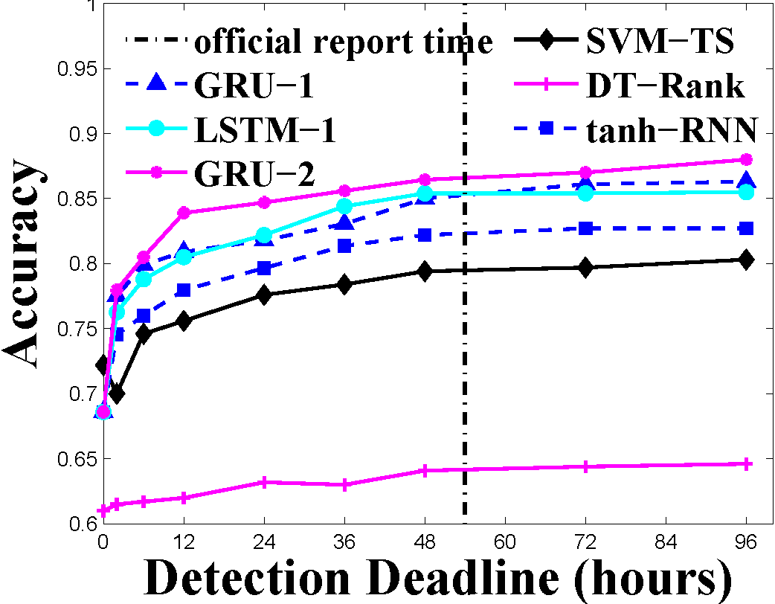
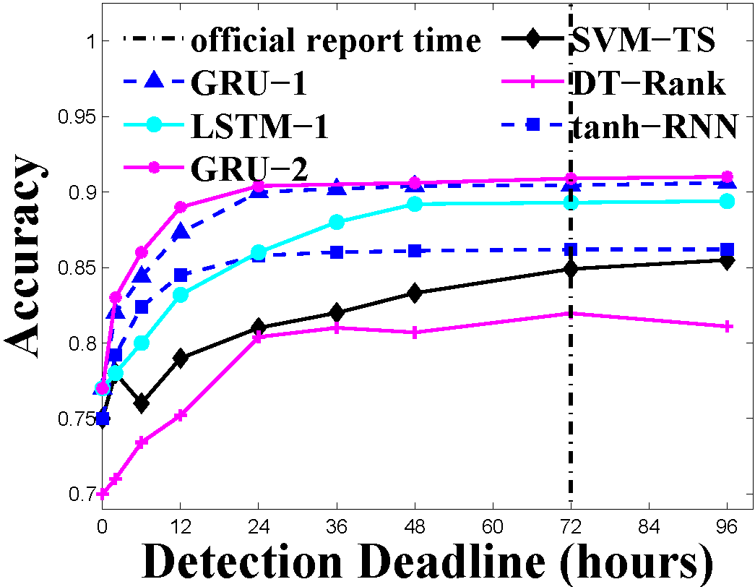
Results on early rumor detection
In the first few hours, the accuracy of the RNN-based methods climbs more rapidly and stabilize more quickly.
GRU-2 can detect rumors with 83.9% accuracy for Twitter and 89.0% for Weibo within 12 hours, which is much earlier than the baselines and the mean official report times.

Slide 38
Recap
Apply deep learning framework for rumor debunking by utilizing the variation of aggregated information across different time intervals related to each event.
Empirically evaluate the RNN-based method with three widely used recurrent units, tanh, LSTM and GRU.
RNN is much better than non-NN-based approaches. Two-layer GRU RNN performs the best.
Notes:
We compare our method with 4 baselines. BL-0 is the lexRank, which simply ranked the two sides separately, no correlation is considered, and we choose the top ranked sentences and tweets as summaries. BL-1 is a variant of contrastive summarization model based on KL-divergence minimization. The Tx and Ty are original text collections and Sx and Sy are the corresponding summaries. This model originally captures contrastiveness, but can also capture shallow complementarity if we change the original minus in front of these two crossing terms to plus, so as to reduce the distance across different collections. BL-2 include two variants of our method. One is called cosine where we simply remove the complementary factor from the similarity function. The other is replace the cosine with the distance function based on kl-divergence. Such a function is often used in language-modeling-based retrieval together with smoothing. In BL-3, we used lexrank to rank news sentences, and then for top sentences we choose the tweets that have the largest complementary score. This is equivalent to removing the co-ranking procedure from our sentence-level method.

Slide 39
Outline
Motivation & Background
Related work
Problem statement
Methods of learning to identify rumors
Experiments and results
Conclusions and future work

Slide 40

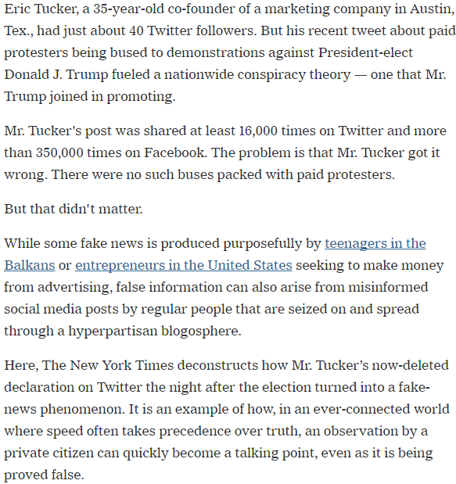
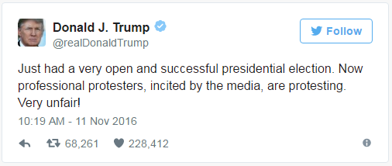
Make use of propagation structure
Notes:
40

Slide 41
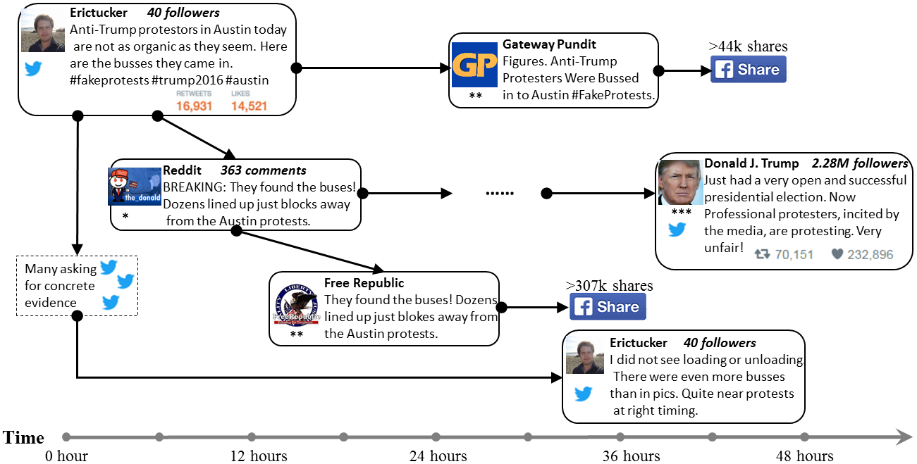
How does it go viral?
‘*’ indicates the level of influence.
Start from a grass-roots users, promoted by some influential accounts, widely spread

Slide 42


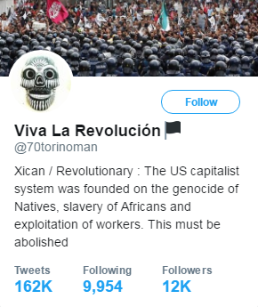
Propagation structure
Text Features
Propagation & Temporal information
User Features
O: Walmart donates $10,000 to support Darren
Wilson and the on going racist police murders
Propagation tree
U6: Need proof of
this-can't find any...
U1: You don't honestly
believe that, do you?
……
U2: i honestly do
U7: not sure....sorry I
see a meme trending
but no proof...perhaps
if we had real journalists?
U3: …Sam Walton gave
300k to Obama's campaign?
THINK.
U5: where is the
credible link?
U8: I'm pretty good at
research-I think this is not
true-plenty of other
reasons to boycott WalMart. :)
U4: Sam Walton was dead
before #Obama was born.
He have wired campaign
donation from heavens.
……

Slide 43
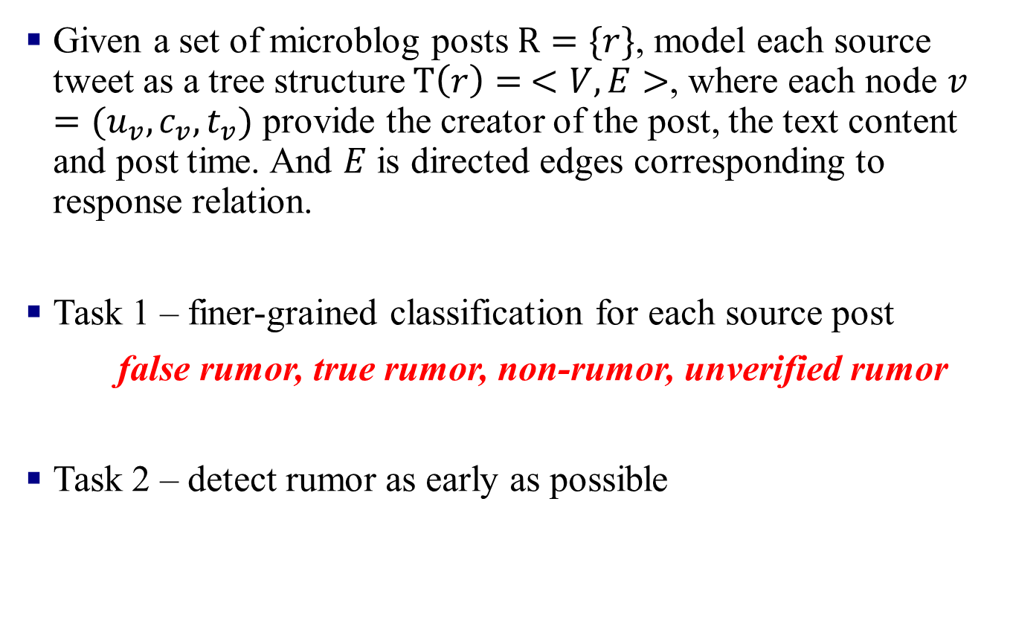
Problem statement (2)
Given a set of microblog posts $R=\{r\}$, model each source tweet as a tree structure $T\left(r\right)= <V,E>$, where each node $v=(u_{v}, c_{v},t_{v})$ provide the creator of the post, the text content and post time. And $E$ is directed edges corresponding to response relation.
Task 1 – finer-grained classification for each source post
false rumor, true rumor, non-rumor, unverified rumor
Task 2 – detect rumor as early as possible

Slide 44
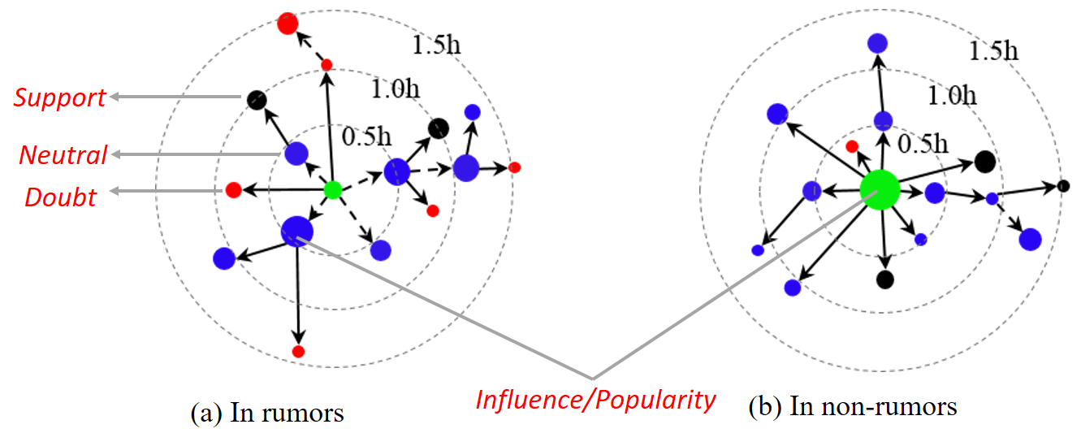
Observation & Hypothesis
Content-based signals (e.g., stance) (Zhao et al., 2015)
Network-based signals (e.g., relative influence) and temporal traits (Kwon et al., 2017)
Our hypothesis: high-order patterns needs to/can be captured holistically using kernel method

Slide 45
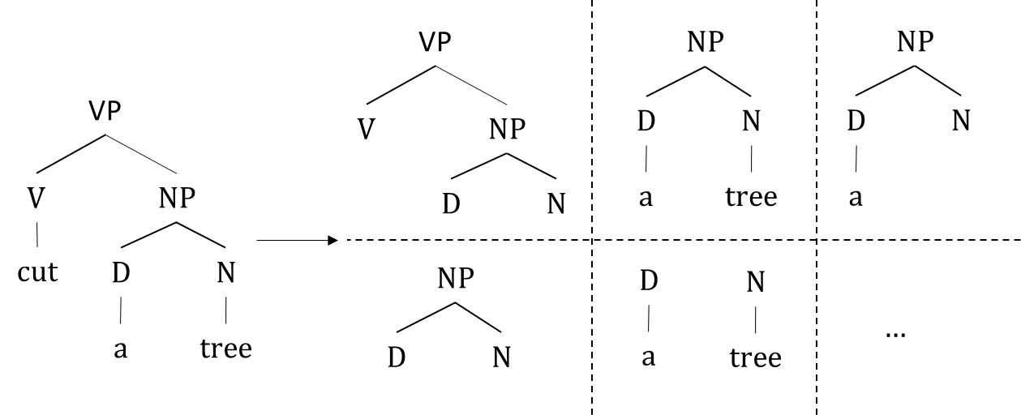
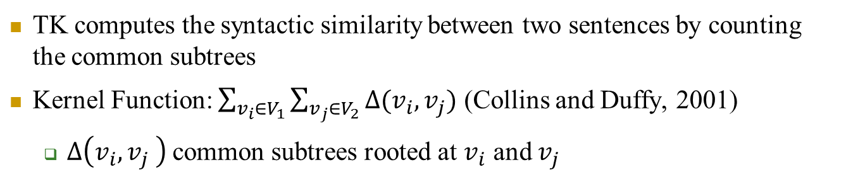
Traditional Tree Kernel (TK) in NLP
TK computes the syntactic similarity between two sentences by counting the common subtrees
Kernel Function: $\sum_{v_{i}∈V_{1}}{\sum_{v_{j}∈V_{2}}{∆(v_{i},v_{j})}}$ (Collins and Duffy, 2001)
  $∆\left(v_{i},v_{j} \right)$common subtrees rooted at $v_{i}$ and $v_{j}$

Slide 46
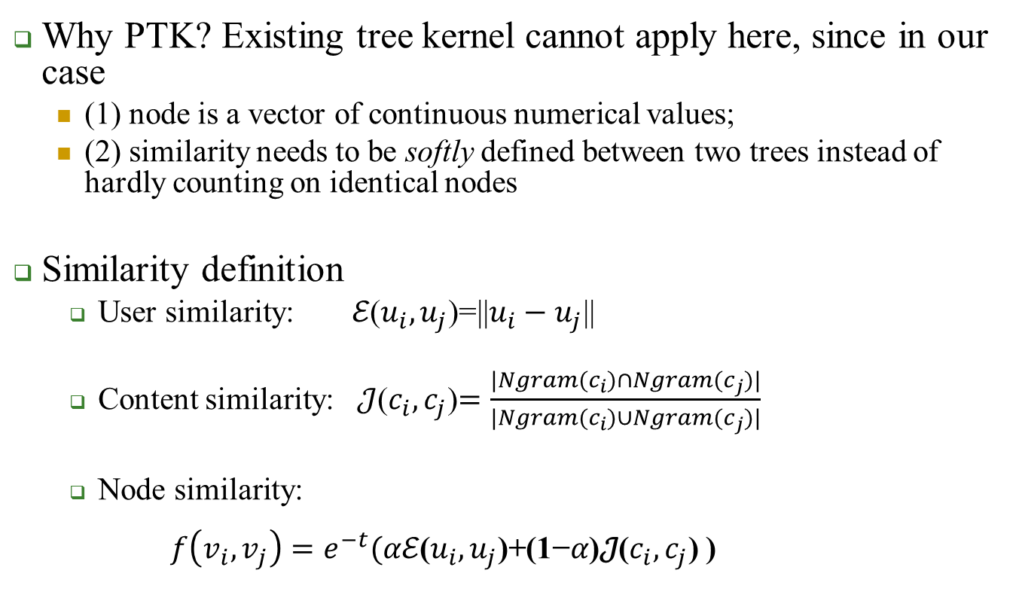
Propagation tree kernel (PTK)
  Why PTK? Existing tree kernel cannot apply here, since in our case
    (1) node is a vector of continuous numerical values;
    (2) similarity needs to be softly defined between two trees instead of hardly counting on identical nodes
  Similarity definition
  User similarity: $ℰ\text{(}u_{i},u_{j}\text{)=}\text{||}u_{i}−u_{j}\text{||}$
  Content similarity: $\text{𝒥}$($c_{i},c_{j}$)$=\frac{|Ngram(c_{i})∩Ngram(c_{j})|}{|Ngram(c_{i})∪Ngram(c_{j})|}$
  Node similarity:
$f\left(v_{i},v_{j}\right)=e^{−t}(αℰ\text{(}u_{i},u_{j}\text{)+(1−}α\text{)}\text{𝒥}$($c_{i},c_{j}$) )

Slide 47





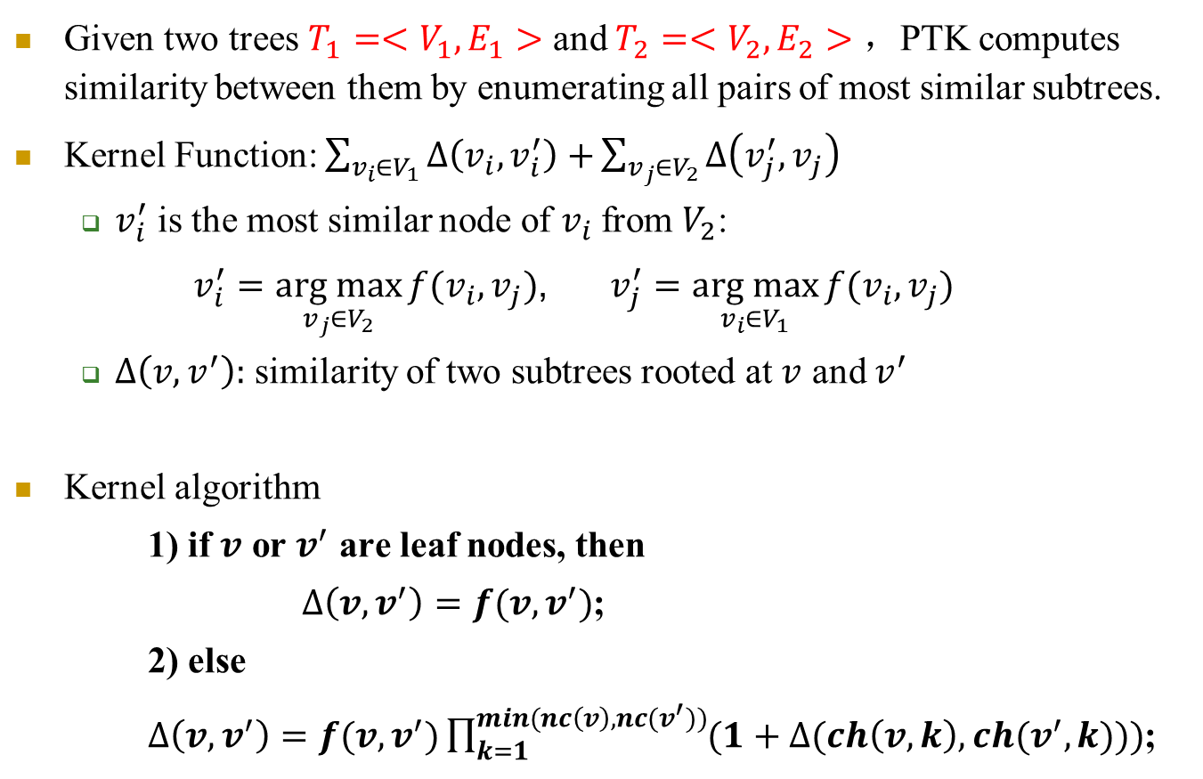
Tree similarity computation
Given two trees $T_{1}=<V_{1},E_{1}>$ and $T_{2}=<V_{2},E_{2}>$ ，PTK computes similarity between them by enumerating all pairs of most similar subtrees.
Kernel Function: $\sum_{v_{i}∈V_{1}}{∆\left(v_{i},v_{i}^{′}\right)+}\sum_{v_{j}∈V_{2}}{∆\left(v_{j}^{′},v_{j}\right)}$
  $v_{i}^{′}$ is the most similar node of $v_{i}$from $V_{2}$:
  $v_{i}^{′}=\underset{v_{j}∈V_{2}}{arg max}{f(v_{i},v_{j})}$, $v_{j}^{′}=\underset{v_{i}∈V_{1}}{arg max}{f(v_{i},v_{j})}$
  $∆\left(v,v^{′}\right):$ similarity of two subtrees rooted at $v$ and $v^{′}$
Kernel algorithm
1) if $v$ or $v^{′}$ are leaf nodes, then
$∆\left(v,v^{′}\right)=f(v,v^{′})$;
2) else
$∆\left(v,v^{′}\right)=f(v,v^{′})\prod_{k=1}^{min(nc\left(v\right),nc(v^{′}))}{(1+∆(ch\left(v,k\right),ch(v^{′},k)))}$;
$$v_{1}$$
$$v_{2}$$
.
Sub-tree
$$v_{3}$$
.
$$v_{4}$$
……
$$v_{5}$$

Slide 48





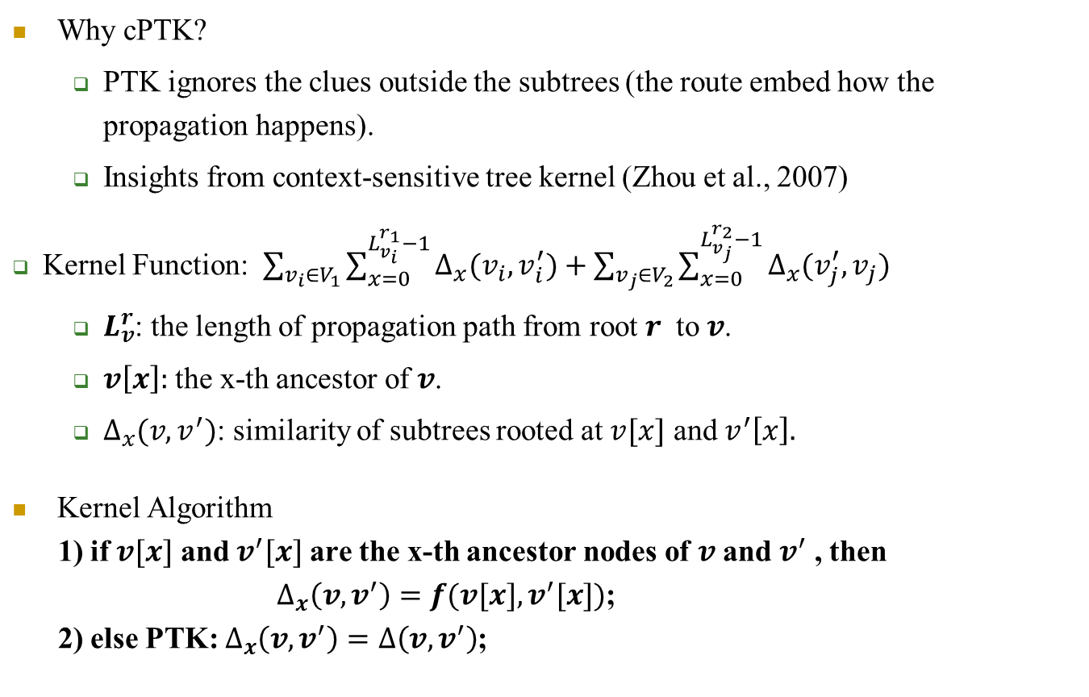
Context-sensitive PTK
Why cPTK?
  PTK ignores the clues outside the subtrees (the route embed how the propagation happens).
  Insights from context-sensitive tree kernel (Zhou et al., 2007)
  Kernel Function: $\sum_{v_{i}∈V_{1}}{\sum_{x=0}^{L_{v_{i}}^{r_{1}}−1}{∆_{x}(v_{i},v_{i}^{′})}}+\sum_{v_{j}∈V_{2}}{\sum_{x=0}^{L_{v_{j}}^{r_{2}}−1}{∆_{x}(v_{j}^{′},v_{j})}}$
  $L_{v}^{r}$: the length of propagation path from root $r$ to $v$.
  $v\left[x\right]:$ the x-th ancestor of $v$.
  $∆_{x}(v,v^{′})$: similarity of subtrees rooted at $v[x]$ and $v^{′}\left[x\right].$
Kernel Algorithm
1) if $v[x]$ and $v^{′}[x]$ are the x-th ancestor nodes of $v$ and $v^{′}$ , then
$∆_{x}\left(v,v^{′}\right)=f(v[x],v^{′}[x])$;
2) else PTK: $∆_{x}\left(v,v^{′}\right)=∆\left(v,v^{′}\right)$;
Context path
$$v_{1}$$
Subtree root
$$v_{2}$$
.
$$v_{3}$$
.
$$v_{4}$$
……
$$v_{5}$$

Slide 49
Classify via Kernel Learning
Incorporate the proposed tree kernel functions (i.e., PTK or cPTK) into a supervised learning framework, for which we utilize a kernel-based SVM classifier.
Avoid feature engineering – the kernel function can explore an implicit feature space when calculating the similarity between two objects.
For multi-class task, perform One vs. all, i.e., building K (# of classes) basic binary classifiers so as to separate one class from all the others.

Slide 50
Outline
Motivation & Background
Related work
Problem statement
Methods of learning to identify rumors
Experiments and results
Conclusions and future work

Slide 51
Data collection
Construct our propagation tree datasets based on two reference Twitter datasets:
  Twitter15 (Reuters) (Li et al., 2015)
  Twitter16 (Built-in-house) (Ma et al., 2015)
Extract popular source tweets
Collect propagation threads
Build trees
Source tweets: highly retweeted or replied tweets
retweets: Twrench.com
replies: Web crawler
Label tree roots based on ground truth

Slide 52
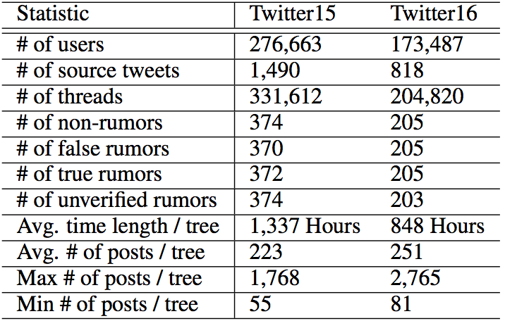
Statistics of data collections
https://www.dropbox.com/s/7ewzdrbelpmrnxu/rumdetect2017.zip?dl=0
Notes:
For generating the summaries, we used a variant of co-hits algorithm to co-rank the sentences and tweets on a bipartite graph by considering both their informativeness and complementarity. We initialized the ranking score of each node with lexrank for the informativeness. The jumping probability between nodes is bi-directional and usually calculated as this, and rou is the similarity function used to be idf-modified-cosine. We modified the similarity function using the proposed complementary measure.

Slide 53
Approaches for comparison
DTR: Decision tree-based ranking model using enquiry phrases to identify trending rumors (Zhao et al., 2015)
DTC and SVM-RBF: Twitter information credibility model using Decision Tree Classifier (Castillo et al., 2011); SVM-based model with RBF kernel (Yang et al., 2012)
RFC: Random Forest Classifier using three parameters to fit the temporal tweets volume curve (Kwon et al., 2013)
SVM-TS: Linear SVM classifier using time-series structures to model the variation of social context features. (Ma et al., 2015)
GRU: The 2-layer RNN-based rumor detection model. (Ma et al., 2016)
BOW: linear SVM classifier using bag-of-words.
Ours (PTK and cPTK): Our kernel based model.
PTK- and cPTK-: Our kernel based model with reduced properties.
Notes:
So the co-ranking is an iterative reinforcement procedure on the bipartite graph, where on the edge is the transition probabilities. The ranking scores of nodes are traded off between the initial score and the weighted sum over the scores of all the linking nodes. So the random walk end up with two ranked lists each for each side. We generate summaries by considering two levels of complementarity, the summary-level and the sentence-level. For summary-level complementarity, we just choose the top ranked sentences and tweets from each ranked list so that the two summaries appear complementary as a whole; for the sentence-level complementary, we start from the top ranked sentences, and for each sentence, we choose the neighboring tweets that have the largest complementary scores. This tries to create one-on-one complementary relation between news sentences and tweets.

Slide 54
Results on Twitter15
NR: Non-Rumor; FR: False Rumor;
TR: True Rumor; UR: Unverified Rumor
Method | Accu. | NR | FR | TR | UR
 |  | F1 | F1 | F1 | F1
DTR | 0.409 | 0.501 | 0.311 | 0.364 | 0.473
SVM-RBF | 0.318 | 0.455 | 0.037 | 0.218 | 0.225
DTC | 0.454 | 0.733 | 0.355 | 0.317 | 0.415
SVM-TS | 0.544 | 0.796 | 0.472 | 0.404 | 0.483
RFC | 0.565 | 0.810 | 0.422 | 0.401 | 0.543
GRU | 0.646 | 0.792 | 0.574 | 0.608 | 0.592
BOW | 0.548 | 0.564 | 0.524 | 0.582 | 0.512
PTK- | 0.657 | 0.734 | 0.624 | 0.673 | 0.612
cPTK- | 0.697 | 0.760 | 0.645 | 0.696 | 0.689
PTK | 0.710 | 0.825 | 0.685 | 0.688 | 0.647
cPTK | 0.750 | 0.804 | 0.698 | 0.765 | 0.733

Slide 55
Results on Twitter16
NR: Non-Rumor; FR: False Rumor;
TR: True Rumor; UR: Unverified Rumor
Method | Accu. | NR | FR | TR | UR
 |  | F1 | F1 | F1 | F1
DTR | 0.414 | 0.394 | 0.273 | 0.630 | 0.344
SVM-RBF | 0.321 | 0.423 | 0.085 | 0.419 | 0.037
DTC | 0.465 | 0.643 | 0.393 | 0.419 | 0.403
SVM-TS | 0.574 | 0.755 | 0.420 | 0.571 | 0.526
RFC | 0.585 | 0.752 | 0.415 | 0.547 | 0.563
GRU | 0.633 | 0.772 | 0.489 | 0.686 | 0.593
BOW | 0.585 | 0.553 | 0.556 | 0.655 | 0.578
PTK- | 0.653 | 0.673 | 0.640 | 0.722 | 0.567
cPTK- | 0.702 | 0.711 | 0.664 | 0.816 | 0.608
PTK | 0.722 | 0.784 | 0.690 | 0.786 | 0.644
cPTK | 0.732 | 0.740 | 0.709 | 0.836 | 0.686

Slide 56
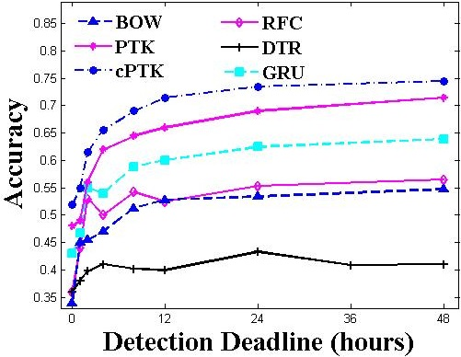
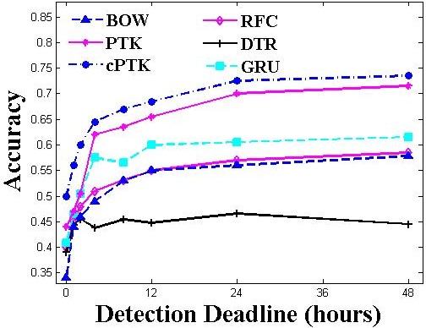
Results on early rumor detection
(a) Twitter15
(b) Twitter16
In the first few hours, the accuracy of the kernel-based methods climbs more rapidly and stabilize more quickly
cPTK can detect rumors with 72% accuracy for Twitter15 and 69.0% for Twitter16 within 12 hours, which is much earlier than the baselines and the mean official report times

Slide 57
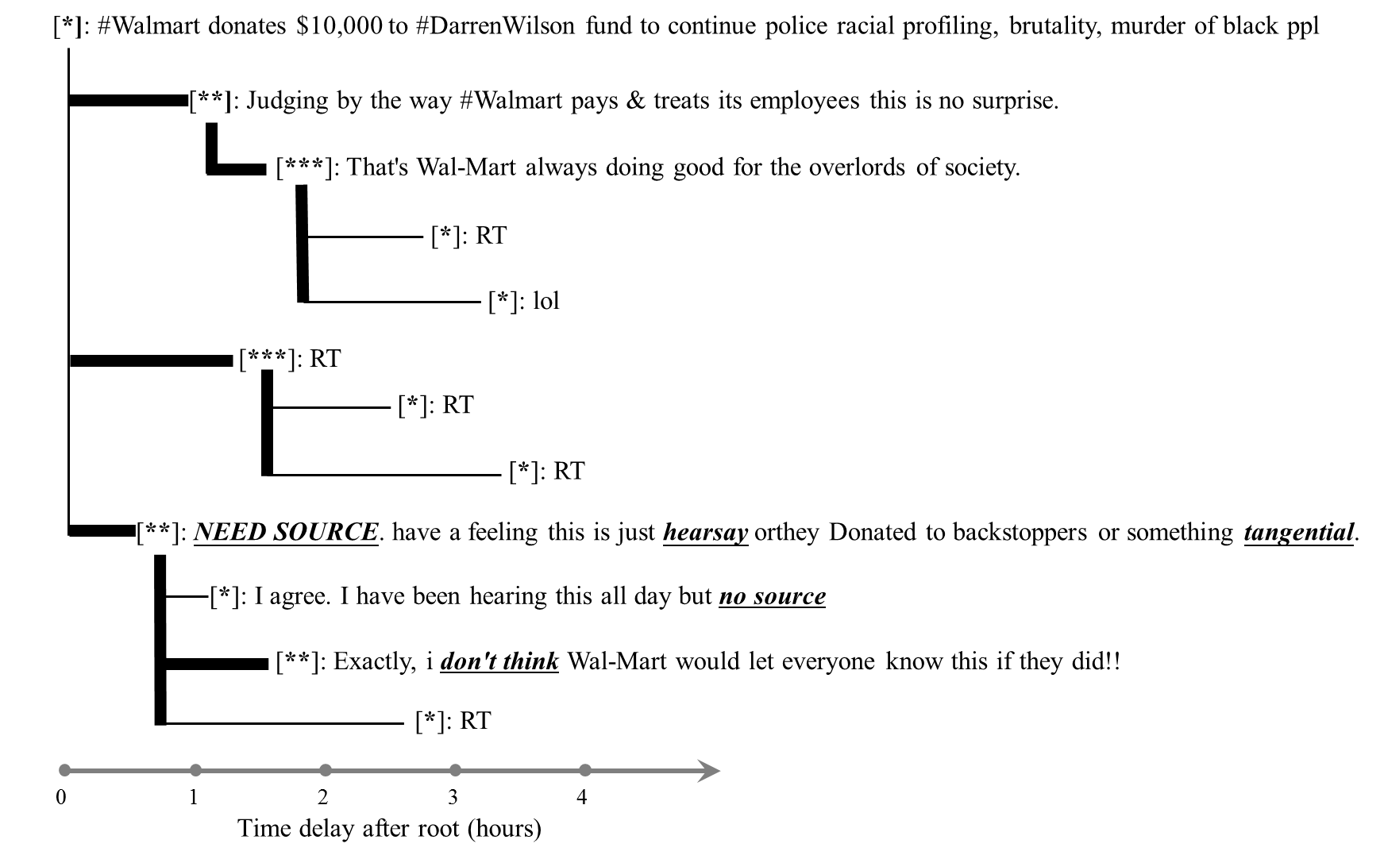
Early detection example
Influential users boost its propagation
Clear unpopular-to-popular-to-unpopular trend in terms of user popularity
(2) Textual signals (underlined)

Slide 58
Outline
Motivation & Background
Related work
Problem statement
Methods of learning to identify rumors
Experiments and results
Conclusions and future work

Slide 59
Conclusion and future work
Apply kernel learning method for rumor debunking by utilizing the propagation tree structures.
Propagation tree encodes the spread of a source tweet with complex structured patterns and flat information on content, user and time associated with the tree nodes.
Our kernel are combined under supervised framework for identifying rumors of finer-grained levels by directly measuring the similarity among propagation trees.
The proposed method outperforms all the state-of-the-art baselines including GRU-based RNN model.
Future work:
  Explore network representation method to improve the rumor detection task.
  Develop unsupervised models due to massive unlabeled data from social media.

