Slide 1
School of
Engineering and Computer Science
Te Kura Mātai Pūkaha, Pūrorohiko
CYBR 171 T1 2024
Ngā whakapūtanga o Te Haumaru rorohiko
Cybersecurity Fundamentals
Week 12 – Recap, Test revision, and Q/As

Slide 2
What are we going to cover?
Coverage
Format & information
Preparation tips

Slide 3
Format & Information

Slide 4
Format
TWO hour
Multichoice Questions
80 Questions, 1 Mark each, choose the best answer
Marks from first test and this exam

Slide 5
Information
When is the test?
  Monday 10th June 2024, all students
  2.30pm New Zealand Time
Where?
The test will be in different rooms based on the surname
KKLT301: A – Co
HULT323: Cr-J
KKLT303: K-Pi
HMLT205: Pr-Z
PLEASE ENSURE YOU GO TO THE CORRECT ROOM!!
This information is also available in your individual Pūaha page

Slide 6
All students
BRING YOUR STUDENT ID (or an alternative photo ID, e.g., passport or driver licence, if the student ID is not available)
Please ensure this is in the name under which you are enrolled!

Slide 7
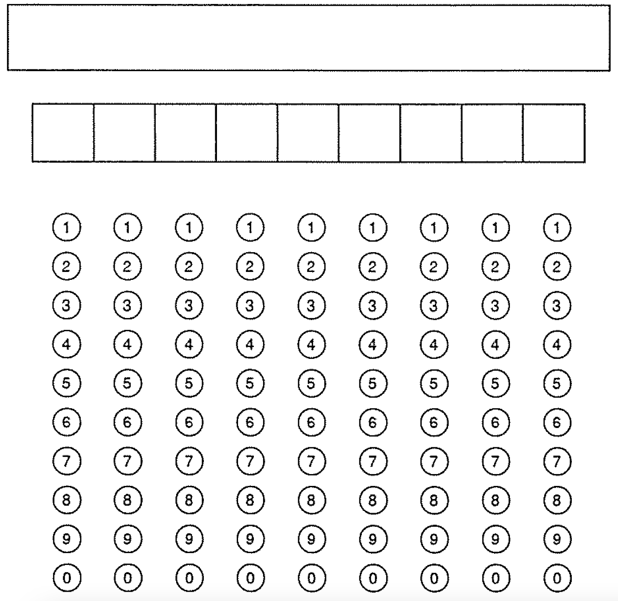
Student name and ID – don’t forget!!!!
Joe Bloggs
3 0 0 1 3 9 6 4 2

Slide 8
Exam rules
You can’t enter the exam room later than the midpoint of the exam (3.30pm for our exam).
You can’t leave the exam room earlier than the midpoint of the exam (also 3.30pm).
After the midpoint of the exam (3.30pm), you can only leave with permission of the invigilator, and only once you have given them your exam papers and any materials.
Once you have handed in your exam papers and materials and left the exam room, you cannot re enter the room.

Slide 9
Materials used during exams
Fill out the answer sheet provided.
Use black or blue pen only.
No calculators required or allowed.
English to foreign language paper dictionary is allowed.
Pencil cases are not permitted unless clear and shown to the invigilator at the start.
Mobile phone must be switched off, kept in a clear ziplock bag under your seat. This ziplock bag can contain your keys, wallet, and any life saving medication.

Slide 10
Exam rules cont.
All other electronic devices including smart watches, fitbits etc must be switched off and left in your bag at the front of the room or given to the invigilator.
You must turn off your phone and any other electronic devices completely, as alarms and notification override silent and do not disturb modes.

Slide 11
If you arrive late or miss the exam:
Email the examinations management team exams@vuw.ac.nz immediately, and/or
Go to the examinations control room Murphy building MY209

Slide 12
Coverage

Slide 13
Content
You will be examined on any of weeks 1-12 content, not only what is listed on today’s slides!
Remember to check the modules especially:
  Week 5 - malware/anti malware
  Week 6 – how the internet and web work
Guest lectures are not included
Lab work aside from lab exercise 3 – web security, what you learnt there is reinforced in the lecture

Slide 14
Examination structure
Organised by theme rather than by week
Foundational [20 marks] – concepts, cryptography and authentication
People and physical security [10 marks] – social engineering and physical protection
System, network and web security [30 marks] – malware & antimalware, internet & web fundamentals, network security and defences
Incident response and consequences [20 marks] – laws & ethics, digital forensics and incident response

Slide 15
What is cybersecurity
Week 1

Slide 16
What is cybersecurity
Cybersecurity key concepts
What is cybersecurity?
What are protecting against and how?
Who are the attackers?
Examples of cybersecurity failures.

Slide 17
cryptography
Weeks 2-3

Slide 18
Classical cryptography
Introduction to cryptography
  Steganography versus ciphers
  Types of cryptographic technologies
  Computationally (perfectly) secure encryption
Transposition, substitution, polyalphabetic ciphers
Syctale, columnar transposition, caesar cipher, code talkers, vigenère, electromechanical and one time pads
Understanding cryptanalysis

Slide 19
Building blocks modern cryptography
Secure communication in the presence of adversaries
Based on mathematical rigor, open standards, and computational complexity
Goals are confidentiality, integrity, authenticity and non-repudiation
Symmetric encryption
  DES, 3DES and AES
Asymmetric encryption
  RSA

Slide 20
Cryptographic protocols
Protocol defines rules for communication
Cryptographic hashes
  Integrity but not confidentiality or non-repudiation
  Example – securing file transfers
Digital signatures
  Integrity and non-repudiation but not confidentiality
  Validating a public key
  Public key certificates distributed via trusted authorities (built into browsers and key servers vs. Web of trust)

Slide 21
Authentication
Week 4

Slide 22
Authentication Part 1
Passwords
  How to meet conflicting requirements
  Hashing
  Salts
What’s wrong with passwords and some fixes
How hardware tokens can be classified in terms of types of passwords and connectivity.
Outline how TOTP and Challenge-Response password types work.
Identify hardware token vulnerabilities.

Slide 23
Authentication Part 2
How software tokens can be classified in terms of types of passwords and connectivity.
Identify software token vulnerabilities.
Explain why software tokens are more vulnerable than hardware tokens.
Discuss why it is important to have 2FA and MFA.
Explain biometric-based authentication techniques
Identify biometrics vulnerabilities
Discuss issues related to facial recognition systems

Slide 24
Malware and anti-malware
Week 5

Slide 25
Malware
Malware – what is it and different types
  Trojan horse, viruses, worms
Delivery methods
  Human and technical methods
  Arrives in parts – droppers and multistage
Infection targets
  Media, executables, RAM, documents, all the things
Payload types
  Financial gain, destruction, defacement, information gathering, maintain access

Slide 26
Anti Malware
Anti malware/anti virus
Detection or scanning methods used by anti-virus/anti-
malware systems
Four scanning methods to detect viruses and malware
  Integrity checkers, signature-based detection, heuristic and behavioural Detection
Strategies for evading detection
Challenges for malware systems

Slide 27
web and network SECURITY vulnerabilities and attacks
Weeks 6-7

Slide 28
Internet and web fundamentals
The internet
  Network of networks, local area networks (bus, switched, star), role of routers in scaling up networks
  ISPs and internet backbone, IP4, IP6, domain names and ports
The web
  Web history
  Client, server, packet, hyperlinks, URLs, HTTP, HTML, web server
  Web browser architecture
  Example php web application

Slide 29
Web security
Browser-side vulnerabilities and countermeasures
  HTTP, cookies, malware, bad extensions
Web application vulnerabilities
  OWASP top 10, web application architecture
  Broken access control, cryptographic failures and injection
  Examples from Juiceshop and countermeasures

Slide 30
Network security
Expanding attack surface
Three common attacks – denial-of-services, eavesdropping, man-in-the-middle/meddler-in-the-middle (MitM)
Attack methodology and tools – attacker methodology, example tools for each phase
Real-world case studies – stuxnet, target data breach, notPetya

Slide 31
Network Security Defences
Week 8

Slide 32
Firewalls and VPNs
PART 1
  What is a firewall?
  How do we describe firewall policies?
  What do advanced firewalls allow?
  How do we configure a personal firewall?
PART 2
  What is a VPN?
  How do VPNs work?
PART 3
  Understand the risks of using VPNs.
  Understand the difference between VPNs and TOR.

Slide 33
IDS and honeypots
PART 1:
  What is an intrusion?
  The main purpose of an intrusion detection system.
PART 2:
  Network versus host-based IDS.
  Anomaly versus misuse-based detection.
  Classification accuracy and tradeoffs.
PART 3:
  Honeypots for observing attackers.

Slide 34
Social engineering
Week 9

Slide 35
What is social engineering?
PART 1:
  What is social engineering?
  Targets of social engineering
  The impact of the Internet on the scalability of social engineering
PART 2: Top threats
PART 3: Steps to perform social engineering attacks
PART 4: Countermeasures

Slide 36
What is social engineering?
Examples of social engineering attacks (non-exhaustive).
  Phishing, whaling, tailgating, pretexting, spamming, quid pro quo, Spanish prisoner …
Why do they work?
What we know from experimental evidence
  Solomon Asch
  Stanley Milgram
  Philip Zimbardo

Slide 37
Why does social engineering work?
Why do people fall for social engineering?
Cognitive psychology
Decision science
Social psychology

Slide 38
Protection Model & Physical Security
Week 10

Slide 39
Protection Model
Protection model and the principle of defence in depth
  Deter
  Detect
  Alarm
  Delay
  Respond
Model of understanding protection – threats, walls and barriers.
Discussed each element with real-world example from case study.

Slide 40
Physical protection
Safety vs security
Physical Protection System Integration Objectives
Physical Security Vulnerabilities
  Methods of breaking into a building and countermeasures
Remarks
Understanding the importance of physical security
Looking for physical security vulnerabilities
Implementing countermeasures for physical security attacks

Slide 41
Incident response
ETHICAL AND LEGAL
Week 11

Slide 42
Ethics and legal
  Discuss different types of computer crimes
  Understand the types of intellectual property
  Understand the key issues in the area of privacy
  Compare various approaches to codifying computer ethics

Slide 43
Ethical aspects
The differences between Ethics and law
Types of computer crimes
Types of property and intellectual property
Privacy
Ethical Issues
Codes of ethics vs The Rules

Slide 44
Incident Response
Forming a team
What goes into the plan
Playbooks
Maintaining capability

Slide 45
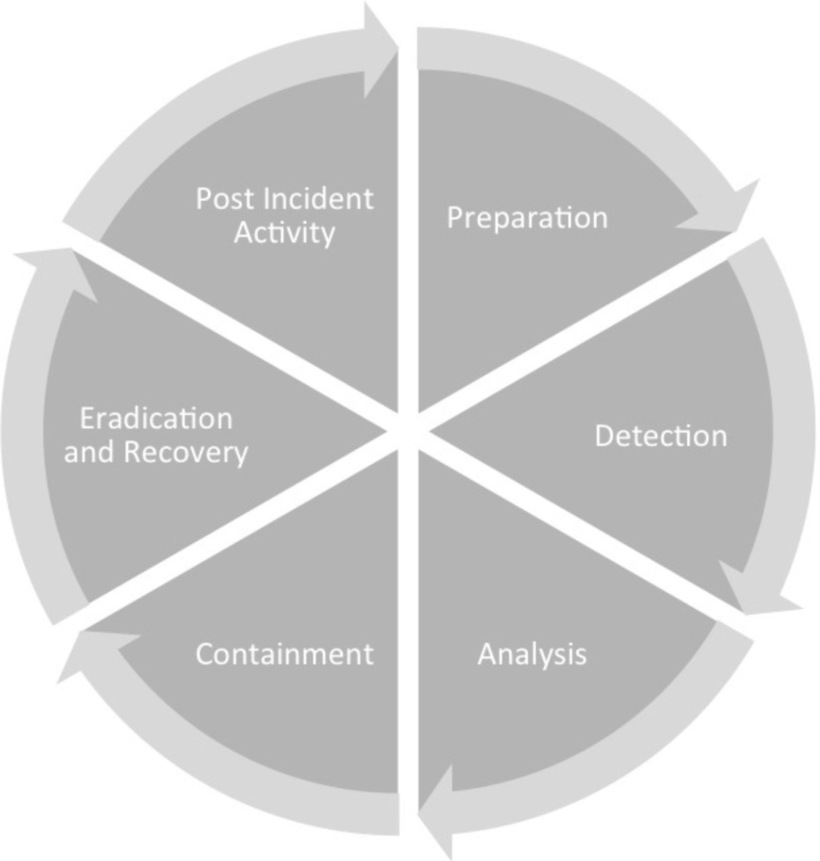
Incident response process
Image from Chapter 1, Incident Response, Digital Forensics and Incident Repsonse, Gerard Johansen, Pakt Publishing (2017)
Notes:
Be familiar with the components of each stage of the process

Slide 46
Incident response and forensics
Incident response process
  Preparation
  Detection
  Analysis
  Containment
  Eradication and Recovery
  Post incident activity
Incident response Team
  Who does what in incident response scenarios
Plans and processes (Playbooks)

Slide 47
Digital Forensics
Week 12

Slide 48
Digital forensics
Brief overview of digital forensics
What’s it for
Legal aspects
Phases
What you need to do it

Slide 49
Digital forensics
Types of evidence and admissibility
Digital forensics process
  Identification
  Preservation
  Collection
  Examination
  Presentation
Chain of custody
Digital Forensics
Lab and Tools

Slide 50
Preparation Tips

Slide 51
General tips
Review 2024T1, 2023T1, and 2022T1 tests/exams
Office hours next week
  Ian: Wednesday 5 June 2-3pm and Friday 7 June 2-3pm CO128
  Lisa: unavailable (working away)
Notes:
The two exams are more than enough to practice for the test

Slide 52

Gosoapbox

