Slide 1
School of
Engineering and Computer Science
Te Kura Mātai Pūkaha, Pūrorohiko
Threat Modeling with STRIDE
Example
CYBR 271 T2 2024
Ian Welch

Slide 2
This lecture
Modelling threat modelling using STRIDE
CYBR 271: Secure Programming
Slide 2

Slide 3
Helpdesks

Slide 5
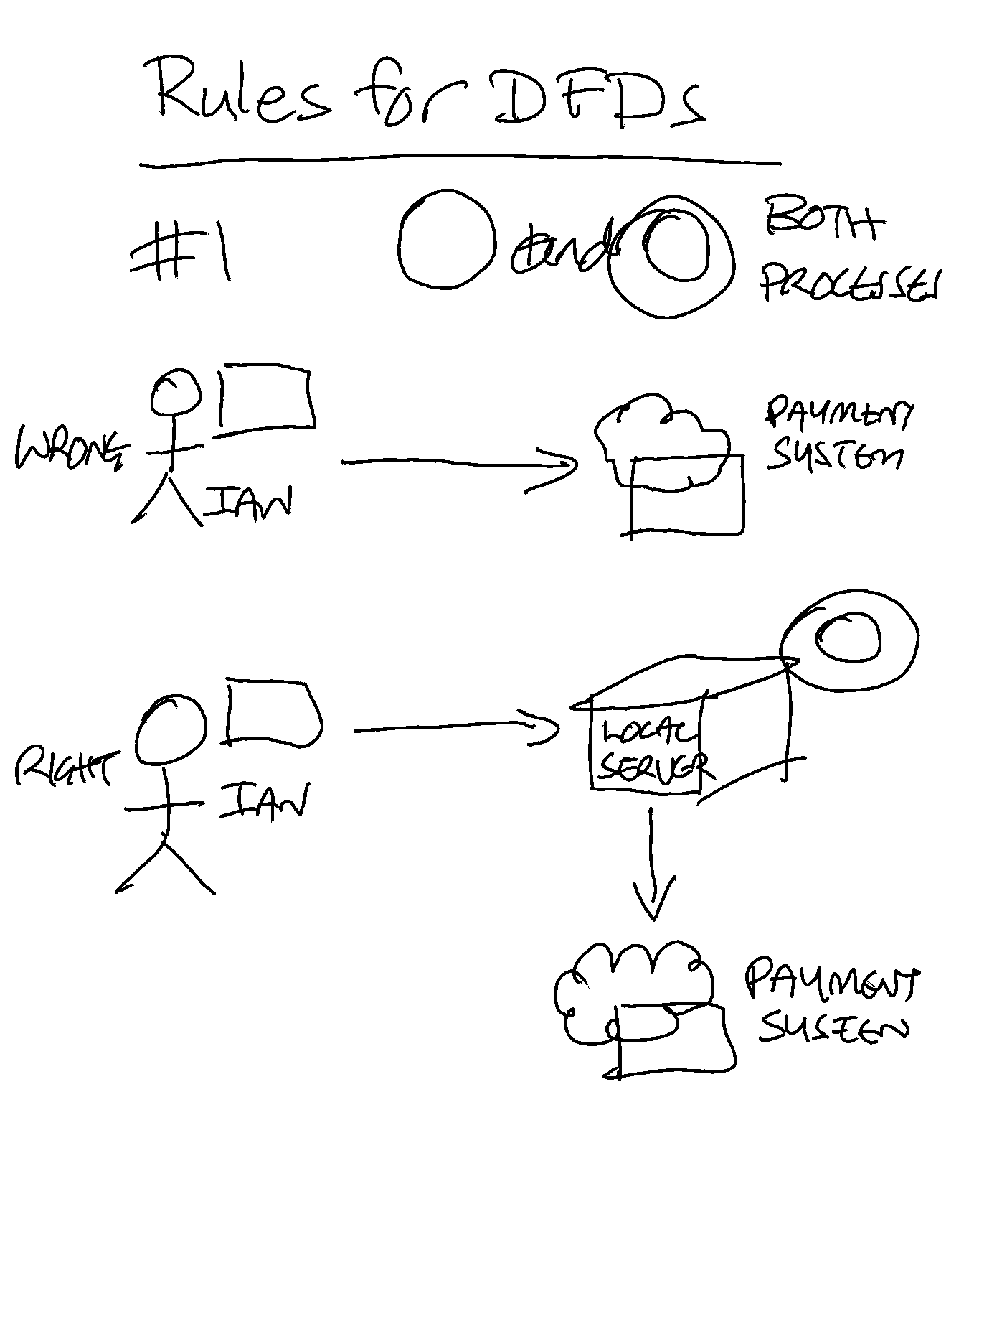
Rules for DFDs
Data cannot flow between two interactors – Data flow must be from interactor to a process or a process to an entity. There can be multiple data flows between one interactor and a process.
CYBR 271: Secure Programming
Slide 5

Slide 6
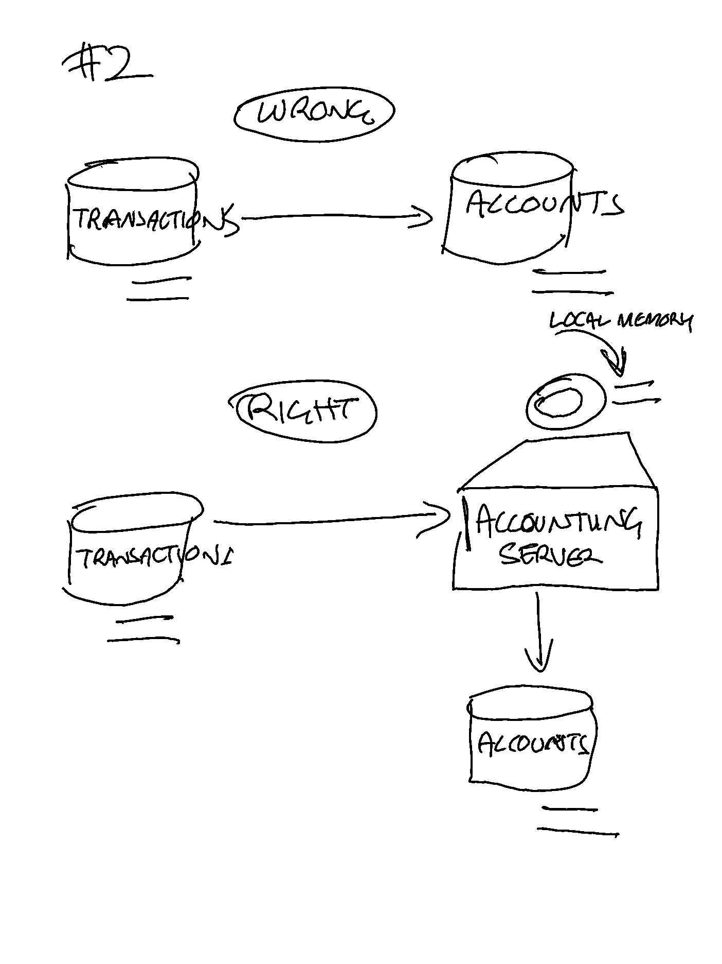
Rules for DFDs
2. Data cannot flow between two datastores – Data flow must be from datastore to a process or a process to a datastore. Data flow can occur from one data store to many processes.
CYBR 271: Secure Programming
Slide 6

Slide 7
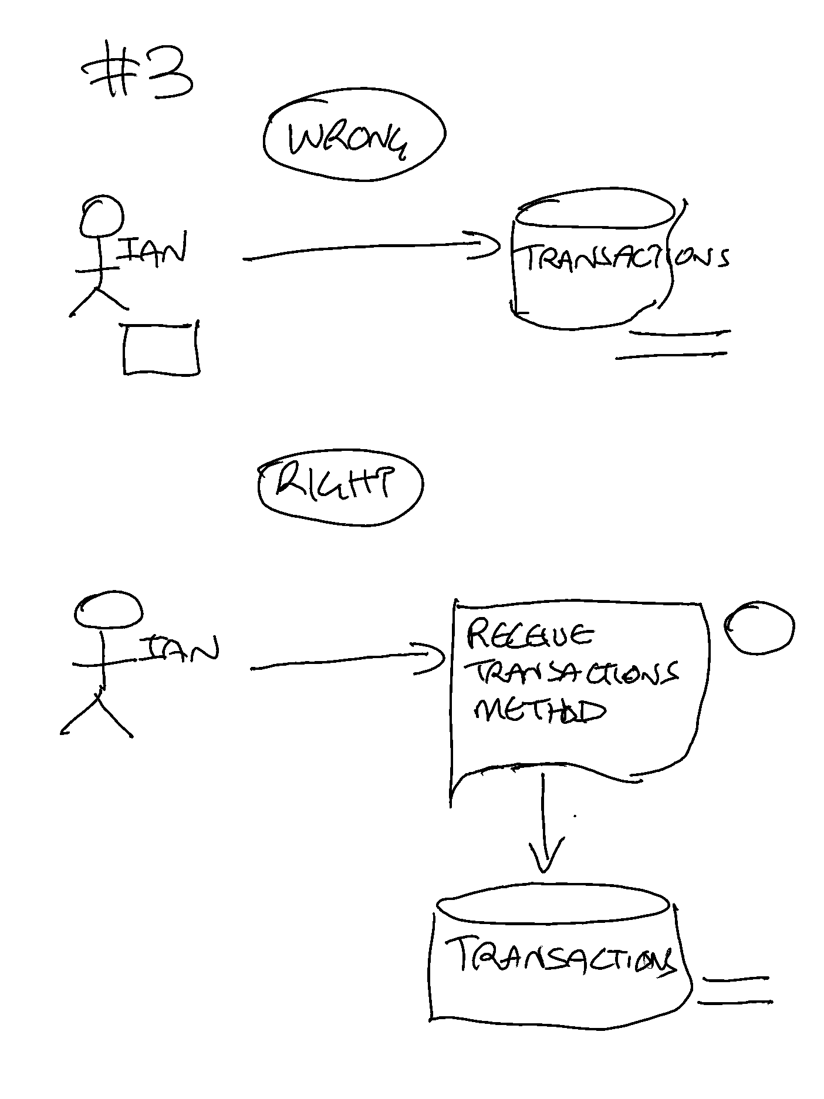
Rules for DFDs
3. Data cannot flow directly from an interactor to data store – Data Flow from entity must be processed by a process before going to data store and vice versa.
CYBR 271: Secure Programming
Slide 7

Slide 8
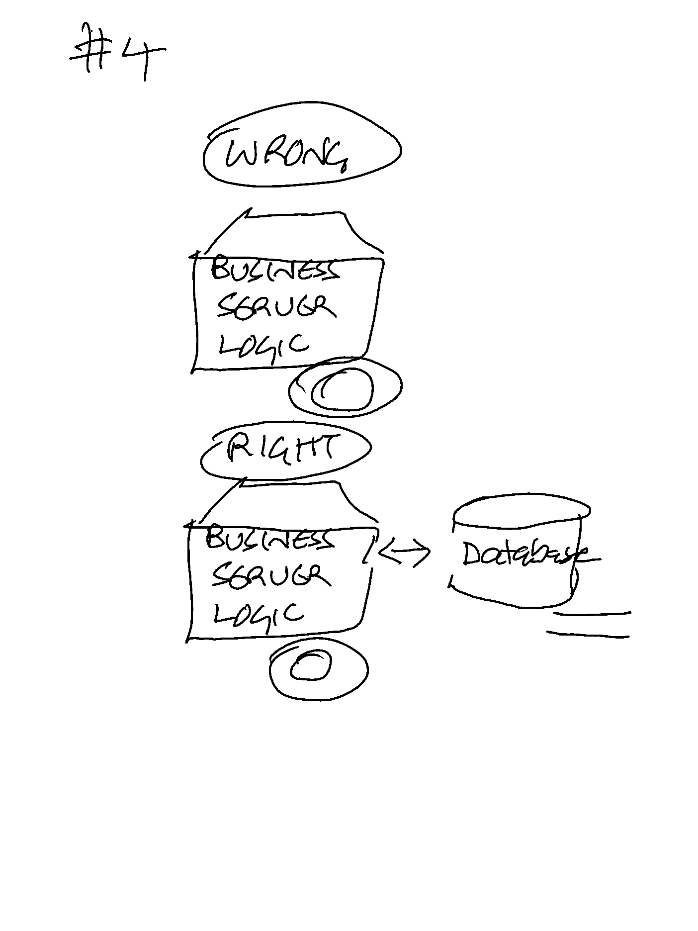
Rules for DFDs
4. A process must have at least one input data flow and one output data flow – Every process must have input data flow to process the data and an output data flow for the processed data.
CYBR 271: Secure Programming
Slide 8

Slide 9
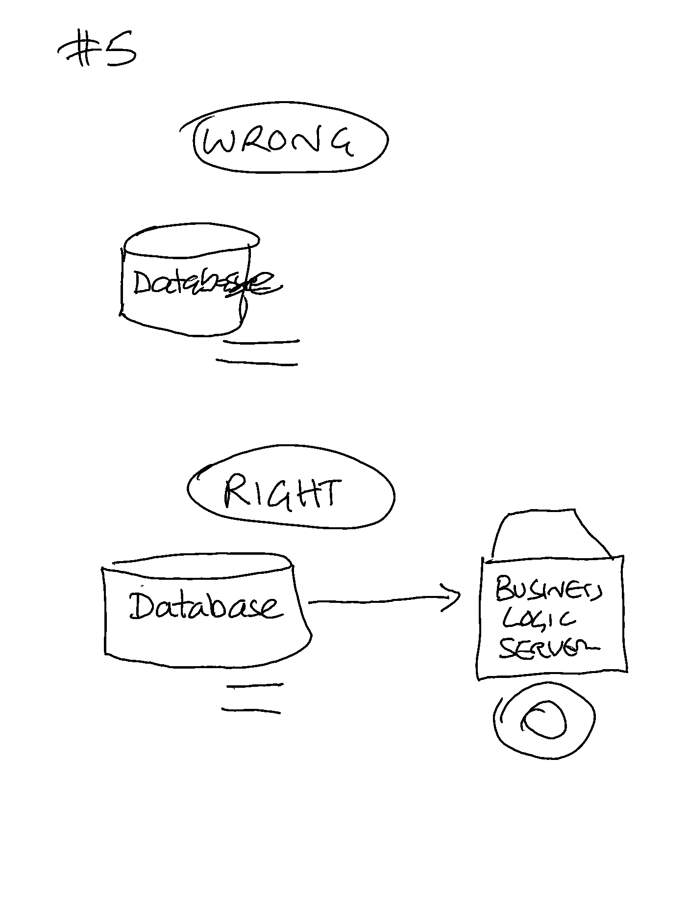
Rules for DFDs
5. A data store must have at least one input data flow and one output data flow – Every data store must have input data flow to store the data and an output data flow for the retrieved data.
CYBR 271: Secure Programming
Slide 9

Slide 10
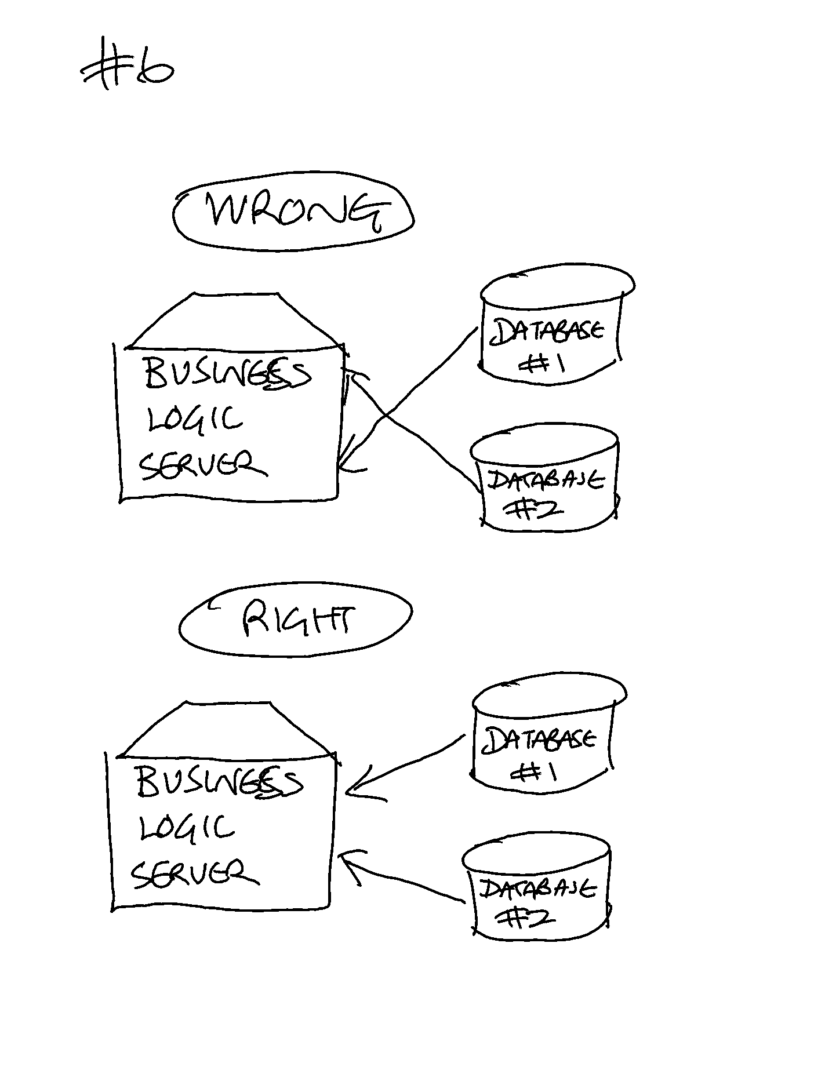
Rules for DFDs
6. Two data flows can not cross each other and all processes must be linked to minimum one data store or any other process/interactor.
https://www.geeksforgeeks.org/rules-for-data-flow-diagram/
CYBR 271: Secure Programming
Slide 10

Slide 11
Use case – register voters
Person visits voting website.
Person provides name and registered address AND MOBILE PHONE NUMBER AND EMAIL
System compares with the details of file, and if they match the person must now verify themselves.
Person can verify either by:
providing their driver licence details
providing their passport number
Using RealMe
Once verified person registered as elector for election and access code sent via mobile phone number or email

Slide 12
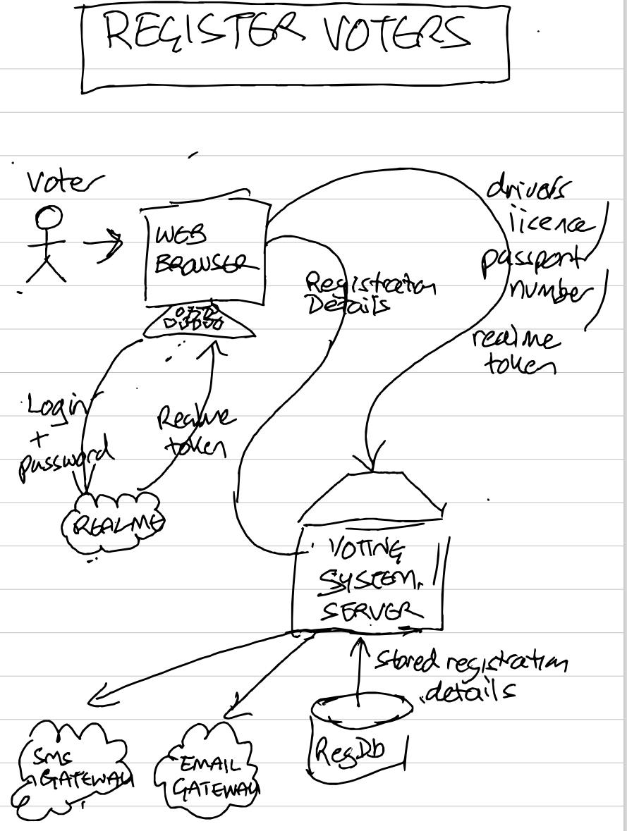

Slide 13
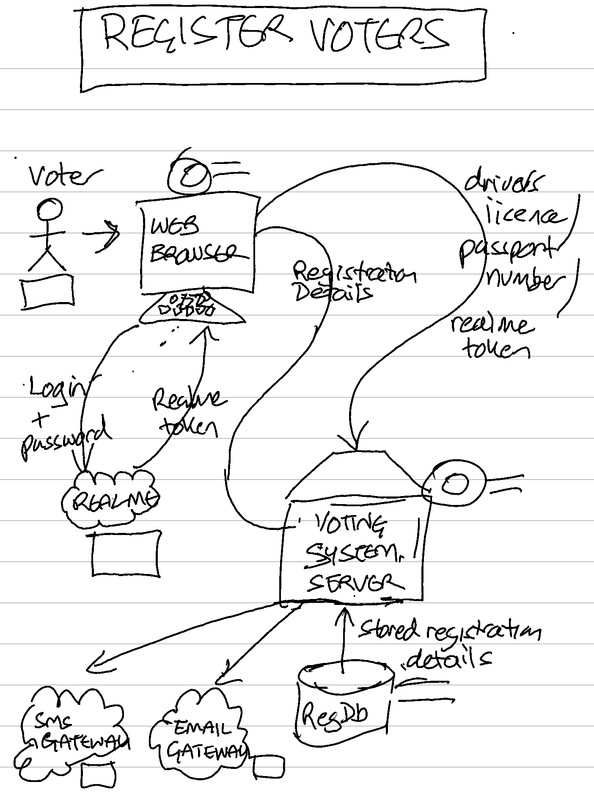

Slide 14
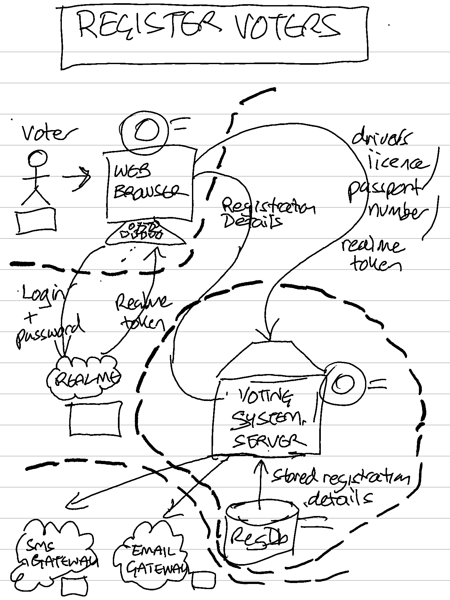

Slide 15
STRIDE
Type | Description | Security Control
Spoofing | Threat action aimed at accessing and use of another user’s credentials, such as username and password. | Authentication
Tampering | Threat action intending to maliciously change or modify persistent data, such as records in a database, and the alteration of data in transit between two computers over an open network, such as the Internet. | Integrity
Repudiation | Threat action aimed at performing prohibited operations in a system that lacks the ability to trace the operations. | Non-Repudiation
Information disclosure | Threat action intending to read a file that one was not granted access to, or to read data in transit. | Confidentiality
Denial of service | Threat action attempting to deny access to valid users, such as by making a web server temporarily unavailable or unusable. | Availability
Elevation of privilege | Threat action intending to gain privileged access to resources in order to gain unauthorized access to information or to compromise a system. | Authorization

Slide 16
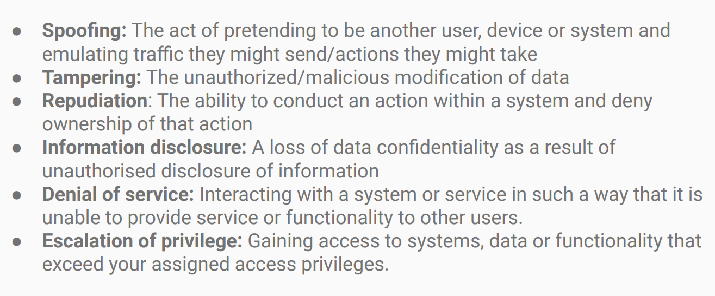
The threats
CYBR 271: Secure Programming
Slide 16

Slide 17
CYBR 271: Secure Programming
Slide 17

Slide 18
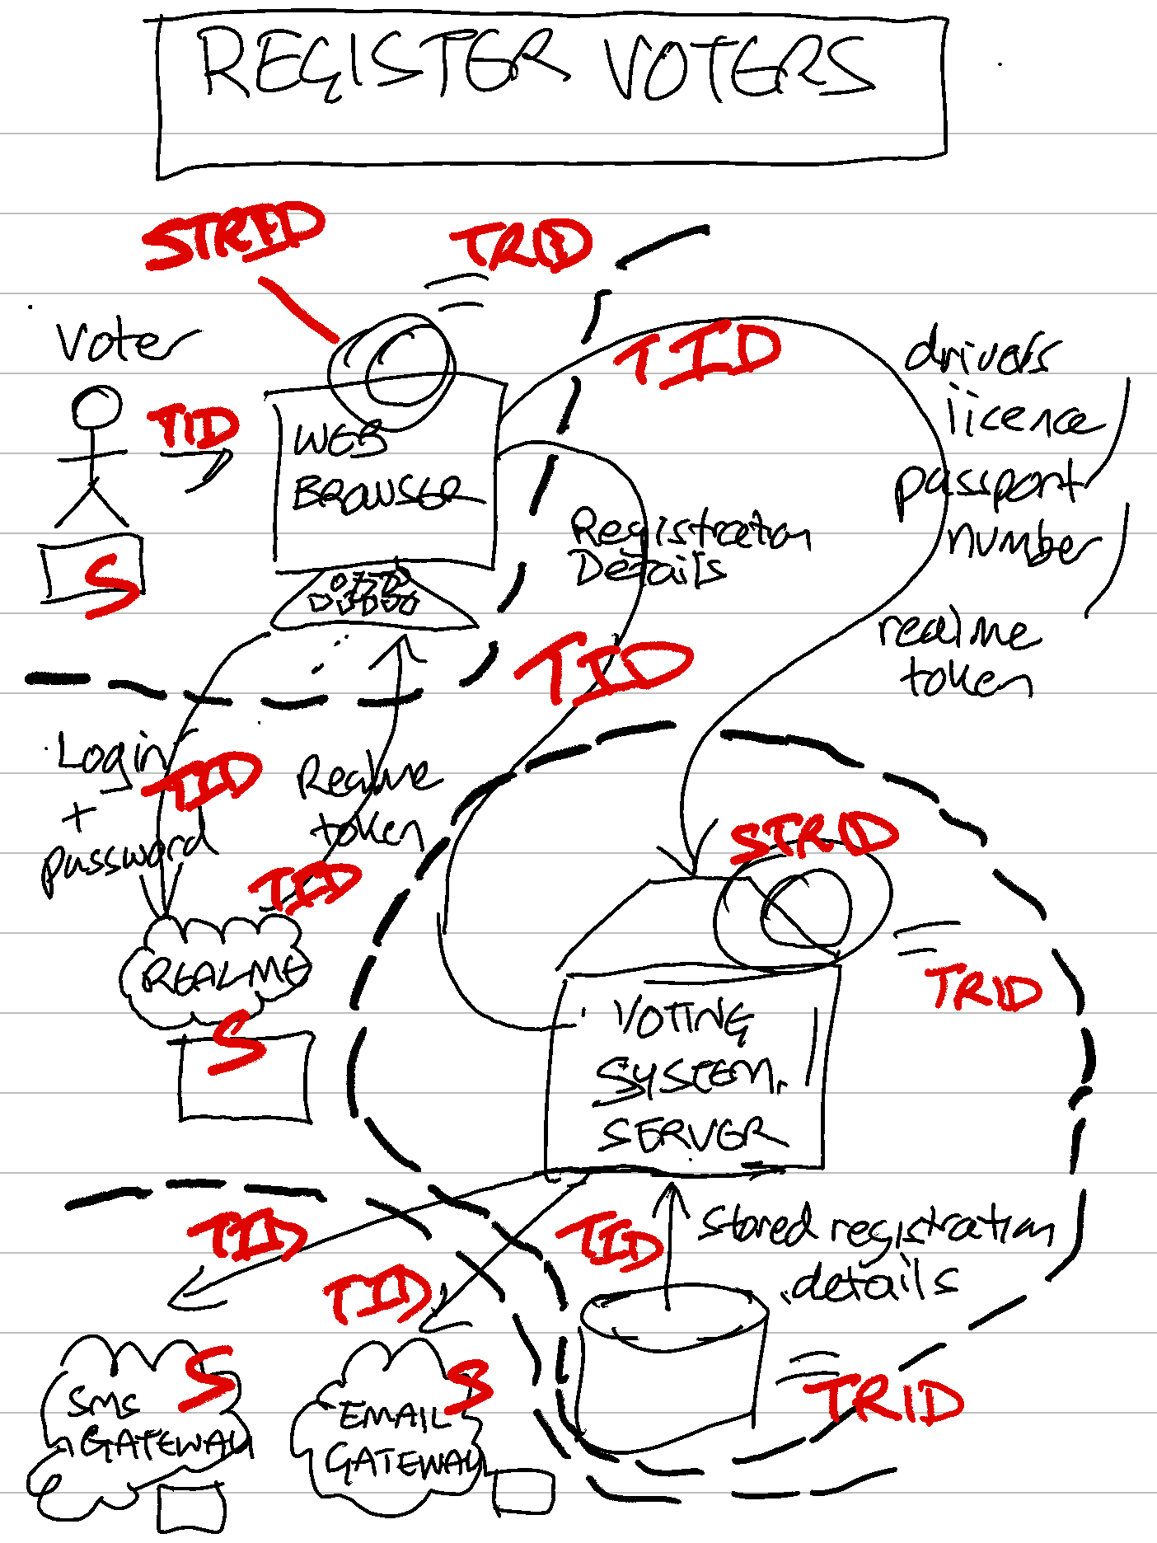

Slide 19
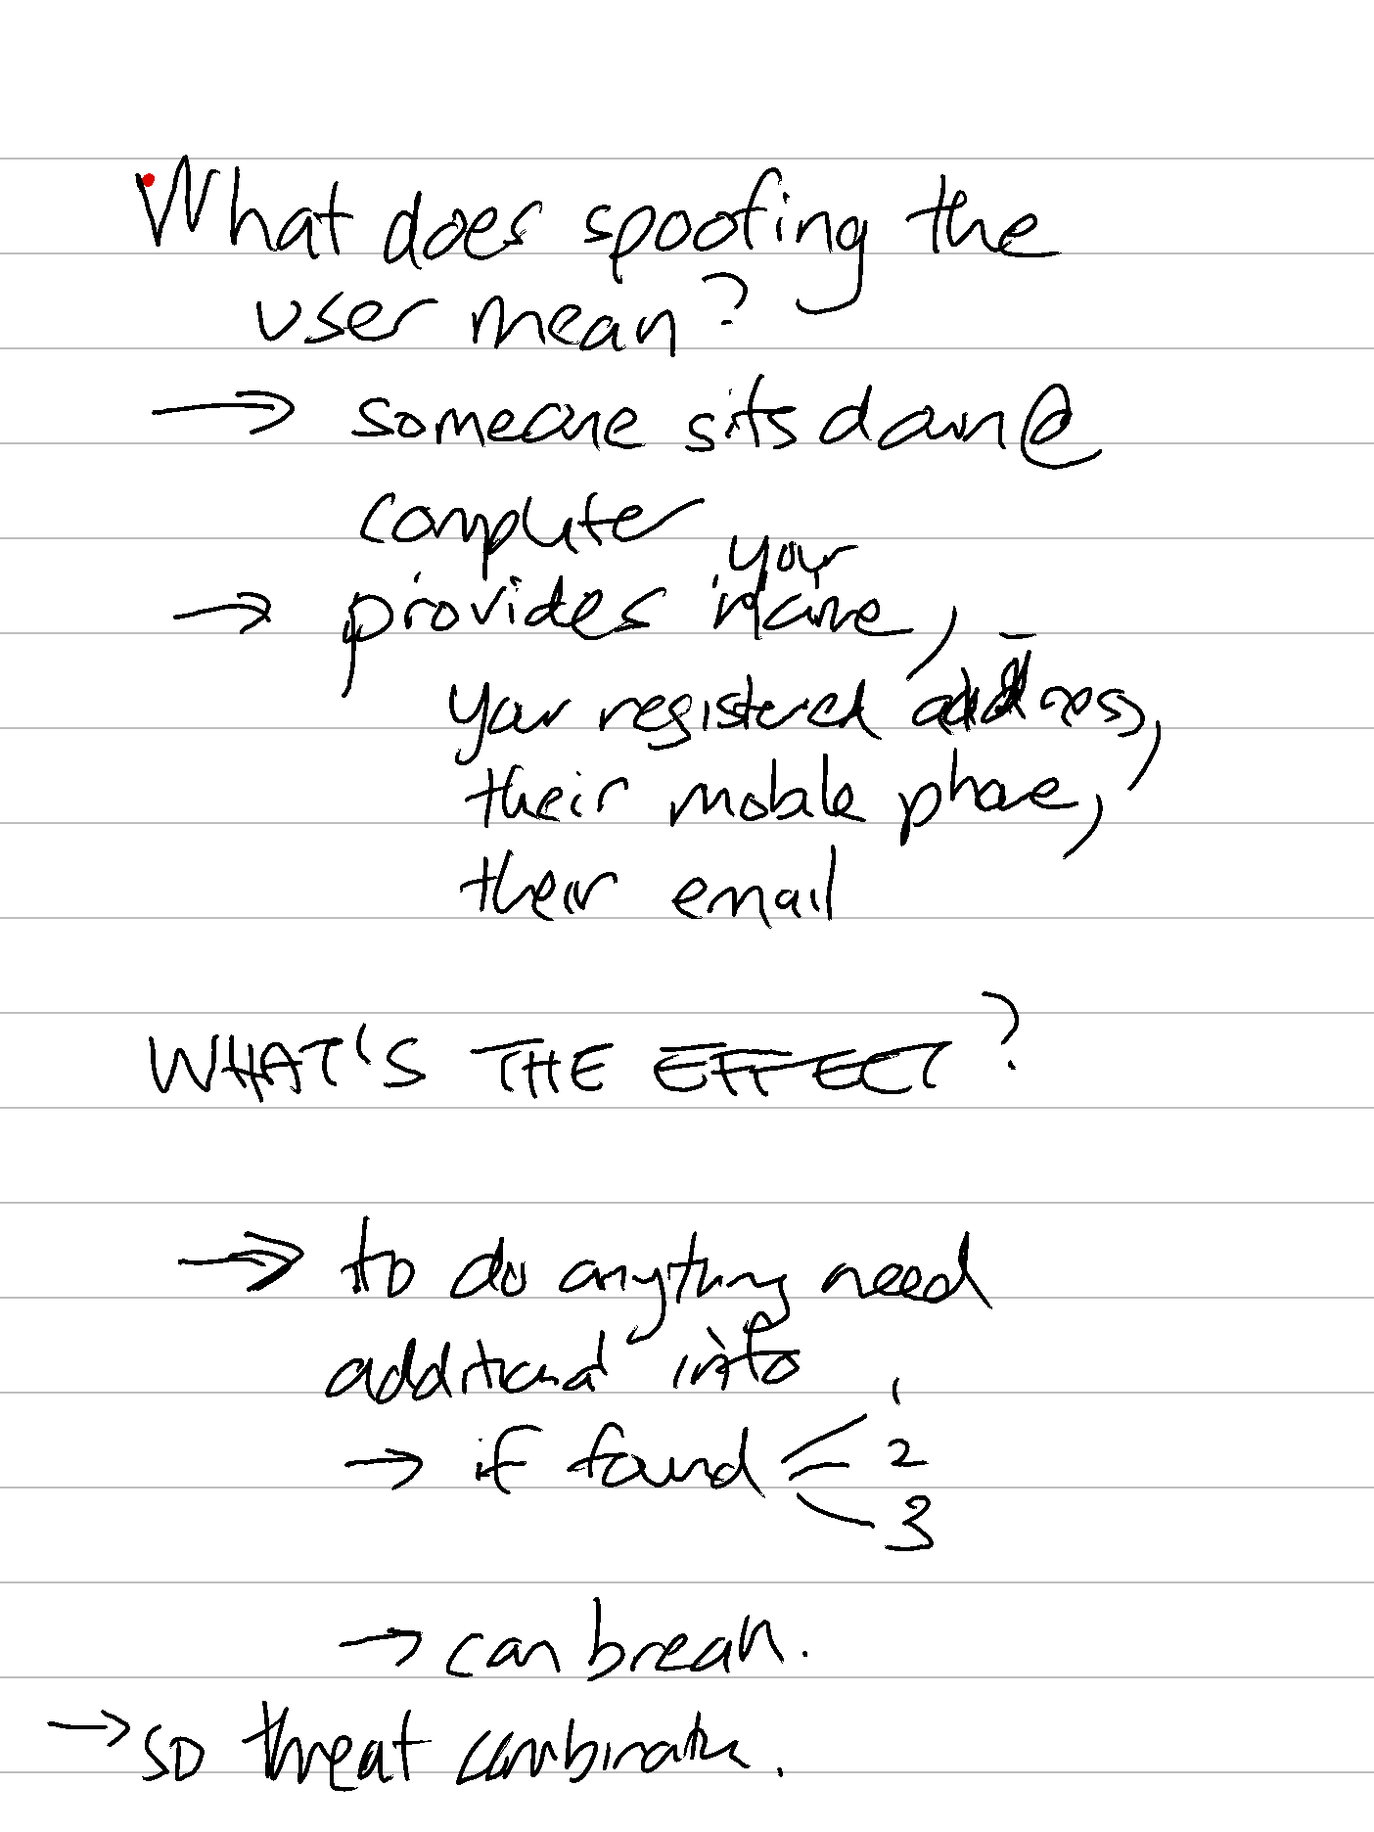

Slide 20
