Slide 1
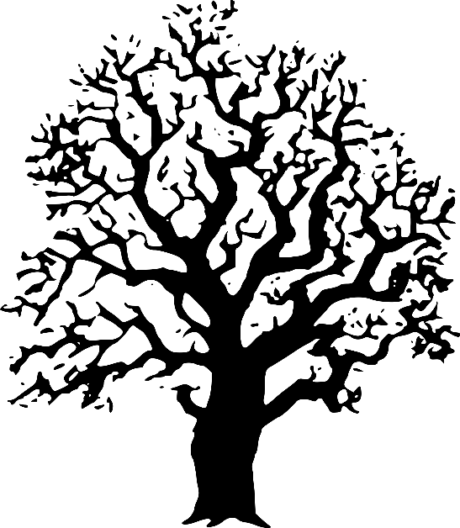
Decision Tree Learning Methods
Dr Andrew Lensen
Andrew.Lensen@ecs.vuw.ac.nz

Slide 2
How do humans make decisions?
Have a think about the last decision you made…
What factors did you take into account?
Can you make these into a set of rules?

Slide 3
How can we make this into an algorithm?
It would be really useful to teach computers to “think” in this way
Allows computers to automatically make decisions for us
For example, “Should this credit card purchase be approved?”
Today we will discuss decision trees, which do just this

Slide 4
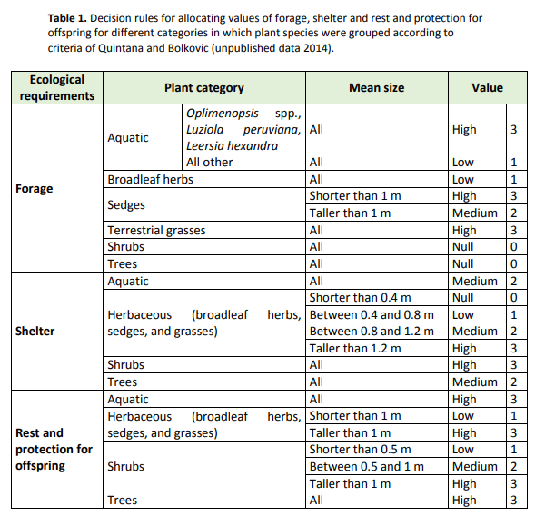
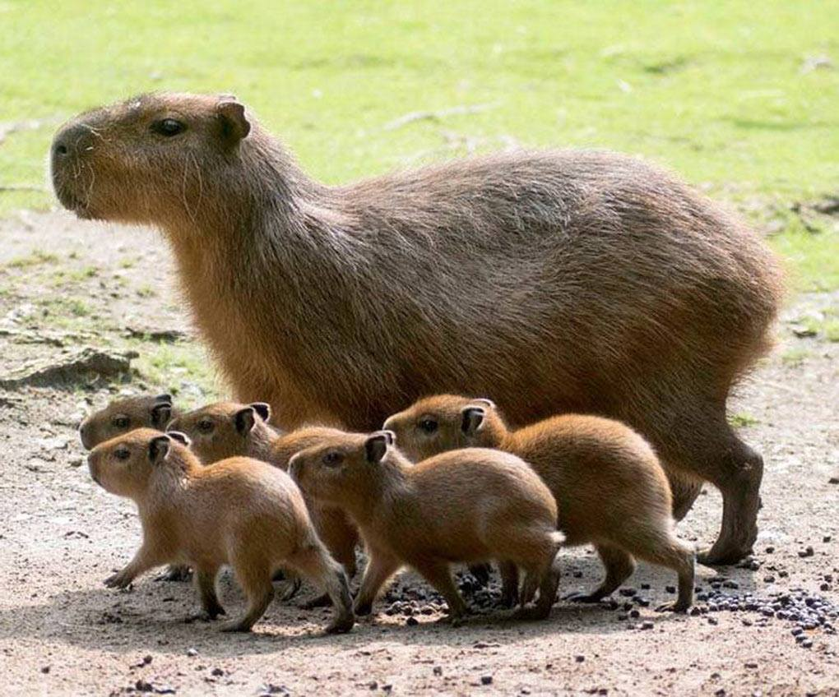
A real-world example:
Which habitat is best for raising capybara offspring?
Schivo, Facundo, et al. “A Habitat Suitability Model for Capybara (Hydrochoerus Hydrochaeris) at Its Core Area in Argentina.” Tropical Conservation Science, Mar. 2015, pp. 150–168, doi:10.1177/194008291500800113.

Slide 5
Outline
What is a decision tree?
How do we create a decision tree given a set of instances (inputs)?
How can we use impurity to measure a decision tree node’s quality?
Using DTs for multi-class classification or with other purity measures

Slide 6
What is a Decision Tree?
A symbolic classifier which uses a series of decisions/rules to make a classification
One “big” rule to make an overall decision
Easy to interpret?
Decision tree learning is a method for creating decision trees
One of the first classification learning methods in AI!

Slide 7
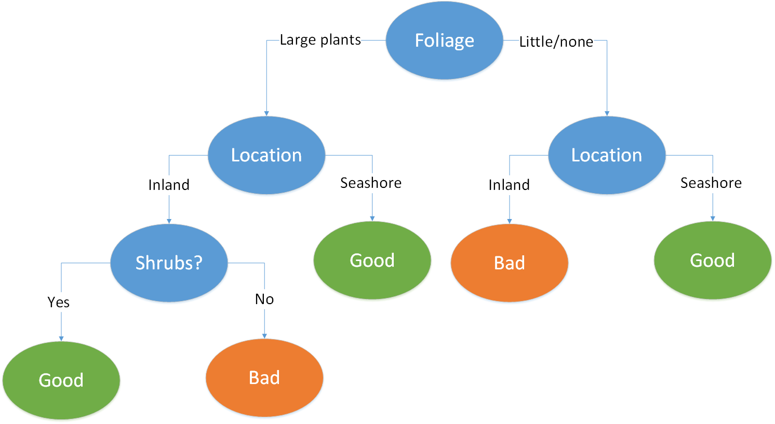
An example decision tree
Decide whether or not a habitat is good for capybara breeding

Slide 8
Constructing Decision Trees
Easy to build a naïve (full) decision tree:
Pick one feature at a time
Use this feature as the next split in the tree
Repeat until all features used
Label each leaf with the corresponding class.

Slide 9
What are the problems with this?
No learning is taking place! Just remembering the inputs
Too specific…not likely to work well on future (unlabelled) inputs
How can we do better?
A smaller decision tree:
Capture the common patterns across the inputs
Discover some underlying rules which are more generic

Slide 10
A better algorithm
Input: a set of instances defined by their feature values
Output: a decision tree classifier which performs classification
Compute if the set of instances is pure enough – if so, then stop!
Select the best (unused) feature to use as the next node – the one which would give the highest purity
Split the dataset into two sub-sets according to the chosen node
Recurse on each of the two sub-sets

Slide 11
Building a DT: is the animal a mammal?
Instances: {✓, ✓, ✓, ✓,✗, ✗, ✗, ✗, ✗, ✗, ✗, ✗}
Available features:
Eggs
Scales
Aquatic
Tail
Legs
Feathers
Milk
Wings
Lays eggs?
Yes
No
Has wings?
Aquatic?
{✓,✗,✗,✗,✗}
{✓,✓, ✓,✗,✗,✗,✗}
Yes
No
Yes
No
Makes milk?
{✗,✗,✗}
Has feathers?
Has scales?
{✓, ✗}
{✓, ✗,✗}
{✓,✓,✗,✗}
Yes
No
Yes
No
Yes
No
{✓}
{✗}
{✗, ✗}
{✓}
{✗, ✗}
{✓, ✓}
https://archive.ics.uci.edu/ml/datasets/zoo

Slide 12
Measuring purity
How do we measure the purity of a node?
Many different ways! Probability-based, information theory-based, …
More pure = can predict the class more confidently
Often easier to talk about impurity
Most impure (least pure) Less impure (more pure) Least impure (most pure)
✓ ✗ ✗ ✓ ✓ ✗ ✗ ✓ ✗ ✓ ✓ ✗
✗ ✓ ✓ ✗ ✓ ✗
✓ ✓ ✗ ✓ ✓ ✗ ✓ ✓ ✗ ✓ ✓ ✓
✗ ✓ ✓ ✓ ✓ ✗
✓ ✓ ✓ ✓ ✓ ✓ ✓ ✓ ✓ ✓ ✓ ✓
✓ ✓ ✓ ✓ ✓ ✓

Slide 13
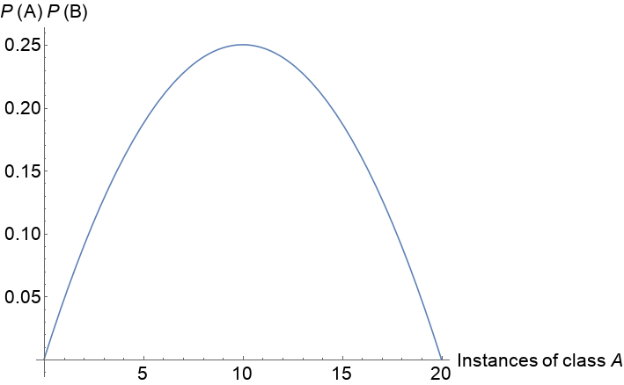
A probability-based impurity measure
If we have class A and B, then we measure a node’s impurity using P(A)P(B), where there are m instances of class A and n of class B:
Impurity = $P\left(A\right)P\left(B\right)= \frac{m}{m+n}×\frac{n}{m+n}=\frac{mn}{(m+{n)}^{2}}$
For example, if we have 20 instances:
This measure is smooth

Slide 14
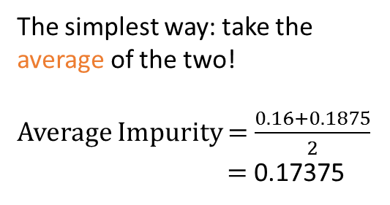
Choosing the next feature split
When we choose a feature to be the next node, we create two children nodes, which each have their own impurity
How do we combine these two impurity values?
Makes milk?
The simplest way: take the average of the two!
Average Impurity = $\frac{0.16+0.1875}{2}$
= 0.17375
{✓, ✓, ✓, ✓, ✓,✗, ✗, ✗, ✗}
Yes
No
{✓, ✓, ✓, ✓,✗}
{✓,✗,✗,✗}
$$Impurity= \frac{4}{1+4}×\frac{1}{1+4}$$
= 0.16
$$Impurity= \frac{1}{1+3}×\frac{3}{1+3}$$
= 0.1875

Slide 15
What is wrong with this?
Consider this example:
But wasn’t this a better split?:
Aquatic?
Makes milk?
{✓, ✓, ✓, ✓, ✓,✗, ✗, ✗, ✗}
{✓, ✓, ✓, ✓, ✓,✗, ✗, ✗, ✗}
Yes
No
Yes
No
{✓}
{✓, ✓, ✓, ✓, ✗,✗,✗,✗}
{✓,✗,✗,✗}
{✓, ✓, ✓, ✓,✗}
$$Impurity= \frac{1}{1}×\frac{0}{1}$$
= 0
$$Impurity= \frac{4}{8}×\frac{4}{8}$$
= 0.25
$$Impurity= \frac{4}{1+4}×\frac{1}{1+4}$$
= 0.16
$$Impurity= \frac{1}{1+3}×\frac{3}{1+3}$$
= 0.1875
Average Impurity = $\frac{0+0.25}{2}$
= 0.125
Average Impurity = 0.17375!

Slide 16
The solution: weighted average impurity
If we weight a child’s impurity by how many instances it has, then the measure is not biased to uneven splits
Aquatic?
Makes milk?
P(node) = $\frac{1}{9}$
P(node) = $\frac{8}{9}$
P(node) = $\frac{5}{9}$
P(node) = $\frac{4}{9}$
Yes
No
Yes
No
{✓}
{✓, ✓, ✓, ✓, ✗,✗,✗,✗}
{✓, ✓, ✓, ✓,✗}
{✓,✗,✗,✗}
Impurity = 0 Impurity = 0.25 Impurity = 0.16 Impurity = 0.1875
Weighted average impurity = $\frac{1}{9} ×0+\frac{8}{9} ×0.25$ Weighted average impurity = $\frac{5}{9} ×0.16+\frac{4}{9} ×0.1875$
≈ 0.222 ≈ 0.172
$$\text{Weighted} \text{average} \text{impurity}=\sum_{i}{{P(node}_{i})×Impurity({node}_{i})}$$

Slide 17
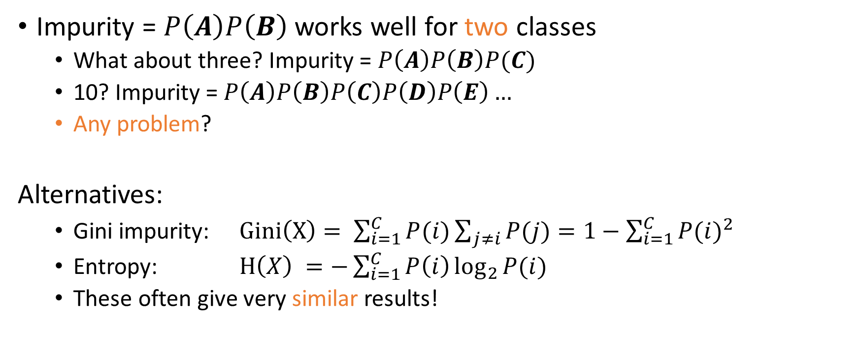
Advanced topics: More than two classes?
Impurity = $P\left(A\right)P\left(B\right)$ works well for two classes
What about three? Impurity = $P\left(A\right)P\left(B\right)P(C)$
10? Impurity = $P\left(A\right)P\left(B\right)P\left(C\right)P\left(D\right)P\left(E\right)…$
Any problem?
Alternatives:
Gini impurity: $Gini\left(X\right)= \sum_{i=1}^{C}{P(i)\sum_{j≠i}{P(j)}}=1−\sum_{i=1}^{C}{{P(i)}^{2}}$
Entropy: $H\left(X\right) =−\sum_{i=1}^{C}{P\left(i\right)\log_{2}{P(i)}}$
These often give very similar results!

Slide 18
Advanced topics: Numerical features (1)
Many features are numerical, e.g. height, tail length, …
How can our DT algorithm cope with this?
Instance # | Height (cm) | Tail length (cm) | Can fly? | Class
1 | 170 | 0 | No | Mammal
2 | 19.5 | 1.1 | Yes | Bird
3 | 90 | 4 | No | Bird
4 | 15 | 30 | Yes | Fish
5 | 4 | 70 | No | Reptile

Slide 19
Advanced topics: Numerical features (2)
Sort the feature we’re considering
Choose split points based on class boundaries
Compute impurity for each split, choose best one
Instance # | Height (cm) | Tail length (cm) | Can fly? | Class
5 | 4 | 70 | No | Reptile
4 | 15 | 30 | Yes | Fish
2 | 19.5 | 1.1 | Yes | Bird
3 | 90 | 4 | No | Bird
1 | 170 | 0 | No | Mammal
<15cm
<19.5cm
<170cm

Slide 20
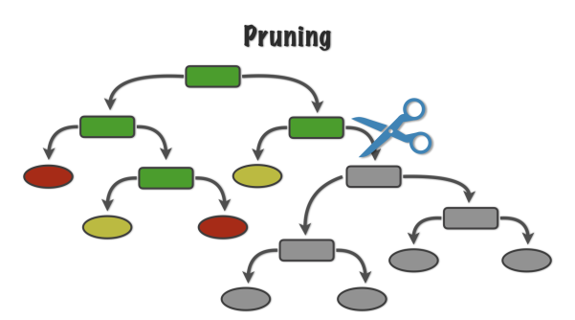
Advanced topics: Overfitting
The larger our tree, the more it will overfit, as it becomes too specific to the training set
How can we avoid this? Stop splitting earlier
Need to be careful we don’t stop too soon – otherwise nodes will not be pure enough → worse performance!
Some approaches:
Stop at a given impurity threshold
Stop at a pre-defined max depth
Use pruning to simplify a completed tree
https://alanjeffares.wordpress.com/tutorials/decision-tree/

