Slide 1
Evolutionary Feature Manipulation for Unsupervised Learning Problems
Dr Andrew Lensen
Andrew.Lensen@ecs.vuw.ac.nz

Slide 2
Outline
Unsupervised Learning (UL)
What are the big challenges in UL?
Background information
My recent work
Research plan

Slide 3
Unsupervised Learning
https://www.linkedin.com/pulse/business-intelligence-its-relationship-big-data-geekstyle/

Slide 4
Unsupervised Learning
Uncover knowledge or patterns in unlabelled data.
Clustering.
Dimensionality reduction.
Visualisation.
Feature relationships.

Slide 5
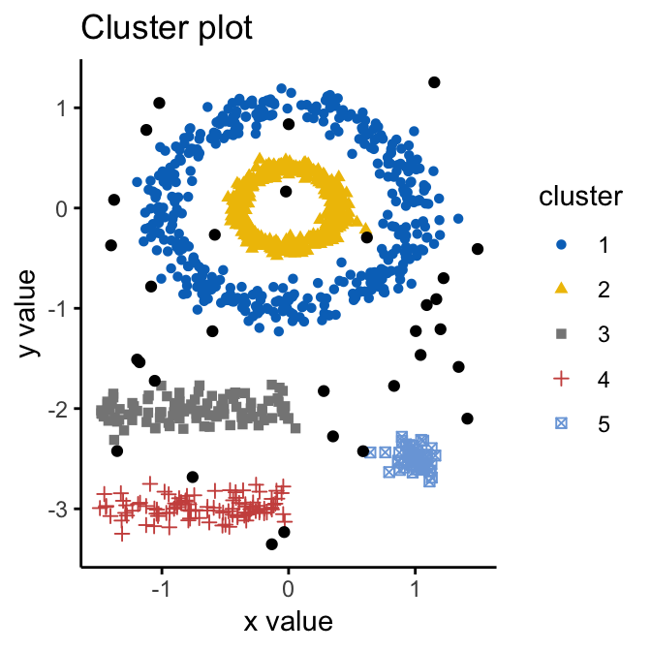
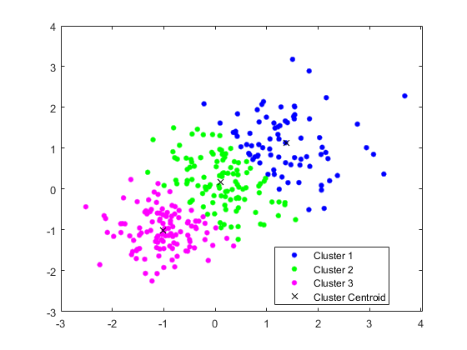
Example: Clustering
Group unlabelled data into some number of natural groups (clusters).
What is natural?
Data in the same cluster is related, data in different clusters is not.
https://www.kdnuggets.com/2019/10/right-clustering-algorithm.html

Slide 6
Example: Visualisation
Shows the structure of data in a human-friendly 2/3D space.
1024 dimensions → 2D!
https://arxiv.org/abs/1802.03426

Slide 7
What challenges are there in UL?
Performance:
No labels ➔ no guidance on what is a “correct” solution.
20 points into 2 clusters: 500k ways.
2000 points into 40 clusters: 1.62 × 10³¹⁵⁶ ways!
Interpretability:
Having a set of clusters or a pretty visualisation is nice – but what do they actually mean?
Can we understand them by the features?
Crucial in many situations.

Slide 8
(Brief) Background

Slide 9
Feature Manipulation
Transform the original feature space into a simpler/more useful one.
Improve performance.
Improve interpretability.
Feature Selection (FS):
Select a subset of features which are most useful and cohesive.
Feature Construction (FC):
Construct a few new meta-features which are more powerful.

Slide 10
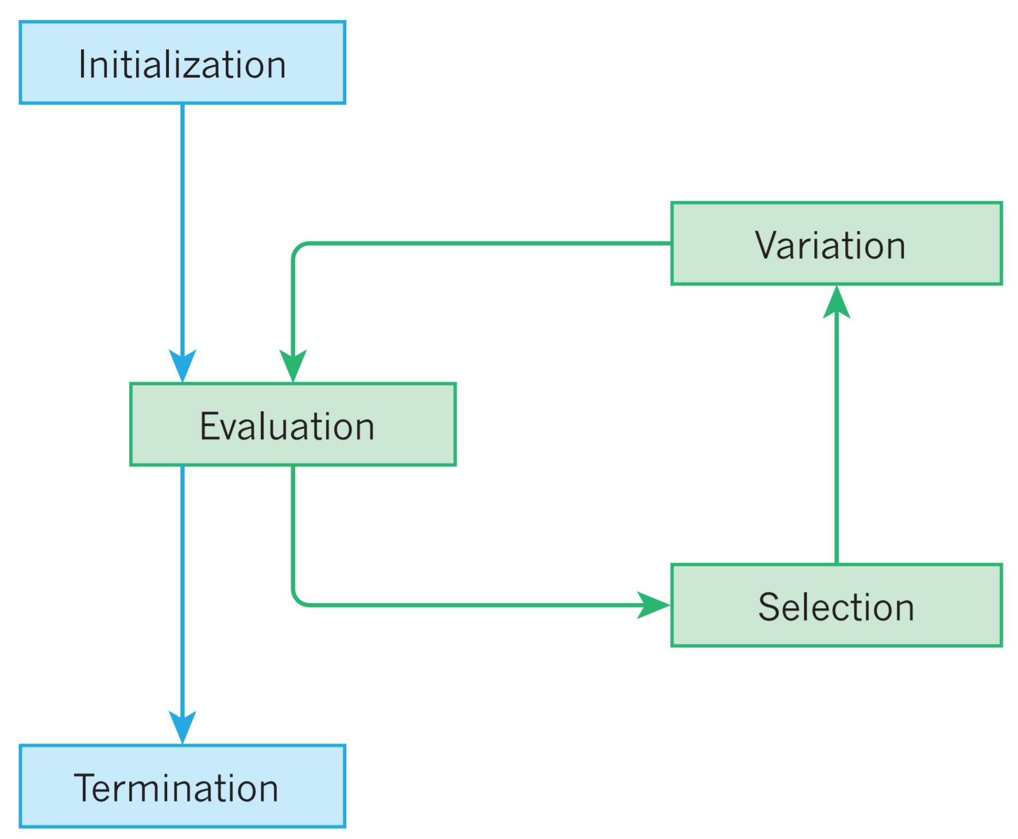
Evolutionary Computation (EC)
Used to generate good-quality solutions (individuals) to problems which can’t be solved deterministically in reasonable time (e.g. NP-hard).
Population-based search: iterative evaluation and variation of candidate solutions.
Eiben, A., Smith, J. From evolutionary computation to the evolution of things. Nature 521, 476–482 (2015). https://doi.org/10.1038/nature14544

Slide 11
EC Representations
Flexible paradigm: many possible representations of solutions.
My research has focused most on tree-based Genetic Programming (GP).
Eiben, A., Smith, J. From evolutionary computation to the evolution of things. Nature 521, 476–482 (2015). https://doi.org/10.1038/nature14544

Slide 12
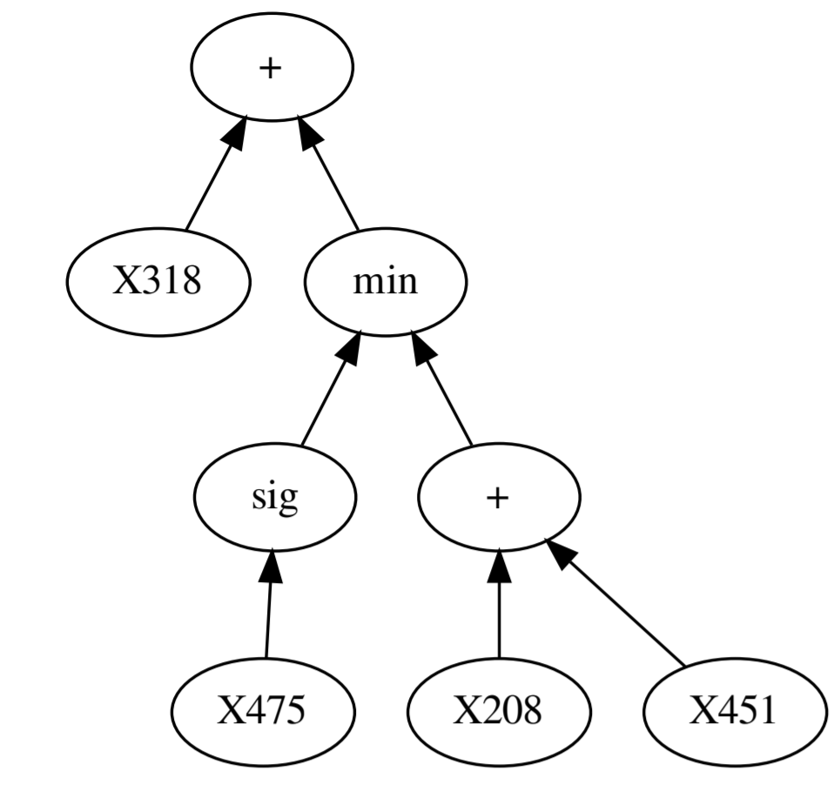
Genetic Programming (GP)
Individuals take the form of programs.
Most common form is lisp-style trees.
Uses Darwinism principles:
Mutation randomly changes a sub-tree.
Crossover swaps two sub-trees between programs.
A terminal set and function set provide the tree representation.
y = X318 + min(sig(X475), X208+X451)

Slide 13
EC for Feature Manipulation
Common representations are intrinsically suited for FS/FC.
FS: Vector or bit-strings.
FC: GP trees.
F0 | F1 | F2 | F3 | F4 | F5 | F6 | F7 | F8 | F9
0 | 1 | 1 | 1 | 0 | 1 | 0 | 0 | 0 | 1

Slide 14
My Recent Work
Using GP for FC to improve the performance and interpretability on unsupervised learning problems.
This talk will focus on two main directions:
GP for evolving similarity functions to improve the performance of clustering algorithms.
Investigating the trade-off between interpretability and quality of visualisations evolved by GP.

Slide 15
GP for Evolving Clustering Similarity Functions
Andrew Lensen, Bing Xue, and Mengjie Zhang. Genetic programming for evolving similarity functions for clustering: Representations and analysis. Evolutionary Computation (Journal), MIT Press, October 2019 (Early Access).
Andrew Lensen, Bing Xue, and Mengjie Zhang. GPGC: genetic programming for automatic clustering using a flexible non-hyper-spherical graph-based approach. In Proceedings of the Genetic and Evolutionary Computation Conference (GECCO), pages 449–456. ACM, July 2017.

Slide 16
Motivation
Nearly all clustering algorithms use a similarity measure such as Euclidean distance to group instances:
$$d\left(a,b\right)= \sqrt{{(a_{1}−b_{1})}^{2}+{(a_{2}−b_{2})}^{2}+…+{(a_{N}−b_{N})}^{2}}$$
What is the issue with this?
Must use every feature – hard to interpret the clusters!
Forces every feature to be weighted equally, limits performance.
Would be nice to have a measure tailored to a dataset and algorithm…

Slide 17
GPGC: Improving (Graph-based) Clustering
GP is good at creating function trees which map inputs to an output.
Why not use GP to design similarity functions? Form of FC.
Tailor the function to a given dataset.
Construct more powerful and interpretable similarity functions.

Slide 18
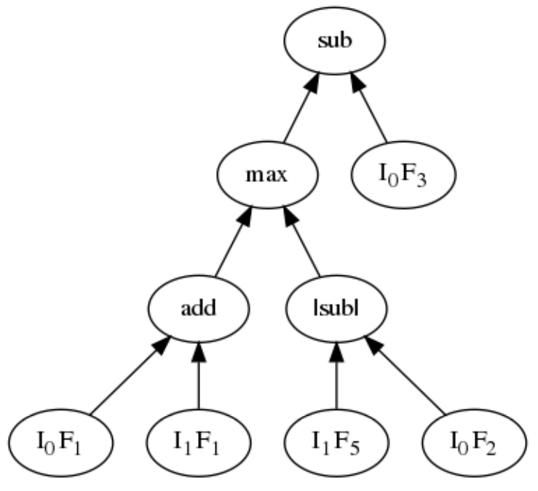
GPGC Program Design
A similarity function takes two instances and outputs their similarity.
Terminal Set: Features from each instance, random constants.
Function set: arithmetic ($+,−,×,÷),$ conditional operators (if/max/min).
Much more flexible than Euclidean distance.

Slide 19
Clustering Algorithm
A GP tree takes two instances and outputs their similarity.
The c most similar neighbours to an instance are given an edge.
Choose from l closest neighbours.
Each graph represents one cluster.

Slide 20
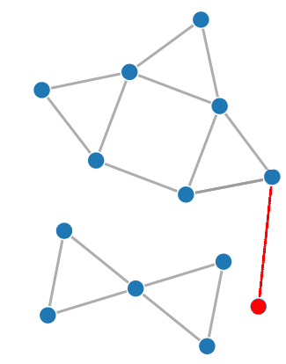
Fitness Function
In EC, we have a fitness function which measures the quality of a candidate solution, driving the evolutionary process.
Clustering algorithms often consider one or more of three things:
Cluster compactness: how densely packed is a cluster?
Cluster separation: how far apart are the clusters?
Instance connectedness: are nearby instances in the same cluster?
All of these are combined in the fitness function.

Slide 21
Extension: A Multi-tree Approach
A kind of ensemble approach: allow each tree to specialise on different parts of the dataset.
Each tree outputs its confidence that two instances should be in the same cluster.
Can design crossover to further encourage specialisation.

Slide 22
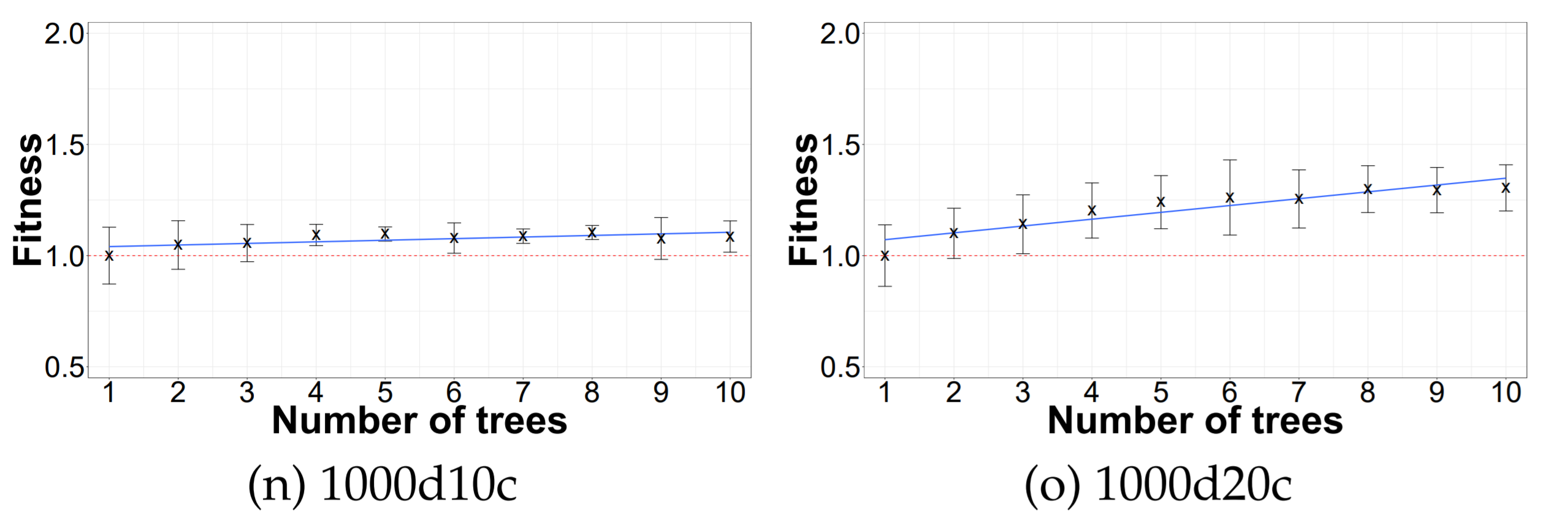
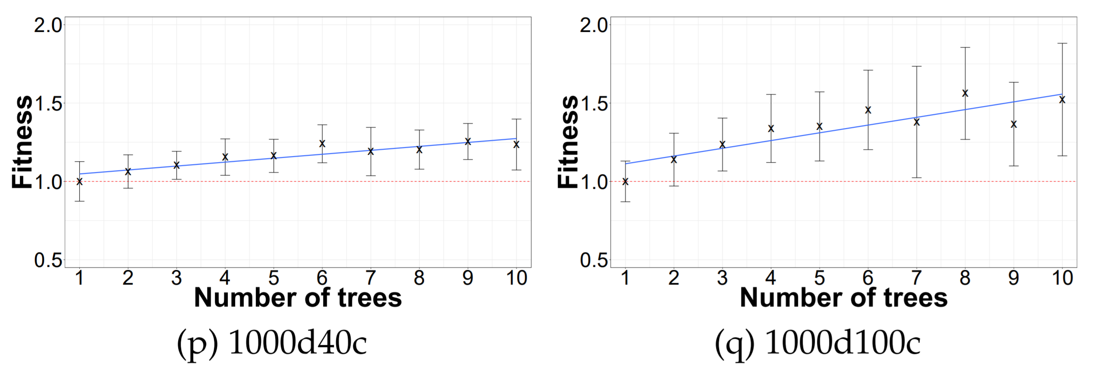
How many trees to use?
Somewhere between 5 and 8, depending on dataset.
More clusters → more trees: more granularity needed.

Slide 23
Crossover with multiple trees?
How do we crossover between two individuals with multiple trees?
If individual A has A₁ to A_{N} for n trees, and B has B₁ to B_{N} for N trees:
Random-index crossover (RIC): A_{y} x B_{z} for y, z $∈U[1,N]$ (obvious?)
All-index crossover (AIC): A₁x B₁,…, A_{N}x B_{N} (aggressive?)
Same-index crossover (SIC): A_{y} x B_{y} for y $∈U[1,N]$ (encourages specificity?)

Slide 24
Comparative Performance
Reasonably similar on easy problems; GPGC-AIC best on harder problems.

Slide 25
Compared to other algorithms
GPGC-AIC most consistent and best-performing on high-dimensional datasets, competitive with MOCK (multi-objective) on the remaining.
Number of “wins” per algorithm:

Slide 26
GP-tSNE: Evolving Interpretable Models for Visualisation
Andrew Lensen, Bing Xue, Mengjie Zhang. "Genetic Programming for Evolving a Front of Interpretable Models for Data Visualisation." IEEE Trans. Cybernetics, IEEE, February 2020 (Early Access).
Andrew Lensen, Mengjie Zhang, Bing Xue. "Multi-objective genetic programming for manifold learning: balancing quality and dimensionality." Genetic Programming and Evolvable Machines, Springer, February 2020 (Early Access).
Andrew Lensen, Bing Xue, Mengjie Zhang. “Can Genetic Programming Do Manifold Learning Too?” In Proceedings of the European Conference on Genetic Programming (EuroGP), pages 114–130. Springer, April 2019.

Slide 27
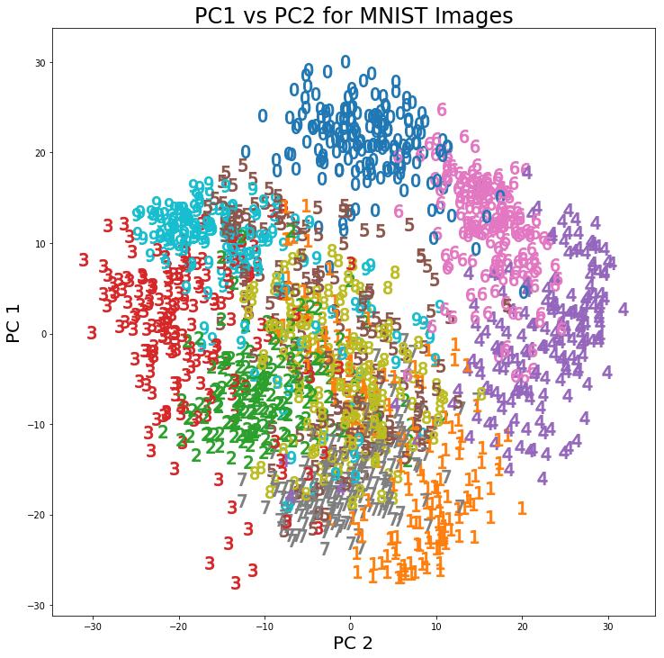
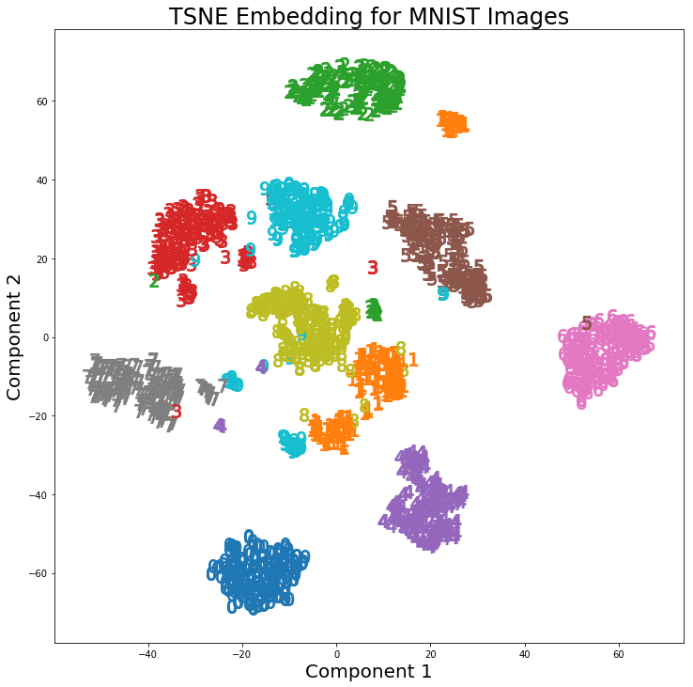
Current state-of-the-art
t-Distributed Stochastic Neighbour Embedding (t-SNE) is the most popular non-linear DR (manifold learning) approach to visualisation.
Much more powerful than PCA which uses linear weightings.
https://stats.stackexchange.com/questions/340175/why-is-t-sne-not-used-as-a-dimensionality-reduction-technique-for-clustering-or

Slide 28
t-SNE’s (and others’) limitations:
It does not learn a function from the original space to the 2D space.
Cannot re-use on unseen (future) data.
Cannot interpret the visualisation in terms of the original features!!
PCA can do these two things – but as we saw, limited by linearity.
Fascinating read on t-SNE: https://distill.pub/2016/misread-tsne/

Slide 29
What about GP?
Tree-based GP can easily produce functions taking inputs as terminals and producing an output at the root.
Such functions can be easily reused.
Intrinsically a white (or grey) box: so potential for interpretability.
Previous work on GP for feature construction is encouraging.

Slide 30
GP-MaL: Representation
Use two trees per individual, to give 2D visualisation.
(Aside: an n-tree version of this can be used to perform GP-based general manifold learning).

Slide 31
Function & Terminal Sets
“Classic” GP arithmetic operators.
Non-linear functions (NN inspiration).
Conditional operators: build higher-level functions.
Problem-specific NF terminal.

Slide 32
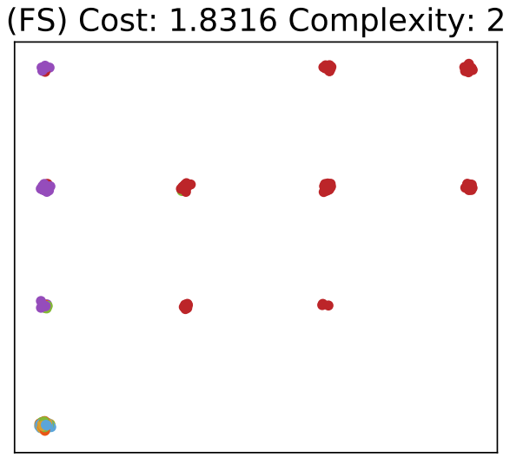
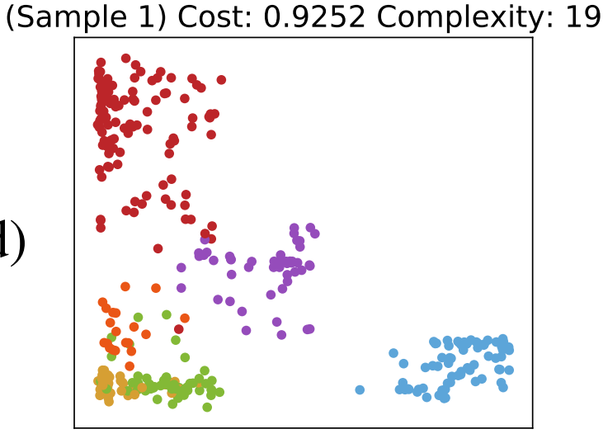
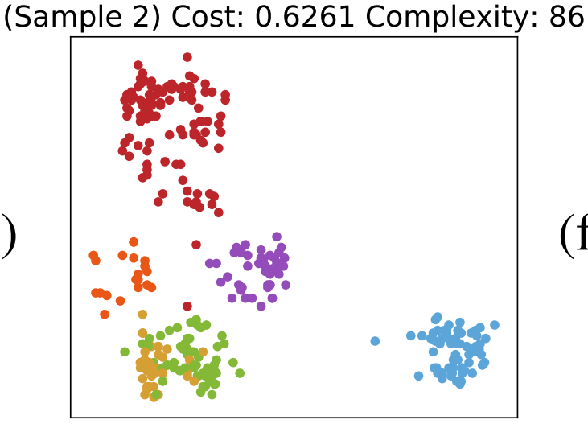
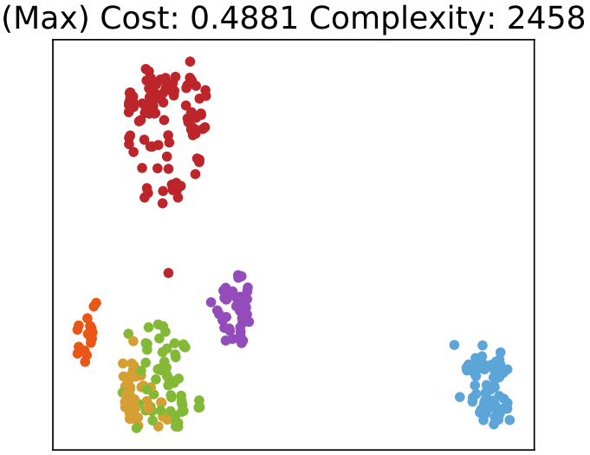
GP-tSNE: Quality vs Complexity

Slide 33
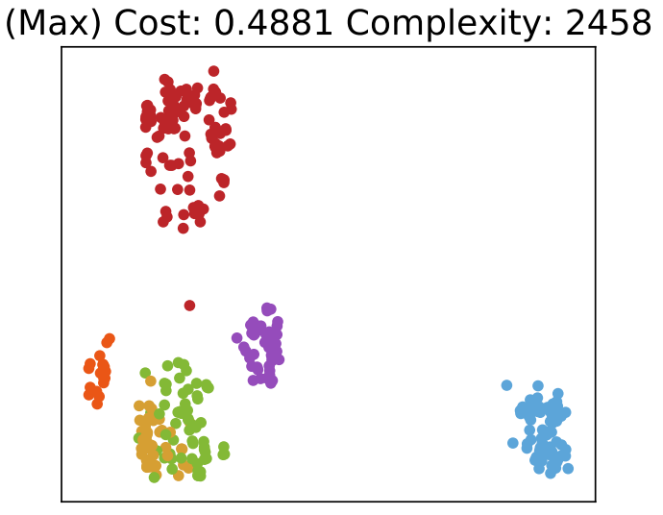
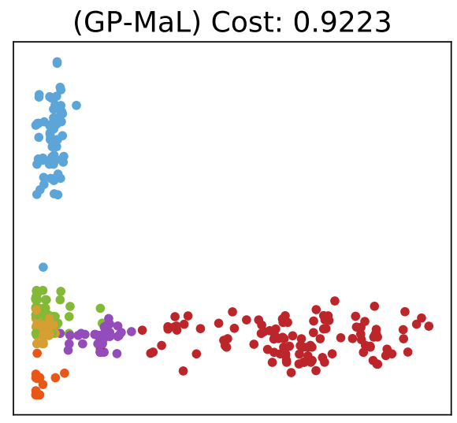
GP-tSNE: Compared to baselines

Slide 34
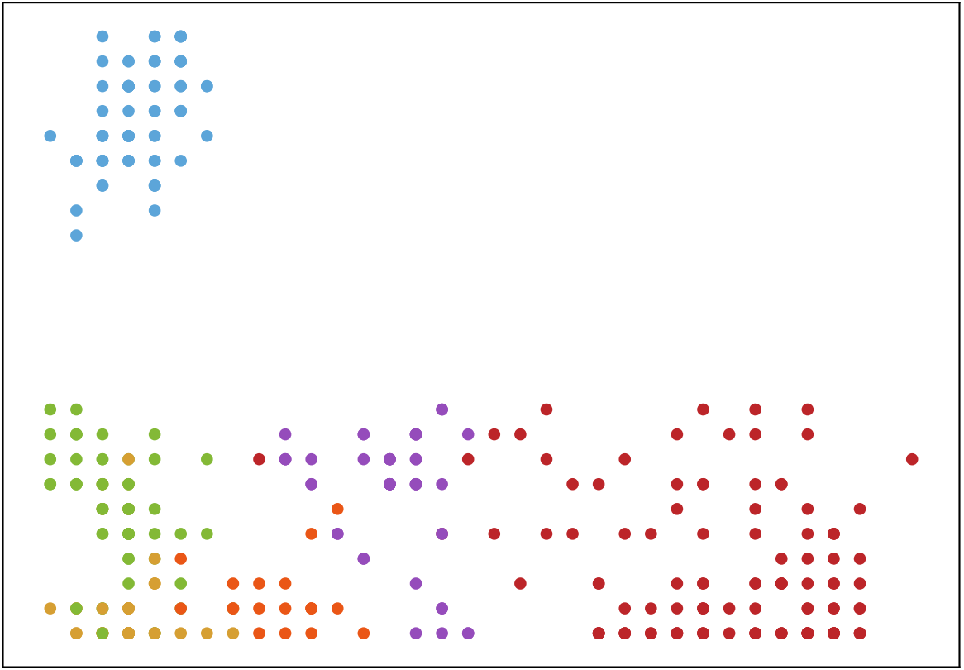
Simple trees can clearly distinguish classes on Dermatology dataset!
Tree 1:
Tree 2:

Slide 35
A nicer way to visualise GP-tSNE…
Backup link
https://ecs.wgtn.ac.nz/foswiki/pub/Main/AndrewLensen/paretoFront_high.mp4

Slide 36
Research Plan
Overall plan: To lead the field in EC feature manipulation and interpretability in unsupervised learning problems.
1–2 year plan:
Further exploration of the GP-manifold learning work from my PhD and postdoc, with a focus on interpretability.
I have submitted a fast-start Marsden proposal (2020) on this topic.
Extending work on similarity functions to more clustering algorithms.
Collaboration across and beyond the school.

Slide 37
Research Plan (2)
Long-term:
Expansion of research agenda to cover other unsupervised AI domains, including hybridisation of EC and non-EC (e.g. DL).
Building international collaborations with world-leaders in GP and unsupervised learning, such as Professor Peter Bosman (Marsden AI).
Leading the ECRG in unsupervised learning, supervising doctoral students and enhancing the school’s reputation for EC in ML.

Slide 38
Kia ora!
Questions?

Slide 39
Backup Slides

Slide 40
Fitness Function: Compactness
Based on the most isolated instance in a cluster.
The instance furthest away from its nearest-neighbour.
The red node is the most isolated in the top cluster.
Let this distance be the sparsity of the cluster.
More sparse ⟷ Less compact.
Minimise sparsity.

Slide 41
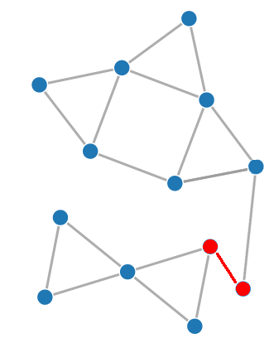
Fitness Function: Separation
Distance to the closest neighbouring cluster.
Minimum distance from any instance in the cluster to any other instance not in the same cluster.
The red connection shows the minimum separation between these two clusters.
Maximise separation.

Slide 42
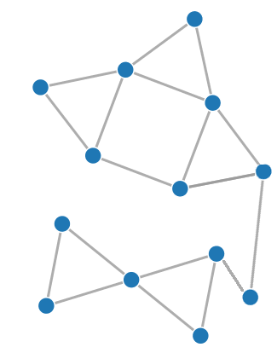
Fitness Function: Connectedness
Is each instance in the same cluster as its nearest neighbours?
For each of the n neighbours: if in the same cluster, add the inverse distance to that neighbour to the total connectedness score.
Close neighbours are weighted higher.
Maximise connectedness.

Slide 43
Fitness Function: Combining the Measures
Find the ratio of cluster sparsity: separation (CS:S) for each cluster.
Sparsity and separation are conflicting.
Find the mean connectedness across all instances.
Maximise the overall fitness.

Slide 44
Links for further details
https://homepages.ecs.vuw.ac.nz/~lensenandr/publications/
https://ecs.wgtn.ac.nz/foswiki/pub/Main/AndrewLensen/lensenThesisFINAL.pdf

