Slide 1
Electronics
An Introduction to basic electronics

Slide 2
Teacher notes
Year 9-10
Prior knowledge about the structure of atoms
Leading towards the end of the unit for Arduino skills
Learning objectives:
Students understand that electricity is a flow of charged particles (electrons)
Magnetic fields are the flow/distribution of these electrons
A circuit has electricity flowing through it in a direction
Analogy to a flow of water
Current, measured in Amps (A) is the FLOW RATE
Voltage, measured in Volts (V) is the force at which electricity flows
The BBC has an excellent series - Show and awe : The story of electricity http://www.bbc.co.uk/programmes/p00kjq6d which can be found in full on you tube: https://www.youtube.com/watch?v=Gtp51eZkwoI

Slide 3
Advanced organiser/resources
Bar Magnets, iron filings and A4 paper
One balloon (and/or glass rod and feathers)
Ton foil (a4 size sheets), AA batteries
Lemons (citrus fruit), wires (alligator clips), zinc and copper connectors, LED

Slide 4
Notes
This material has been put together by the Outreach coordinator of the School of Engineering and Computer Studies (SECS) at Victoria University of Wellington (VUW), New Zealand.
It is free to distribute and pass on to all who may find it useful.
The author of this presentation and supporting documents can be reached at: john.barrow@vuw.ac.nz

Slide 5
What is electronics?
Electronics is the science of how to control electric energy
We use this in electronic circuits
We use electronic circuits in computers, cell phones and many other devices

Slide 6
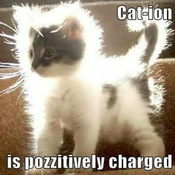
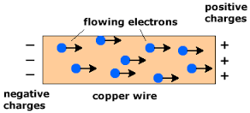
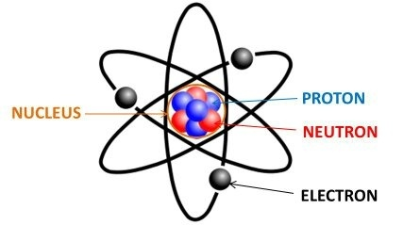
Charged particles, electrons
Atoms are composed of charge carrying particles: electrons (-) and protons (+) (and neutral particles – neutrons)
Electricity is the flow of electrons (it is actually the flow of electric charge)

Slide 7
Static vs Current
Static electricity exists when there is a build-up of opposite charges on objects separated by an insulator (lightning, the balloon on your head expt)
Current electricity exists when charges are able to constantly flow
In order to flow, current electricity requires a circuit: a closed, never-ending loop of conductive material

Slide 8
For current electricity what we have is:

Slide 9
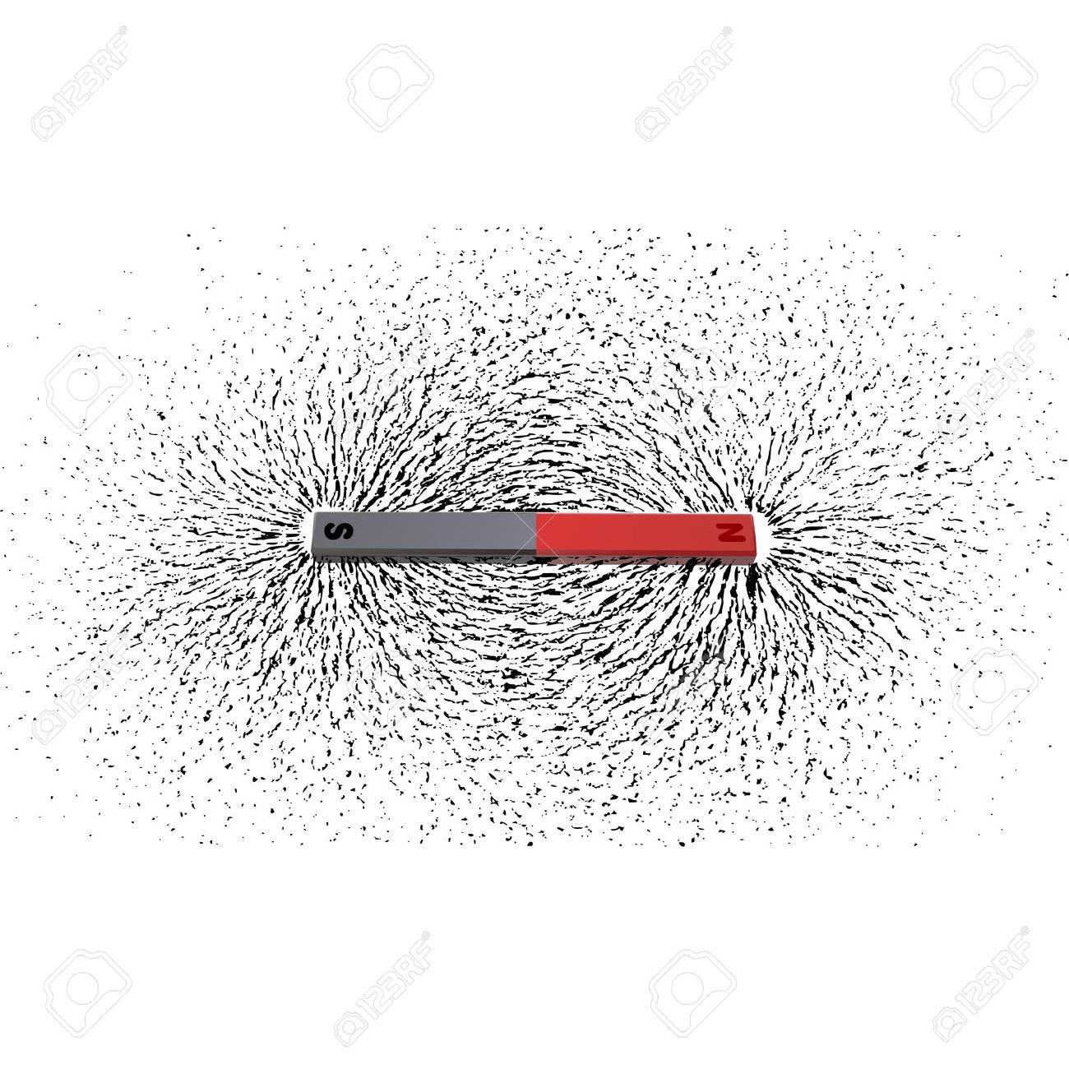
Like charges repel
Looking at static electricity….
A field is a tool we use to model physical interactions which don’t involve any observable contact. Fields can’t be seen as they don’t have a physical appearance, but the effect they have is very real.
Magnet exercise:
Align to magnets to attract and repel each other
Using a sheet of paper and magnetic filings have students explore a magnetic field around a magnet

Slide 10
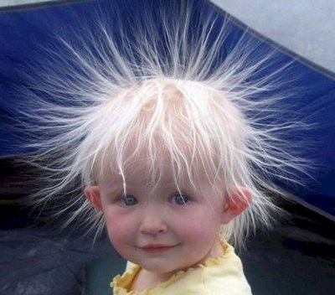
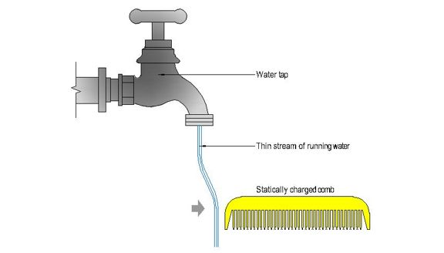
Static charges
Demonstration: rubbing a balloon (and/or a glass rod and feathers)

Slide 11
Just FYI
Did you know ancient Greeks used to rub amber to get small charge generated and they called it electron

Slide 12
Magnet Car
Using a combination of magnetic fields and electricity flow lets make our own magnet car:
http://www.kjmagnetics.com/blog.asp?p=AA-motor&utm_source=K%26J+Magnetics+Newsletter&utm_campaign=17d4ab196f-2016_01_January_Newsletter&utm_medium=email&utm_term=0_73e0031e12-17d4ab196f-244070225

Slide 13
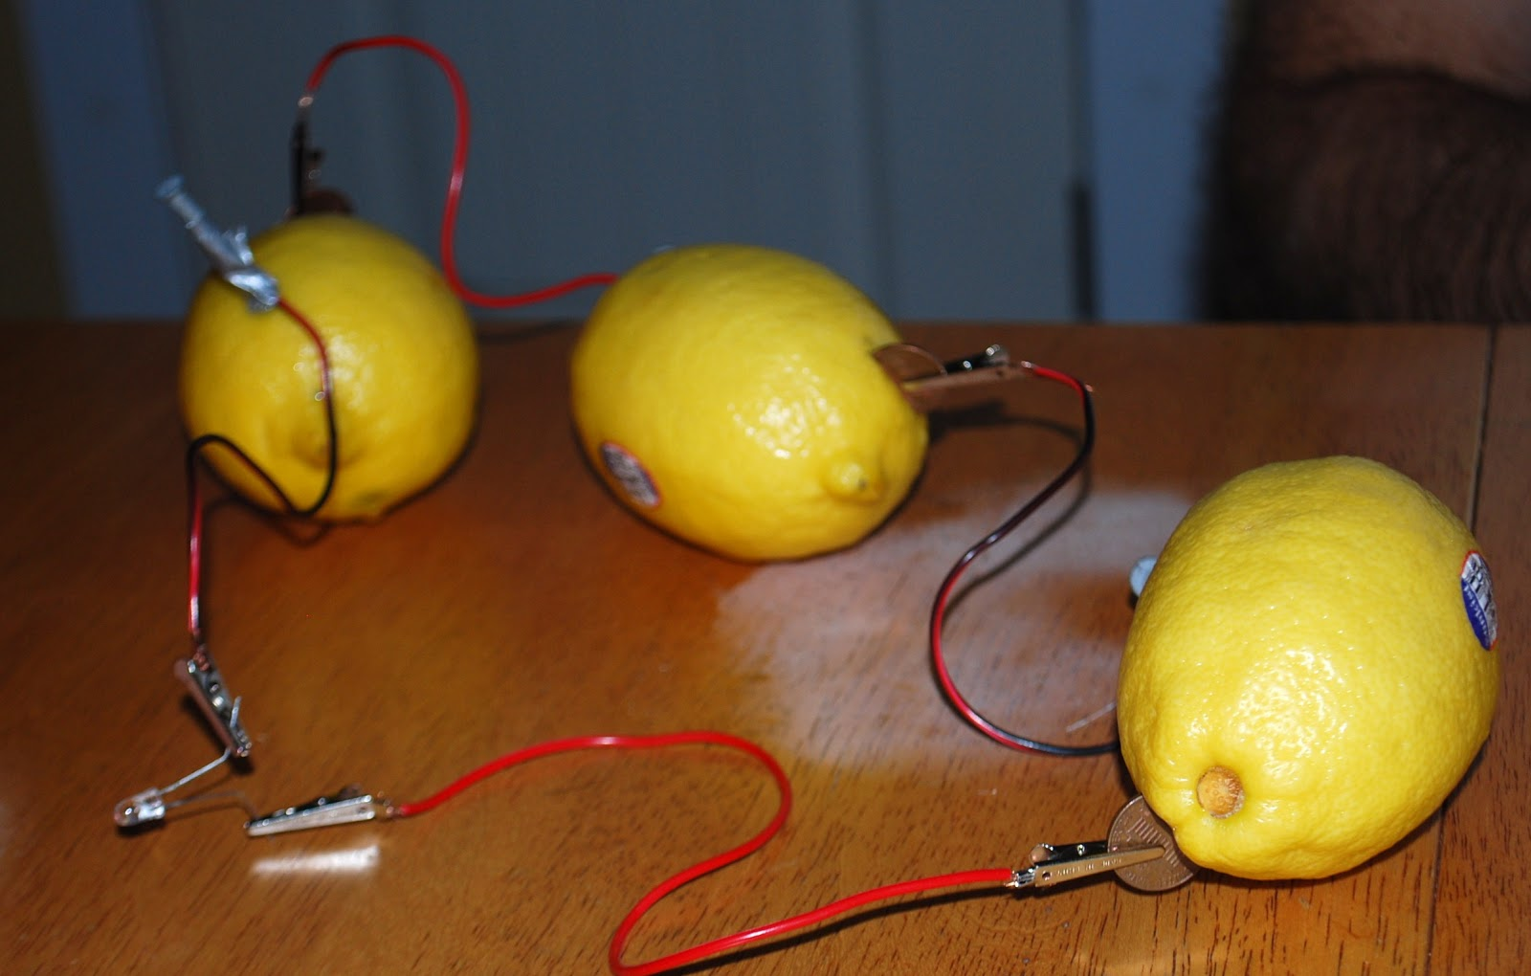
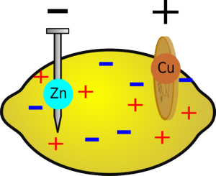
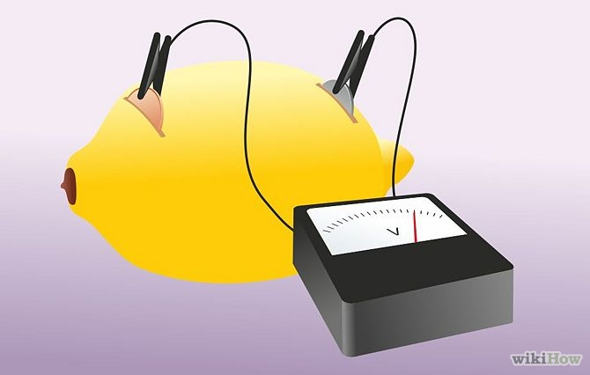
Now we are going to make our own circuit using Current electricity

Slide 14
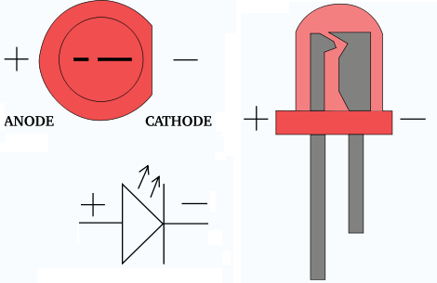
Problems
Positive and negative terminals on the LED (electricity flows in a direction)
Clean connections between wires

Slide 15
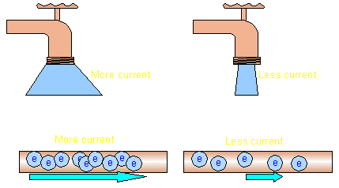
What is going on here?
Current is the measure of the flow of charge (the amount)
Current is measured in Amps (A)
‘Like a flow of water’

Slide 16
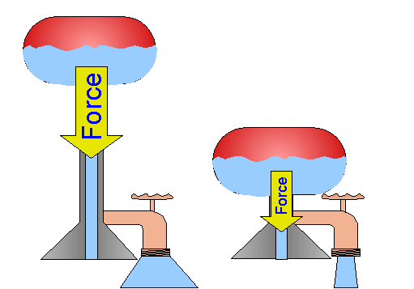
Voltage
Potential difference across 2 terminals in a circuit
In order to move a charge from point A to point B work needs to be done
Like potential energy at a water fall
Measured in Volts (V)
(the intensity)

Slide 17
Voltage/Current water analogy

