Slide 1
Electronics
Ohm’s law & Resistance.

Slide 2
Teacher notes
Year 9-10
Hidden learning objective – numeracy, integrating maths into the unit

Slide 3
Advanced organiser/resources
Journal to take notes and do calculations in

Slide 4
Notes
This material has been put together by the Outreach coordinator of the School of Engineering and Computer Studies (SECS) at Victoria University of Wellington (VUW), New Zealand.
It is free to distribute and pass on to all who may find it useful.
The author of this presentation and supporting documents can be reached at: john.barrow@vuw.ac.nz

Slide 5
Controlling electricity
Because the relationship between voltage, current, and resistance in any circuit is so regular, we can reliably control any variable in a circuit simply by controlling the other two.
Special components called resistors are made for the express purpose of creating a precise quantity of resistance for insertion into a circuit

Slide 6
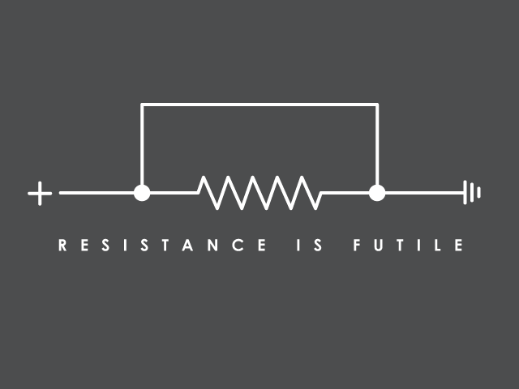
Ohm’s law
Resistors provide a specific amount of resistance to a path in a circuit or wire.
Ohm’s law can be used to calculate resistance, current and voltage.

Slide 7
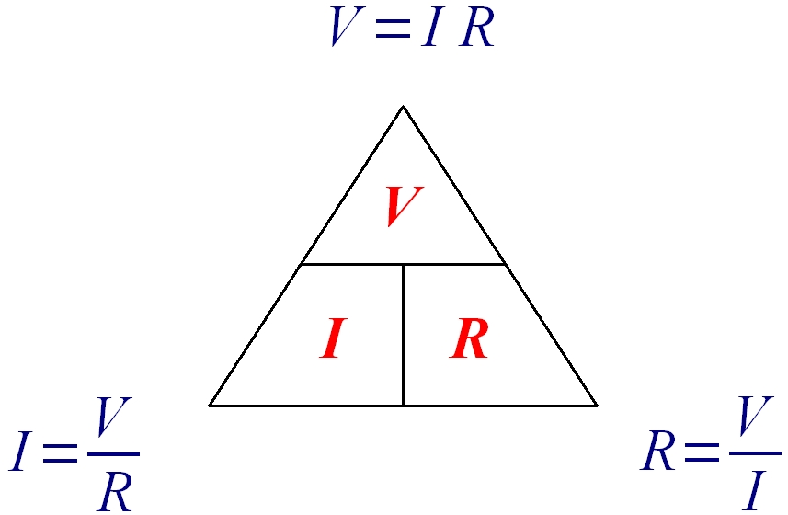
Ohms Law
E=IR?
E can be electromotive force or volts by another name…

Slide 8
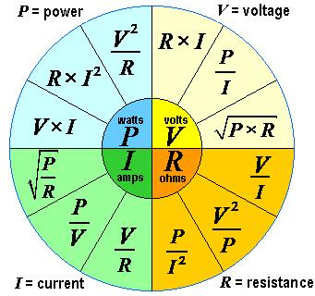
We can extend this by adding power
Measure | Unit
Voltage (V) in Volts | V
Current (I) in Amps | A
Resistance (R) in Ohms | Ω
Power (P) in Watts | W

Slide 9
Resistors
Colour coded so we can read them
K = kilo = 1,000 (thousand)
M = mega = 1,000,000 (million)
Tolerance = how accurate
What happens when they ‘resist’ = energy given off as heat

Slide 10
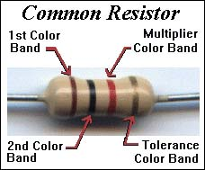
The Gold or Silver band is always set to the right, then you read from left to right. Sometimes there will be no tolerance band -- simply find the side that has a band closest to a lead and make that the first band.
Tolerance Rating
Red = 2%
Gold = 5%
Silver = 10%
No band = 20%
So gold band to the right, then read it: Brown, Black, Red, Gold:
So the maths is first digit, second digit, third digit (if noted) with the multiplier being the number of zero’s….
1, 0, 100, 5% tolerance = 1000 Ω (or 1K Ω)

Slide 11
The rules for reading resistors
Orient the resistor so you can read the stripes properly.
You should read the stripes from left to right.
If noted, set the tolerance band (gold or silver normally) to the right.
No tolerance band? - the first stripe is the one that's closest to one end of the resistor (often it is thicker). If this stripe is on the right side of the resistor, turn the resistor around so the first stripe is on the left.
Look up the color of the first stripe to determine the value of the first digit.
Look up the color of the second stripe to determine the value of the second digit.
Look up the color of the third stripe to determine the multiplier.
Multiply the two-digit value by the multiplier to determine the resistor's value.

Slide 12
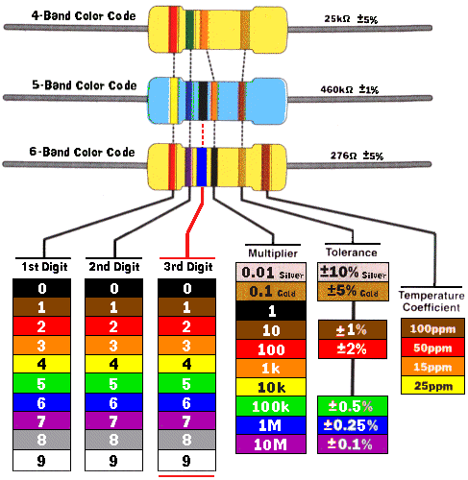
2, 5, x1000, ± 5% = 25kΩ
4, 6, 0 x1000, ± 1% = 460kΩ
2, 7, 6, x1, ± 5% = 276Ω

Slide 13
exercise
Colour Stripe | Digit Values | Multiplier (in Ohms, Ω) | Resistor Value
Brown, Black, Brown
Brown, Black, Red
Red, Red, Orange
Red, Red, Yellow
Yellow, Violet, Black
Brown, Yellow, Black, Green
Colour Stripe | Digit Values | Multiplier (in Ohms, Ω) | Resistor Value
Brown, Black, Brown | 10 | 10 | 100 Ω
Brown, Black, Red | 10 | 100 | 1kΩ
Red, Red, Orange | 22 | 1000 (1K) | 22 kΩ
Red, Red, Yellow | 22 | 10,000 (10K) | 220 kΩ
Yellow, Violet, Black | 47 | 0.1 | 47 Ω
Brown, Yellow, Black, Green | 140 | 100 k | 14 mΩ

Slide 14
Trouble shooting
Occasionally the colors are jumbled or burnt off. The only way to read it is with a multi-meter across the leads
How do I remember the sequence of colors?
B ig B rown R abbits O ften Y ield G reat B ig V ocal G roans W hen G ingerly S lapped
Better be right or your great big venture goes west

Slide 15
Get APP calculator!
Electrodroid (Android, Windows, Blackberry phones)
http://electrodroid.it/electrodroid/
iCircuit
http://icircuitapp.com/

Slide 16
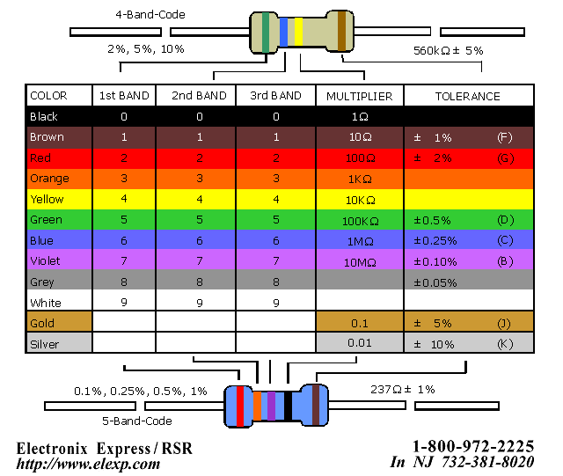

Slide 17
So now we can….
We know what Ohm’s law is
Why to use a resistor
How to read a resistor
Time now to do some maths with Ohm’s law…. (parallel and series from last lesson)

Slide 18
Exercises:
Voltage = 1.5v, Current = 2A, Resistance = ? Ω
Voltage = 5v, Current = ?A, Resistance = 3Ω
Voltage = 9v, Current = 1A, Resistance = ? Ω
Voltage = 1.5v, Current = 10A, Resistance = ?
Voltage = 5v, Current = 10A, Resistance = ?
Voltage = ?v, Current = 2A, Resistance = 100Ω
Voltage = 3.5v, Current = ?A, Resistance = 1000 Ω

Slide 19
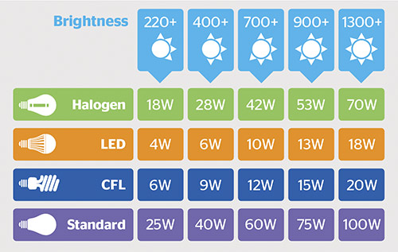
Power, Watts
A light bulb is measured in watts
(brightness is measured in ANSI-lumens)
How many?
P =? V=5v I=2A

Slide 20
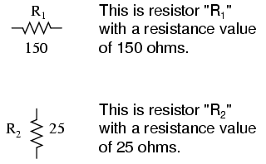
Circuit diagram symbols

Slide 21
A simple one to think about:
Resistance = V/I
Power = V x I
Current (I) = 2A
Voltage = ?
Resistance = ?
Power = ?
1 Battery = 5V
1 Battery = 5V
Voltage = 10V
Resistance = 5Ω
Power = 20 Watts

Slide 22
Resistors in series and parallel
When used in series, resistors can be said to be a “voltage dividing network.”
When used in parallel, resistors can be said to be a “current dividing network.”

Slide 23
Current in series and parallel:
2A
2A
2A
2A
1A
2A
1A
Series Circuit:
Current is the same at all points in the circuit
Parallel Circuit:
Current is the shared between the components in the circuit

Slide 24
Exercise
?
?
3A
3A
4A
?
1A
?
4A
4A
1A
?
1A

Slide 25
Voltage
Voltage is shared between the components in a circuit in SERIES
3V
1.5V
1.5V

Slide 26
Voltage
In a PARALLEL circuit the voltage is the same in all parts of the circuit
3V
3V
3V

Slide 27
In series

Slide 28
In parallel

Slide 29
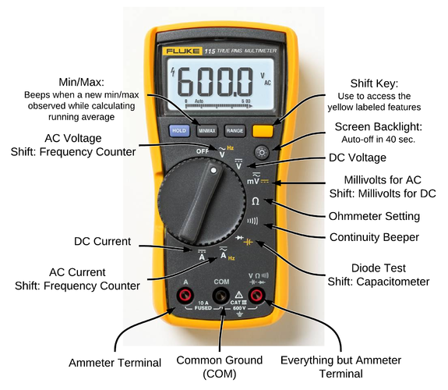
Measuring current and voltage
We use an ammeter
We use a voltmeter
We use a multimeter (later lesson)
V
A

