Slide 1

Raspberry Pi
A microcontroller
Raspberry Pi 2 Model B V1.1
RPi

Slide 2
Objectives
Learning objective: to be able to install Raspberry Pi (RPi) microcontrollers
Learning outcome: students can find the software, install it and set the board so they can manage RPi’s
This is lesson ‘00’ as it is most likely in schools this step will already be setup for students.
This resource is so that after school clubs and other organisations (even students at home) can use this if required

Slide 3
Computer in your hand
A microcontroller (sometimes abbreviated µC, uC or MCU) is a small computer on a single integrated circuit containing a processor core, memory, and programmable input/output peripherals. The majority of microcontrollers in use today are embedded in other machinery, such as automobiles, telephones, appliances, and peripherals for computer system.
A system on a chip (SoC) combines the required electronic circuits of various computer components onto a single, integrated chip (IC).
The difference between a SoC and a microcontroller often times is defined by the amount of random access memory (RAM).
A SoC is capable of running its own operating system.
Sooner or later you just need more power! (Arduino vs RPi)

Slide 4
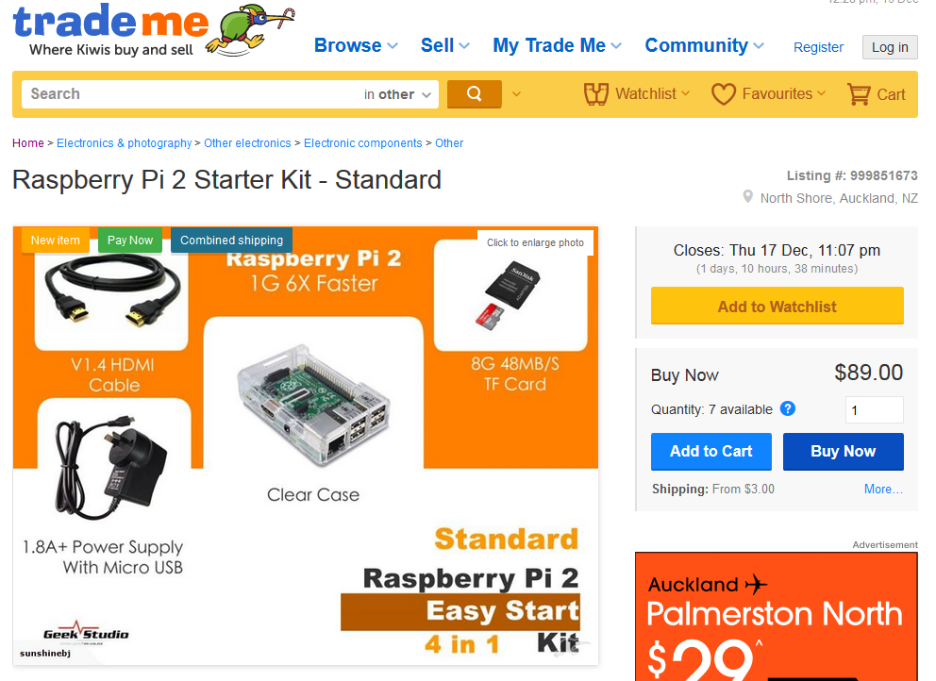

Slide 5
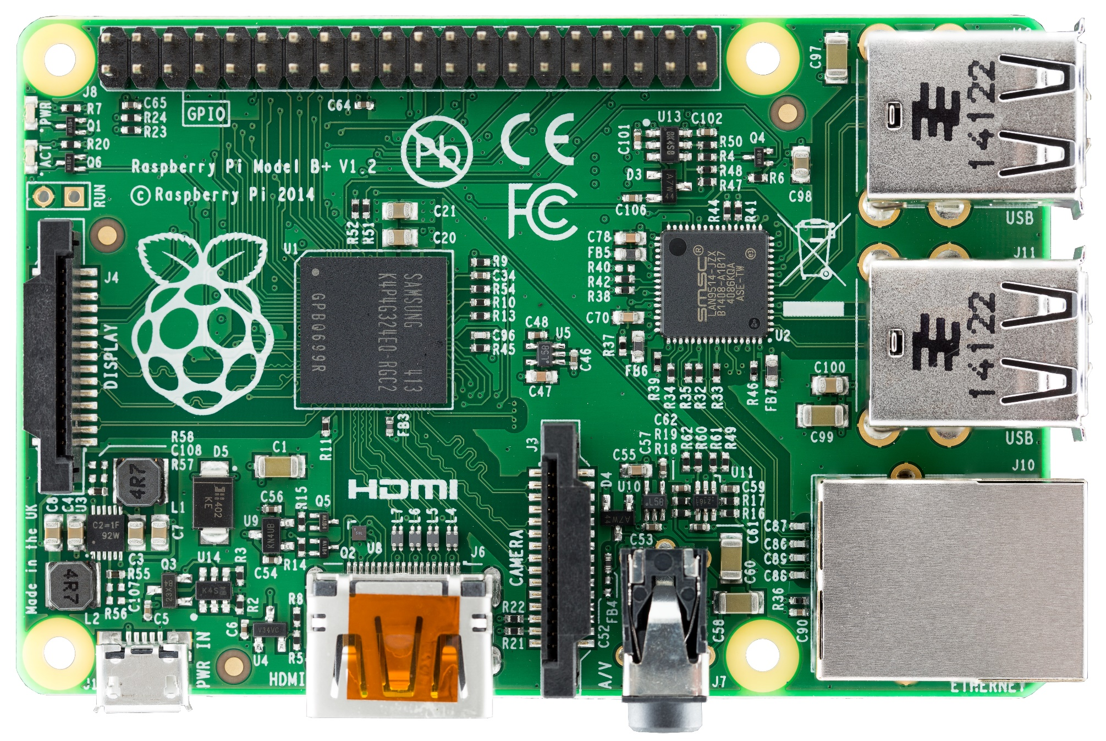
40 GPIO (Input /Output)
SOC – System On a Chip
(Broadcom BCM2836) + 1GB RAM
Mounting hole
SMSC LAN9514 USB Ethernet controller
Power & activity LED’s
Close RUN header to reset Pi
4 USB ports
DSI Display Connector
SD Card (underneath)
Switching regulator for less power consumption
10/100 T Base Ethernet port
Power - Micro USB 5v
HDMI Digital video out
CSI Camera Connector
4 Pole 3.5mm jack
(stereo audio & composite video)

Slide 6
RPi
https://www.raspberrypi.org/
The challenge with RPi’s is that you can run different operating systems and different code on them
They are more flexible, more powerful than many others on the market
This means more options = more confusion

Slide 7
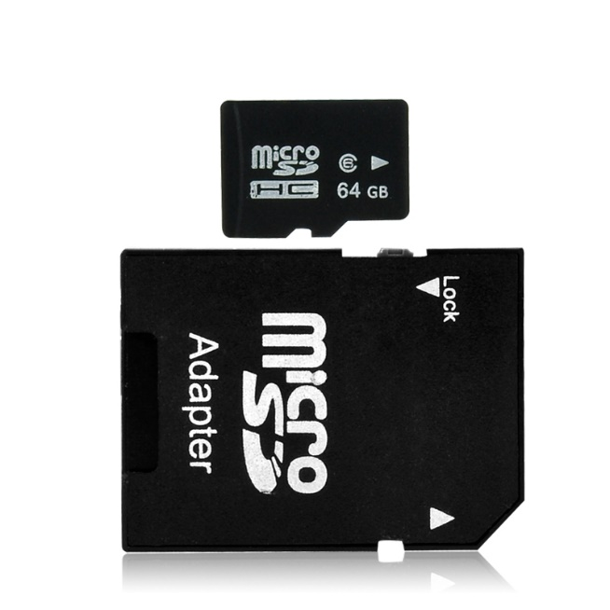
Our recommendation
Raspbian
https://www.raspberrypi.org/downloads/raspbian/
NOTE: all images run from the Micro SD card – you may need the adapter to fit into your PC/laptop

Slide 8
Other OS’s
NOOBS (New Out Of the Box Software)
https://www.raspberrypi.org/help/noobs-setup/
NOOBS can often come as a pre-install option
Openelec for home media centre
Yes you can run Windows or Ubuntu and others…
Unzip as required and install to the Micro SD

Slide 9
Installing raspbian with windows
Install Win 32 disk imager
http://www.raspberry-projects.com/pi/pi-operating-systems/win32diskimager
Use the disk imager to point the Raspbian image to the Micro SD card to write the image
Install the card into the RPi and power it on….

Slide 10
Installing raspBian with linux
Start the terminal app (console or command line)
Note: the ‘dd’ tool can overwrite ANY partition, be careful!
https://www.raspberrypi.org/documentation/installation/installing-images/linux.md
sudo dd bs=4M if=path_of_your_image.img of=/dev/sdd
‘If=‘ is the argument with the path to your *.img file
‘Of=‘ is the output argument, the destination

Slide 11
Installing raspbian with Apple
Start the terminal app (console or command line)
Note: the ‘dd’ tool can overwrite ANY partition, be careful!
https://www.raspberrypi.org/documentation/installation/installing-images/mac.md
sudo dd bs=1m if=path_of_your_image.img of=/dev/rdiskn
‘n’ on rdiskn should equal the number for the Micro SD card
If the command doesn’t work try (disk not rdisk):
sudo dd bs=1m if=path_of_your_image.img of=/dev/diskn

Slide 12
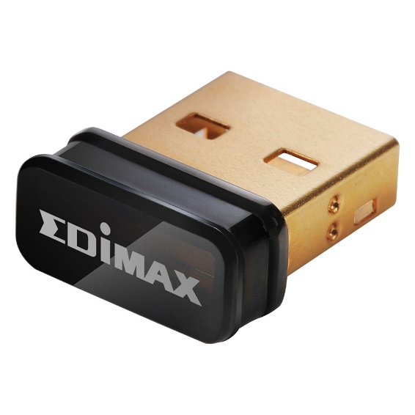
Starting up the Rpi for the first time
Insert prepared micro SD card with OS installed
Connect HDMI to monitor
Connect a USB keyboard and mouse
Connect to a network (Ethernet or wireless USB)
Connect the power (it will then start)

Slide 13
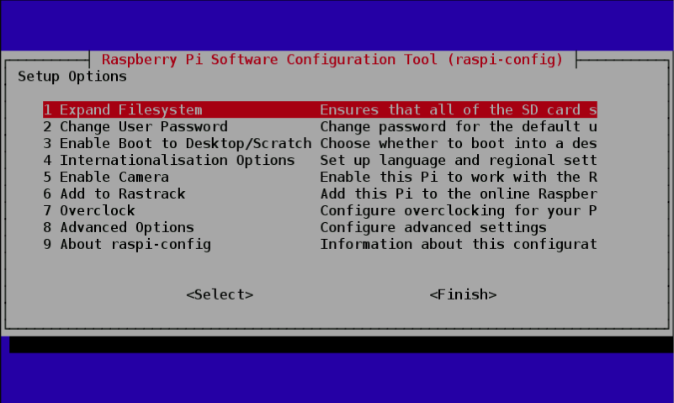
You will see a configuration window:
Enable SSH

Slide 14
login
Standard user = pi
Standard password = raspberry

Slide 15
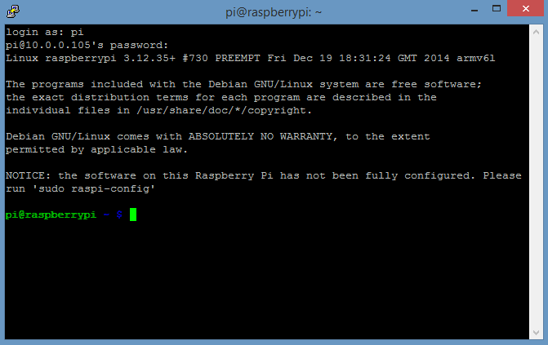
The Shell, or Bash:
Born Again SHell
Logged in as user ‘pi’
Logged into this host
Home directory (~)
Ordinary user
LXTerminal

Slide 16
Enable ssh manually
Enter sudo raspi-config in the terminal
Then navigate to ssh
Hit Enter and select Enable or disable ssh server.

Slide 17
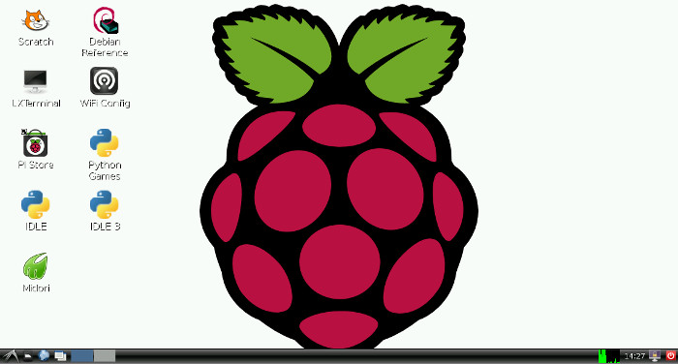
startx

