Slide 1
Test session
A Microcontroller, using Sumobot juniors

Slide 2
Notes
This material has been put together by the Outreach coordinator of the School of Engineering and Computer Studies (SECS) at Victoria University of Wellington (VUW), New Zealand.
It is free to distribute and pass on to all who may find it useful.
The author of this presentation and supporting documents can be reached at: john.barrow@vuw.ac.nz

Slide 3
Learning Objectives
Students overcome any hurdles they have encountered to date to ensure they have a fully functional sumo-bot

Slide 4
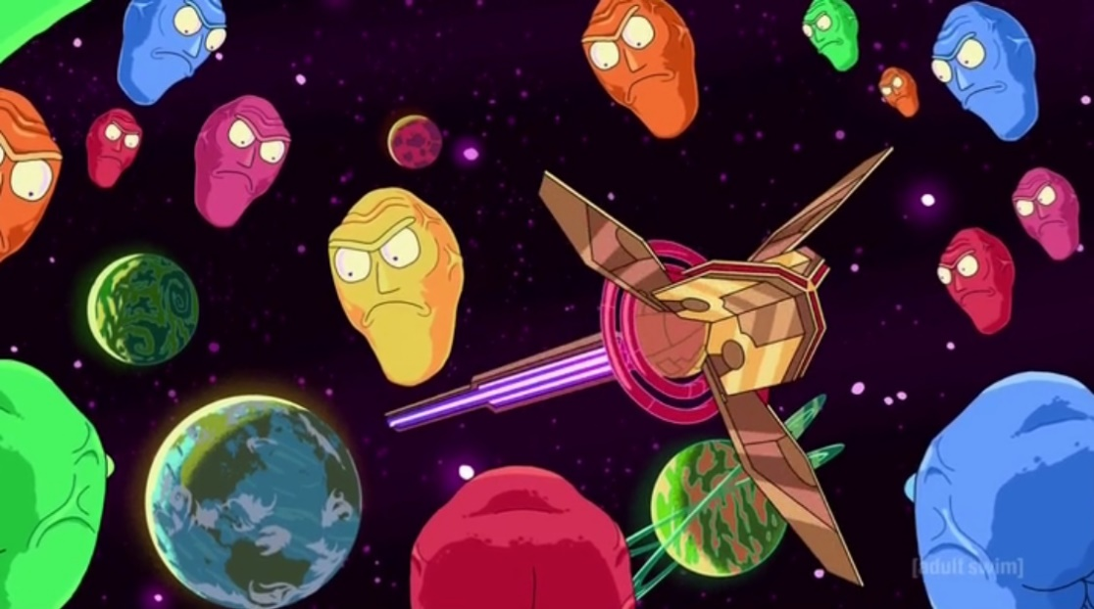
Time to get things working as you expected
The next 2 lessons will be a competition
So this lesson you need to get everything sorted ready to go
If you are already at this stage please help others

