Slide 1
Makey Makey
Exploring a musical keyboard

Slide 2
Teaching notes
Year 5- 8
Prior knowledge; electricity makes electronic devices work
Leading towards learning about electronics and subsequently microcontrollers such as Arduino or Raspberry Pi at high school
Learning objectives:
We can use a microcontroller to control inputs to a computer

Slide 3
Notes
This material has been put together by the Outreach coordinator of the School of Engineering and Computer Studies (SECS) at Victoria University of Wellington (VUW), New Zealand.
It is free to distribute and pass on to all who may find it useful.
The author of this presentation and supporting documents can be reached at: john.barrow@vuw.ac.nz

Slide 4
resources
http://www.makeymakey.com/
The name is based on ‘Make’ and ‘Key’
It acts like a simple input device, like a keyboard

Slide 5
Top of the board

Slide 6
Bottom of the board

Slide 7
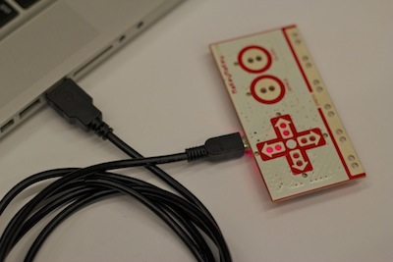
Setup
1) Plug in USB
Small side of USB cable plugs into Makey Makey, big side plugs into computer.
2) Close Popup Window
Your computer may ask you to install drivers or do other setup. You can click cancel or close the window.

Slide 8
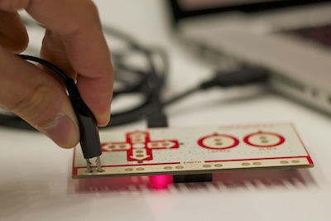
Clip it
3) Connect to Earth
Connect one end of an alligator clip to "Earth" on the bottom of the front side of Makey Makey.

Slide 9
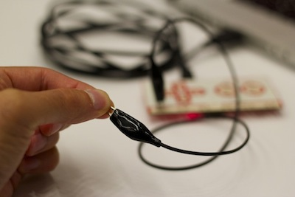
Connect it
4) Connect to Yourself
Hold the metal part of the other end of the alligator clip between your fingers. You are now "grounded."

Slide 10
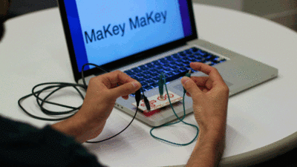
Test it
5) Connect to "Space" and Try It
While you're still grounded, touch the round "Space" pad on the Makey Makey. You should see a green light on the Makey Makey, and your computer will think the space bar was pressed. If you click in the text area below, you can make the cursor move. You can also complete the circuit by connecting another alligator clip to "Space."

Slide 11
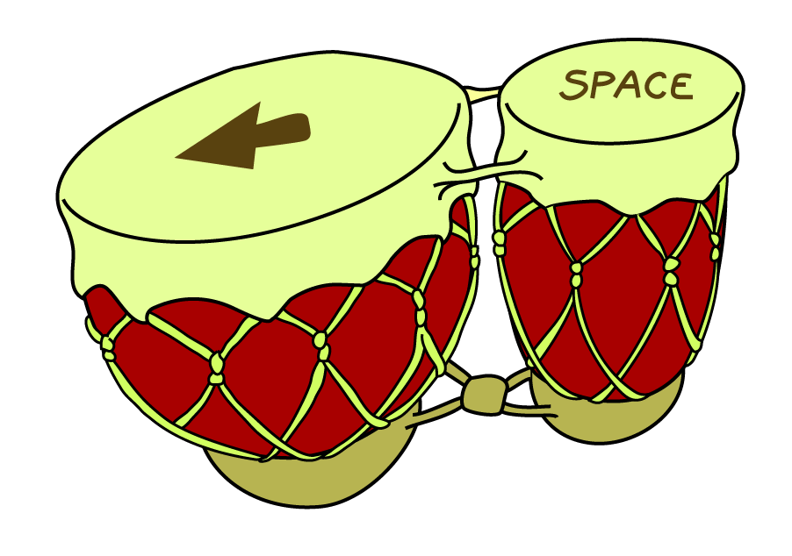
Make some noise
6) Play some Makey Makey drums!
Click below to play some drum sounds using the arrow keys and space on your Makey Makey:
http://makeymakey.com/bongos/
7) Explore more
Try some other materials
More to explore:
https://labz.makeymakey.com/d/

Slide 12
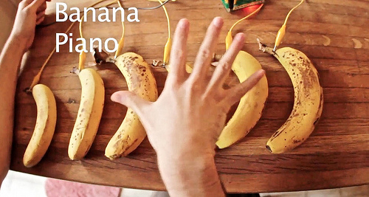
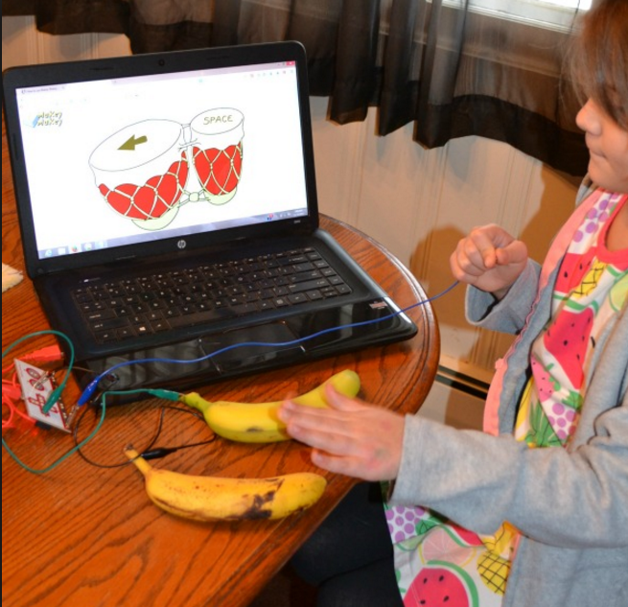
Fruit keyboard

Slide 13
experiment

Slide 14
Build your own

Slide 15
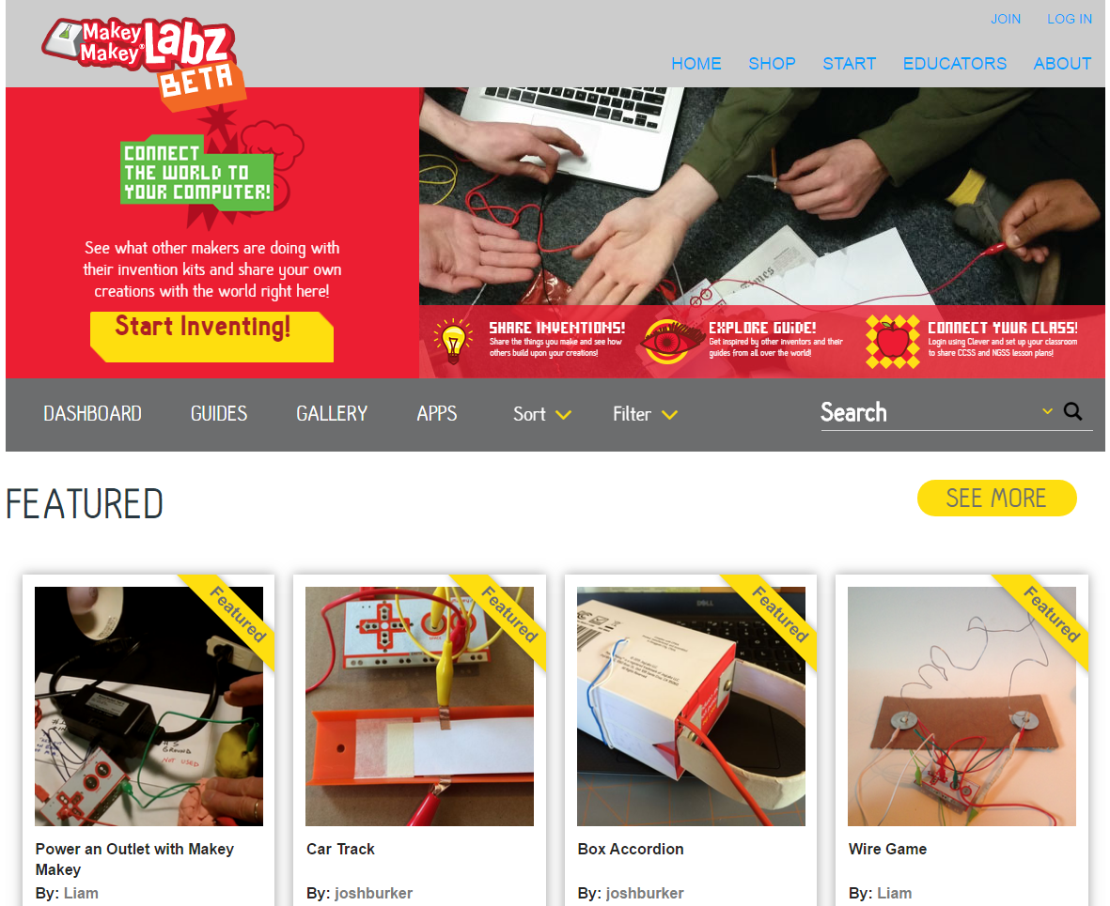
extension
https://labz.makeymakey.com/#/

Slide 16
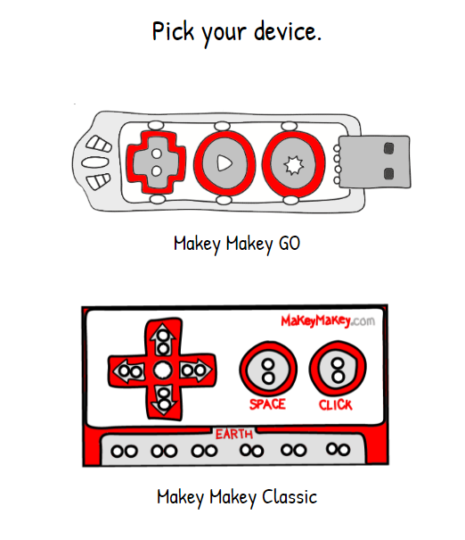
remap
http://makeymakey.com/remap/

