Slide 1
Tickle
An introduction to Programming

Slide 2
Teaching notes
Year 5-8
Prior knowledge; None required
Leading towards learning about programming in Swift, C, Java, Python at high school
Students who are interested can be directed to extension that they can self direct.

Slide 3
Teaching notes
Through this unit we will cover this key terminology:
Commands
Functions
Parameters
Loops
Conditional statements
Variables
Operators
Types
Initialization
http://www.computerhope.com/jargon/program.htm

Slide 4
Notes
This material has been put together by the Outreach coordinator of the School of Engineering and Computer Studies (SECS) at Victoria University of Wellington (VUW), New Zealand.
It is free to distribute and pass on to all who may find it useful.
The author of this presentation and supporting documents can be reached at: john.barrow@vuw.ac.nz

Slide 5
resources
Everything has been sourced online, free, from:
https://tickleapp.com/hour-of-code/orca/
http://www.computerhope.com/jargon/program.htm

Slide 6
Learning objectives
Students can drag, drop and snap programs together (visual programming)
Program the Orca to move (swim) using basic motion commands
Program the Orca to be accompanied by music
Students can change the background image
Students can select different ‘Devices & Characters’
Students can identify the sequential nature of a computer program
Students have a basic understanding of sequential execution of commands and repetition (forever and repeat loops)

Slide 7
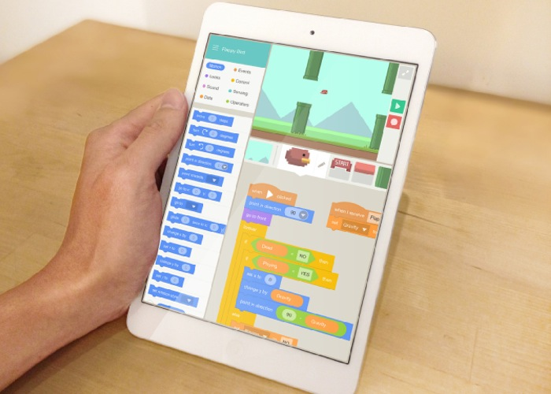
What is tickle
Scratch is free and works on Windows:
https://scratch.mit.edu/
Tickle is also free and works on Apple:
https://tickleapp.com/
It is drag and drop programming

Slide 8
Tickleapp.com

Slide 9
Demo
At the main tickle screen you can see a number of projects
Click on the Cog wheel (settings) in the lower right hand corner
Select ‘Show Introduction’
Slide left on each screen until you reach ‘Tap to start with a demo project’
Do the demo project…

Slide 10
Help
Full screen play the active program
Project name
Start and Stop button
Active Program
X&Y coordinates
Display active program view
Devices and Characters (add)
Programming modules
Program specific to each device or character

Slide 11
Part 1: NYAN orca
Do to this manually:
Start new project, Select Orca
Give it your name if you want to (it will name it Orca 1,2,3… to rename go to the project window, click on the 3 dots for the project and select rename).
Double tap on the screen background in the right hand picture window
Change the background to ‘8Bit Night Sky’
Click on Add
Select the ‘8Bit Swimming Orca’ (with rainbow streamer!)
To delete the default Orca press and hold on it, then select delete in the top left hand corner

Slide 12
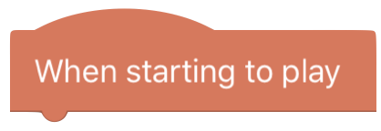
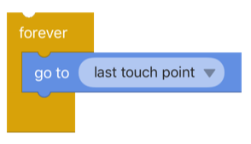
Cutting the code
First block of code:
Add an event ‘When starting to play’
Add a motion ‘go to last touch point’
Add a control ‘forever’
Second block of code:
Add an event ‘When starting to play’
Add a sound ‘Play sound Nyan Cat until done’
Add a control ‘forever’

Slide 13
Try it
Hit play, the green arrow in the upper right hand corner
Tap the screen to move the Nyan Orca around
We cannot access the Nyan Cat sound so select a different one it is only for the demo)

Slide 14
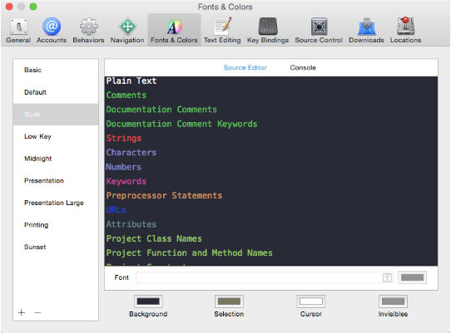
Advanced view
func onStart() {
guard let nyanWhale = getCurrentCharacter() else {
return
}
while true {
nyanWhale.goTo(_last_touch_point_)
}
}
func onStart() {
guard let nyanWhale = getCurrentCharacter() else {
return
}
while true {
nyanWhale.playSoundAndWait(Nyan Cat)
}
}
https://developer.apple.com/swift/
https://developer.apple.com/swift/playgrounds/

Slide 15
Q&A
What is a program?
A set of instructions that tell the computer what to do
What does the ‘forever’ block do?
A loop, to repeat a block of code over and over until it is interrupted or a threshold (limit) is reached.
Go to does?
Sends you to a place to do something in the code
An argument is what you are to do, in this program we have 2 arguments:
the ‘last touch point’ and ‘play sounds Nyan Cat’

Slide 16
Teaching notes
It is intended that these slides be delivered at a rate appropriate to the audience which can vary greatly.
Therefore these slides are all in ‘one lesson’ but can be broken up and delivered as suits the teacher’s, students’ and classroom needs.
The Nyan Orca was noisy and fun to encourage engagement, but to be enough as a standalone with extension for those that were keen. It is the demo on offer with tickle.
The next exercises are more structured and intended to be more disciplined in the teaching delivered. These are all taken directly from the web site.

Slide 17
Part 2: Swimming orca
The blocks attached to this block start to execute after tapping the button.
To make the Orca swim to your finger point touch
We did this with the Nyan Orca
Start a new project, choose Orca
We have a loop and an 2 arguments:

Slide 18
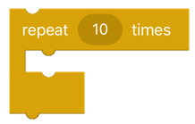
Exploring the program
The blocks attached to this block start to execute after tapping the button.
The block will play the sound of the selected audio file (if we add one!).
The blocks inside this block will be executed n number of times.

Slide 19
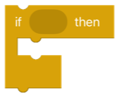
Loops
The blocks inside this block will execute forever until the stopbutton is tapped (a loop).
The block will check its boolean condition, if the condition is true then the code inside this block will run (a conditional loop).

Slide 20
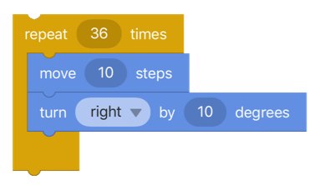
Swimming Orca
What does this bit do:
And together these blocks of code do?

Slide 21
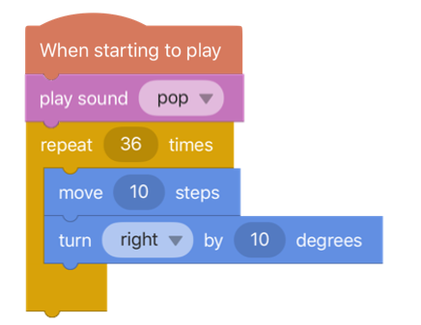
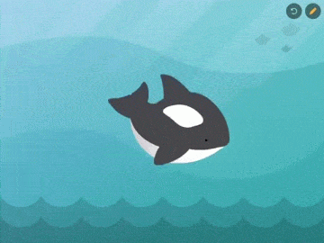
Figure of 8 Swimming orca
So lets take this bit of code and COPY and PASTE part of it, change it, and now our Orca can swim a figure of 8.
What ARGUMENT do we change?

Slide 22
Swimming orca answer

Slide 23
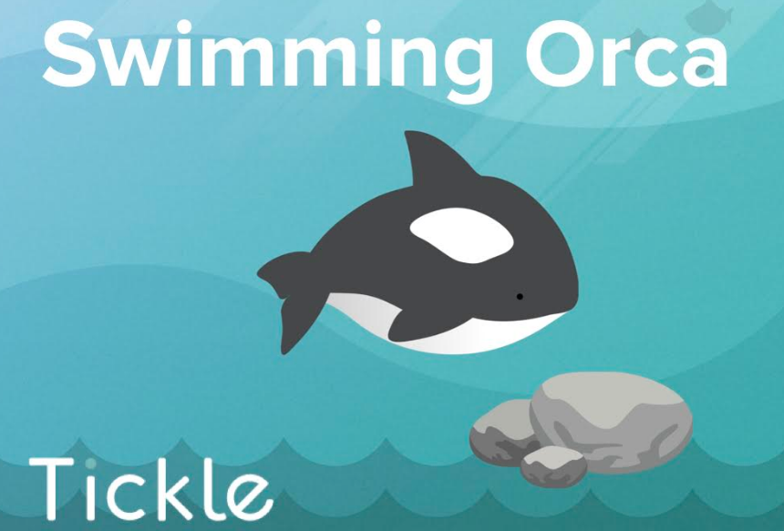
Learning objectives with the swimming orca
Building more familiarity with visual programming.
Program the Orca to swim using basic motion commands.
Learn coordinate system with direction (0-360 degrees) and distance.
Understand sequential execution of commands and conditional (if-else) statement.

Slide 24
Part 3: Swim along the edge

Slide 25
We need to move it move it

Slide 26
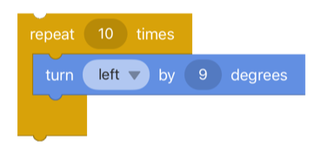
Turning the corner
There is a few ways we can do this, this is one:
What else could we try?

Slide 27
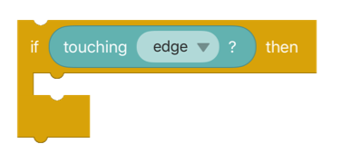
If this happens then do this…
Look in the control blocks, what could we use for this?
What argument would we use for touching the edge? (look in sensing)

Slide 28
Put it all together

Slide 29
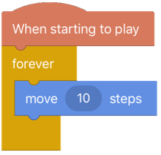
Part 4: Swimming back from the edge
So start with moving….
What do we need?

Slide 30
This time…
We will use a variable to remember the direction the Orca should swim in. In computer science, a variable is a symbolic name associated with a value and whose associated value may be changed.
Click on:
Give it the name ‘Direction’

Slide 31
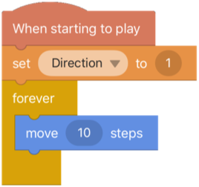
New category
You will now see a new category called Data
From data select:
Set the variable to the newly created ‘Direction’
Set the value to 1

Slide 32
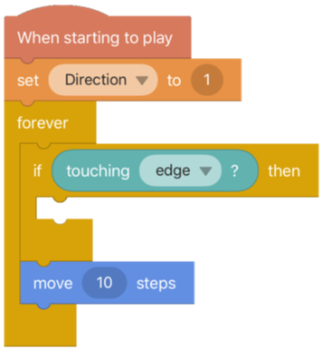
Sensing the edge
Now if we add the IF/THEN is TRUE then the code inside the block will run, otherwise it wont. If it is inside a LOOP it will only loop if it is true.
So now we can add the touching edge in a LOOP:

Slide 33
To make Orca move in the opposite direction, change the variable "Direction" into its opposite value using the multiplication block in Operators, and typing in value "-1" (i.e.. Direction * -1):
To make Orca move in the opposite direction, change the variable "Direction" into its opposite value using the multiplication block in Operators, and typing in value "-1" (i.e. Direction * -1):

Slide 34
So now we have

Slide 35
Now we need to move in the right direction

Slide 36
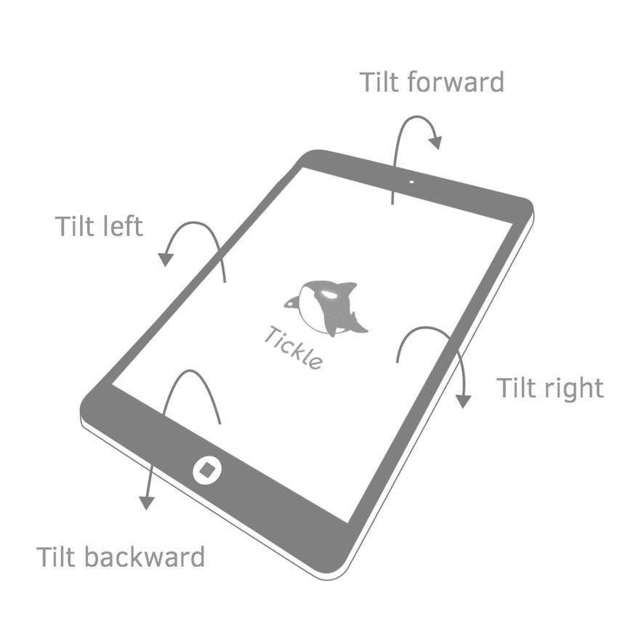
Part 5: swimming by motion sensor
That was tricky using a variable we specified.
Lets use some inbuilt tools
The iPad has an inbuilt gyro

Slide 37
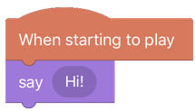
A number of separate blocks
This time we will use a number of blocks of code for each action
So we will start simply with a ‘hello’

Slide 38
Add a new block

Slide 39
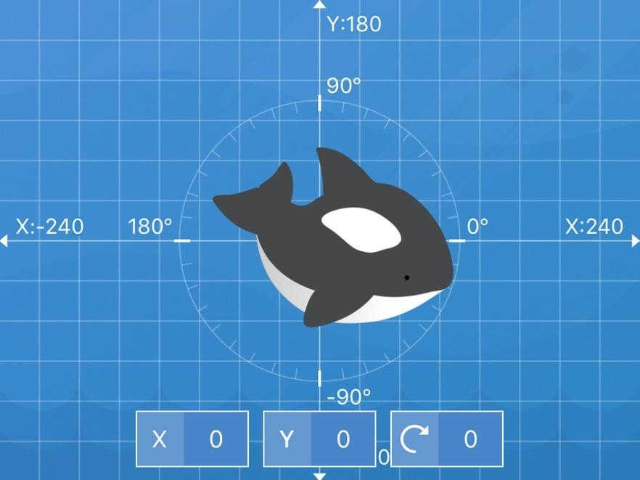
Then we need the other motions

Slide 40
Hitting the edge
Add one of the Control blocks called if … then, and put it into the forever loop. This is a conditional block that runs the code inside it when the condition in the if … then block occurs (i.e. evaluates to True). Otherwise, none of the code inside runs.
Add one of the Sensing blocks called touching edge? from category Sensing, and put it into the if ... then block. When Orca touches any edge of the stage screen, the condition in block if ... then evaluates to TRUE and the code inside runs.
Add these blocks under the block say Hi! and play the project. You will discover that as the Orca swims around and touches an edge, it will say "Ouch!".

Slide 41
So it looks like:

Slide 42
The whole picture

Slide 43
Extra for experts
Challenge #1: Spin when Shaken
Make the Orca spin around when you shake the iPad.
Challenge #2: Change Orca Size by Tapping and Shaking
Make the Orca bigger when Orca is tapped on, and smaller when you shake the iPad.
Tip: The size of Orca can be changed using the block change scale by … %. To sense when the Orca is tapped on, use the When this character clicked
Challenge #1:
Set selection to iPad
Change scale to MINUS 10
Challenge #2:

Slide 44
resources
https://tickleapp.com/press_kit/
Photos and screen shots:
https://drive.google.com/drive/folders/0B09VFAbe_8VMT0RJRlRfZk1wMEk
You can get all the images, blocks of code and everything else from the tickle web site.

