Slide 1
Squishy circuits
Learning about electricity and circuits

Slide 2
Teaching notes
Year 5-8
Prior knowledge; electricity makes electronic devices work
Leading towards learning about electronics and subsequently microcontrollers such as Arduino or Raspberry Pi at high school
Learning objectives:
Students understand that electricity is a flow
Basic conductors and insulators
Series and parallel – a conceptual introduction only

Slide 3
Notes
This material has been put together by the Outreach coordinator of the School of Engineering and Computer Studies (SECS) at Victoria University of Wellington (VUW), New Zealand.
It is free to distribute and pass on to all who may find it useful.
The author of this presentation and supporting documents can be reached at: john.barrow@vuw.ac.nz

Slide 4
resources
http://courseweb.stthomas.edu/apthomas/squishycircuits/index.htm
http://fablearn.stanford.edu/fellows/blog/rethinking-squishy-circuits
http://www.sciencebuddies.org/science-fair-projects/search.shtml?v=pi&s=squishy+circuit

Slide 5
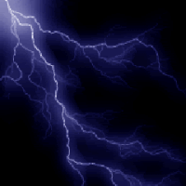
What is electronics?
Electronics is the science of how to control electric energy
We use this in electronic circuits
We use electronic circuits in computers, cell phones and many other devices

Slide 6
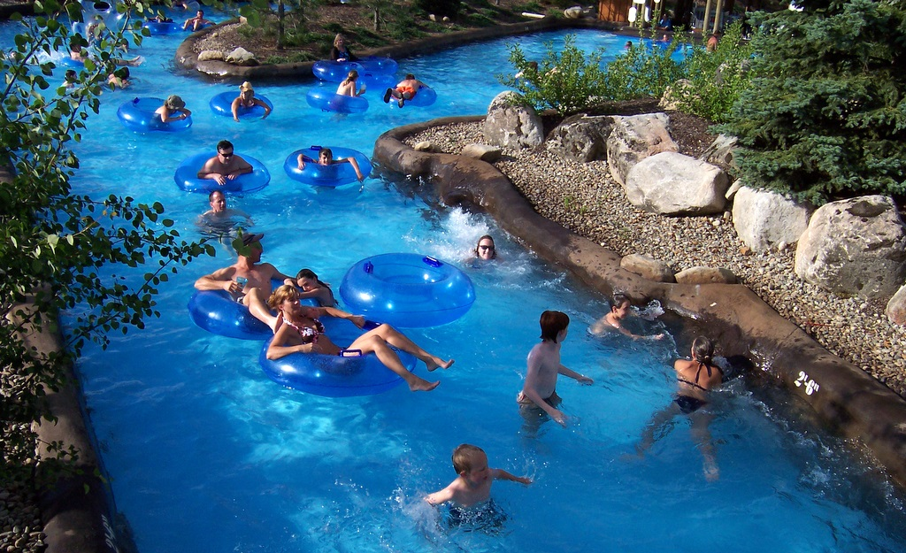
Static vs Current
Static electricity is naturally occurring, like lightning
Current electricity exists when charges are able to constantly flow (think - like water)
In order to flow, current electricity requires a circuit: a closed, never-ending loop of conductive material (we will explore this)
We are going to explore current electricity in circuits

Slide 7
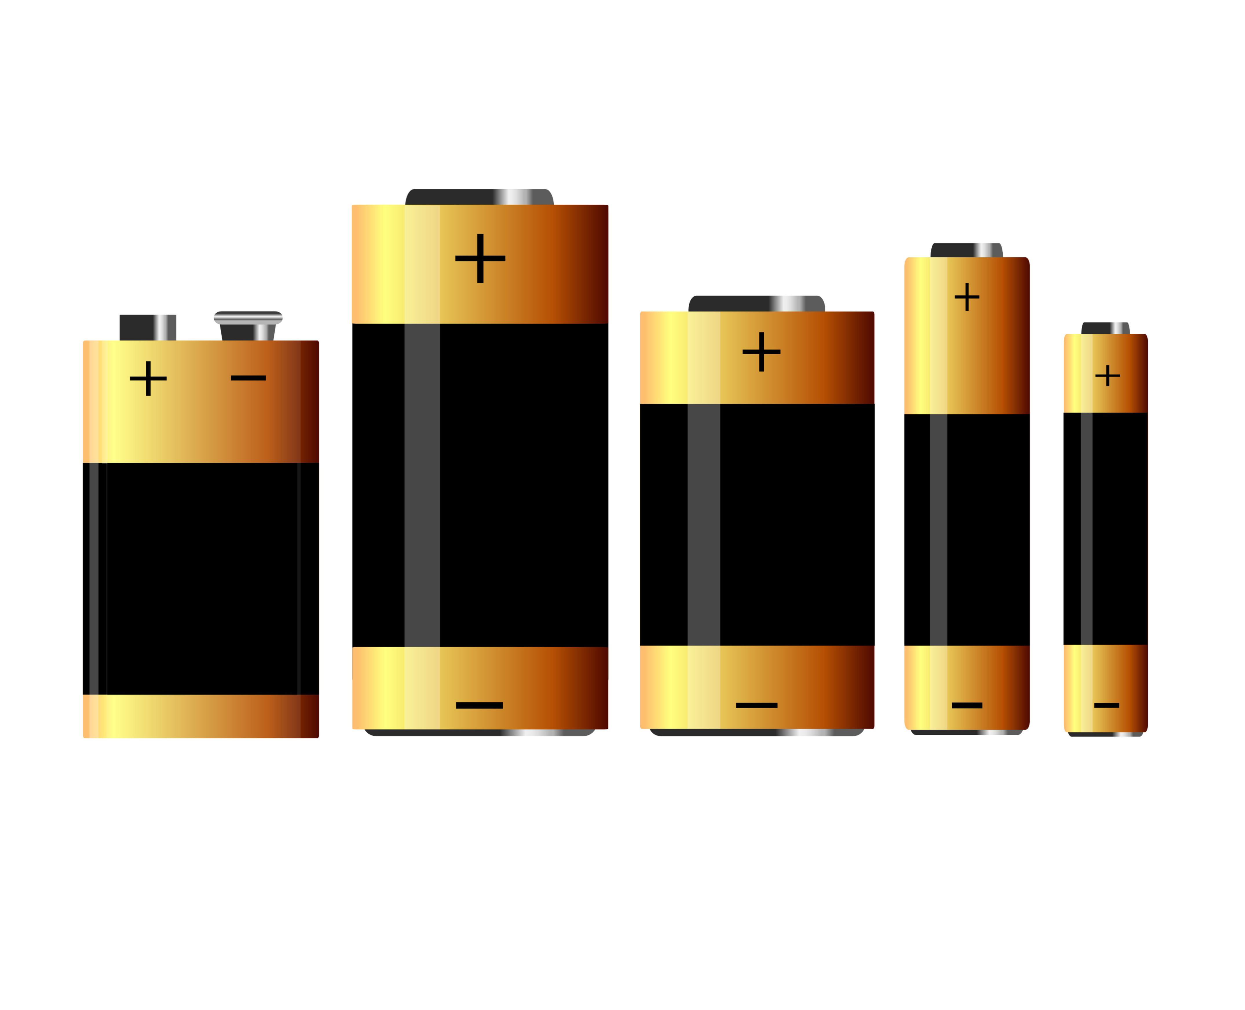
battery
Ever notice the bump on one end and the flat face on the other end?
Notice the symbols? What are they?

Slide 8
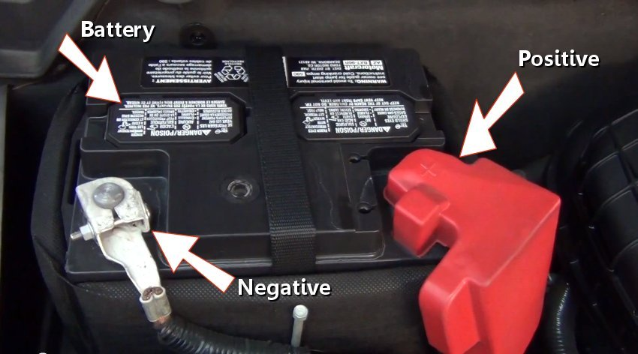
Colour codes
(+) Positive – positively dangerous! So red in colour
(-) Negative – a dark mood, so black in colour
Things such as LEDS (light emitting diodes) have (+) and (-) ends too
For an LED the longer leg is (+)

Slide 9
Blobbing it
Get some doh and make two cherry sized balls
Stick the (+) end from the battery into one ball, which is what colour?
RED
Stick the long leg of the LED into the same blob of doh, which is the…
POSITIVE
Stick the (-) leg of the LED into the second blob
Stick the black wire to the second blob

Slide 10
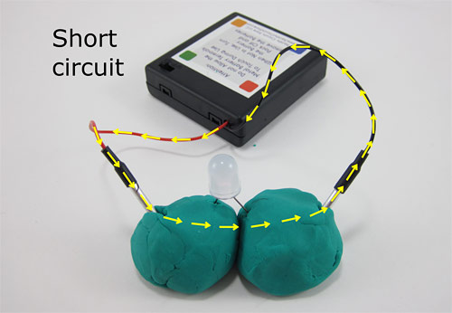
experimenting
Touch the two blobs together, what happens?
Why?
Electricity will take the shortest path (sometimes this can be called a short circuit)
Try something other than the doh
What happens?
Why?
Insulators and conductors

Slide 11
More led’s
Series and parallel
Series – you read one book after the other
So electricity flows to one, then the next…
In parallel the electricity goes down multiple paths at once
Try a number of LED’s

Slide 12
series
The LED’s will dim as you add more
They will all be the same brightness, but all will get dimmer
(in the picture they have an insulator between the conductive doh)

Slide 13
Parallel
The LED’s will all be the same brightness
The battery will go flat faster
(in the picture they have an insulator between the conductive doh)

Slide 14
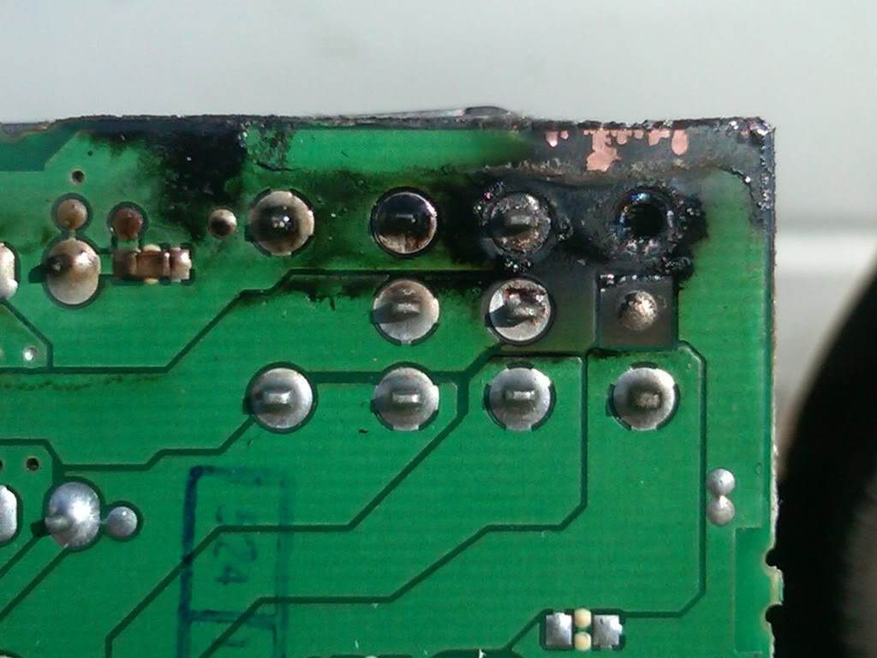
More power!
What if the power source (battery) provides more energy than the components need?
Boomf! The magic smoke comes out – its ‘fried’
How do we stop this?
We use resistors that restrict the flow of electricity, to help control how much power

Slide 15
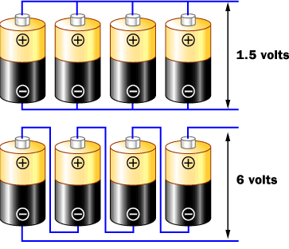
Stacking batteries
4 x 1.5V batteries
In parallel we get 1.5V
In Series we get:
4 x 1.5V = 6V

Slide 16
motors
Lets connect a motor
Where do you think it may come from?
This motor is what makes a cell phone vibrate
Attach the small propeller with a small blob of blue tack
Red wire goes to?
Black wire goes to?
Give it a spin ☺

Slide 17
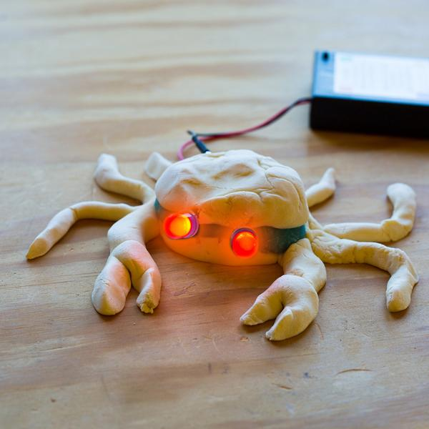
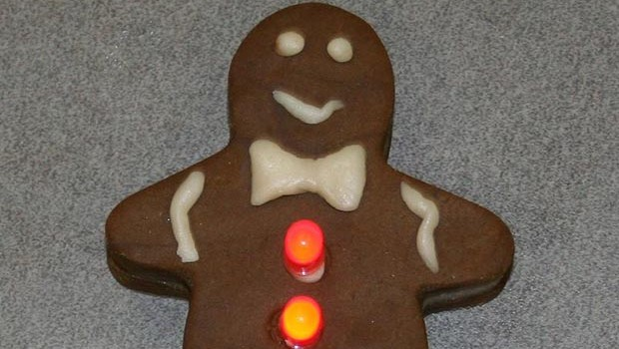
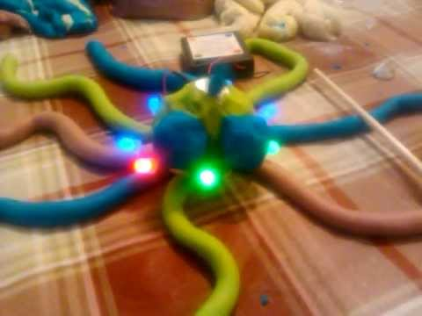
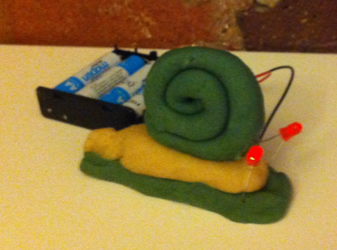
Free play
Make an animal
Make something cool
Take some pictures
Show your friends

Slide 18
Key words
Circuit – like a circle of energy, complete paths for an electrical current
Components – parts of a larger whole, especially a machine or system
Conductive – able to allow electricity to pass through
Insulating – preventing electricity from passing through
Leads – ‘legs’ or wires that help electricity flow more effectively through a component
Parallel circuit – circuits in which energy flows through two or more paths at once
Series circuit - circuits in which energy flows from one component to the next in order.
Terminals – Y shaped metal parts that are attached to the end of a wire to increase the contact surface area
Volts – units for measuring the force of an electrical current or the stored power of a battery.

